Slide 1
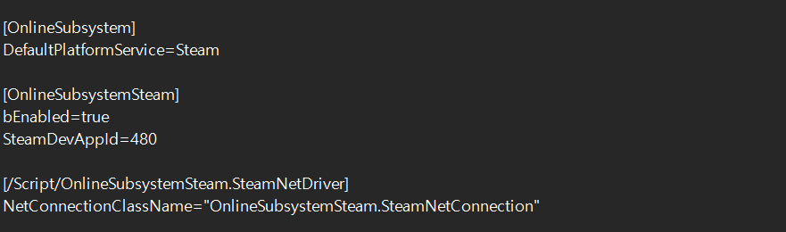
DefaultEngine.ini
[OnlineSubsystem]
DefaultPlatformService=Steam
[OnlineSubsystemSteam]
bEnabled=true
SteamDevAppId=480
[/Script/OnlineSubsystemSteam.SteamNetDriver]
NetConnectionClassName="OnlineSubsystemSteam.SteamNetConnection"

Slide 2
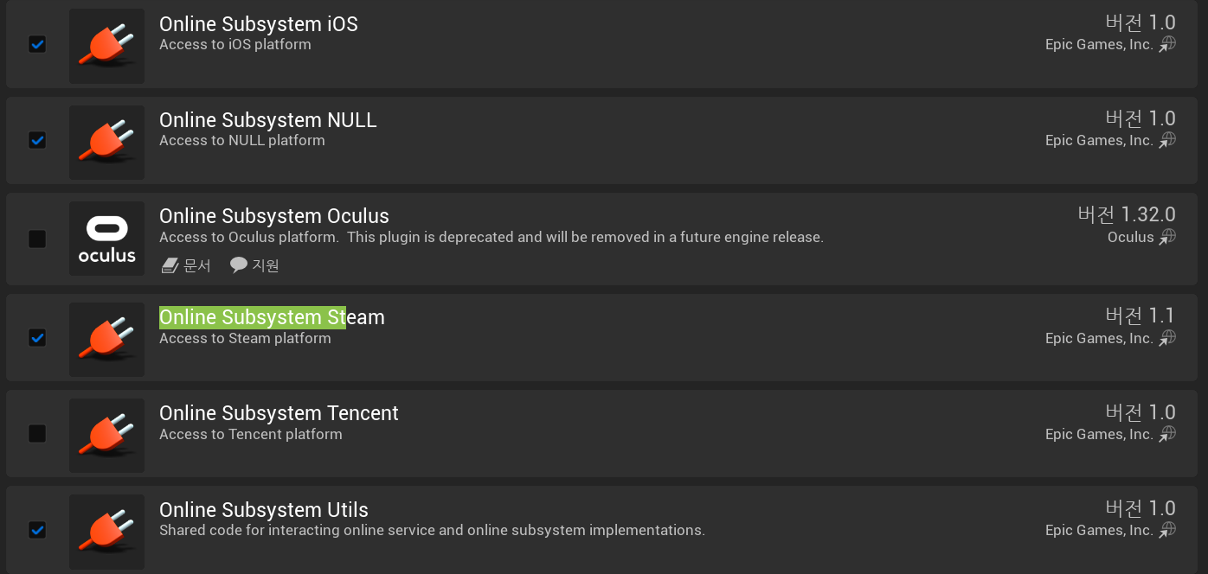
PlugIn

Slide 3
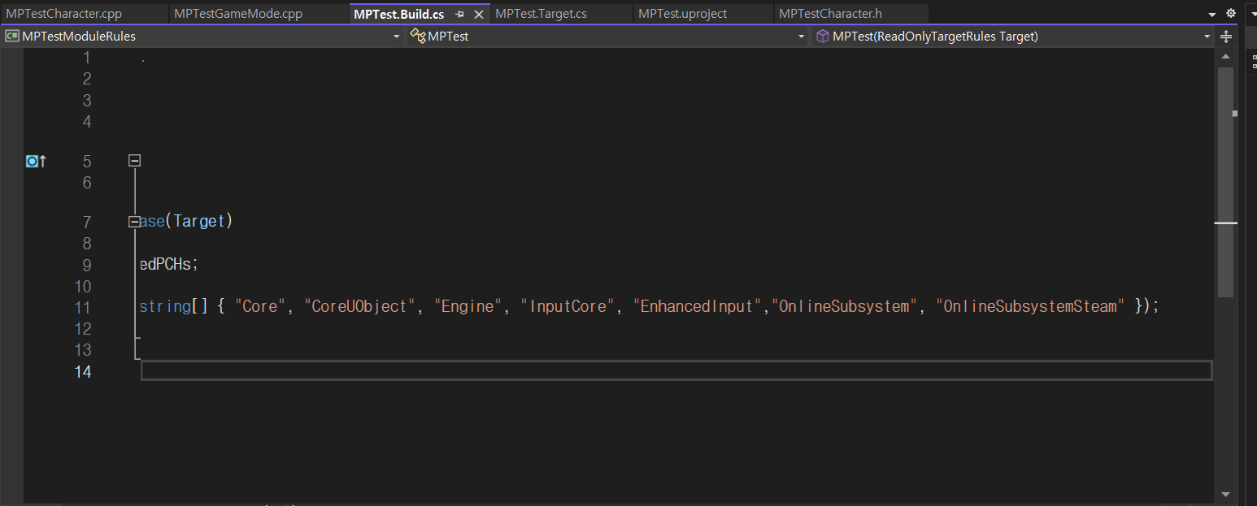
PlugIn

Slide 4
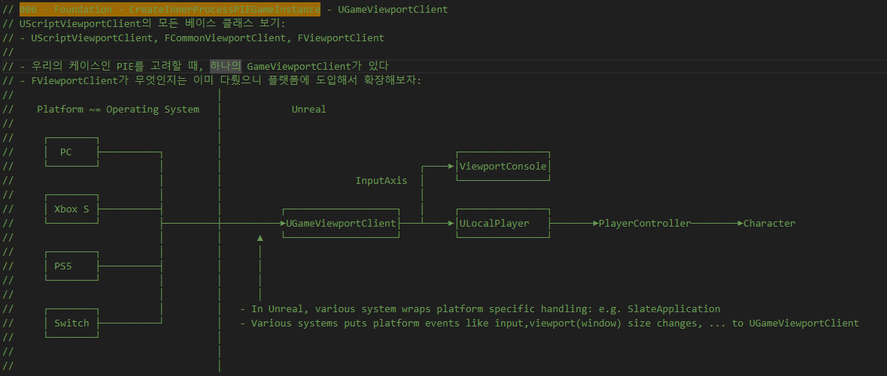
GameViewportClient UGameViewportClient 006

Slide 5
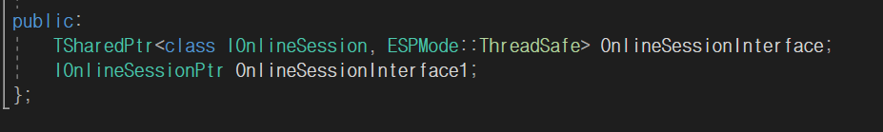
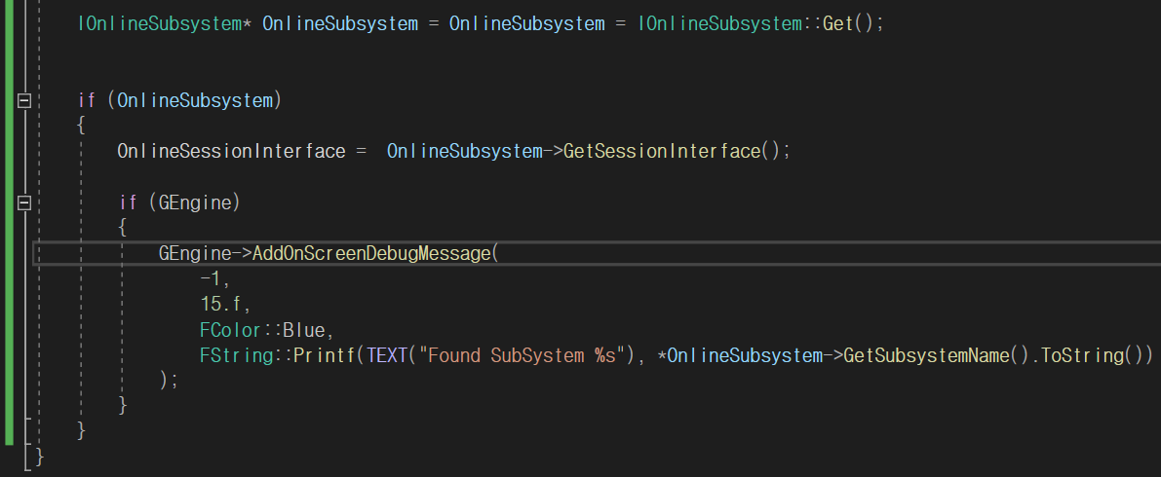
IOnlineSessionPtr

Slide 6
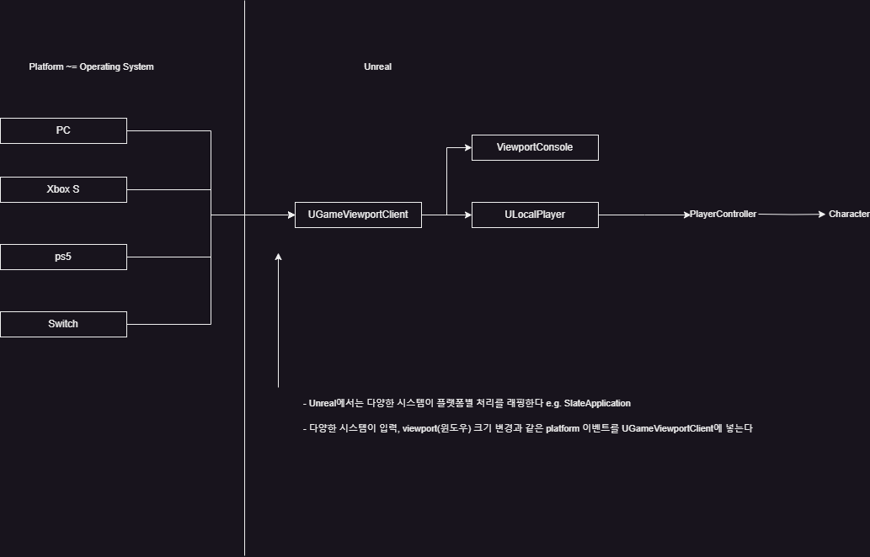
GameViewportClient UGameViewportClient 006

Slide 7
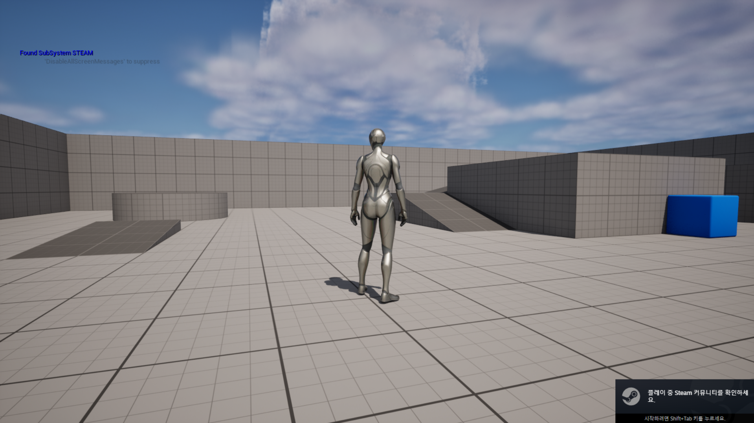
Steam Subsystem

Slide 8
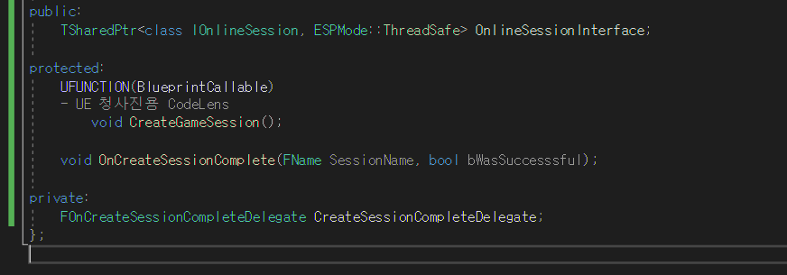
CreateSession

Slide 9

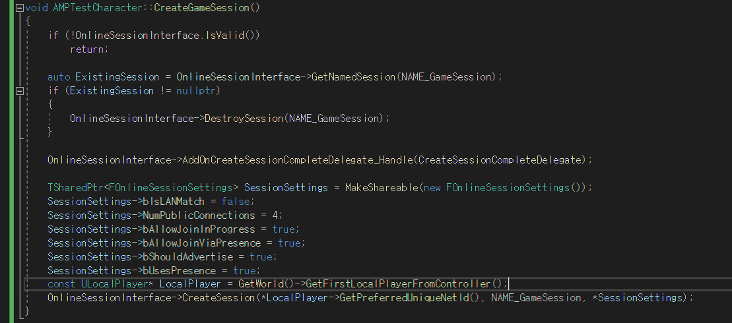
CreateSession

Slide 10
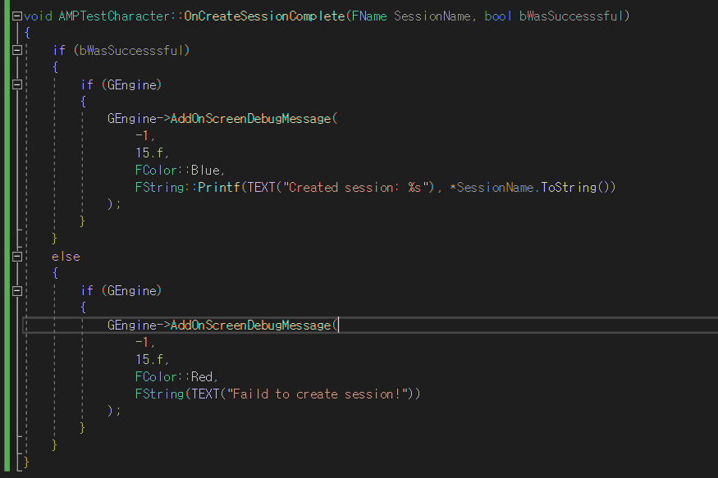
CreateSession

Slide 11
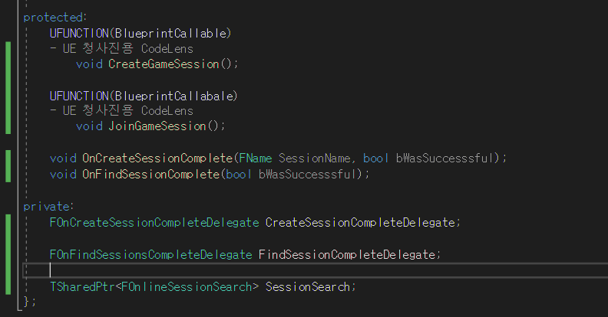
FindSession

Slide 12
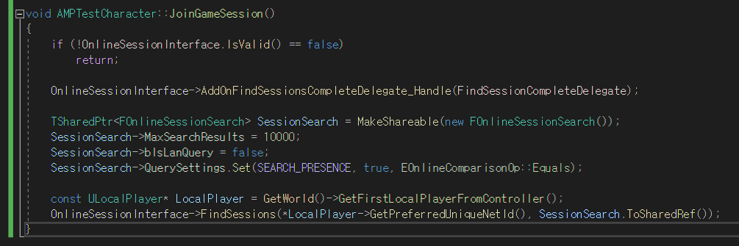
FindSession

Slide 13
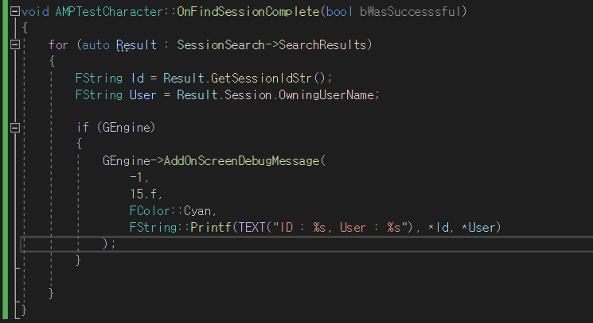
FindSession

Slide 14
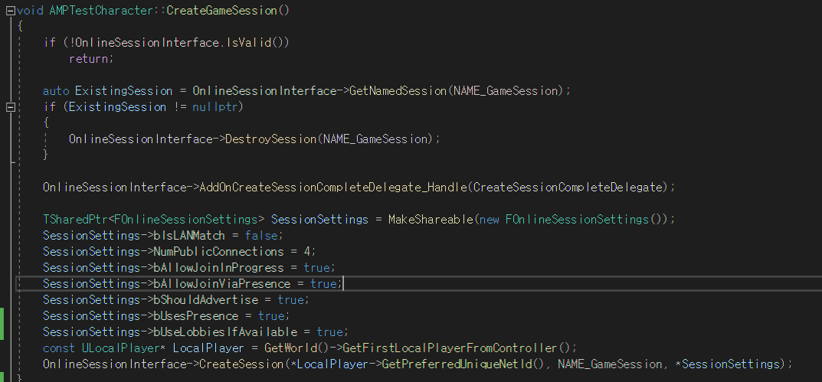
FindSession

Slide 15
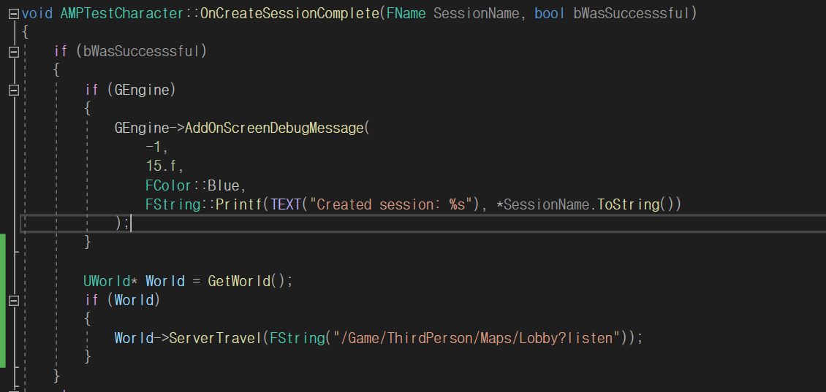
CreateSession

Slide 16
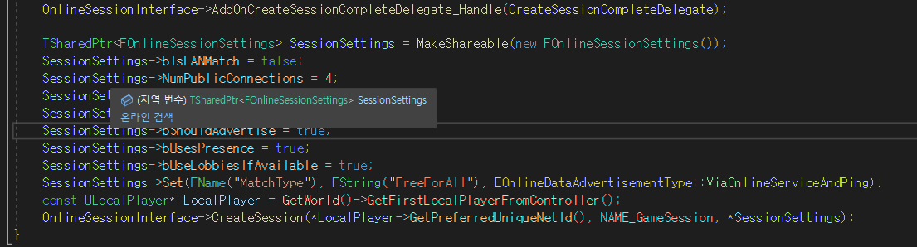
CreateSession Setting

Slide 17
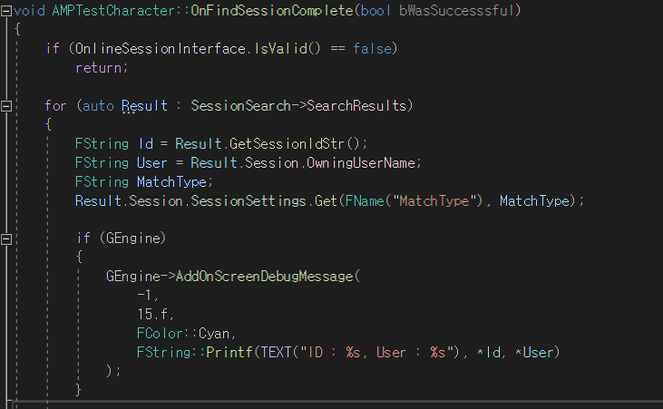
FindSession

Slide 18
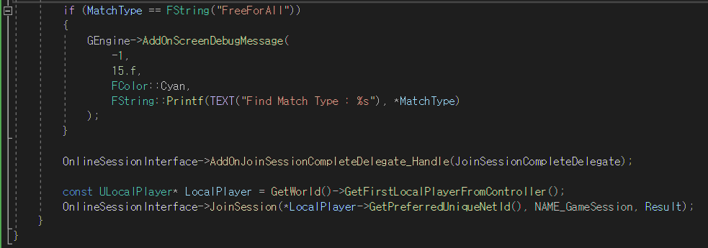
FindSession

Slide 19
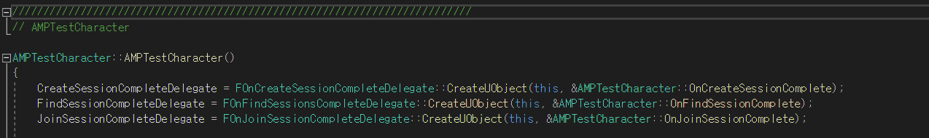
JoinSession

Slide 20
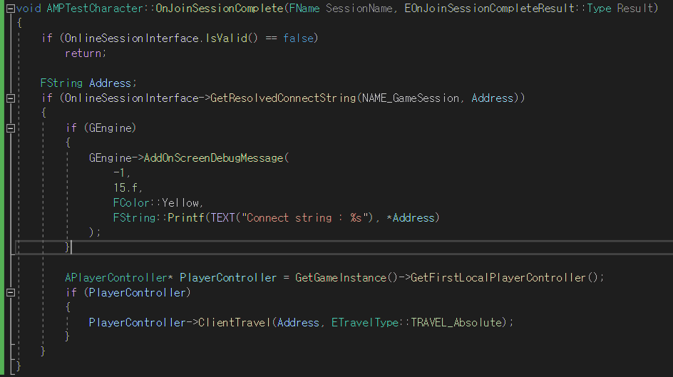
JoinSession

