Slide 1
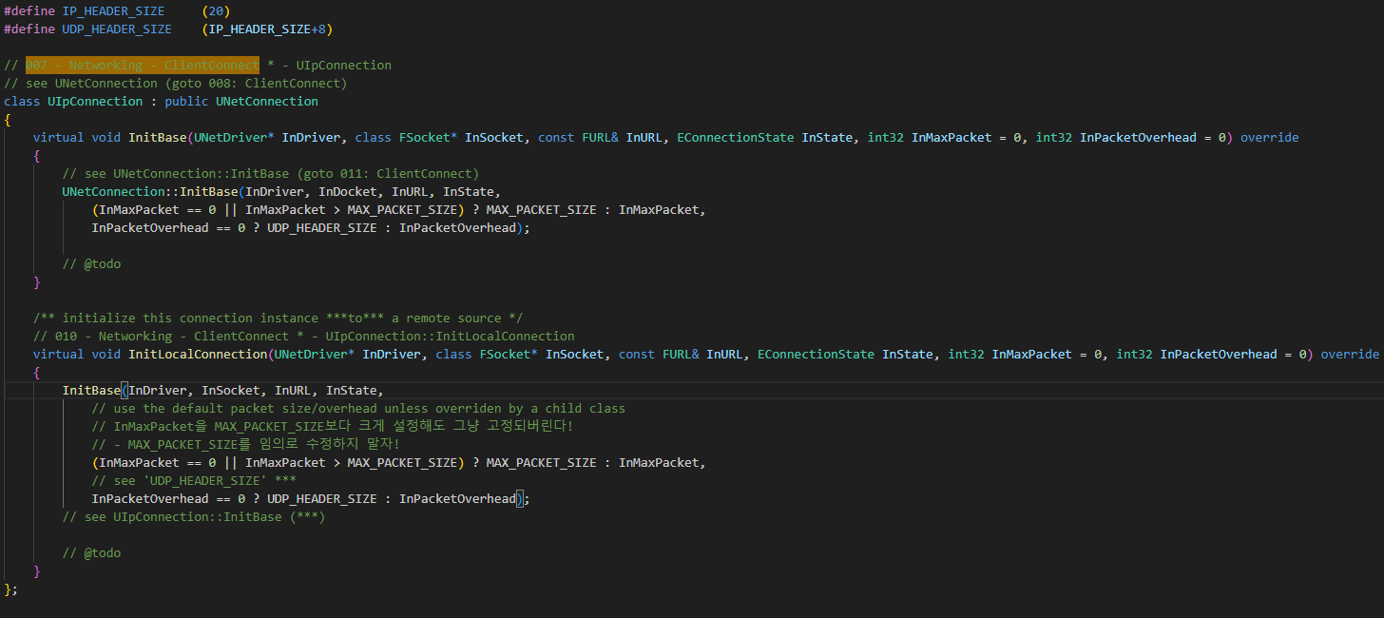
UIpConnection InitLocalConnection 010

Slide 2
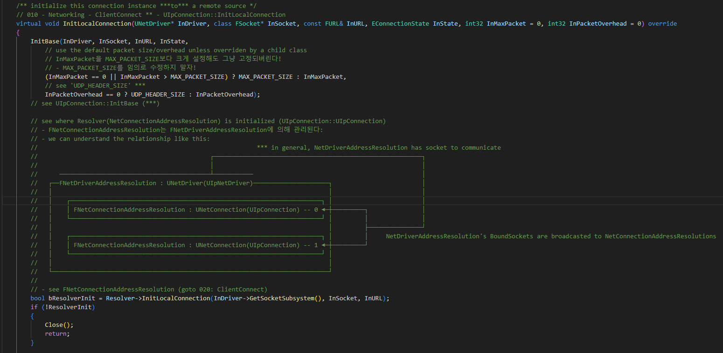
UIpConnection InitLocalConnection 010

Slide 3
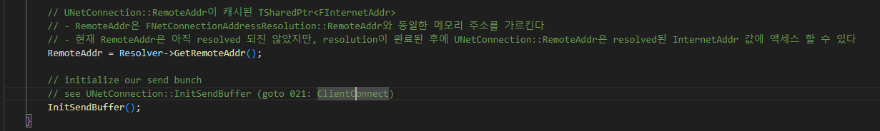
UIpConnection InitLocalConnection 010

Slide 4
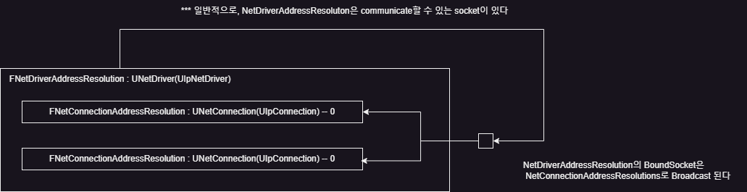
UIpConnection InitLocalConnection 010

Slide 5
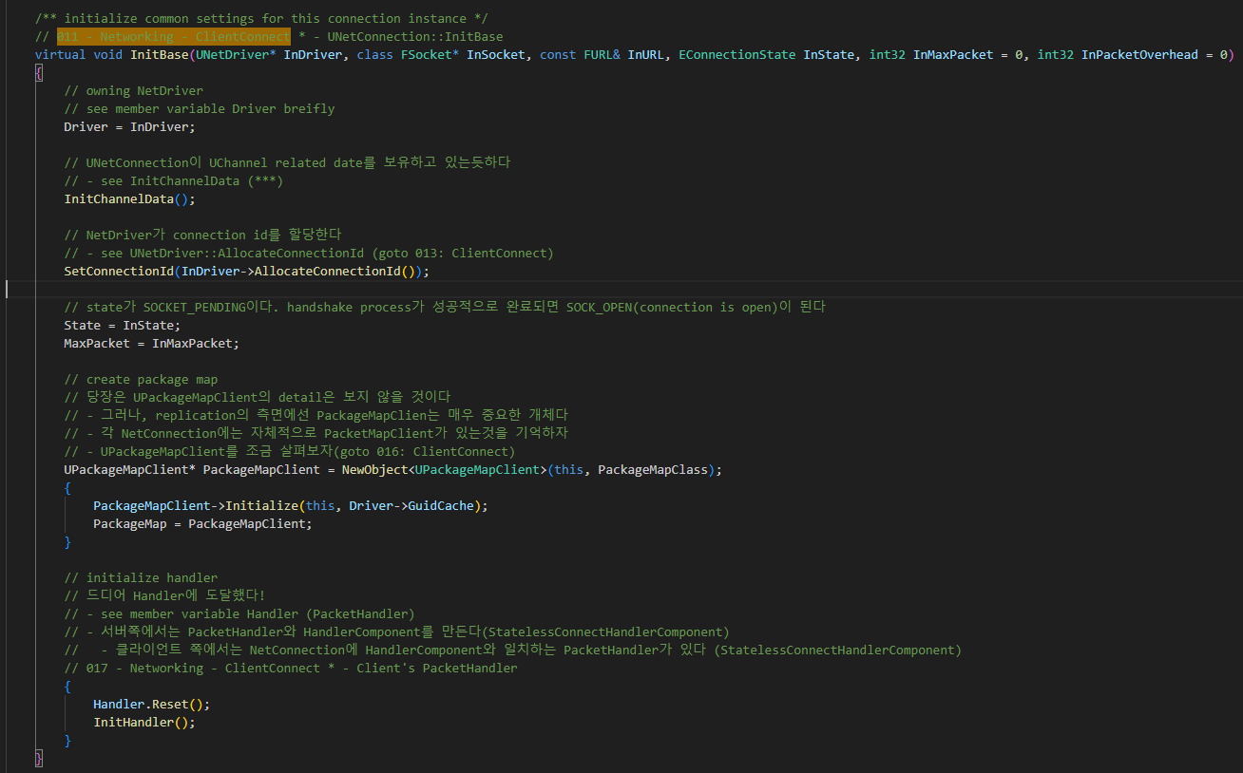
UNetConnection InitBase 011

Slide 6
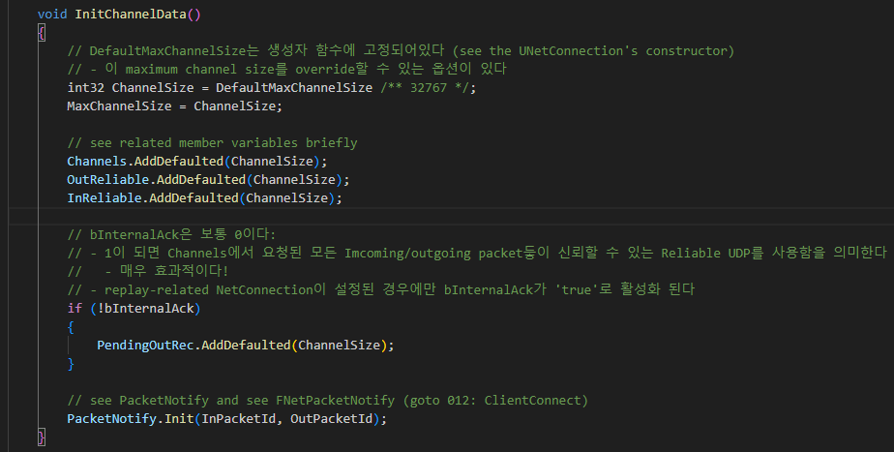
UNetConnection InitBase 011

Slide 7
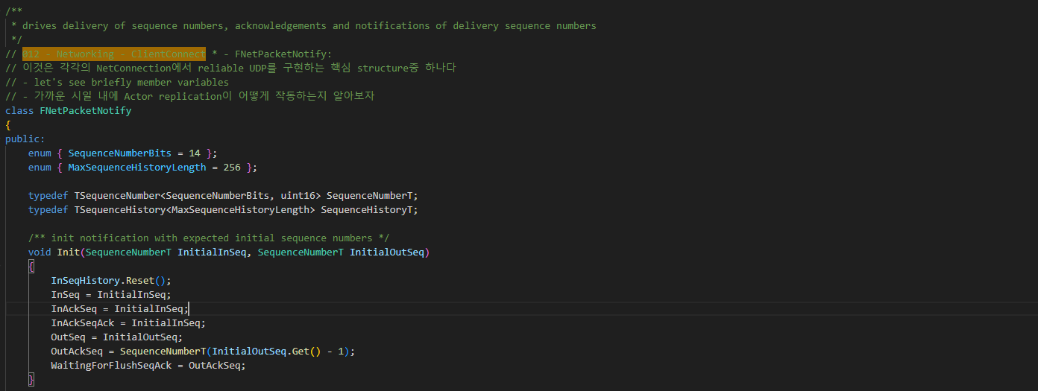
FNetPacketNotify 012

Slide 8
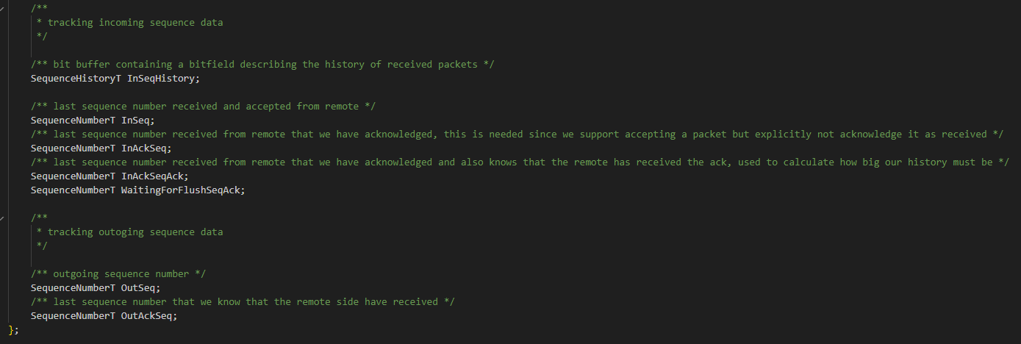
FNetPacketNotify 012

Slide 9
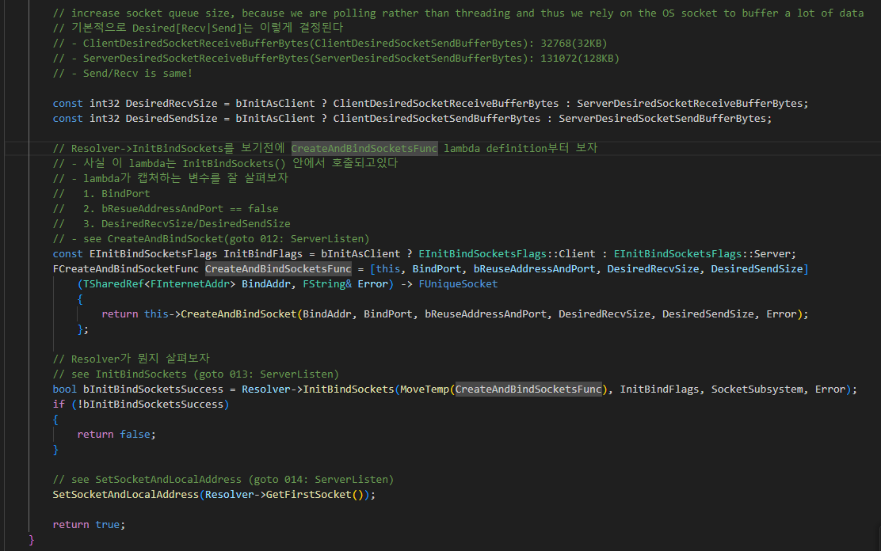
UIpNetDriver InitBase 006

Slide 10
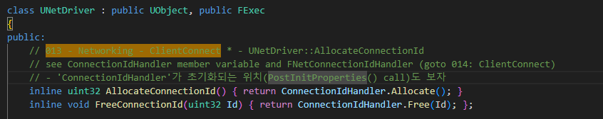
UNetDirver AllocateConnectionId 013

Slide 11
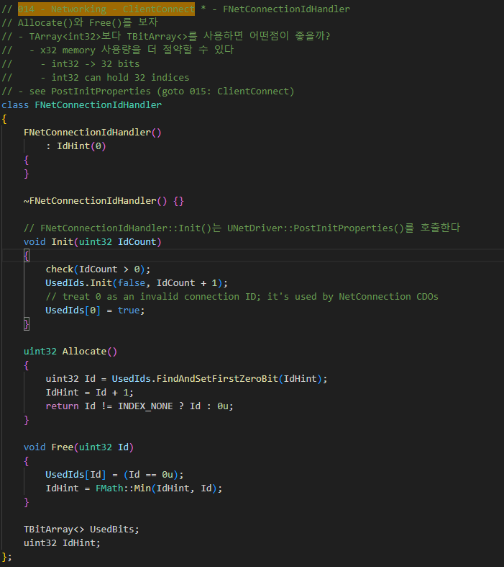
FNetConnectionIdHandler 014

Slide 12
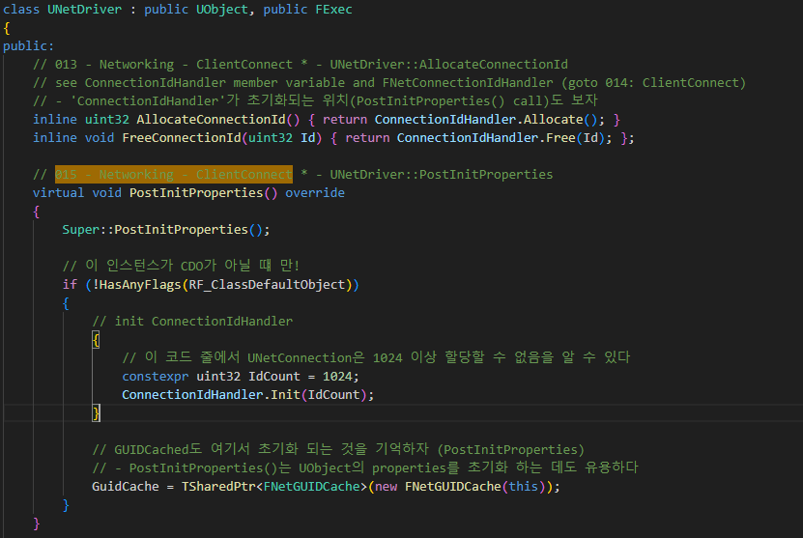
UNetDriver PostInitProperties 015

Slide 13
UNetConnection InitBase 011

Slide 14
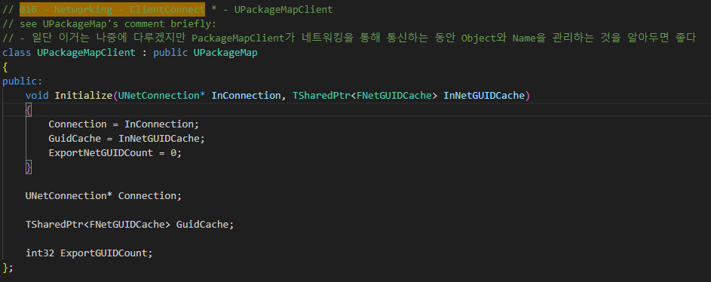
UPackageMapClient 016

Slide 15
UNetConnection InitBase 017

Slide 16
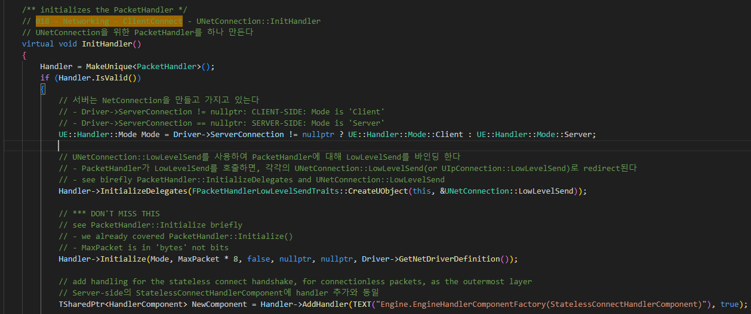
UNetConnection InitHandler 018

Slide 17
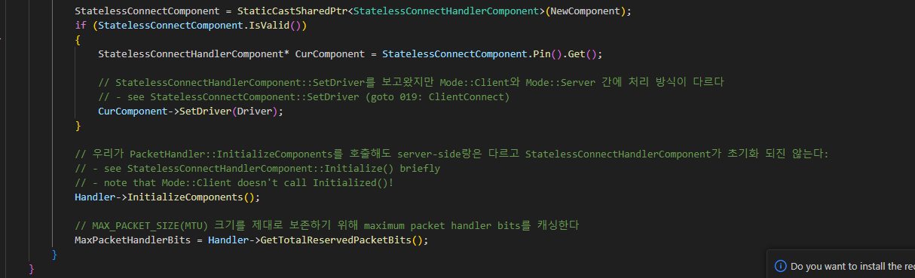
UNetConnection InitHandler 018

Slide 18
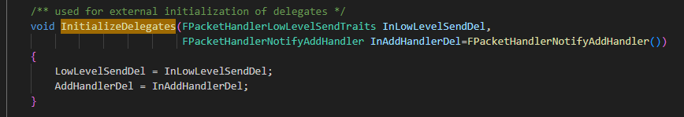
UNetConnection InitHandler 018

Slide 19
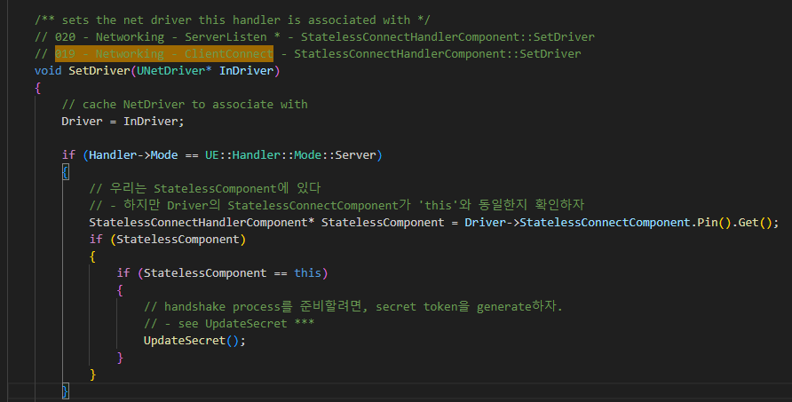
StatelessConnectHandlerComponent SetDriver 019

Slide 20
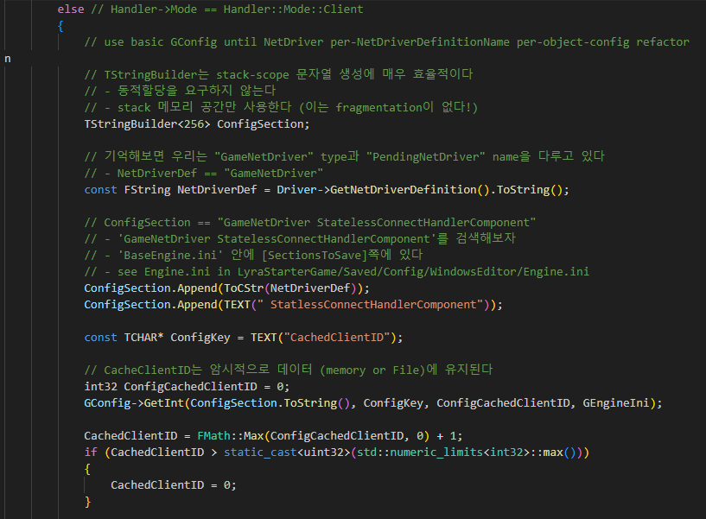
StatelessConnectHandlerComponent SetDriver 019

Slide 21
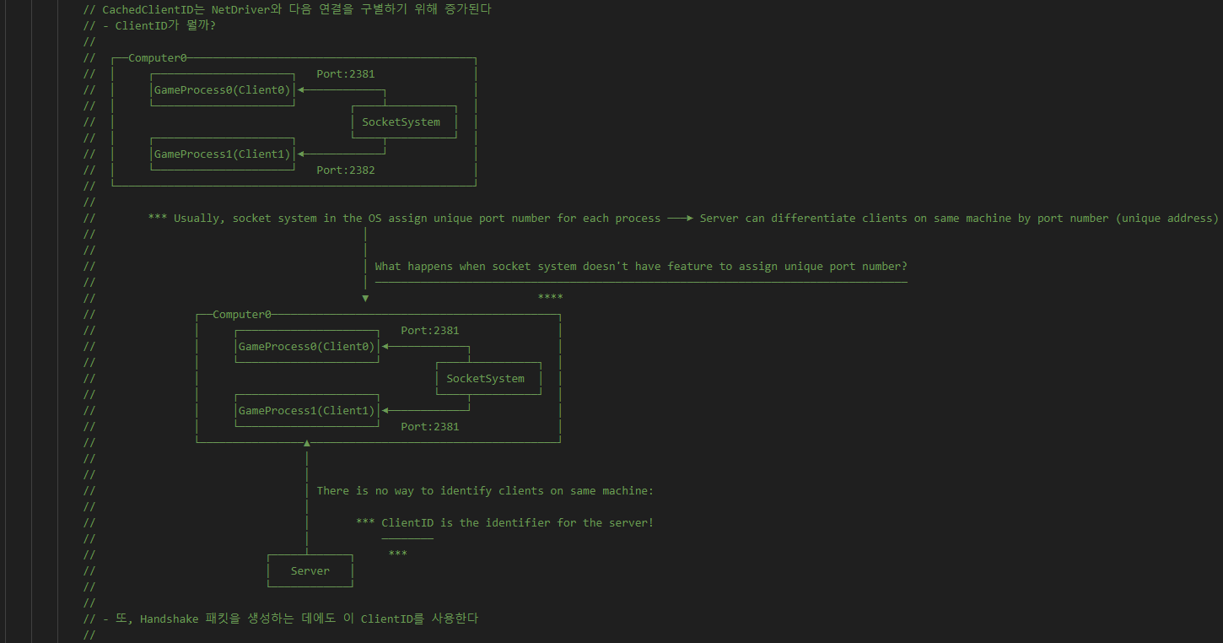
StatelessConnectHandlerComponent SetDriver 019

Slide 22
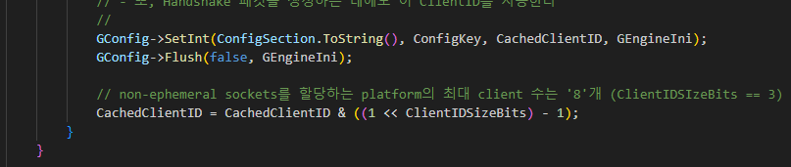
StatelessConnectHandlerComponent SetDriver 019

Slide 23
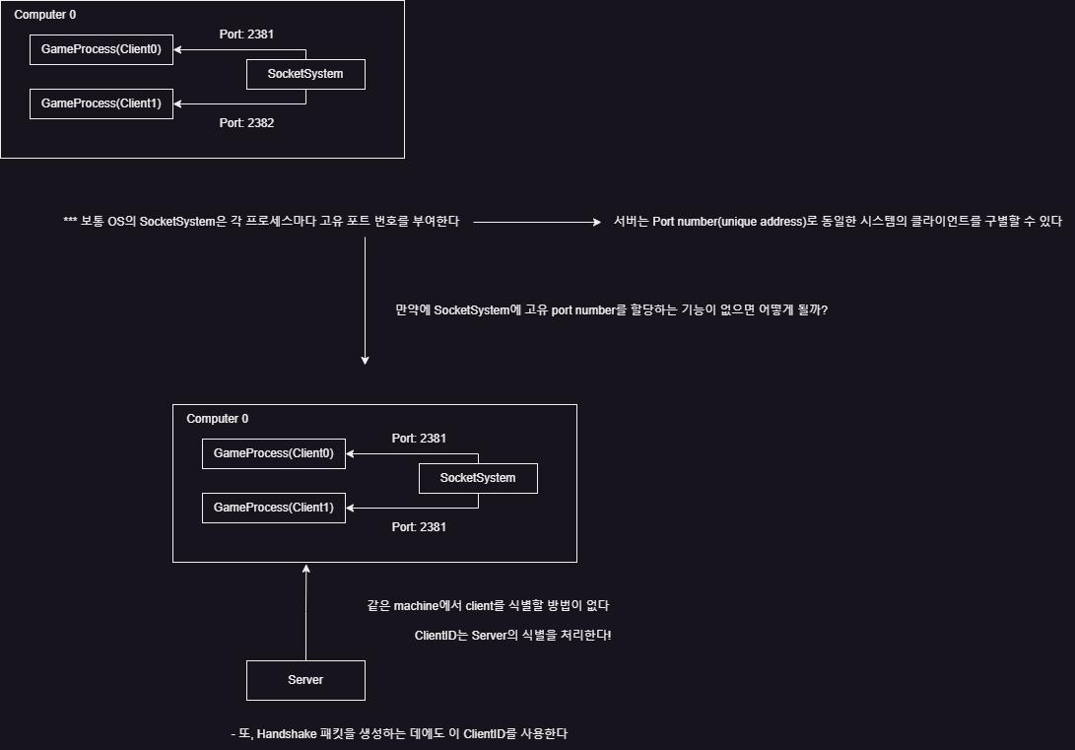
StatelessConnectHandlerComponent SetDriver 019

Slide 24
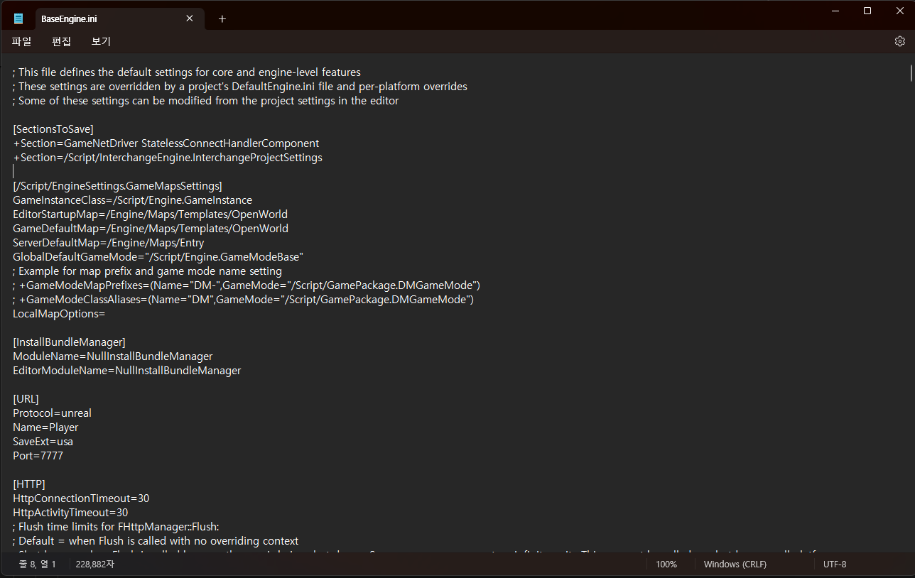
StatelessConnectHandlerComponent SetDriver 019

Slide 25
UIpConnection InitLocalConnection 010

Slide 26
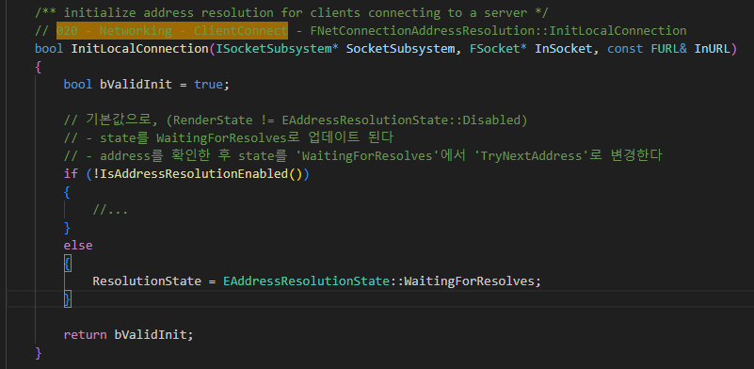
FNetConnectionAddressResolution InitLocalConnection 020

Slide 27
UIpConnection InitLocalConnection 010

Slide 28
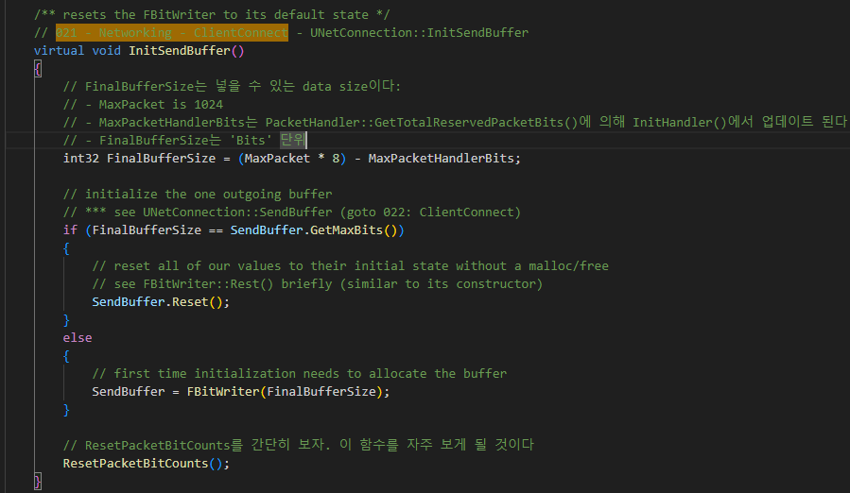
UNetConnection InitSendBuffer 021

Slide 29
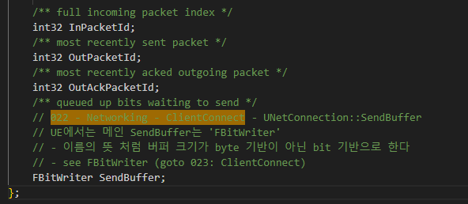
UNetConnection SendBuffer 022

Slide 30
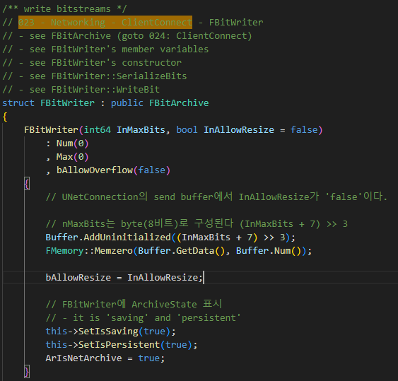
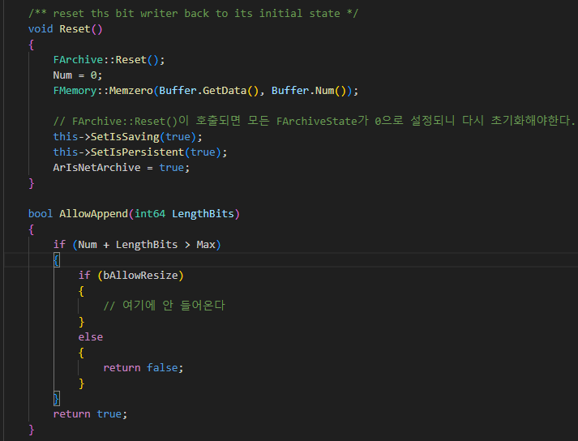
FBitWriter 023

Slide 31
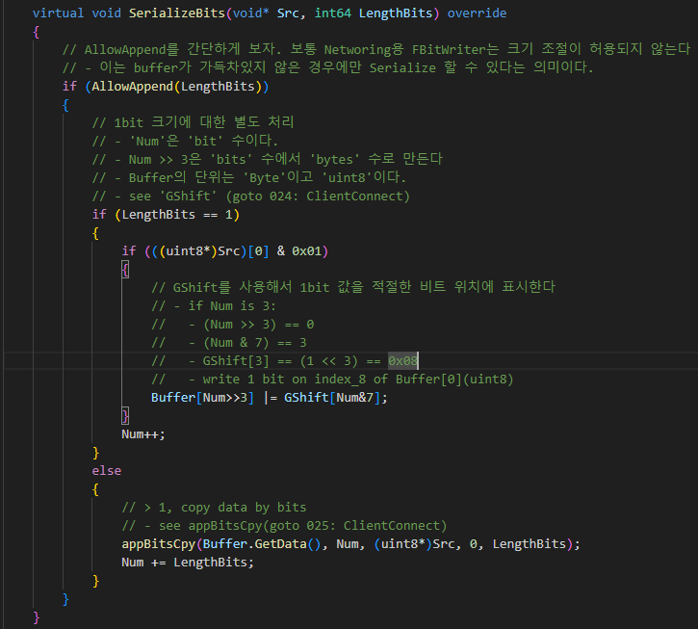
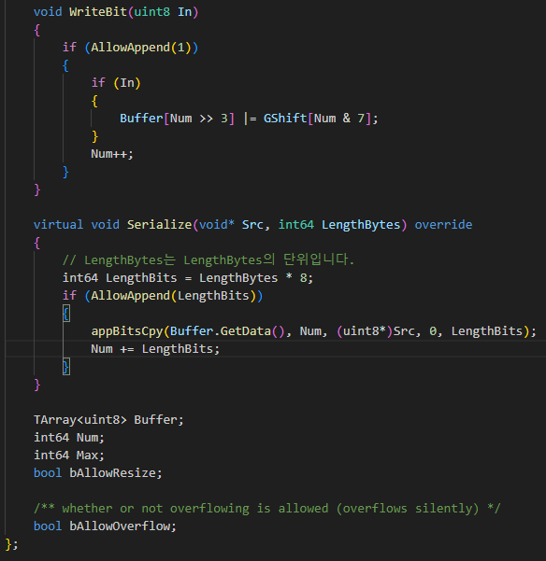
FBitWriter 023

Slide 32
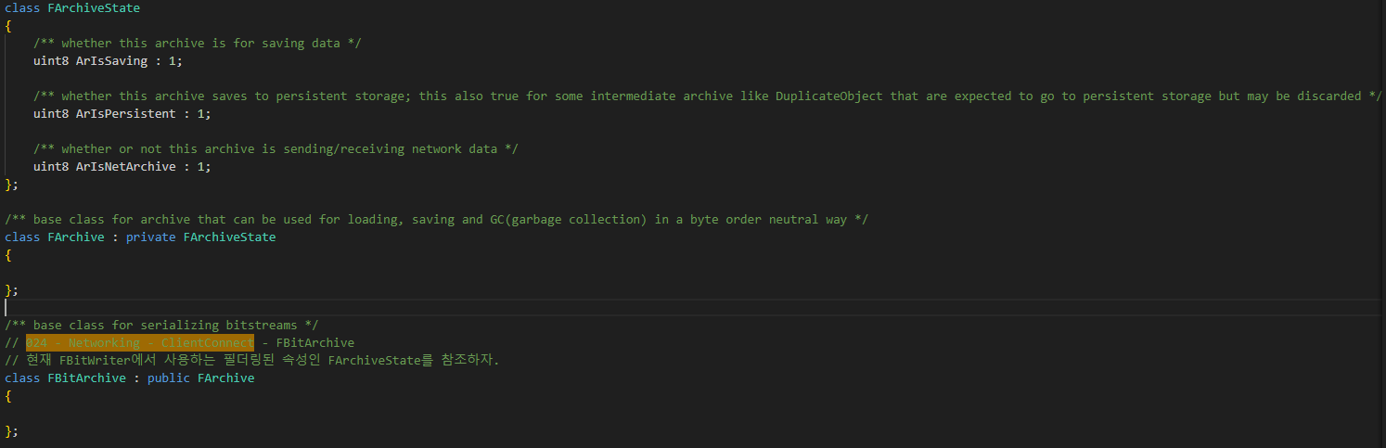
FBitArchive 024

Slide 33
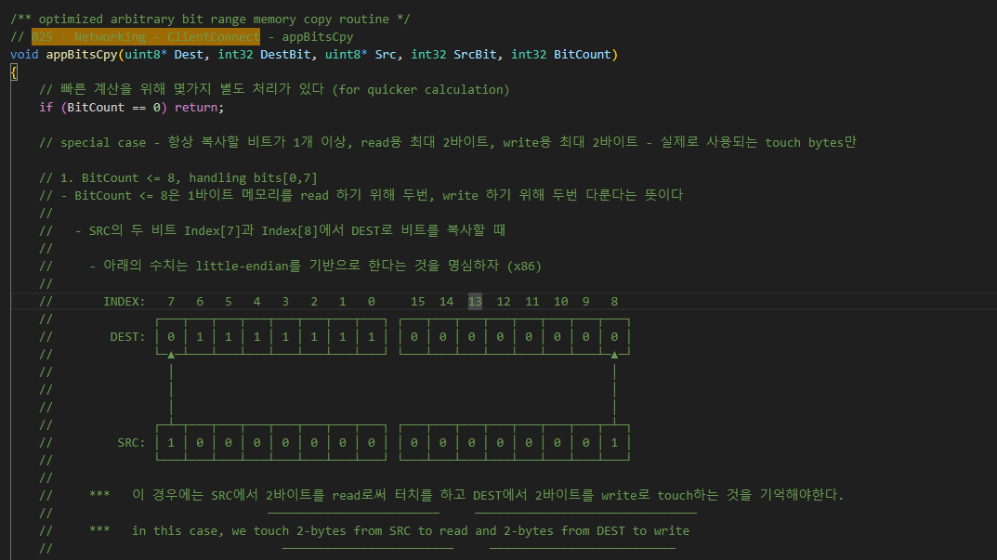
appBitCpy 025

Slide 34
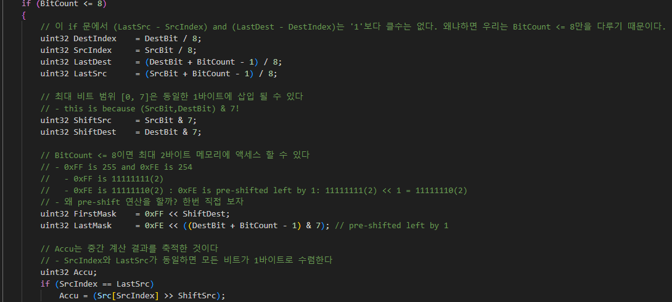
appBitCpy 025

Slide 35
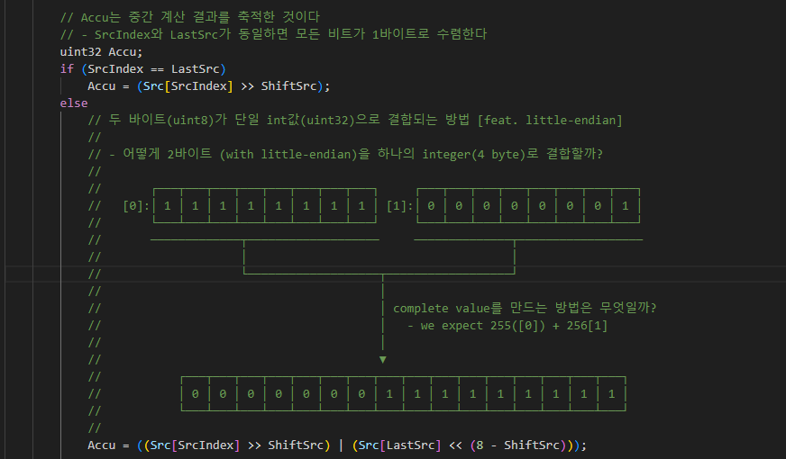
appBitCpy 025

Slide 36
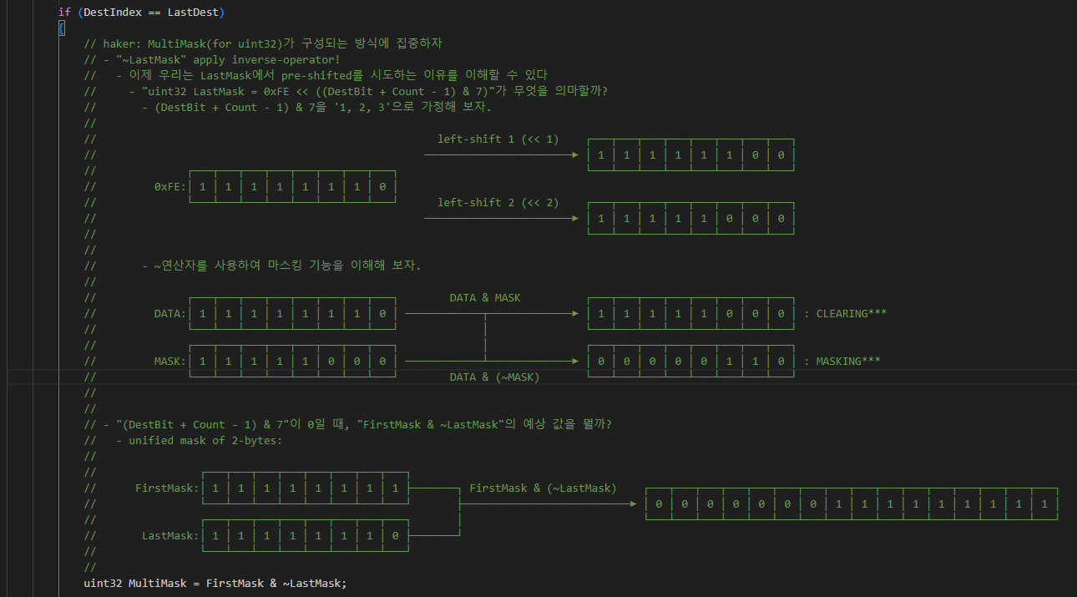
appBitCpy 025

Slide 37
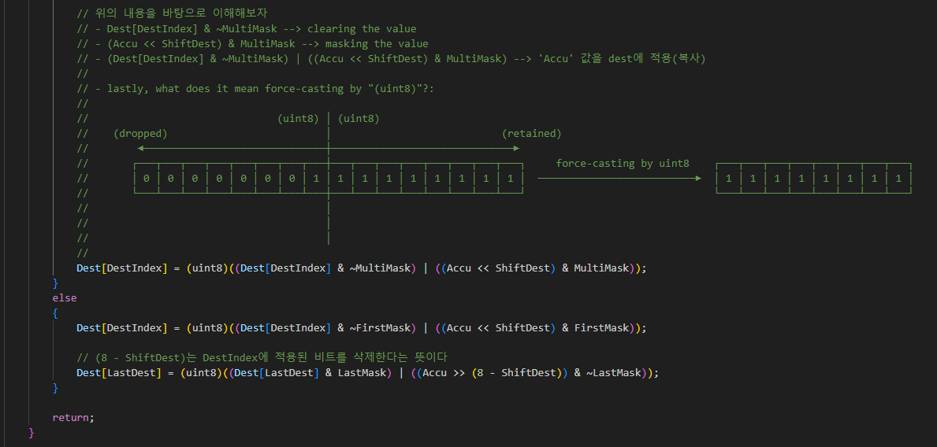
appBitCpy 025

Slide 38
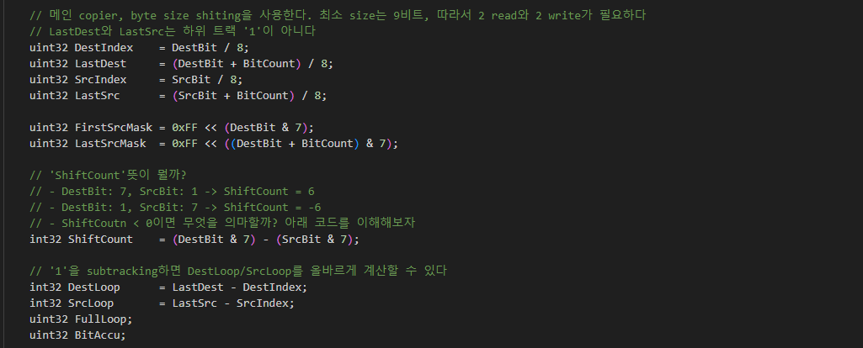
appBitCpy 025

Slide 39
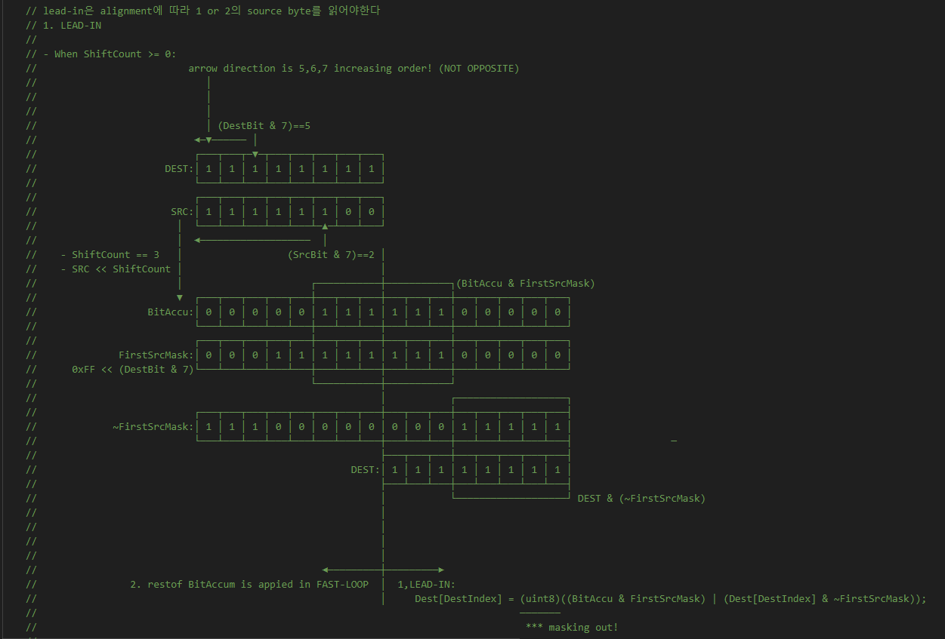
appBitCpy 025

Slide 40
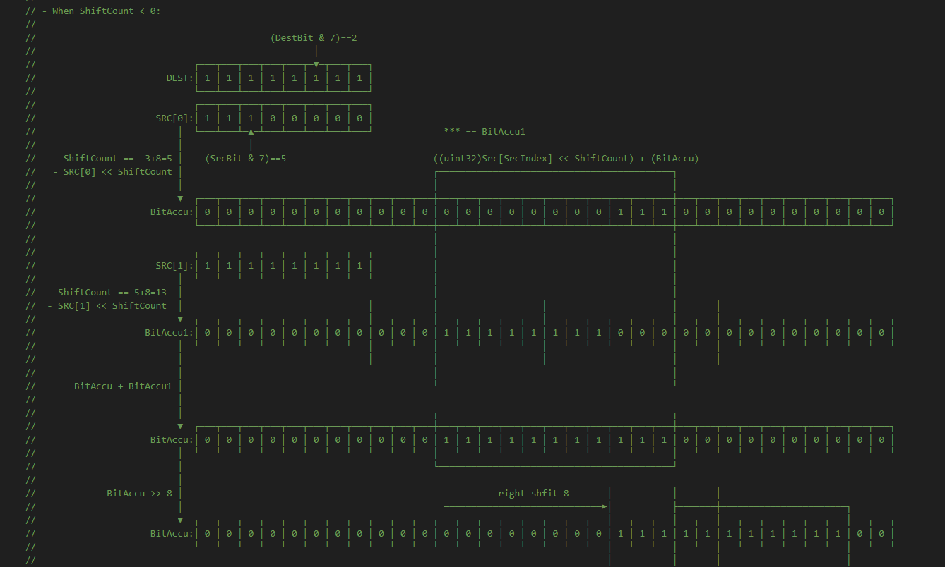
appBitCpy 025

Slide 41
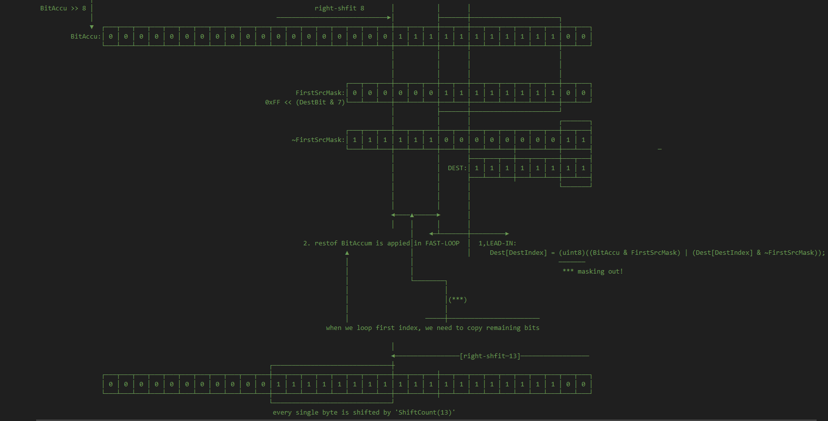
appBitCpy 025

Slide 42
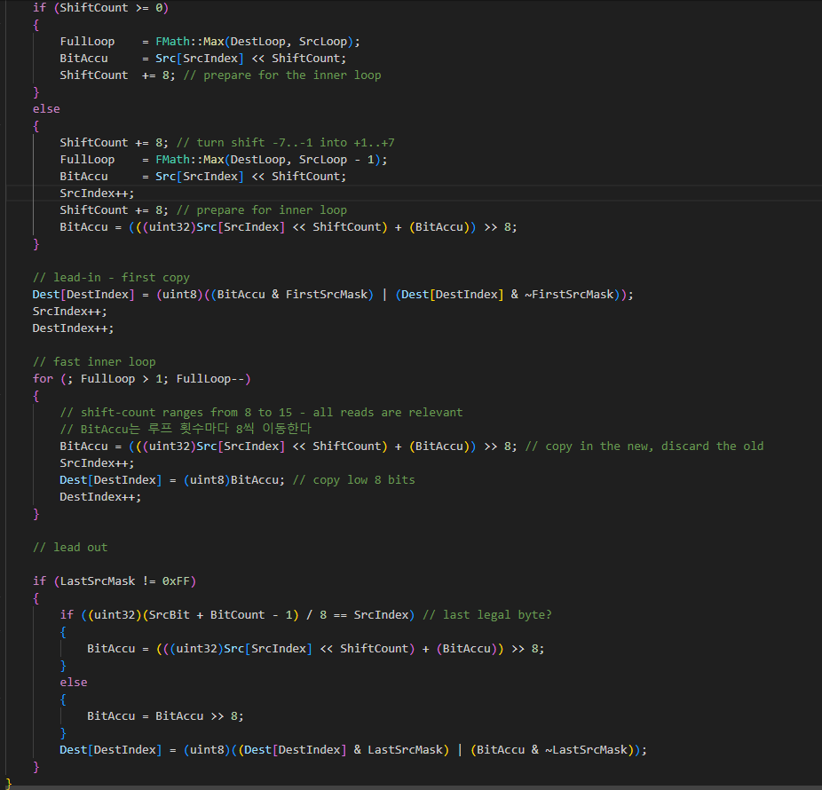
appBitCpy 025

Slide 43
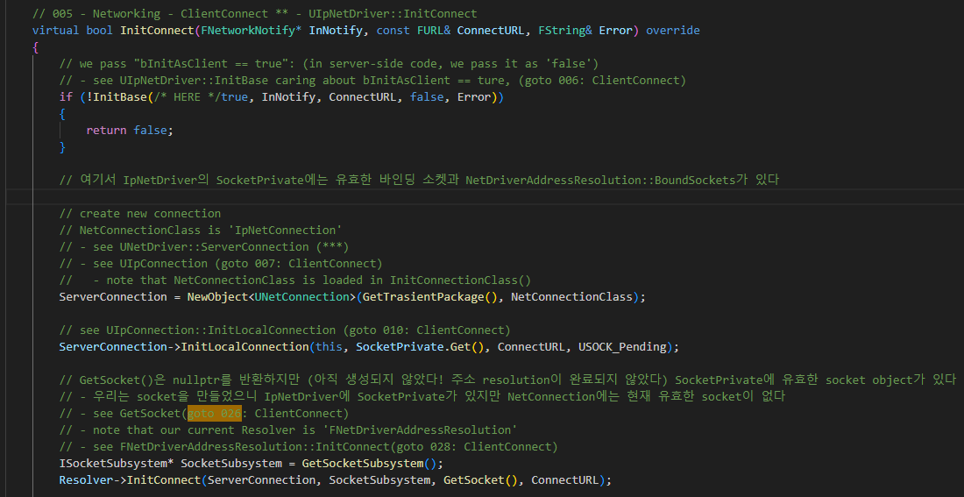
UIpNetDriver InitConnect 005

Slide 44
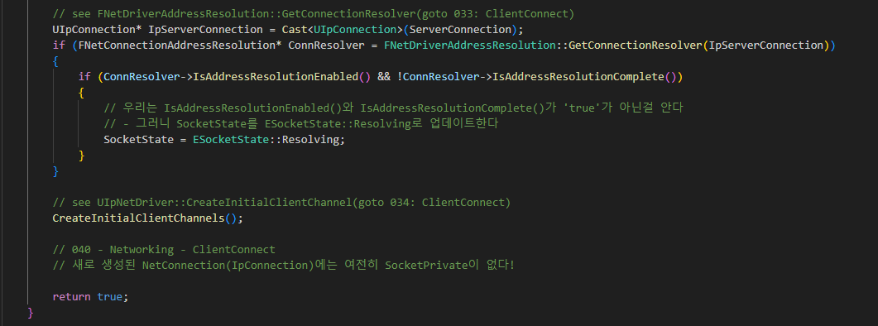
UIpNetDriver InitConnect 005

Slide 45
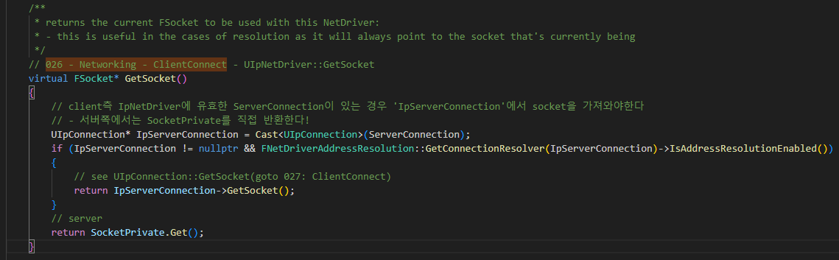
UIpNetDriver GetSocket 026

Slide 46
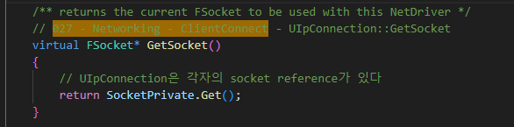
UIpConnection GetSocket 027

Slide 47
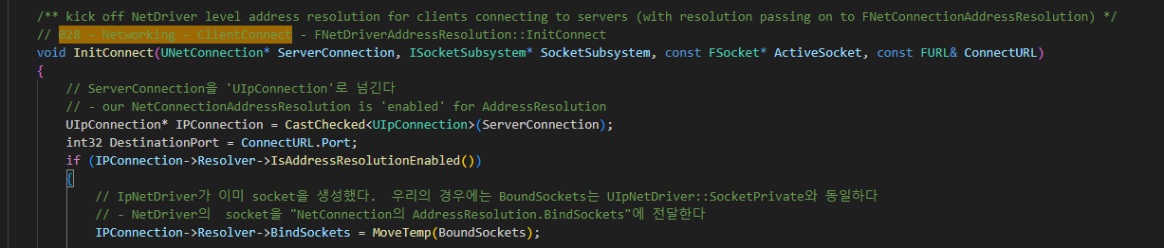
FNetDriverAddressResolution InitConnect 028

Slide 48
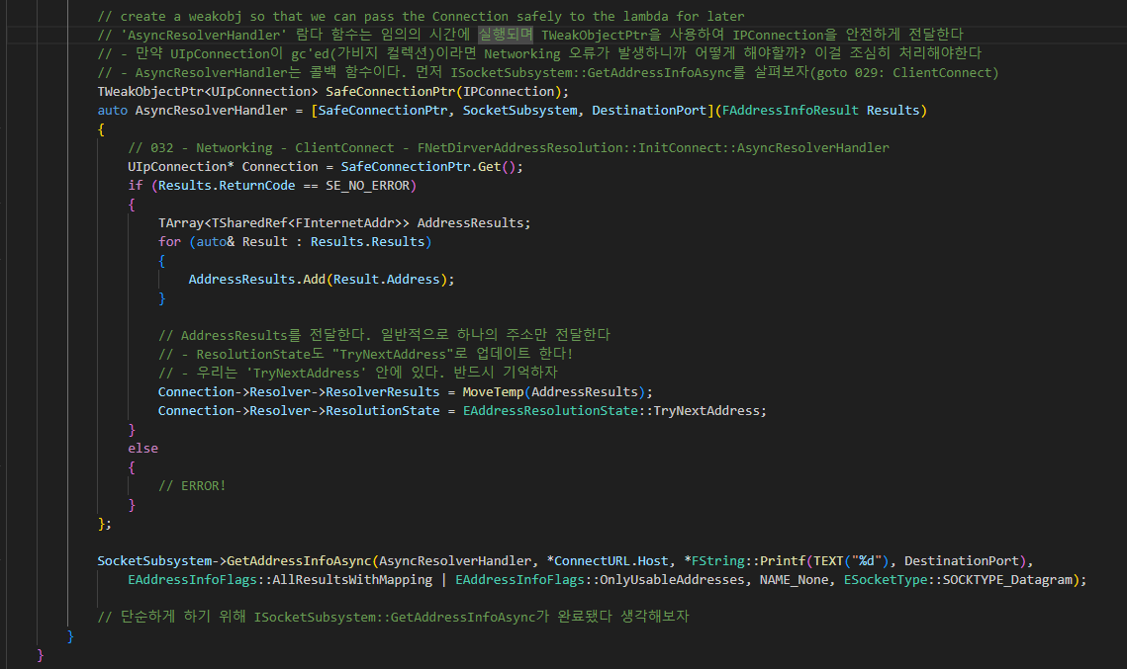
FNetDriverAddressResolution InitConnect 028

Slide 49
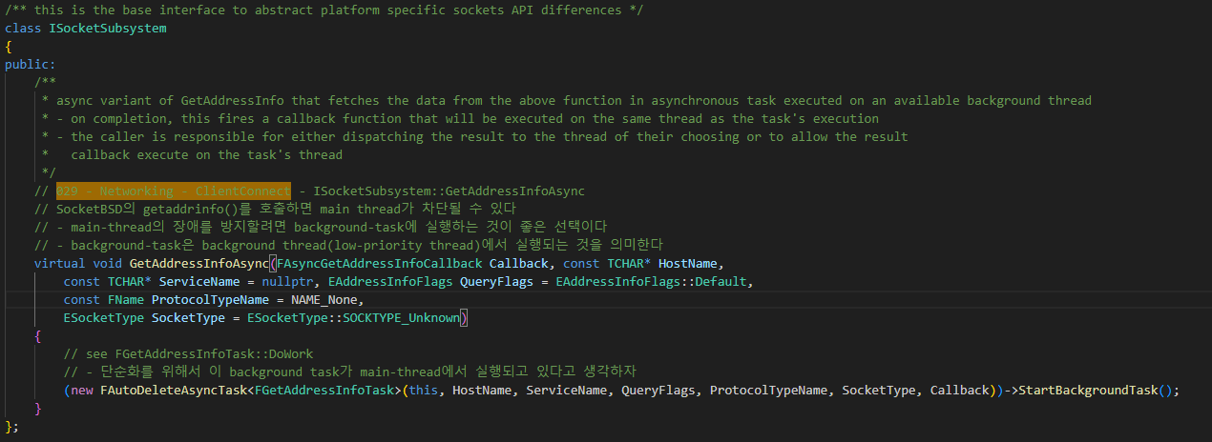
ISocketSubsystem GetAddressInfoAsync 029

Slide 50
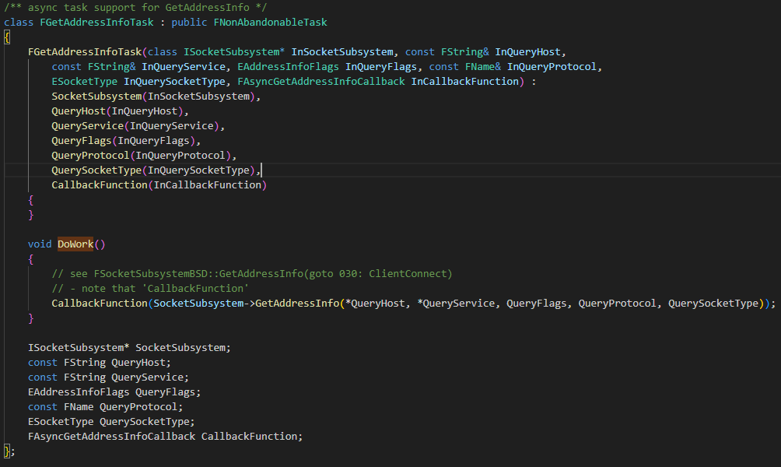
ISocketSubsystem GetAddressInfoAsync 029

Slide 51
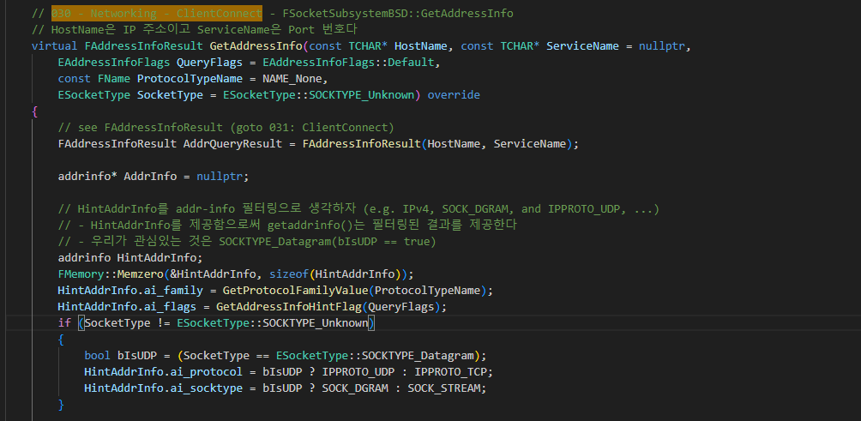
FSocketSubsystemBSD GetAddressInfo 030

Slide 52
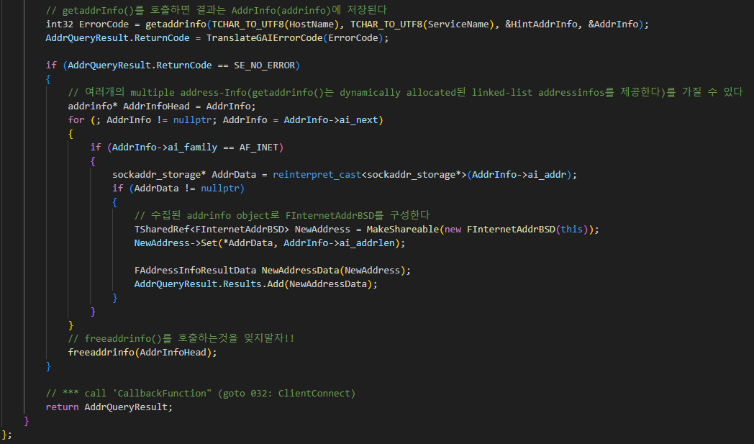
FSocketSubsystemBSD GetAddressInfo 030

Slide 53

FAddressInfoResult 031

Slide 54
FNetDriverAddressResolution InitConnect AsyncResolverHandler 032

Slide 55
UIpNetDriver InitConnect 005

Slide 56

FNetDriverAddressResolution GetConnectionResolver 033

Slide 57

UNetDriver CreateInitialClientChannels 034

Slide 58


UNetDriver ChannelDefinitions 035

Slide 59

UNetConnection CreateChannelByName 036

Slide 60

UNetDriver GetOrCreateChannelByName 037

Slide 61

UNetDriver GetOrCreateChannelByName 037

Slide 62

Uchannel Init 038

Slide 63
UNetConnection CreateChannelByName 036

Slide 64

UNetConnection ChannelsToTick 039

Slide 65
UIpNetDriver InitConnect 005

Slide 66


UEngine GetFirstGamePlayer 041

Slide 67


PacketHandler BeginHandShaking 042

Slide 68

StatelessConnectHandlerComponent NotifyHandshakeBegin 043

Slide 69

StatelessConnectHandlerComponent NotifyHandshakeBegin 043

Slide 70

StatelessConnectHandlerComponent NotifyHandshakeBegin 043

Slide 71

StatelessConnectHandlerComponent GetAdjustedSizeBit 044

Slide 72

StatelessConnectHandlerComponent BeginHandshakePacket 045

Slide 73


StatelessConnectHandlerComponent BeginHandshakePacket 045

Slide 74

StatelessConnectHandlerComponent SendToServer 046

Slide 75


StatelessConnectHandlerComponent CapHandshakePacket 047

Slide 76

UIpNetDriver IsNetResourceValid 048

Slide 77

UGameInstance StartPlayInEditorGameInstance 049

