Slide 1
Dovecot IMAP Server
http://www.dovecot.org/
Timo Sirainen
August 2008

Slide 2
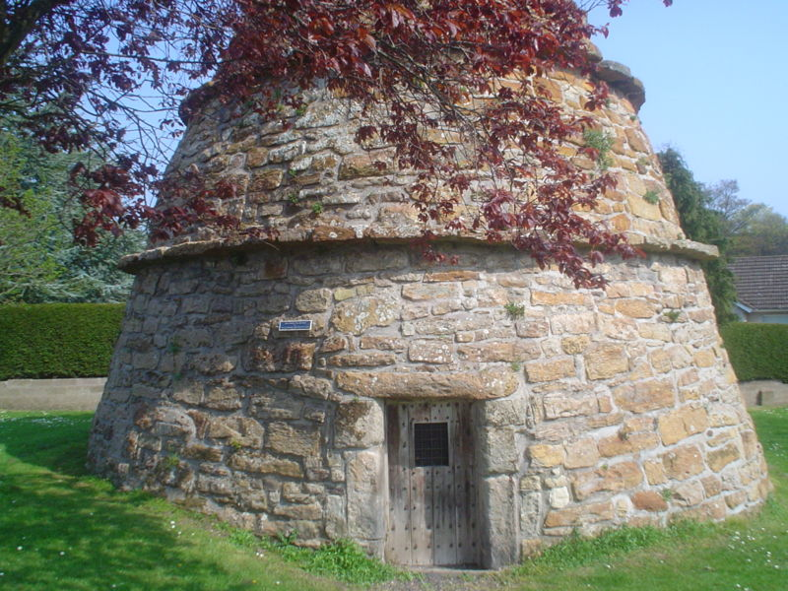
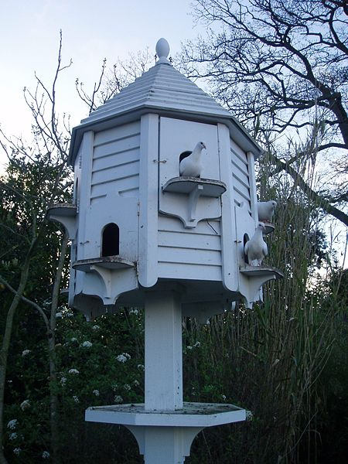
Dovecot
Pictures from Wikipedia, by Cyril Thomas and Carcharoth

Slide 3
Features
Often has better performance than competition.
Optimized for minimizing disk I/O (index/cache files)
Highly configurable for different environments
Support for standard mbox and maildir formats, as well as a new Dovecot-specific high-performance dbox format
Supports NFS and clustered filesystems, soon support for internal multi-master replication
Extremely flexible authentication
Postfix and Exim support Dovecot for SMTP AUTH
Admin-friendly / self-healing
All errors are logged
Understandable error messages
Detected (index) corruption gets fixed automatically

Slide 4
History
Dovecot design was started around June 2002
Why?
First release was July 2002
Late 2003 a redesign started
v1.0.0 released April 13th 2007
v1.1.0 released June 21st 2008
v1.2 dev tree already has a lot of new features
95% of code is written by me – others have mostly written authentication related code

Slide 5
Development
All discussions in mailing list
I try to answer all questions others don’t answer
Mercurial for version control
Distributed VCS should make it easier for others to contribute code
Currently no bug tracking system
I fear it would make my life more difficult
BTS that fully integrated with mailing list would be nice

Slide 6
Code Design
Written with C language
Uses several Dovecot-specific APIs to make coding easier and more difficult to cause security holes
Memory pools, data stack – avoid free()
Buffers, strings and type-safe arrays
Stackable input/output streams
Some say it’s very unlike any other C code
Prefers to (assert-)crash rather than continue with possibly bad state
Unit tests are slowly being added..
Help would be appreciated. ☺

Slide 7
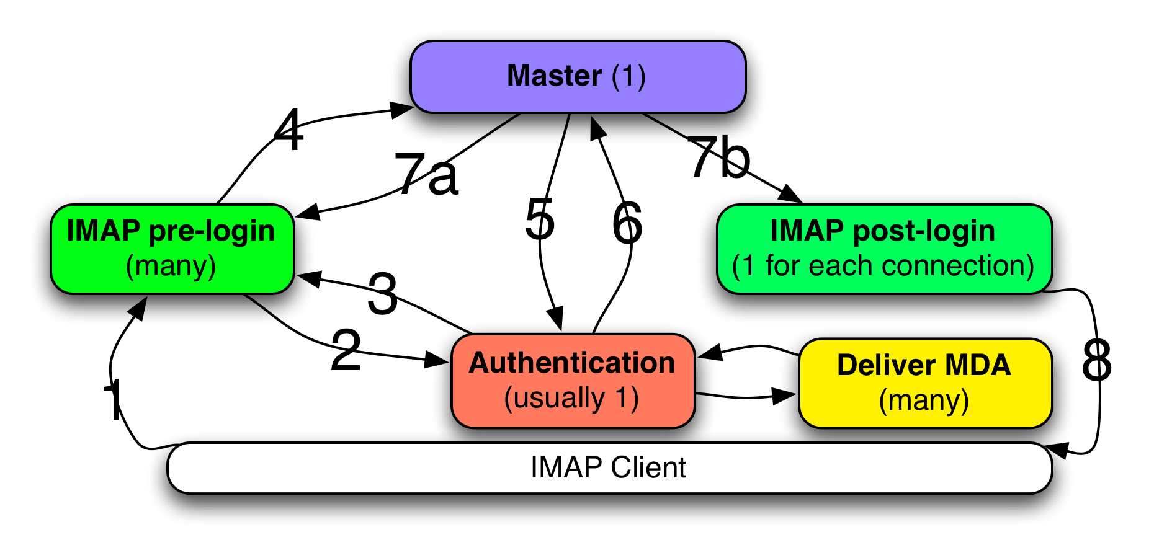
Dovecot Processes
IMAP command: LOGIN username password
Forward username and password to auth process
Success/Failure reply (reason isn’t returned – see log for that)
“Log me in” request – TCP socket fd sent via UNIX socket
Auth verification (to make sure pre-login didn’t fake it)
Returns userdb fields (home, UNIX UID & GID, etc.) or “Internal failure” (practically never)
a) Returns success / failure – pre-login stops IMAP processing b) IMAP process forked & fd transferred
IMAP reply: OK Logged in.

Slide 8
Authentication
Authentication mechanisms: PLAIN, CRAM-MD5, DIGEST-MD5, Kerberos, etc.
Password schemes: Plaintext, CRYPT, MD5, SHA1, SHA256, SSHA, etc.
Password databases: User <-> password mapping mostly (PAM, SQL, LDAP, etc)
User databases: User’s home dir, UNIX UID&GID, other settings like quota (passwd, SQL, LDAP, etc.)
Passdb/userdb separation allows e.g. passdb PAM + userdb LDAP or passdb SQL + userdb static
Support for multiple dbs: Support for both system (passwd) and virtual (e.g. SQL) users (or for any other reason)
SQL/LDAP lookups are fully configurable

Slide 9
IMAP Protocol
Base protocol is complex – difficult to implement it correctly (both client & server)
Flexible – many different ways to implement a client (online & offline – defined later)
Extensible – there are a lot of extensions. IETF groups:
imapext created many extensions over many years (ACL, SORT, THREAD, etc). Shut down on June 2008.
Lemonade contains many extensions mainly intended for mobile clients (forward-without-download, etc)
Message Organizing (morg) group is starting up (e.g. multi-mailbox search, mailbox metadata, new comparator, etc)
Talks about a simplified IMAP5 protocol have started

Slide 10
Dovecot’s IMAP Extensions
v1.0: SASL-IR SORT THREAD=REFERENCES MULTIAPPEND UNSELECT LITERAL+ IDLE CHILDREN NAMESPACE
v1.1: UIDPLUS LIST-EXTENDED I18NLEVEL=1 STATUS-IN-LIST (draft)
v1.2: CONDSTORE QRESYNC WITHIN ID SEARCHRES SEARCH=INTHREAD ESEARCH
Future: Lemonade extensions (CATENATE, URLAUTH, NOTIFY, ..)

Slide 11
ImapTest IMAP server tester
Written originally for Dovecot stress testing
Found a lot of crashes, hangs and mailbox corruption on other IMAP servers as well
Tests IMAP server compliance with static tests and dynamic random stress testing.
Dovecot is currently the only IMAP server that fully passes all of ImapTest tests.
Most other servers fail in many different ways.
“Professional” IMAP servers from large companies are among the worst.
http://imapwiki.org/ImapTest

Slide 12
IMAP Server Performance
Difficult to benchmark
Depends a lot on clients (online vs. offline – more on next slides)
What data to index/cache?

Slide 13
Offline clients
Typically downloads the newly seen messages’ bodies once and caches them locally
Often can be configured to download immediately vs. download when reading
Some use server side searches (Thunderbird) and some don’t (Outlook – if some messages haven’t been downloaded, those aren’t searched)
Usually also fetch messages’ metadata once (headers, received date)
Caching may help, but not that much

Slide 14
Online clients
Webmails often keep asking for the same information over and over and over again
Pine and some webmails cache what they’ve already seen, but not permanently
Mutt (without local cache) and some others fetch all messages’ metadata every time when opening a mailbox
Caching is very useful, but different clients want different metadata

Slide 15
Dovecot Cache File
Dynamic: caches only what clients want.
Specific message headers (From:, Subject:, etc)
Message MIME structure information
Message sent / received date
etc.
Caching decisions for each field: “no”, “temporary”, “permanent”
Unused fields dropped after a month.
Cached data never changes (IMAP guarantees)
Cache file gets “compressed” once in a while
Often about 10-20% of mailbox size

Slide 16
Dovecot Index Files
dovecot.index contains current metadata
Fixed size records only, one per message
IMAP Unique ID number (UID) identifies messages
Flags (\Seen, \Answered, etc.)
Keywords (aka. tags, labels,custom flags) as a bitmask (optimized for few keywords)
Extension data: mbox file offsets, cache file offsets, modseq number (v1.2 CONDSTORE), etc.
Lazily created/updated since v1.1
dovecot.index.log has all the latest changes. dovecot.index is updated after 1 kB of new data has been written to the .log

Slide 17
Dovecot Index Files
dovecot.index.log contains transaction log
Somewhat similar to databases’ transaction logs or filesystem journals.
Contains all changes to be done to dovecot.index.
After dovecot.index is read once, Dovecot usually never reads it again but only updates the in-memory copy from dovecot.index.log
Very efficient with NFS / clustered filesystems!

Slide 18
Locking
Dovecot uses several techniques to avoid traditional read/write locking (no waiting!)
dovecot.index.log is currently write-locked when writing, reads are lockless
O_APPEND could be used to make write-lockless
dovecot.index is read-locked. If write-locking fails, the file is recreated instead of waiting.
dovecot.index.cache does short write locks to reserve space. Reads are lockless.
Maildir syncing requires locking (or inotify)

Slide 19
Plugins
Dovecot plugins can hook into almost anything and modify Dovecot’s behavior
Access Control Lists
Quota
Full text search indexes
Reading gzip-compressed mboxes/maildir files
Can add new IMAP commands (although enhancing existing commands could use more work)
Implement new mail storage backends (virtual, SQL, IMAP proxying)

Slide 20
Mailbox Formats
mbox
Oldest format, widely supported
One mailbox = one file
Slow to delete messages from the middle
Maildir
One file = one message
Fast to delete messages
Slow(er) to read through all messages
dbox
Dovecot’s extensible and high-peformance mailbox format

Slide 21
Dbox Mailbox Format
Either one file = one message
Lockless reads
Main difference to Maildir: file name doesn’t change
Or one file = multiple messages
Some locking necessary for reads
A new file is created when old one grows above configured size (e.g. 2 MB) or when the file is older than n days (useful for incremental backups)
Changing used file size changes read/delete performance
Not fully implemented yet

Slide 22
Dbox Mailbox Format
Primary metadata storage is Dovecot’s index files
Metadata is backed up to dbox files about once a day, so if indexes are lost, all flags won’t get lost
Messages’ metadata is extensible with arbitrary key=value pairs. This will useful in future:
Separating attachments to a single instance storage
Storing messages compressed
Extremely easy and fast migration from Maildir
Compatibility mode: Rename cur/ to dbox dir, move files in new/ and metadata files

Slide 23
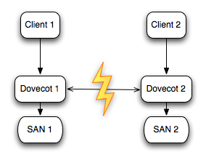
Multi-Master Replication
Necessary?
Not possible to implement reliably with low-level replication because of IMAP Unique message ID (UIDs)
IMAP UIDs are increasing 32bit numbers
Global sync required or conflicts will happen
Conflicts always possible with M-M replication, but fixing not possible with low-level replication

Slide 24
Multi-Master Replication Goals
Synchronous operation: Never lose even a single mail (if 1..n replicas die)
Performance should be good in all-active multi-master setup
Desynchronizations happen: Fix them and conflicts caused by syncing automatically and efficiently

Slide 25
Multi-Master Replication
Saving mails (the most critical part)
Expunging mails
Updating message flags/keywords
CONDSTORE extension: Updating modification sequences (modseqs)
Per-msg modseq increases on every flag etc. change
Modseqs are also very useful for replication
Mailbox creates, renames, deletes, etc.
Two very different data: Potentially huge message bodies vs. small metadata

Slide 26
Replication Parts
3 mostly separate parts:
Incremental mailbox sync
Fixing a (large) mailbox desync
Syncing mailbox list (mailbox creates, deletes, renames)
Implemented in different stages (1-3). Incremental mailbox sync is the most difficult to get working correctly and fast.

Slide 27
Replication Master
IMAP UIDs must be globally growing -> UIDs can be allocated only by a “mailbox master” server
Master may move between servers (and at least initially it always will if a server wants to save a new mail)
Master can also handle CONDSTORE extension’s STORE UNCHANGEDSINCE.
If network dies between two servers, both may allocate the same UID -> UID conflict that must be fixed later when servers see each others again

Slide 28
Replication Processes
Simpler to have separate processes for separate tasks.
Better security: Less code that has write access to users’ mailboxes
Worker processes when there can be waiting on locks, so work still continues elsewhere

Slide 29
