Slide 1

Bioinformatics Bootcamp
Biomedical Machine Learning with Python
PART II: Machine Learning for Biomedical Applications
Module 6: Feature Selection

Slide 2
Contact Info
Daniel Montemayor Ph.D.
Assistant Professor / Research
Center for Renal Precision Medicine
Department of Medicine
UT Health San Antonio
Email: montemayord2@uthscsa.edu
Office hours: https://calendly.com/daniel_montemayor/montemayor-office-hours

Slide 3
Part II : Overview
Getting to know your data
Formatting | Visualization | Partitioning | Normalization | Integrity
Feature Selection
Parsimony | Dimension Reduction | PLS-DA | t-SNE | SOM
Classification Models
Cross-Entropy and other Error Metrics | Random Forest | Logistic Regression
Regression Models
Linear Regression | Regularization | LASSO | Elastic-Net
End-to-End ML Workflow – Leukemia Project (two weeks)
Convolutional Neural Networks – MRI Brain Tumor Project
Adv. Topics – Sequence. Models | Encoders |GANs | Reinforcement Learning

Slide 4
What is Feature Selection?
Process of choosing the features that go into the model based on their utility to answer the central question.
How to quantify that utility is what gives the variety of feature selection schemes.
Features can be considered alone or as a set.
Some ML classifiers naturally do feature selection.

Slide 5
Why Feature Selection?
Mitigates overfitting
“With four parameters I can fit an elephant, with five I can make him wiggle his trunk”- John von Neumann
Lowers Cost
“If everything seems under control, you’re not going fast enough” – Mario Andretti
Reduces error
“Mo’ Features, Mo’ Problems” – no one, ever

Slide 6
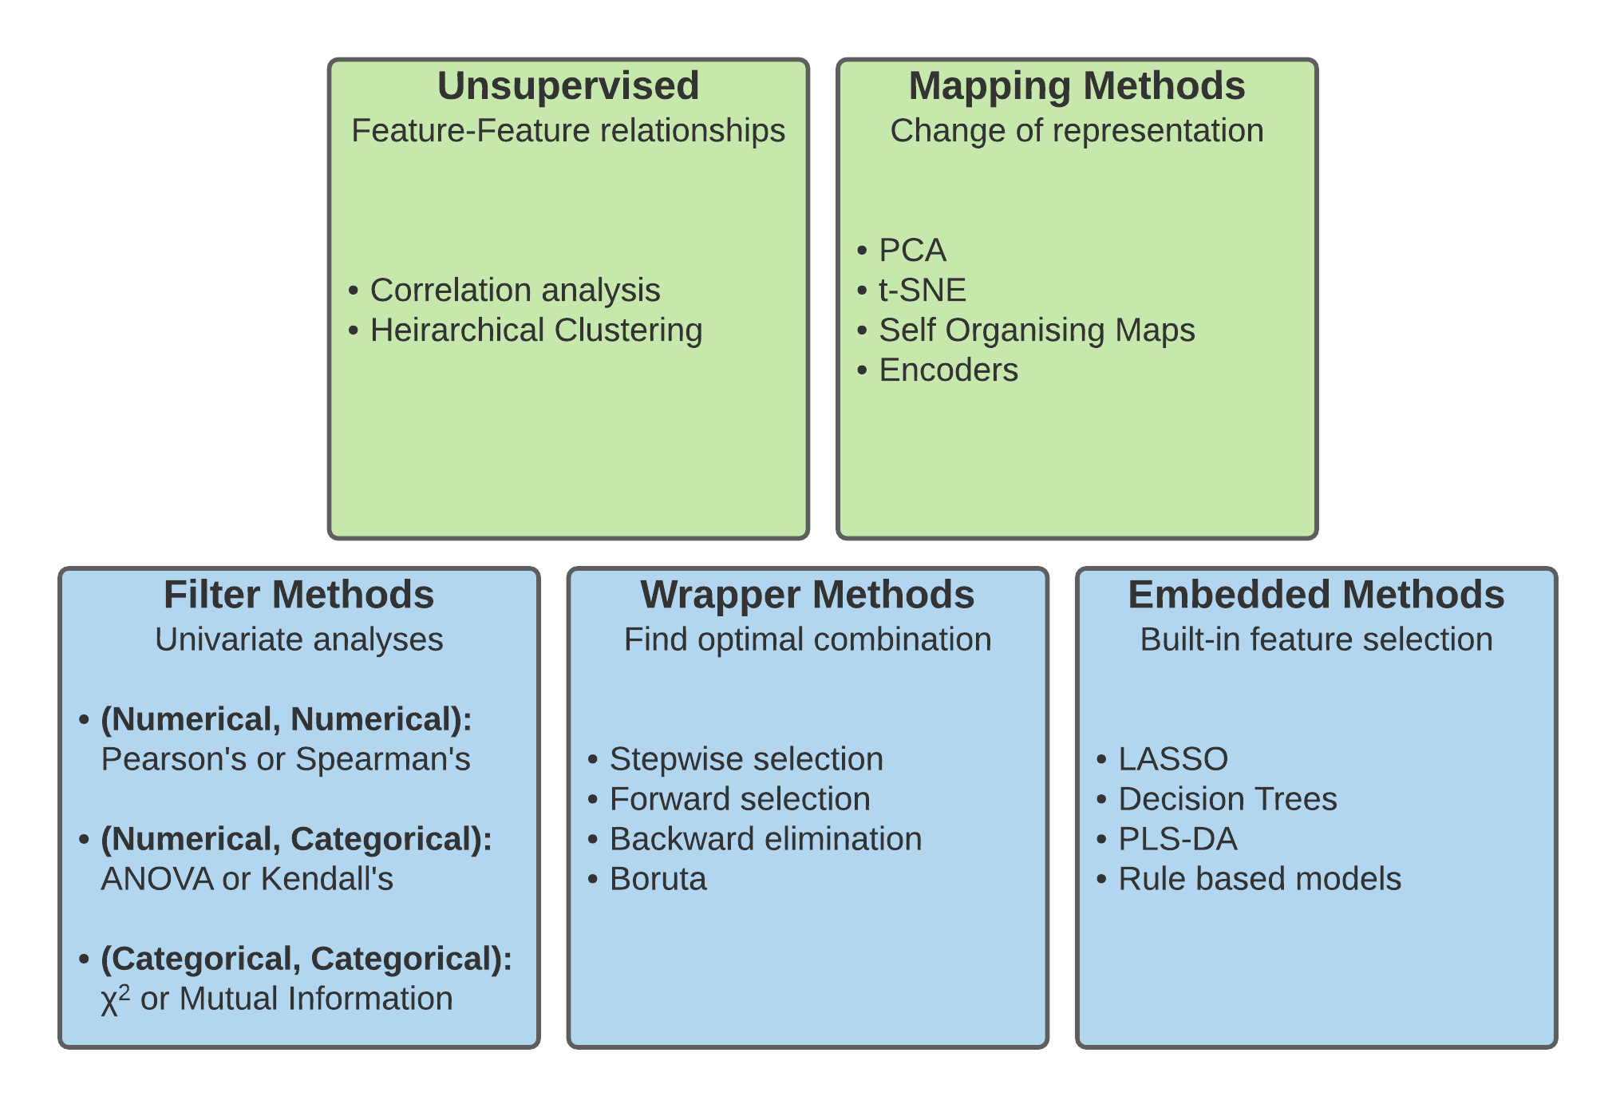
Types of Feature Selection

Slide 7
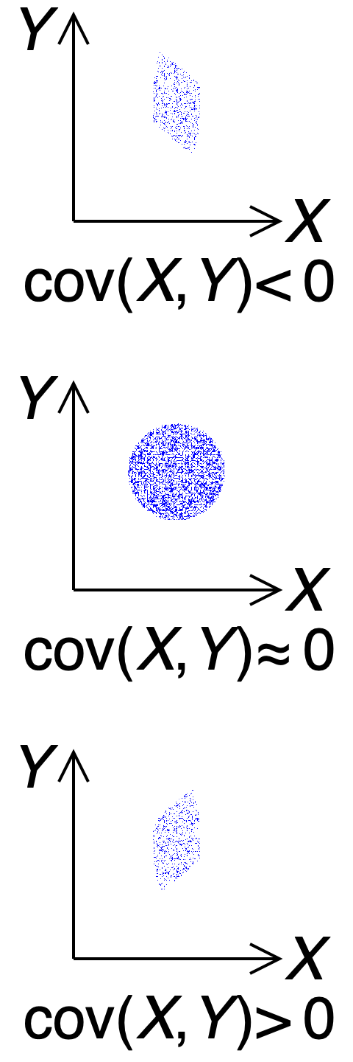
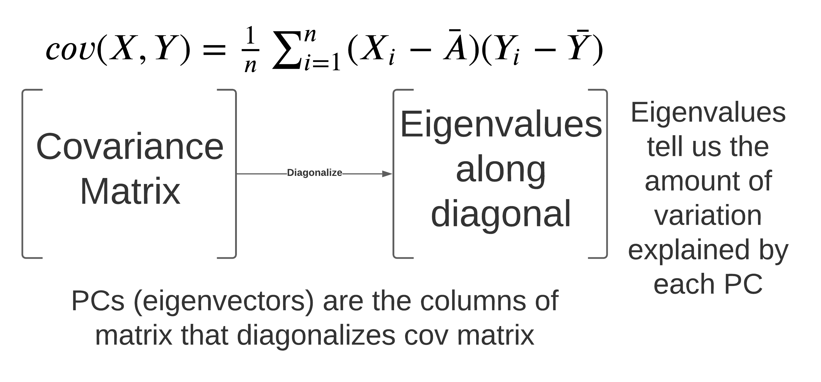
Mapping Methods – Dimension Reduction
PCA
Notes:
PCA graphic how to use – what is the new representation. End with calcualtion

Slide 8
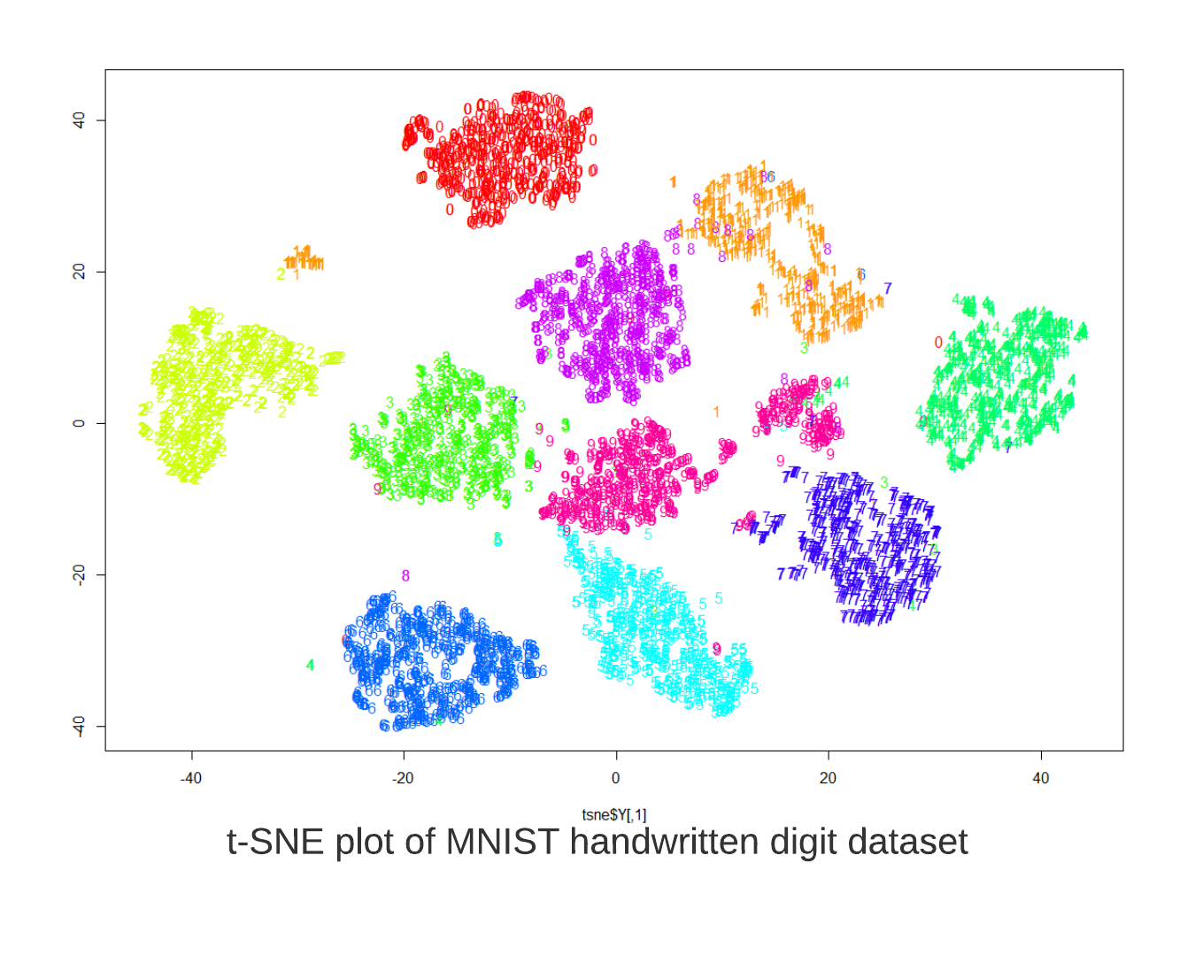
Mapping Methods – Dimension Reduction
t-Distributed Neighbor Embedding (t-SNE)
2D mapping
Preserves locality - similar points remain close to each other
Stochastic – every map is different
Can not be used to categorize new data
Notes:
Mnist is hello world for ML. previous slide with hand written digigts

Slide 9
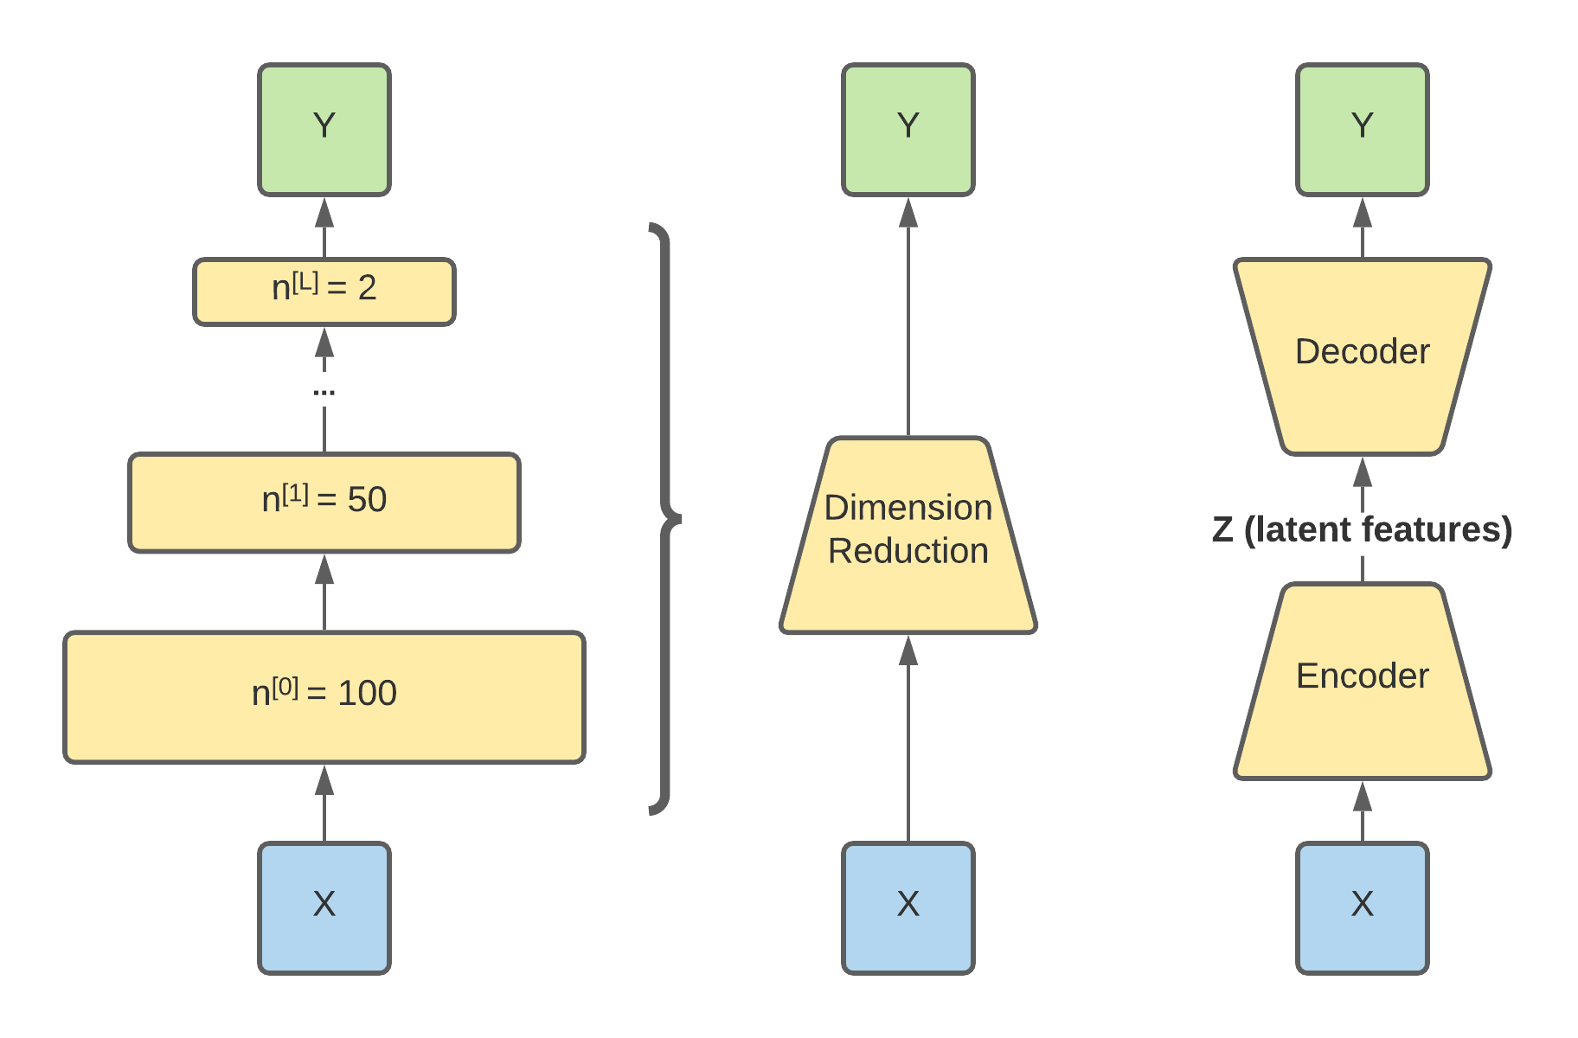
Mapping Methods – Dimension Reduction
Encoders
Applied with deep networks
Think data compression
When paired with a decoder can be used to reproduce input (autoencoder)

Slide 10
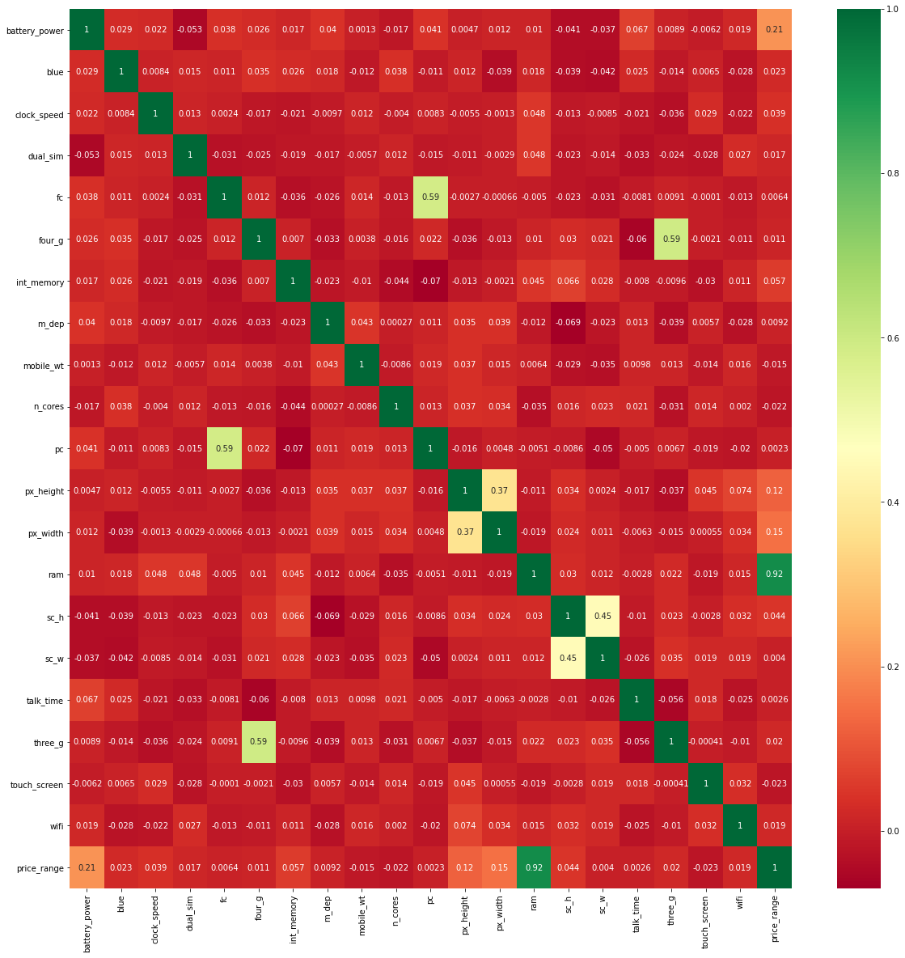
Unsupervised Methods
Remove Correlated Variables – Visualize with heatmaps
Heatmap of feature correlations from mobile price dataset
Notes:
Orthogonality – biological meaningful – why is it expected.

Slide 11
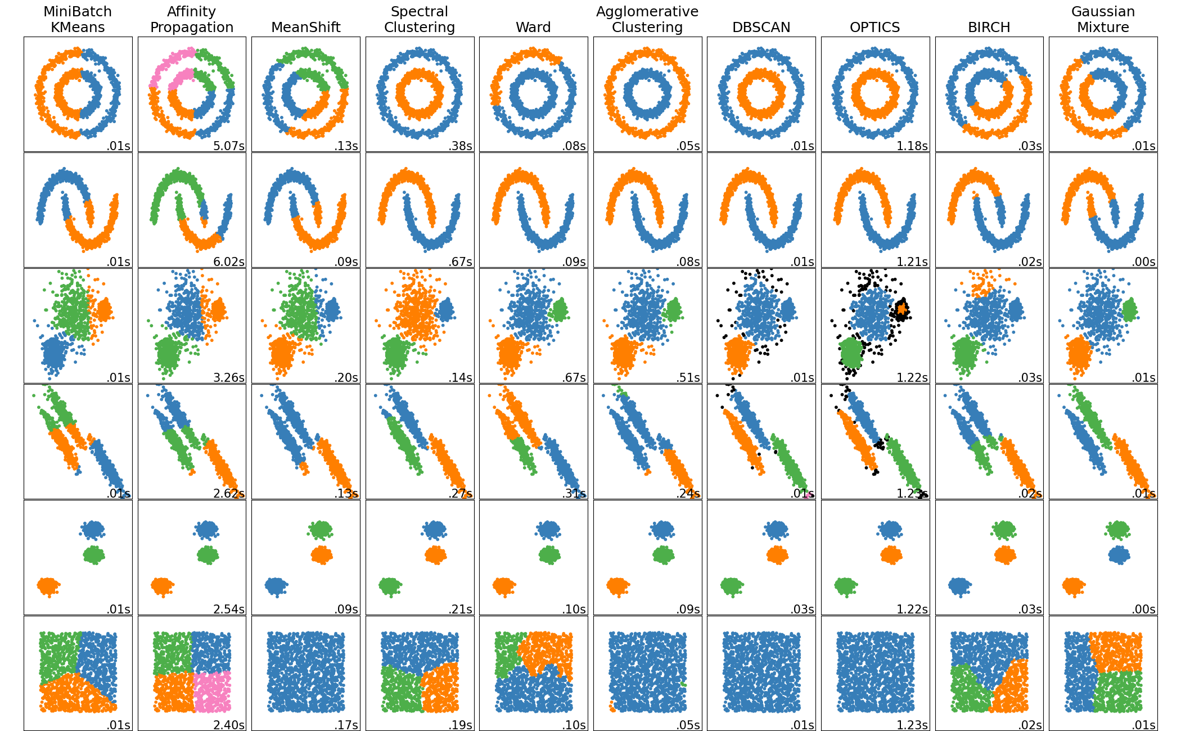
Unsupervised Methods
Clustering
Comparison of clustering methods in sklearn. Relative compute times for test distributions in rows are shown.

Slide 12
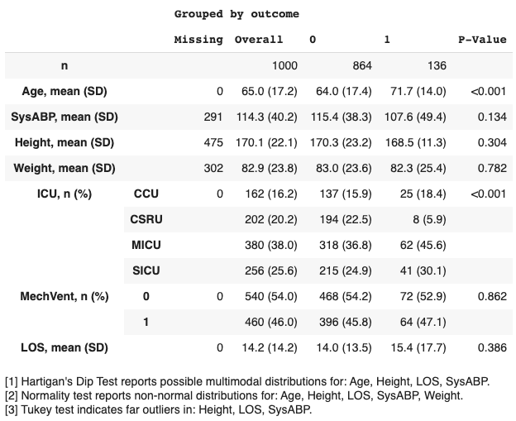
Filter Methods
Filter features based on their association with the outcome

Slide 13
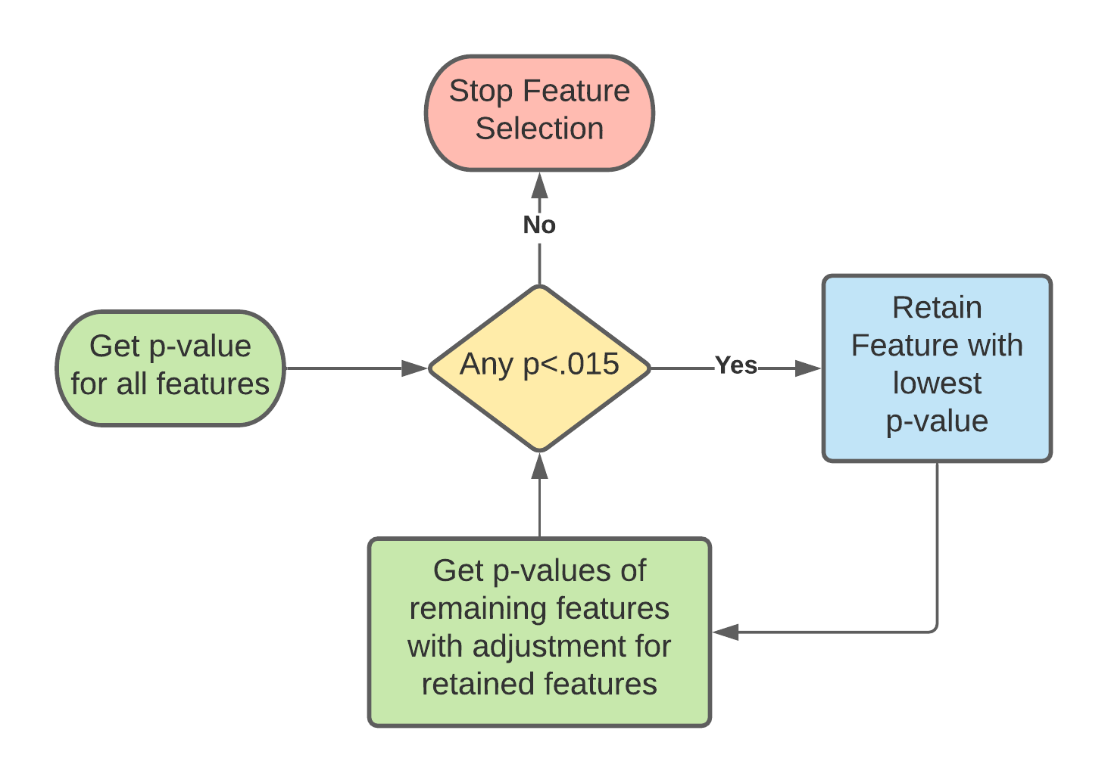
Wrapper Methods
Forward Stepwise Selection
Features added/removed one at a time
Start with univariate models for each feature
Features ranked by variation explained (pvalue)
P-value cutoff is usually ~0.15
AIC = -2*log-likelihood + 2*nfeat
Notes:
Basically p-hacking. Multiple hypothesis tests leads to more false positives (too many features selected). Problem is worse with correlated features.

Slide 14
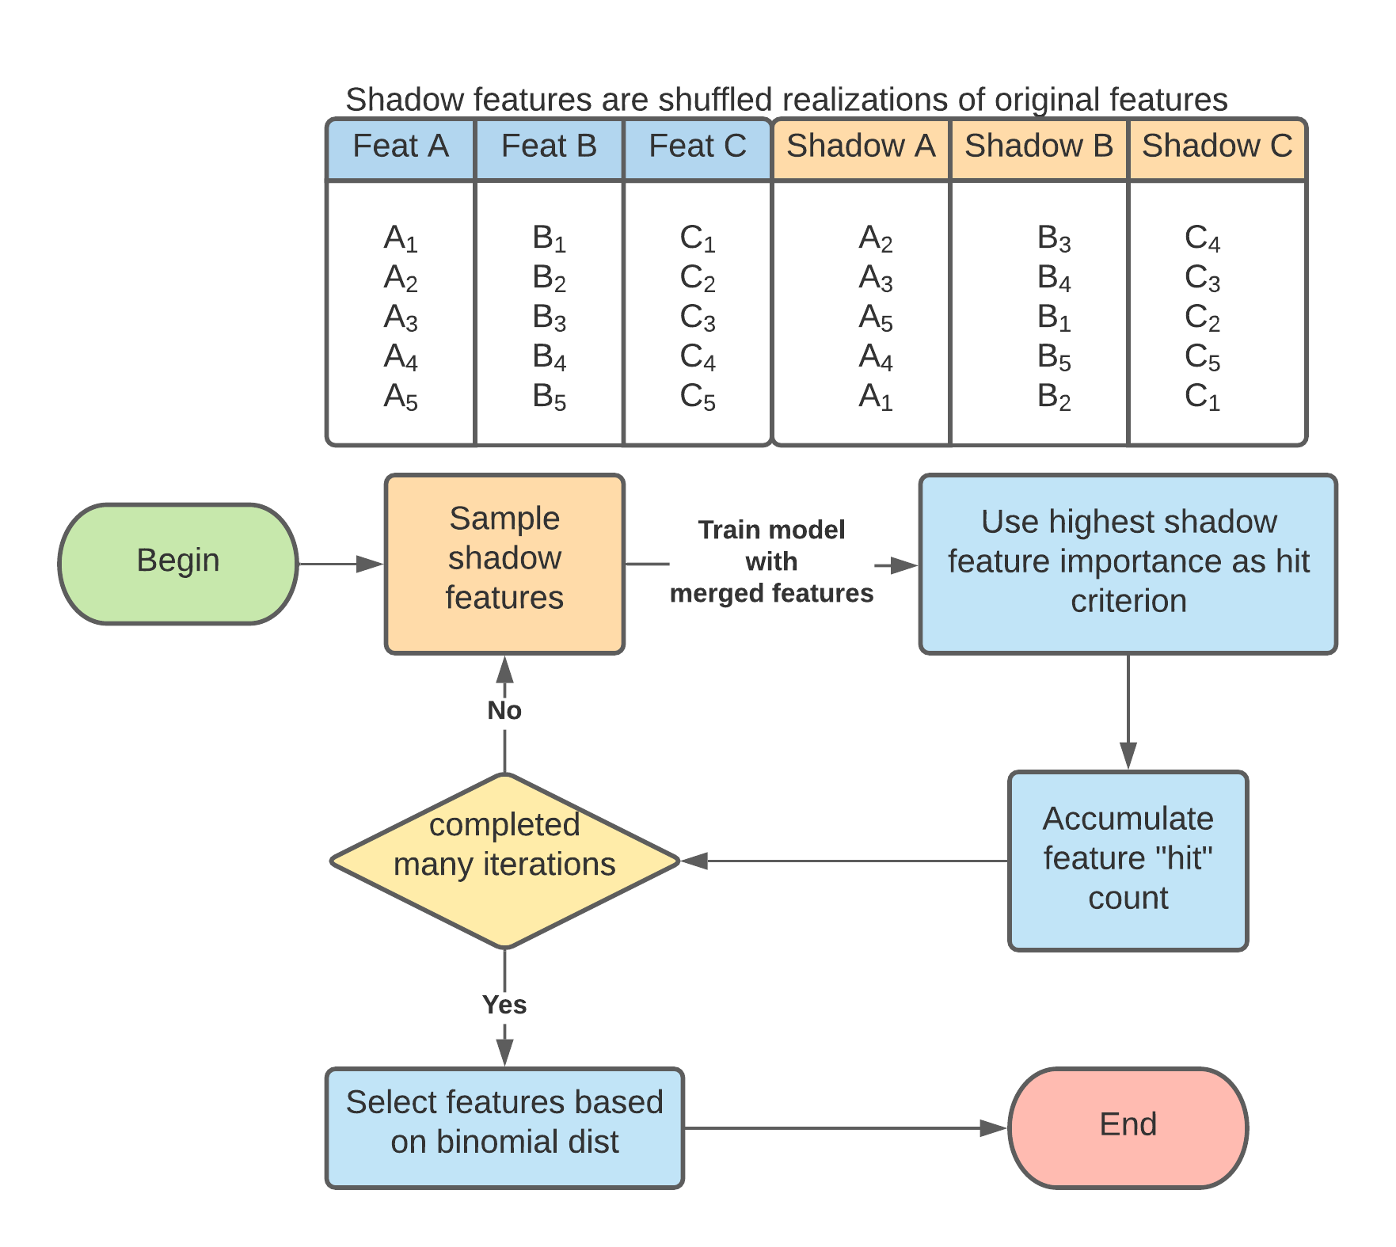
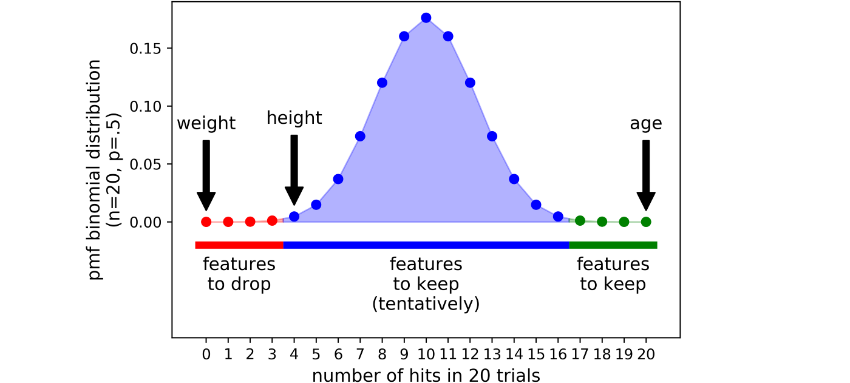
Wrapper Methods
Boruta
Eliminates arbitrary cutoff criterion
Features not compared to each other rather compared to stochastic realizations of themselves

Slide 15
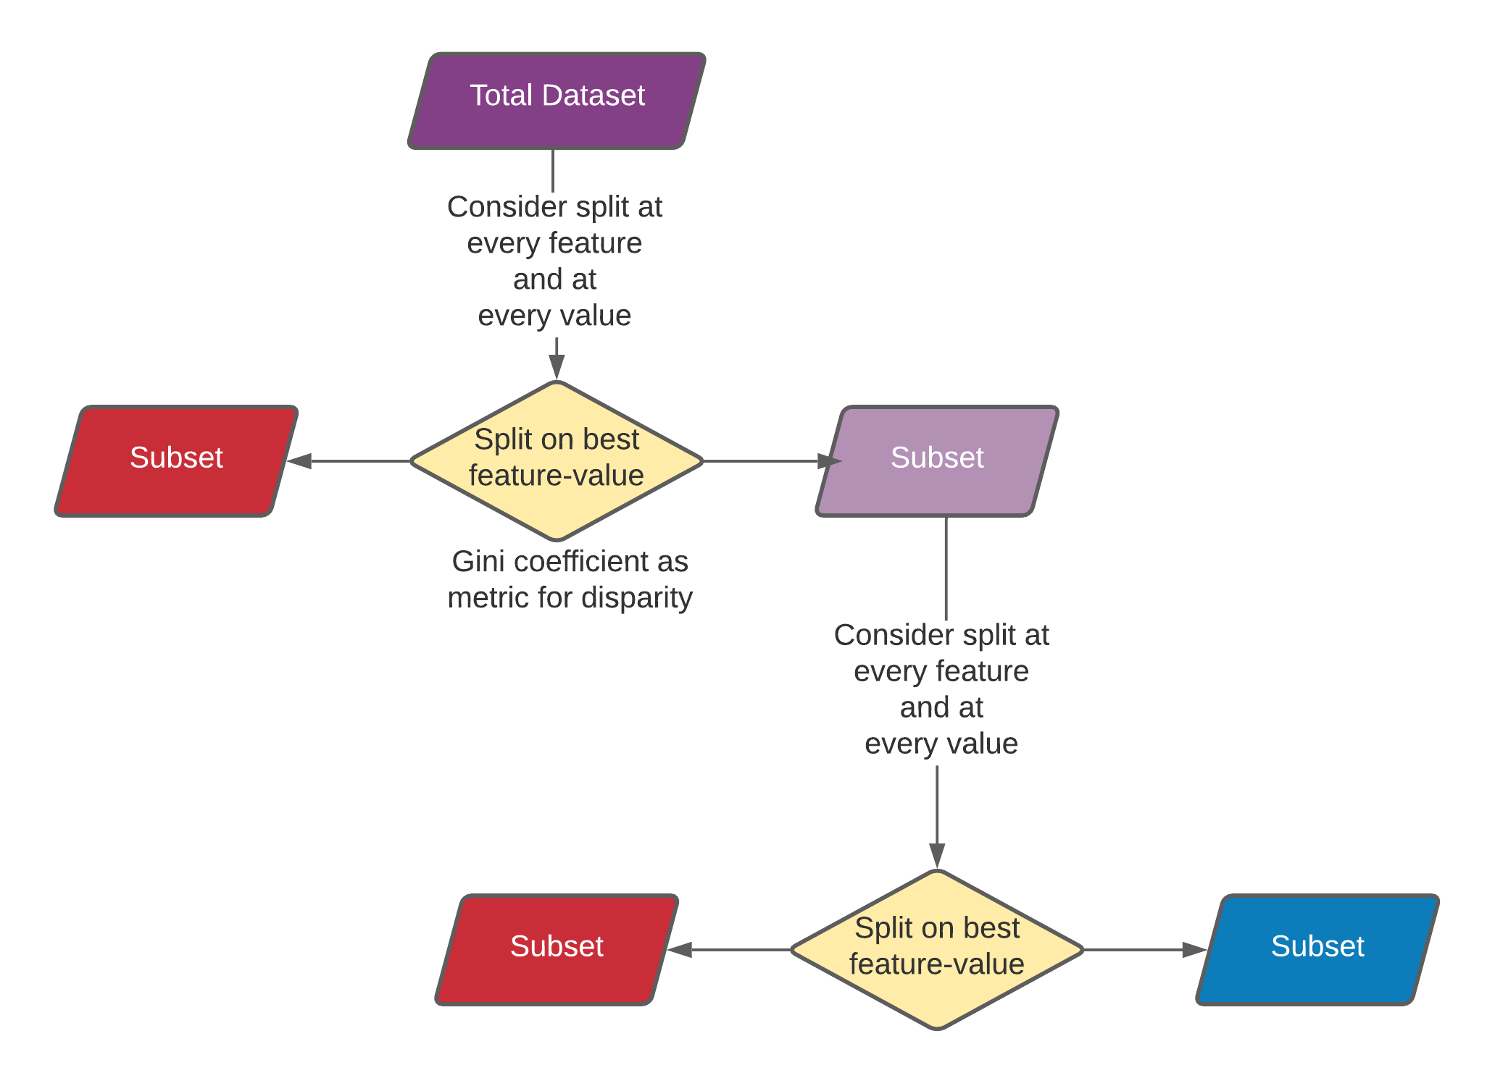
Embedded Methods
Decision tree
Can achieve 100 accuracy
Limit branching depth and number of features considered to reduce expense. Random forest is stochastic realizations of DTs
Feature importance can be expressed by mean decrease accuracy
Notes:
Subset of samples every sample in subset – feature <5 – PCA to demonstrate withingroup and intra group separation.

Slide 16
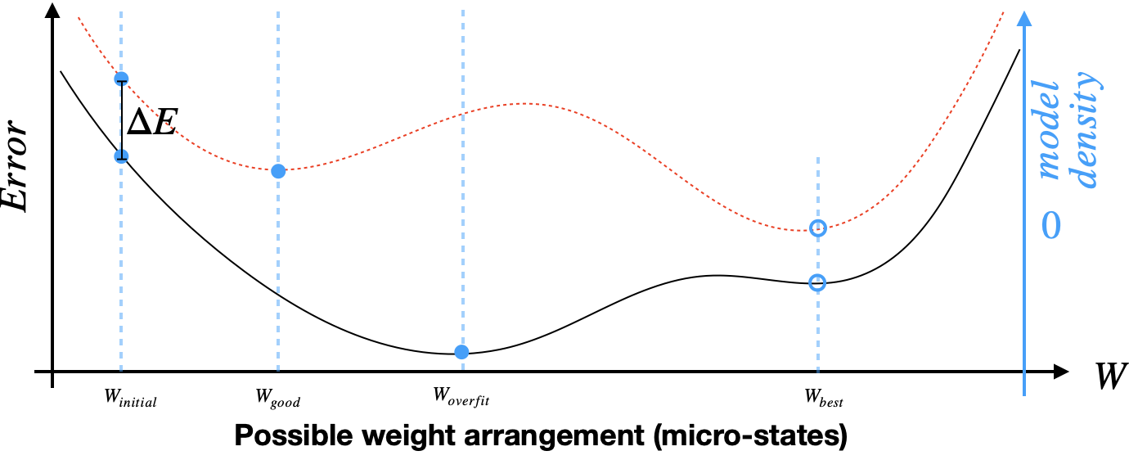
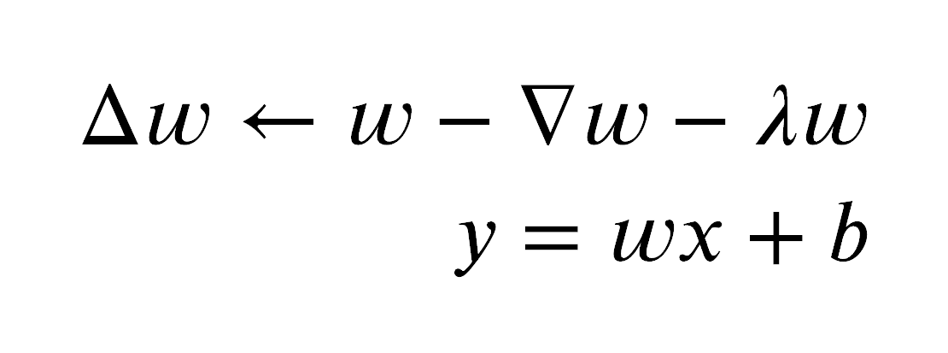
Embbeded Methods
Least absolute shrinkage & selector operator (LASSO)
Regularized model (L1)
Penalizes features proportionally to weight
Uninformative weights tend to zero
Picks only one when features are correlated
Notes:
What is error – multivar linear. reg. – flowchart for itertion

