Slide 1
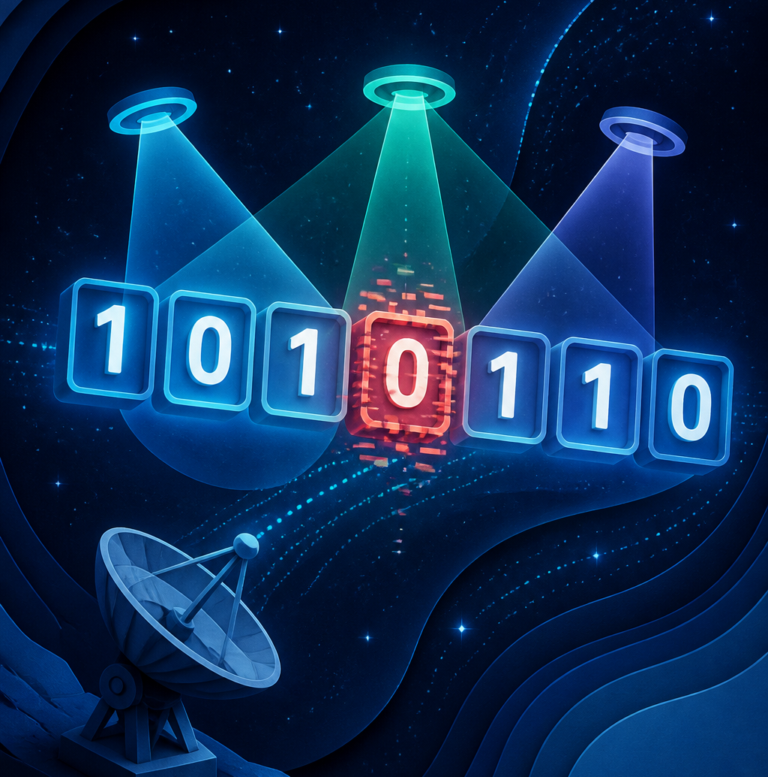
GLITCH! // LEVEL 2
Can a message point to its own mistake?
Today you will design the idea—not just learn the recipe.
A two-hour math circle • Grades 9–10
01
Notes:
Timing: 2 minutes.
Ask students to inspect the image. What could the three beams be doing? Do not name parity or Hamming codes. Say: our goal is to invent a message that helps the receiver locate one damaged bit.
[Sources] - Hero illustration generated for this deck with OpenAI ImageGen on 2026-08-25; no external asset. - Session theme continues the local GLITCH! math-circle deck in this workspace. [/Sources]

Slide 2
THE INFORMATION PROBLEM
Why can’t the receiver recover a missing bit?
1 0 1 ? 1 1 0
Both 0 and 1 fit what the receiver can see.
Once information disappears, clever guessing cannot bring it back.
WHAT EXTRA INFORMATION WOULD HELP?
02
Notes:
Timing: 4 minutes.
Give silent think time, then pairs. Ask for two different original messages consistent with the damaged string. The proof of impossibility is that both choices fit. The design lesson: correction requires redundancy sent before the damage happens. Worksheet 1A.
[Sources]
- R. W. Hamming, “Error Detecting and Error Correcting Codes,” Bell System Technical Journal 29(2), 1950. https://doi.org/10.1002/j.1538-7305.1950.tb00463.x
[/Sources]

Slide 3
ENGINEERING CONSTRAINT
What must the extra bits tell us?
The channel may flip at most one of seven transmitted bits.
NO ERROR
+
ERROR AT 1, 2, 3, 4, 5, 6, OR 7
The receiver must distinguish eight possible states.
03
Notes:
Timing: 3 minutes.
Have students count the possibilities aloud: one no-error state plus seven possible error positions. Ask what kind of information could name one of eight states. Do not answer yet.
[Sources]
- R. W. Hamming, “Error Detecting and Error Correcting Codes,” Bell System Technical Journal 29(2), 1950. https://doi.org/10.1002/j.1538-7305.1950.tb00463.x
[/Sources]

Slide 4
TRY THE OBVIOUS IDEA
Why isn’t one parity check enough?
1
0
1
0
+ check
Even before sending
After one flip, parity changes to odd.
It answers “Did something change?”—not “Where?”
04
Notes:
Timing: 4 minutes.
Model even parity, then use Worksheet 1B. Ask students to imagine each of four positions flipping: every case makes parity odd. One parity answer collapses all error locations into the same alarm. Detection is not location.
[Sources]
- R. W. Hamming, “Error Detecting and Error Correcting Codes,” Bell System Technical Journal 29(2), 1950. https://doi.org/10.1002/j.1538-7305.1950.tb00463.x
[/Sources]

Slide 5
COUNTING INFORMATION
Why are three yes/no checks exactly enough?
1 question
2 questions
3 questions
2 outcomes
4 outcomes
8 outcomes
Three answers can name exactly: no error + seven positions.
Could you invent eight different three-answer fingerprints?
05
Notes:
Timing: 5 minutes.
Let students predict the third number before revealing 8. Each yes/no question doubles the number of distinguishable cases. Three is both sufficient and minimal for eight states. This is the first reason Hamming(7,4) needs three check bits.
[Sources]
- R. W. Hamming, “Error Detecting and Error Correcting Codes,” Bell System Technical Journal 29(2), 1950. https://doi.org/10.1002/j.1538-7305.1950.tb00463.x
[/Sources]

Slide 6
DESIGN CHALLENGE
Can you invent seven unique error fingerprints?
Give each state a different pattern of three answers.
no error
bit 1
bit 2
bit 3
bit 4
bit 5
bit 6
bit 7
Rule: no two columns may match.
PAIRS • 3 MINUTES • MANY DESIGNS WORK
06
Notes:
Timing: 6 minutes.
Pairs invent eight distinct three-answer patterns on scrap paper or Worksheet 1C. Do not insist on binary order. After three minutes, compare designs: all successful solutions use every possible pattern exactly once. Ask which pattern naturally means no error.
[Sources]
- R. W. Hamming, “Error Detecting and Error Correcting Codes,” Bell System Technical Journal 29(2), 1950. https://doi.org/10.1002/j.1538-7305.1950.tb00463.x
[/Sources]

Slide 7
A NATURAL NAMING SYSTEM
Binary gives every state a three-answer name
0
1
2
3
4
5
6
7
000
001
010
011
100
101
110
111
NO ERROR
Each position’s number is also its answer fingerprint.
Read the three answers as the 4s, 2s, and 1s digits.
07
Notes:
Timing: 4 minutes.
Reveal binary as a naming convenience, not a prerequisite. Read 6 as 110: yes to the 4-question, yes to the 2-question, no to the 1-question. Students may instead think of adding labels 4+2.
[Sources]
- R. W. Hamming, “Error Detecting and Error Correcting Codes,” Bell System Technical Journal 29(2), 1950. https://doi.org/10.1002/j.1538-7305.1950.tb00463.x
[/Sources]

Slide 8
FROM ADDRESSES TO CHECK GROUPS
The names tell us what each question must cover
1
2
3
4
5
6
7
check 1
YES
YES
YES
YES
check 2
YES
YES
YES
YES
check 4
YES
YES
YES
YES
Question 1 asks about positions whose 1s digit is 1; question 2 uses the 2s digit; question 4 uses the 4s digit.
08
Notes:
Timing: 5 minutes.
Before showing each row, ask students to derive it from the binary names. Position 5=101 belongs to questions 1 and 4. Position 7=111 belongs to all three. The overlapping sets are not magic; they are the columns of the address system.
[Sources]
- R. W. Hamming, “Error Detecting and Error Correcting Codes,” Bell System Technical Journal 29(2), 1950. https://doi.org/10.1002/j.1538-7305.1950.tb00463.x
[/Sources]

Slide 9
HUMAN ADDRESS GAME
Three questions can locate someone you cannot see
Secret position: 6
question 1
NO
6
YES
question 2
question 4
YES
NO, YES, YES → 0 + 2 + 4 = 6
09
Notes:
Timing: 6 minutes.
Play with seven volunteers or pairs choosing secret positions. Ask only the three fixed membership questions. Students should experience the address pattern identifying the position before parity is introduced as the way to store those answers in a transmitted message.
[Sources]
- R. W. Hamming, “Error Detecting and Error Correcting Codes,” Bell System Technical Journal 29(2), 1950. https://doi.org/10.1002/j.1538-7305.1950.tb00463.x
[/Sources]

Slide 10
STORE THE EXPECTED ANSWERS
Why parity makes the questions travel with the message
Question 1 group
If one covered bit flips…
positions 1, 3, 5, 7
EVEN → ODD
Choose its check bit so the group is EVEN.
That question’s answer changes from no to yes.
Parity works because every single flip toggles odd/even.
10
Notes:
Timing: 4 minutes.
Ask why even/odd is a good stored answer. A single bit flip changes a count by exactly one, so it always toggles parity. Each check group carries one durable yes/no answer. The three answers together carry an address.
[Sources]
- R. W. Hamming, “Error Detecting and Error Correcting Codes,” Bell System Technical Journal 29(2), 1950. https://doi.org/10.1002/j.1538-7305.1950.tb00463.x
[/Sources]

Slide 11
BUILD THE SEVEN-SLOT MACHINE
A self-checking message needs three adjustable bits
1
2
3
4
5
6
7
?
?
d₁
?
d₂
d₃
d₄
check 1
check 2
data 1
check 4
data 2
data 3
data 4
Four slots hold the message. Three slots are knobs that force the three parity promises to be true.
11
Notes:
Timing: 3 minutes.
Ask students to identify how many adjustable bits are needed to set three independent parity answers. The data bits are fixed by the message; the check bits are the three available knobs.
[Sources]
- R. W. Hamming, “Error Detecting and Error Correcting Codes,” Bell System Technical Journal 29(2), 1950. https://doi.org/10.1002/j.1538-7305.1950.tb00463.x
[/Sources]

Slide 12
INDEPENDENT KNOBS
Why the check bits live at positions 1, 2, and 4
1 = 001
2 = 010
4 = 100
only question 1
only question 2
only question 4
Each check bit changes only its own parity equation.
That is why powers of two are the cleanest places for the knobs.
12
Notes:
Timing: 4 minutes.
This is the crucial why behind positions 1,2,4. Their binary addresses contain exactly one 1, so each belongs to only one check group. Adjusting p1 cannot disturb checks 2 or 4, and similarly for the others.
[Sources]
- R. W. Hamming, “Error Detecting and Error Correcting Codes,” Bell System Technical Journal 29(2), 1950. https://doi.org/10.1002/j.1538-7305.1950.tb00463.x
[/Sources]

Slide 13
RESTRICTED WARM-UP
Can we practice with one data slot locked?
1
2
3
4
5
6
7
p₁
p₂
d₁
p₄
d₂
d₃
0
check 1
check 2
data 1
check 4
data 2
data 3
fixed 0
Use three message bits in positions 3, 5, 6. Fix position 7 at zero.
This is practice inside the full machine—not a standard Hamming(7,3) code.
13
Notes:
Timing: 2 minutes.
Explain that locking one data slot reduces cognitive load without changing the check groups. Worksheet 2B uses this restricted subcode.
[Sources]
- R. W. Hamming, “Error Detecting and Error Correcting Codes,” Bell System Technical Journal 29(2), 1950. https://doi.org/10.1002/j.1538-7305.1950.tb00463.x
[/Sources]

Slide 14
ENCODE 1 0 1
Build the first self-checking word
1
2
3
4
5
6
7
?
?
1
?
0
1
0
check 1
check 2
data 1
check 4
data 2
data 3
fixed 0
For each question: count the known 1s, then choose its knob to make the total even.
WHY CAN EACH KNOB BE SOLVED SEPARATELY?
14
Notes:
Timing: 5 minutes.
Pairs solve 101. Use a hint ladder rather than giving formulas. Ask the displayed why: positions 1,2,4 each belong only to their own question. Expected p1=1, p2=0, p4=1. Worksheet 2B.
[Sources]
- R. W. Hamming, “Error Detecting and Error Correcting Codes,” Bell System Technical Journal 29(2), 1950. https://doi.org/10.1002/j.1538-7305.1950.tb00463.x
[/Sources]

Slide 15
WARM-UP REVEAL
Every check is even because we chose it that way
1
2
3
4
5
6
7
1
0
1
1
0
1
0
check 1
check 2
data 1
check 4
data 2
data 3
fixed 0
Q1: 1+1+0+0=2
Q2: 0+1+1+0=2
Q4: 1+0+1+0=2
The codeword carries three promises about itself.
15
Notes:
Timing: 2 minutes.
Have three students each audit one group. Ask what the receiver expects before any error: three even totals, equivalent to fingerprint 000.
[Sources]
- R. W. Hamming, “Error Detecting and Error Correcting Codes,” Bell System Technical Journal 29(2), 1950. https://doi.org/10.1002/j.1538-7305.1950.tb00463.x
[/Sources]

Slide 16
A PERFECT PACKING
Why seven protected bits carry at most four data bits
2⁷ = 128
÷ 8
= 16
possible received strings
one clean word + seven one-flip versions
protected messages
16 messages = 2⁴ choices = four data bits
Hamming(7,4) fills the space exactly: no room is wasted.
16
Notes:
Timing: 5 minutes.
Ask each count before revealing it. Every valid codeword must own eight possible received strings: itself and its seven single-bit neighbors. The 128 total strings can therefore protect at most 16 messages, exactly four bits. This is the intuitive Hamming bound and why (7,4) is called perfect.
[Sources]
- R. W. Hamming, “Error Detecting and Error Correcting Codes,” Bell System Technical Journal 29(2), 1950. https://doi.org/10.1002/j.1538-7305.1950.tb00463.x
[/Sources]

Slide 17
THE FULL CODE
Unlocking the final slot gives Hamming(7,4)
1
2
3
4
5
6
7
p₁
p₂
d₁
p₄
d₂
d₃
d₄
check 1
check 2
data 1
check 4
data 2
data 3
data 4
3 address bits + 4 message bits = 7 transmitted bits
17
Notes:
Timing: 2 minutes.
Now the notation should feel earned: seven transmitted positions, four free message bits, and three check bits forced by the parity promises.
[Sources]
- R. W. Hamming, “Error Detecting and Error Correcting Codes,” Bell System Technical Journal 29(2), 1950. https://doi.org/10.1002/j.1538-7305.1950.tb00463.x
[/Sources]

Slide 18
DERIVE THE ROUTINE
Can you reconstruct the encoder from its job?
1
2
3
4
Name slots
Place data
Keep promises
Audit
Write positions 1–7 and mark 1,2,4 as checks.
Put the four message bits in 3,5,6,7.
Choose p₁,p₂,p₄ so their groups are even.
Verify all three expected answers are NO.
18
Notes:
Timing: 3 minutes.
Ask students to propose the steps before revealing them. The routine should be reconstructed from the purpose of the code, not memorized as an arbitrary recipe. Worksheet 3A.
[Sources]
- R. W. Hamming, “Error Detecting and Error Correcting Codes,” Bell System Technical Journal 29(2), 1950. https://doi.org/10.1002/j.1538-7305.1950.tb00463.x
[/Sources]

Slide 19
USE YOUR DESIGN
Pair challenge: encode 1 0 1 1
1
2
3
4
5
6
7
?
?
1
?
0
1
1
check 1
check 2
data 1
check 4
data 2
data 3
data 4
Builder chooses the three knobs. Auditor explains why each promise is true.
WORKSHEET 3B • DO NOT GUESS THE CHECK BITS
19
Notes:
Timing: 6 minutes.
Pairs encode 1011. Require reasoning in terms of the three questions. Expected p1=0, p2=1, p4=0. The auditor must explain why each even total means the receiver will expect a no-error fingerprint of 000.
[Sources]
- R. W. Hamming, “Error Detecting and Error Correcting Codes,” Bell System Technical Journal 29(2), 1950. https://doi.org/10.1002/j.1538-7305.1950.tb00463.x
[/Sources]

Slide 20
ENCODING REVEAL
Three checks prove the codeword is ready
1
2
3
4
5
6
7
0
1
1
0
0
1
1
check 1
check 2
data 1
check 4
data 2
data 3
data 4
Q1 even
Q2 even
Q4 even
Expected receiver fingerprint: 000
20
Notes:
Timing: 2 minutes.
Verify each group. Ask where the original data is hiding: positions 3,5,6,7. The all-pass fingerprint 000 is now visibly built into the word.
[Sources]
- R. W. Hamming, “Error Detecting and Error Correcting Codes,” Bell System Technical Journal 29(2), 1950. https://doi.org/10.1002/j.1538-7305.1950.tb00463.x
[/Sources]

Slide 21
ENCODING SPRINT
Test whether your method transfers
0 0 0 0
_______
1 1 1 1
_______
0 1 0 1
_______
1 1 0 0
_______
If two teammates disagree, audit the three promises instead of voting.
21
Notes:
Timing: 5 minutes.
Teams divide Worksheet 3C and cross-audit. Answers: 0000000; 1111111; 0100101; 0111100. The point is transfer: the groups and logic remain fixed while the message changes.
[Sources]
- R. W. Hamming, “Error Detecting and Error Correcting Codes,” Bell System Technical Journal 29(2), 1950. https://doi.org/10.1002/j.1538-7305.1950.tb00463.x
[/Sources]

Slide 22
PAUSE THE SIGNAL
05:00
When you return: we use the same three questions to find a flip.
Stretch • water • keep your worksheet
22
Notes:
Timing: 5 minutes.
Take a real five-minute break. Resume by asking: Why were three questions enough? Why were positions 1,2,4 special?

Slide 23
RECEIVED WORD 0 1 1 0 0 0 1
Which questions noticed the flip?
1
2
3
4
5
6
7
0
1
1
0
0
0
1
check 1
check 2
data 1
check 4
data 2
data 3
data 4
Do not hunt by eye. Ask the same three parity questions.
Q1? Q2? Q4?
23
Notes:
Timing: 4 minutes.
Students run the checks on Worksheet 4A. Q1 passes with two ones; Q2 and Q4 fail with three ones. Ask why a flipped bit changes exactly the questions that contain its position.
[Sources]
- R. W. Hamming, “Error Detecting and Error Correcting Codes,” Bell System Technical Journal 29(2), 1950. https://doi.org/10.1002/j.1538-7305.1950.tb00463.x
[/Sources]

Slide 24
THE SYNDROME
Why the failed questions spell the error address
Q1
Q2
Q4
PASS → 0
FAIL → 2
FAIL → 4
answers 110₂ = 4 + 2 = 6
The error reproduces the fingerprint of its position.
24
Notes:
Timing: 5 minutes.
This is the core explanation of the syndrome. Position 6 belongs to Q2 and Q4, so a flip there makes exactly those questions fail. The failed-answer pattern is 110, the binary name of 6. Adding failed labels is simply another way to read the same address.
[Sources]
- R. W. Hamming, “Error Detecting and Error Correcting Codes,” Bell System Technical Journal 29(2), 1950. https://doi.org/10.1002/j.1538-7305.1950.tb00463.x
[/Sources]

Slide 25
CORRECTION IS THE INVERSE
Why one flip repairs the word
flip at position 6
→
syndrome points to 6
→
flip 6 back
The second flip toggles the same checks back to even.
Repair first. Then read the message from positions 3, 5, 6, 7.
25
Notes:
Timing: 3 minutes.
Ask students to explain why flipping the addressed bit, rather than replacing it with a guessed value, works. A binary flip is its own inverse. Then emphasize repair before extraction.
[Sources]
- R. W. Hamming, “Error Detecting and Error Correcting Codes,” Bell System Technical Journal 29(2), 1950. https://doi.org/10.1002/j.1538-7305.1950.tb00463.x
[/Sources]

Slide 26
REPAIR RACE
Two packets, same logic
Packet A
Packet B
0 1 0 1 1 0 1
0 1 1 1 1 0 1
Which questions fail?
Which questions fail?
Explain why the failed-question fingerprint identifies the bit.
WORKSHEET 4B
26
Notes:
Timing: 6 minutes.
Packet A: only Q4 fails → position 4 → corrected 0100101 → message 0101. Packet B: all fail → position 7 → corrected 0111100 → message 1100. Require the causal explanation, not only the arithmetic.
[Sources]
- R. W. Hamming, “Error Detecting and Error Correcting Codes,” Bell System Technical Journal 29(2), 1950. https://doi.org/10.1002/j.1538-7305.1950.tb00463.x
[/Sources]

Slide 27
CREATE • CORRUPT • EXPLAIN
Invent a codeword your partner can rescue
1
2
3
4
Choose
Encode
Flip
Explain
Invent any four-bit message.
Build three even parity promises.
Corrupt exactly one secret position.
Partner repairs it and justifies the address.
A successful rescue reproduces the sender’s message for the right reason.
27
Notes:
Timing: 6 minutes.
Use Worksheet 5. Keep this shorter than the previous deck so there is time for the conceptual why. Receivers must say which parity questions failed and why those answers name the sender’s secret position.
[Sources]
- R. W. Hamming, “Error Detecting and Error Correcting Codes,” Bell System Technical Journal 29(2), 1950. https://doi.org/10.1002/j.1538-7305.1950.tb00463.x
[/Sources]

Slide 28
THE BOUNDARY—AND THE EIGHTH BIT
Why two errors can impersonate a third
errors at 2 and 4
their fingerprints combine
syndrome 6
010 ⊕ 100 = 110
Hamming(7,4) may wrongly flip bit 6.
An eighth overall parity bit separates odd flips from even flips.
That is the intuition behind extended Hamming(8,4).
28
Notes:
Timing: 3 minutes.
Show why the one-error promise matters: two error fingerprints XOR into another valid address. The optional eighth overall parity bit reveals whether the total number of flips is odd or even, enabling double-error detection.
[Sources]
- R. W. Hamming, “Error Detecting and Error Correcting Codes,” Bell System Technical Journal 29(2), 1950. https://doi.org/10.1002/j.1538-7305.1950.tb00463.x
[/Sources]

Slide 29
SOLO CERTIFICATION
Can you do the whole job alone?
Part A
Part B
Encode message 1 0 0 1
Repair 0 0 1 1 1 0 1
Explain why all three checks pass.
Explain why the syndrome names the error.
Method matters: roles → parity promises → address → repair → extract
WORKSHEET 6A • 5 MINUTES
29
Notes:
Timing: 5 minutes.
Students work independently. Part A: 0011001. Part B: Q1 and Q4 fail → position 5 → corrected 0011001 → message 1001. Score the explanation as well as the result.
[Sources]
- R. W. Hamming, “Error Detecting and Error Correcting Codes,” Bell System Technical Journal 29(2), 1950. https://doi.org/10.1002/j.1538-7305.1950.tb00463.x
[/Sources]

Slide 30
SIGNAL RESTORED
You did not memorize Hamming(7,4). You derived it.
8 states
→ 3 questions
→ binary address
→ parity promises
Check: Part A 0011001 • Part B error at 5 → message 1001
Exit whisper: Which design choice now feels inevitable?
30
Notes:
Timing: 1 minute.
Students name one why they can now explain: three checks, the overlap sets, positions 1/2/4, or the syndrome. The close resolves the opening question: the message points to damage because its three parity promises form an address.
[Sources]
- R. W. Hamming, “Error Detecting and Error Correcting Codes,” Bell System Technical Journal 29(2), 1950. https://doi.org/10.1002/j.1538-7305.1950.tb00463.x
[/Sources]

