Slide 1

Quantum programming
LORENZELLI Antony

Slide 2

Summary
What is programming ?
What is quantum ?
Why combine the two ?
An example
By the traditional way
By the quantum way
Conclusion
Thanks & sources

Slide 3
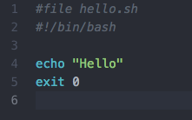
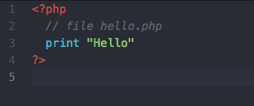
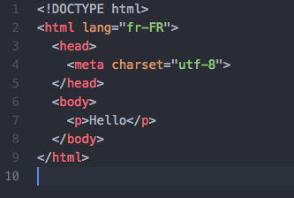
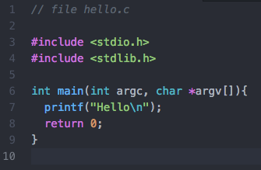

What is programming ?
Programming is the method by which we can give instructions to a computer
For example we can ask a computer to say : Hello by different ways

Slide 4
What is quantum ?
Quantum is first and foremost a science of the very small
The principle is that atoms can be superimposed but we can not see them so we put statistics

Slide 5
Why combine the two ?
The link to use both is to superimpose not atoms but bits
Bit is the quantity used to measure information, transmission and storage is done with these bits
But with the traditional way, the bits can only take two values: 0 and 1
With quantum way, bits can take 0 and 1 values at the same time

Slide 6
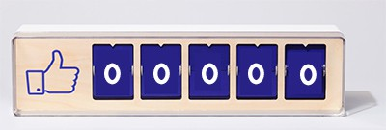
An example
We want to display all the values ​​from 0 to 99999

Slide 7
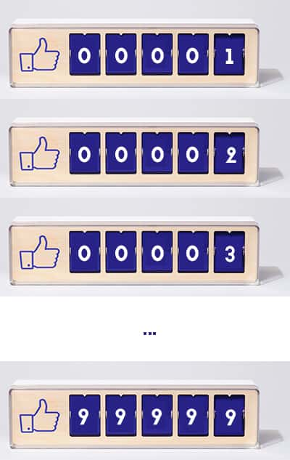
by the traditional way

Slide 8
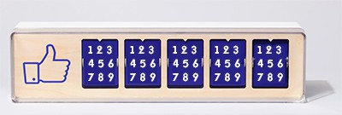
By the quantum way

Slide 9
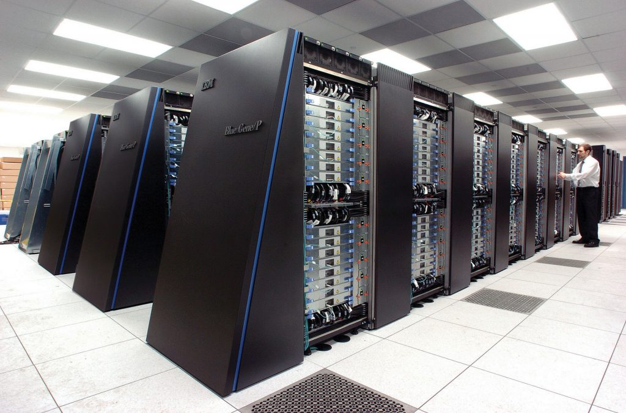
conclusion
Quantum programming is the programming of tomorrow because it still requires research and processors much more powerful!

Slide 10
Thanks & sources
Pictures : https://www.institut-pandore.com/physique-quantique/informatique-ordinateur-quantique/

