Slide 1


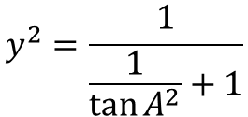
Move Direction
radius=1
y
α
x
$$\tan{A}=\frac{y}{x} → x=\frac{y}{\tan{A}}$$
$$r=\sqrt{x^{2}+y^{2}}$$
$$y^{2}=\frac{1}{\frac{1}{\tan{A^{2}}}+1}$$

