Slide 1

MySQL Project
Adianis Metz

Slide 2
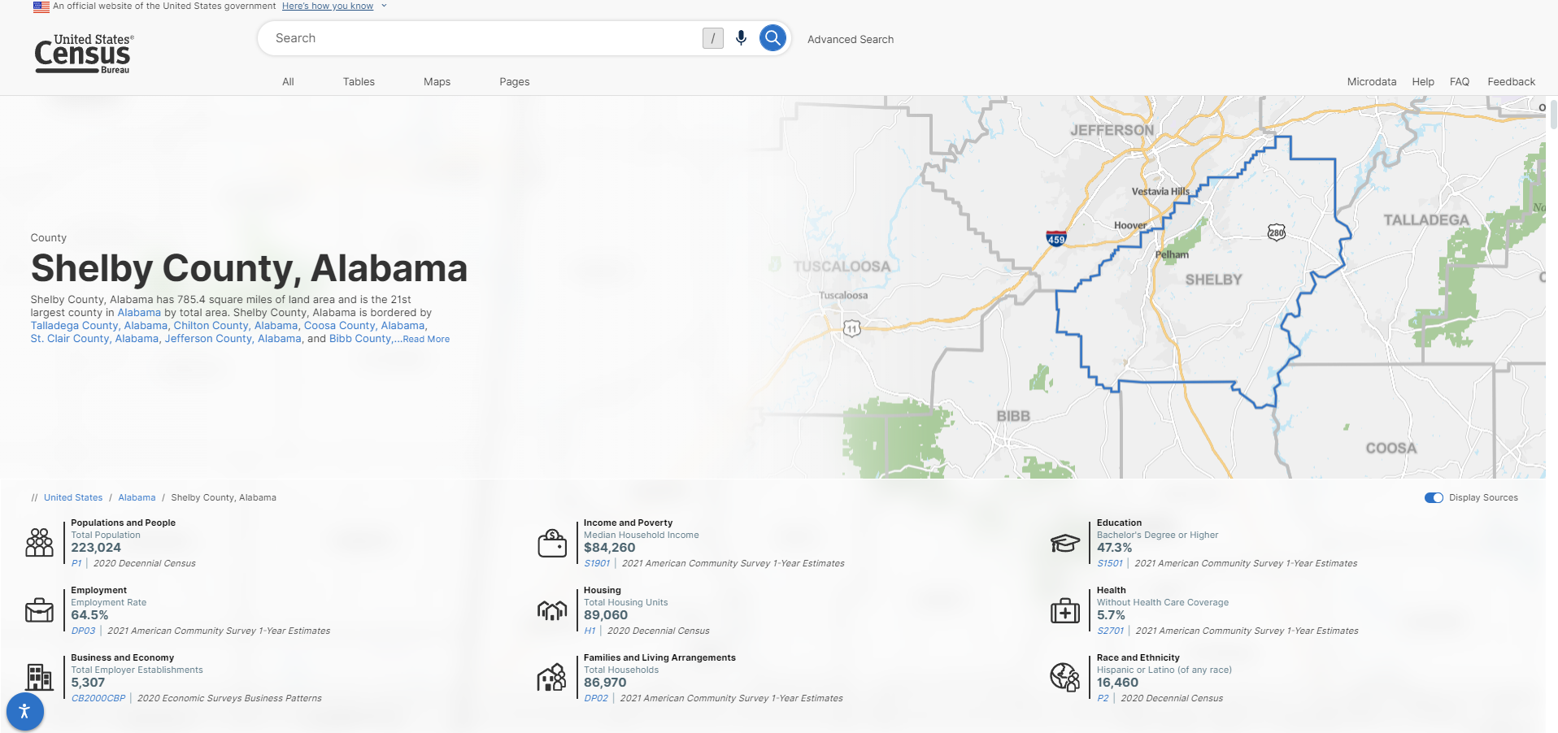
Project topic
Manipulating data on Alabama 2020 Census on Shelby county.
Housing and Income data

Slide 3
Original concept
I wanted to combine SQL with a Python library like PANDAS which allows for the manipulation of tables and visualization of data.
The reason I am using Python along with the data from the Census is because I want to visualize relationships between data to draw conclusions from it.
I focused on the Housing and Income tables for this project.

Slide 4
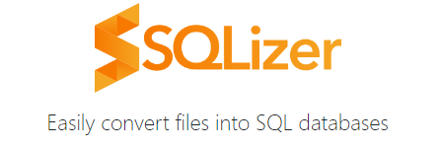
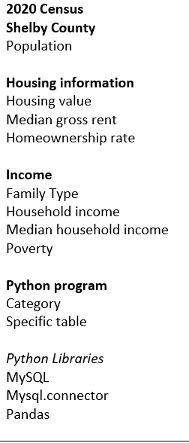
Investigation
The Census Bureau uploaded the raw data online which I had converted into a workable format using sqlizer.io
Before determining entities, I made a test run of libraries like mysql.connector to make sure it would work.

Slide 5
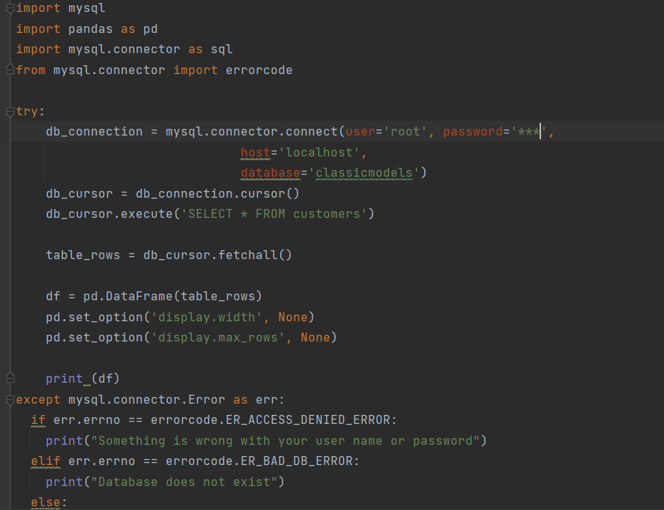
Test run

Slide 6
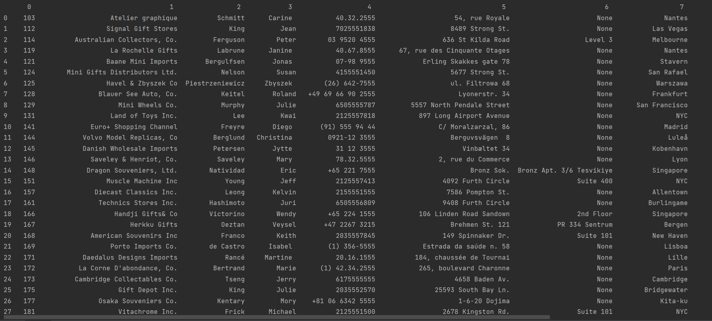
Test output

Slide 7
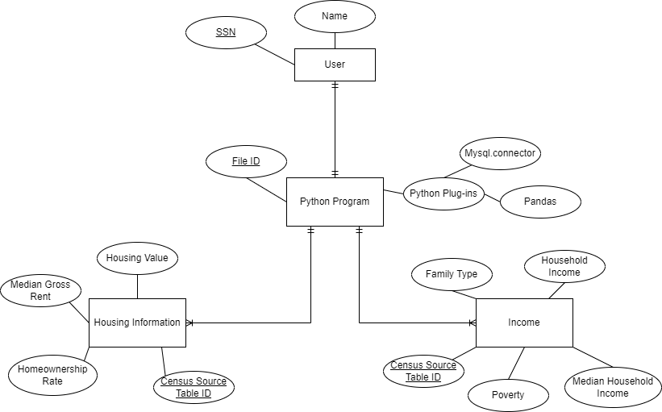
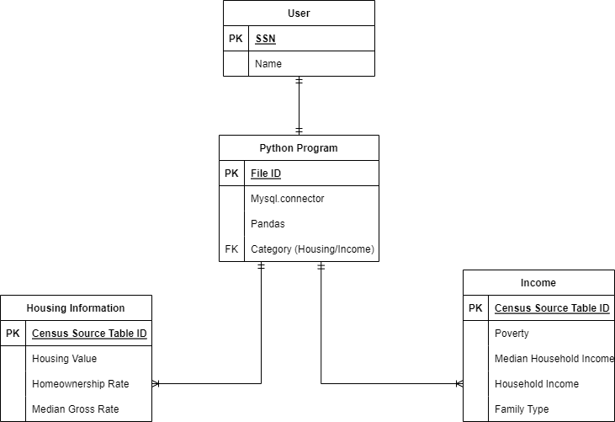
ERDs

Slide 8
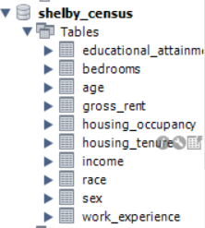
Schema

Slide 9
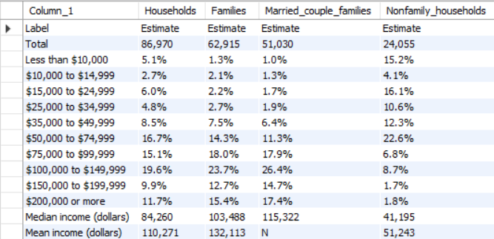
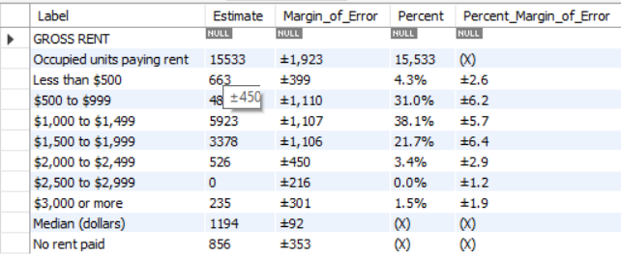
Relevant Tables
Income table (from “Income”)
Gross Rent table (from “Households”)

Slide 10
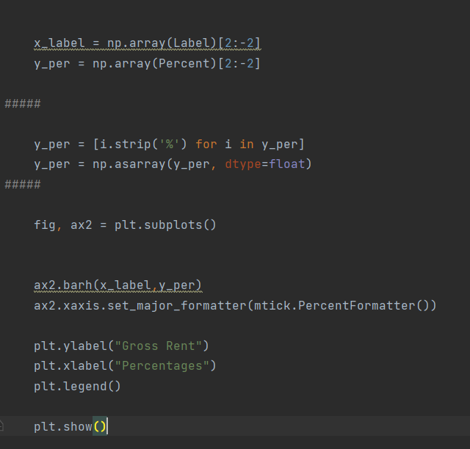
Snippet of Gross Rent

Slide 11
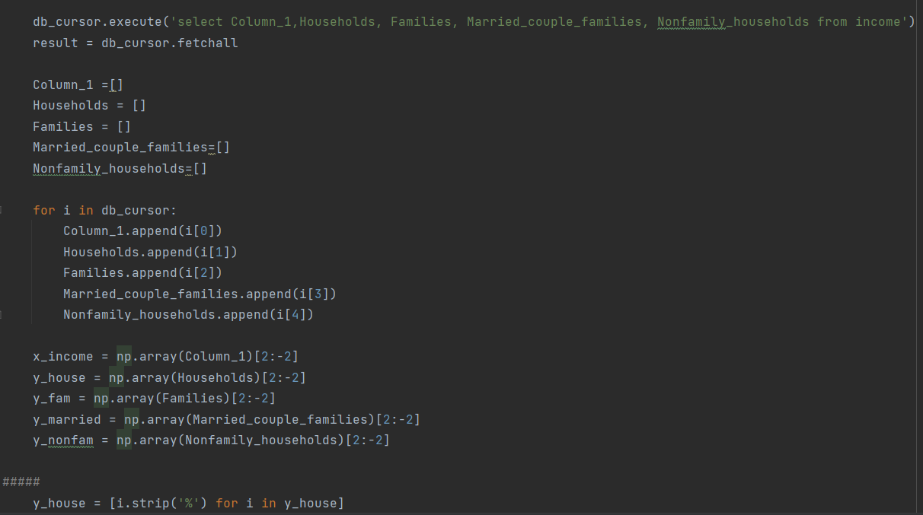
Snippet of Household

Slide 12
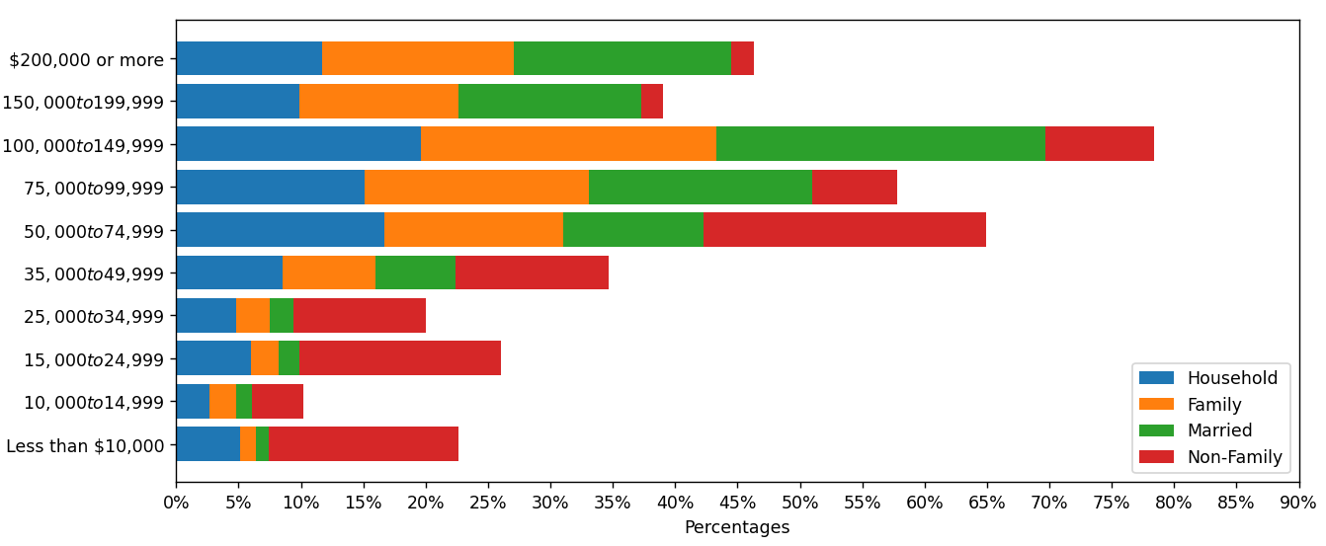
Income Table

Slide 13
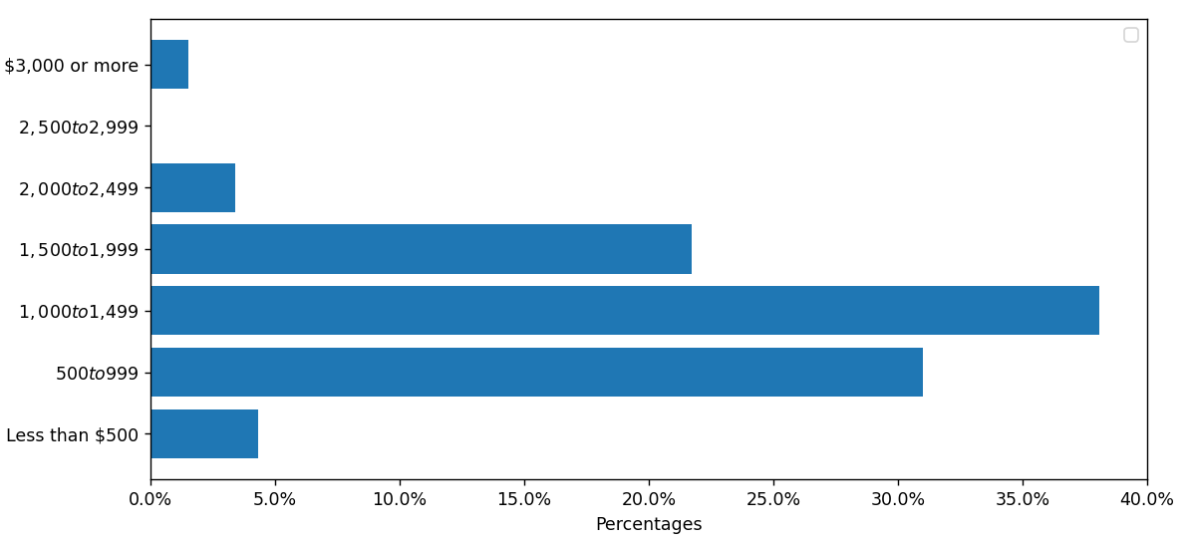
Gross Rent table

