Slide 1
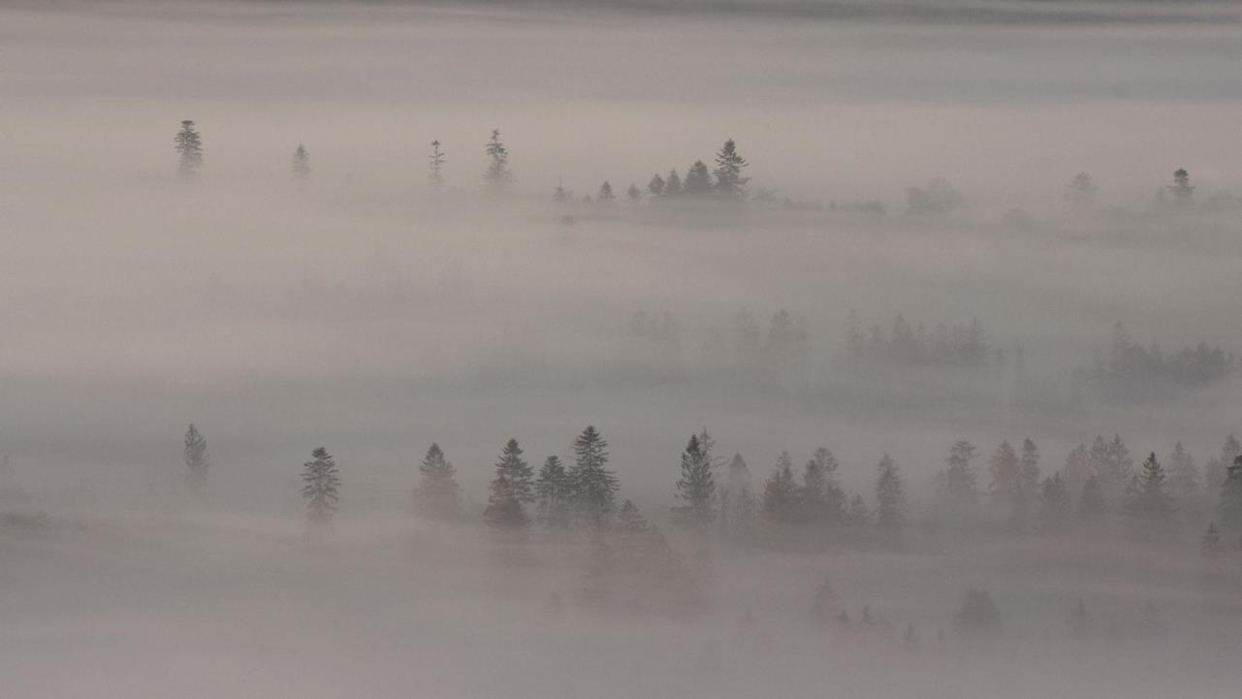
The theme of this slide is about Mist Forest. And it was created and designed by Windy.
Mist Forest
Mist Forest
The theme of this slide is about Mist Forest. And it was created and designed by Windy.

Slide 2
Contents
PART ONE ------ 01
PART TWO ------ 02
PART THREE ------ 03
PART FOUR ------ 04
The theme of this slide is about Mist Forest. And it was created and designed by Windy.The theme of this slide is about Mist Forest. And it was created and designed by Windy.

Slide 3
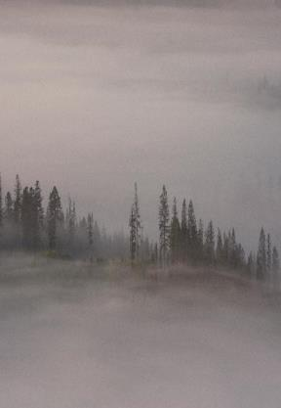
The theme of this slide is about Mist Forest. And it was created and designed by Windy.
Part one

Slide 4
The theme of this slide is about Mist Forest. And it was created and designed by Windy.
Mist Forest
The theme of this slide is about Mist Forest. And it was created and designed by Windy.The theme of this slide is about Mist Forest. And it was created and designed by Windy.
“The theme of this slide is about Mist Forest. And it was created and designed by Windy.”

Slide 5
Mist
Forest
Your Text
Your Text
Donec gravida leo porttitor
Donec gravida leo porttitor
The theme of this slide is about Mist Forest. And it was created and designed by Windy.The theme of this slide is about Mist Forest. And it was created and designed by Windy. The theme of this slide is about Mist Forest. And it was created and designed by Windy.
Your Text
Your Text
Donec gravida leo porttitor
Donec gravida leo porttitor

Slide 6
The theme of this slide is about Mist Forest. And it was created and designed by Windy.
Mist Forest
Mist
Forest
The theme of this slide is about Mist Forest. And it was created and designed by Windy.The theme of this slide is about Mist Forest. And it was created and designed by Windy. The theme of this slide is about Mist Forest. And it was created and designed by Windy.

Slide 7
The theme of this slide is about Mist Forest. And it was created and designed by Windy.
Part Two

Slide 8
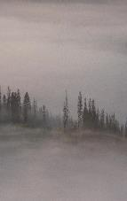
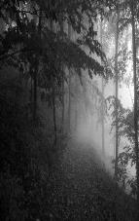
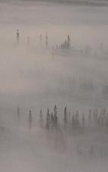
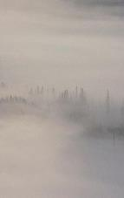
The theme of this slide is about Mist Forest. And it was created and designed by Windy.
Mist Forest
Mist
Forest
The theme of this slide is about Mist Forest. And it was created and designed by Windy.The theme of this slide is about Mist Forest. And it was created and designed by Windy. The theme of this slide is about Mist Forest. And it was created and designed by Windy.

Slide 9
The theme of this slide is about Mist Forest. And it was created and designed by Windy.
Mist Forest
Mist
Forest
The theme of this slide is about Mist Forest. And it was created and designed by Windy.The theme of this slide is about Mist Forest. And it was created and designed by Windy. The theme of this slide is about Mist Forest. And it was created and designed by Windy.

Slide 10
The theme of this slide is about Mist Forest. And it was created and designed by Windy.
Mist
Forest
The theme of this slide is about Mist Forest. And it was created and designed by Windy.
The theme of this slide is about Mist Forest. And it was created and designed by Windy.

Slide 11
The theme of this slide is about Mist Forest. And it was created and designed by Windy.
Part Three

Slide 12
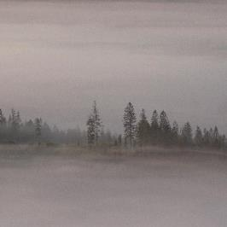
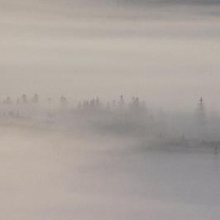
The theme of this slide is about Mist Forest. And it was created and designed by Windy.
Mist Forest
Your Title
Your Title
Helping you open windows of opportunity worldwide
Helping you open windows of opportunity worldwide

Slide 13
Mist
Forest
Your Text
Your Text
Donec gravida leo porttitor
Donec gravida leo porttitor
The theme of this slide is about Mist Forest. And it was created and designed by Windy.The theme of this slide is about Mist Forest. And it was created and designed by Windy. The theme of this slide is about Mist Forest. And it was created and designed by Windy.
Your Text
Your Text
Donec gravida leo porttitor
Donec gravida leo porttitor

Slide 14
The theme of this slide is about Mist Forest. And it was created and designed by Windy.
Mist Forest
The theme of this slide is about Mist Forest. And it was created and designed by Windy.The theme of this slide is about Mist Forest. And it was created and designed by Windy.
“The theme of this slide is about Mist Forest. And it was created and designed by Windy.”

Slide 15
The theme of this slide is about Mist Forest. And it was created and designed by Windy.
Part Four

Slide 16
The theme of this slide is about Mist Forest. And it was created and designed by Windy.
Mist Forest
Mist
Forest
The theme of this slide is about Mist Forest. And it was created and designed by Windy.The theme of this slide is about Mist Forest. And it was created and designed by Windy. The theme of this slide is about Mist Forest. And it was created and designed by Windy.

Slide 17
The theme of this slide is about Mist Forest. And it was created and designed by Windy.
Mist Forest
Mist
Forest
The theme of this slide is about Mist Forest. And it was created and designed by Windy.The theme of this slide is about Mist Forest. And it was created and designed by Windy. The theme of this slide is about Mist Forest. And it was created and designed by Windy.

Slide 18
THANKS
感谢您的观看
更多精品模板: https://www.ppthub.shop/

