Slide 1

Amore
My Own Three Thank-you Letters
我的三封感谢信

Slide 2


Amore
Writing Three Thank-You Letters
By Alex Haley
我的三封感谢信
给我最亲爱的家人们
给我最可爱的朋友们
给我最敬爱的老师们
To the End
End

Slide 3

The texts of my letters began something like,
我的信是这样开头的：
" Here, this Thanksgiving at sea, I find my thoughts upon how much you have done for me , but I have never stopped and said to you how much I feel the need to thank you-"
“在这里，这个在海上的感恩节，我回想起了你们为我付出的一切，但是我却从来没有对你们说过我多么感激你们。”
And briefly I reccalled for each of them specific acts performed on my behalf.
我回忆起他们为我做的特殊的事情的简短片段。
Writing Three Thank-You Letters

Slide 4

Writing Three Thank-You Letters
For instance, something uppermost about my father was how he had impressed upon me from boyhood to love books and reading.
比方说，我父亲做出的最让我印象深刻的事便是他培养我从小就爱读书。
In fact, this graduated into a family habit of after-dinner quizzes at the table about books read recently and new words learned.
实际上，这种做法最终演变为一种家庭习惯——饭后桌前围绕最近读的书和新学词汇的小测试。
My love of books never diminished and later led me toward writing books myself.
我对书籍的热爱从未褪色过，之后这种热爱也促使我开始自己写书。

Slide 5
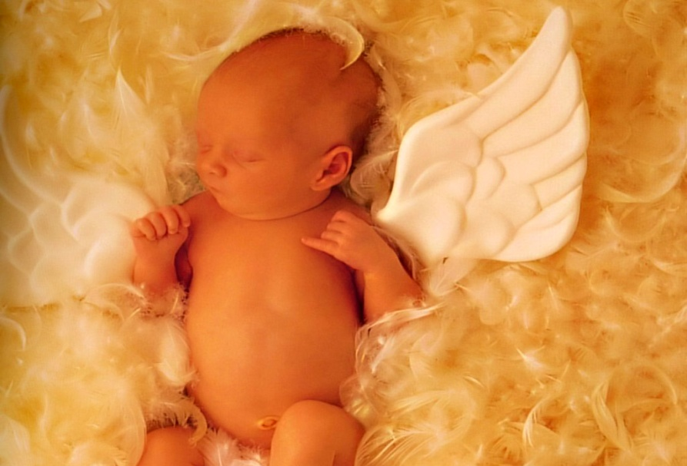
Writing Three Thank-You Letters
I reminded the Reverend Nelson how each morning he would open our little country town's grammar school with a prayer over his assembled students.
我回忆起尊敬的尼尔森校长是怎样每天早上打开我们镇上小学的门并召集起同学们为他们祈祷的。
I told him that whatever positive things I had done since had been influenced at least in part by his morning school prayers.
我告诉他，我做过的那些有积极意义的事，
有很大一部分是受到了他的早晨祷告的影
响。

Slide 6


Writing Three Thank-You Letters
In the letter to my grandmother, I reminded
her of a dozen ways she used to teach me
how to tell the truth, to share, and to be
forgiving and considerate of others.
在给我祖母的信中，我提到了她用几十种方式教我如何讲
真话、如何分享、如何原谅并且关心别人。
I thanked her for the years of eating her
good cooking, the equal of which I had not
found since.
我感谢她精妙的厨艺，那以后我再也没有吃到比那更好吃
的饭了。
Finally, I thanked her simply for having sprinkled my life with stardust.
最后，我感谢她，仅仅是因为她使我的生命充满了想象和梦幻。

Slide 7

给我最亲爱的家人们：
感谢你们！感谢你们关心我、包容我、支持我。有了你们的存在，我才敢有恃无恐地往前闯。因为我知道，无论我闯了什么祸、无论我受了什么伤，总有一个叫“家”的地方可以提供我臂膀，总有一群叫“家人”的人可以让我依赖不再彷徨。
你们的无私付出我可能永远都回报不了，最尴尬的就是我总是理所当然地接受你们为我做的事。而我甚至从来没有表达一句简单的、真诚的“谢谢你”。我为此感到羞愧。
也许未来我仍然做不了可以回报你们的举动，但是至少你们知道，我一直都感谢你们的付出、我一直都能感受到……
朋友会负我，天下人都会负我。我知道，你们永远不会负我，永远站在我触手可到的地方。

Slide 8


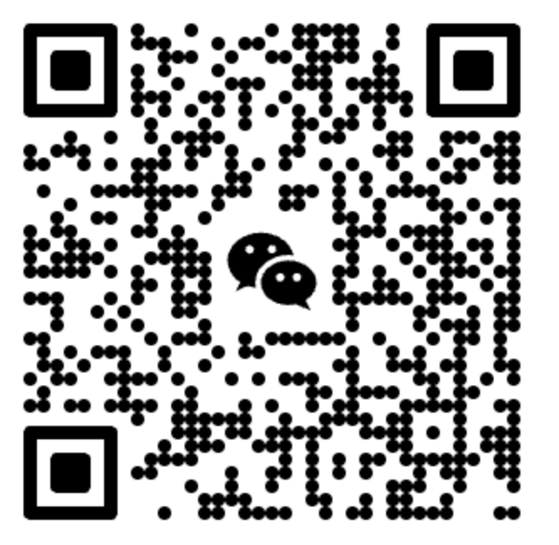
THANKS
感谢您的观看
更多精品模板: https://www.ppthub.shop/

