Slide 1

Project 3
Northwestern University data science boot camp 2020
Presentation 8/20/2020
Exploring the relationship between the availability of food and the occurrence of diabetes in the United States
Sushank Abbaraju
Tania Manrique
Emma Szczesiul
Aashish Mewada

Slide 2
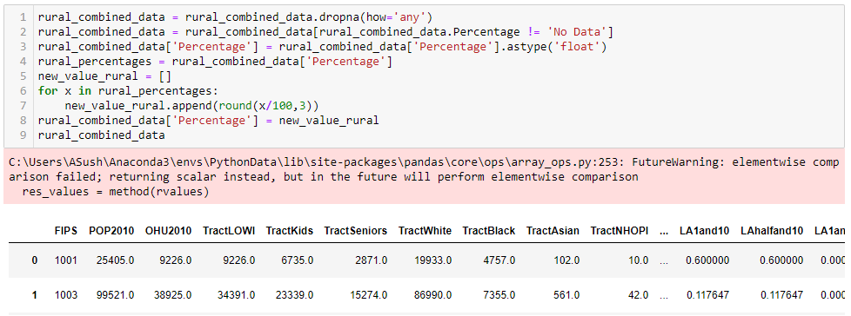

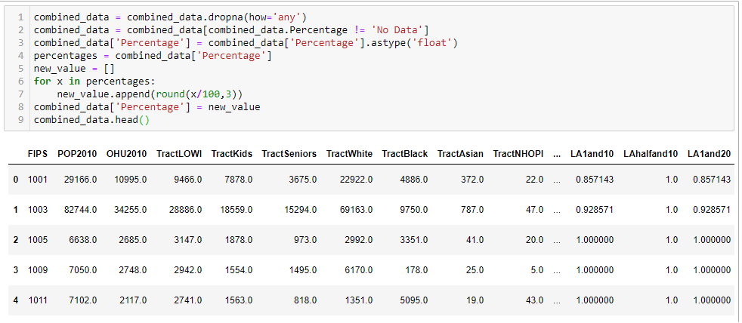

DATA SET 1
DATA SET 2

Slide 3
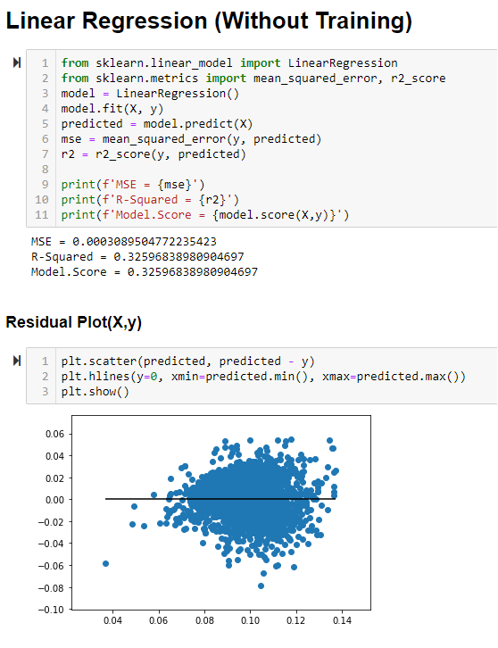
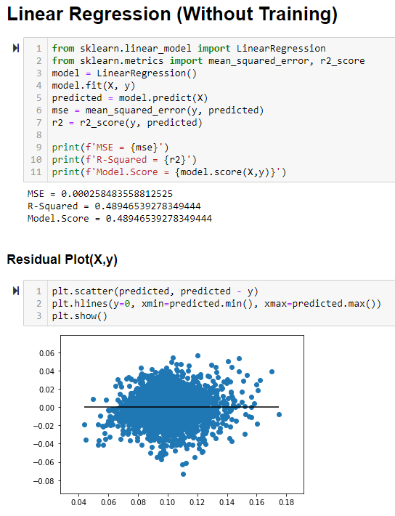
Linear Regression: Urban vs. Rural
Urban:
Rural:

Slide 4
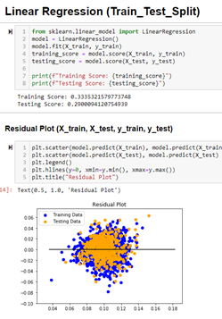
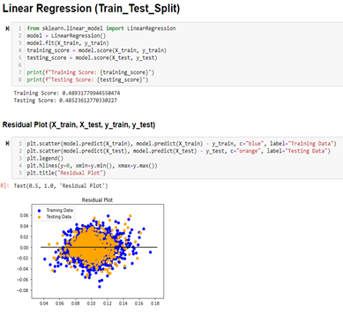
Linear Regression
Urban:
Rural:

Slide 5
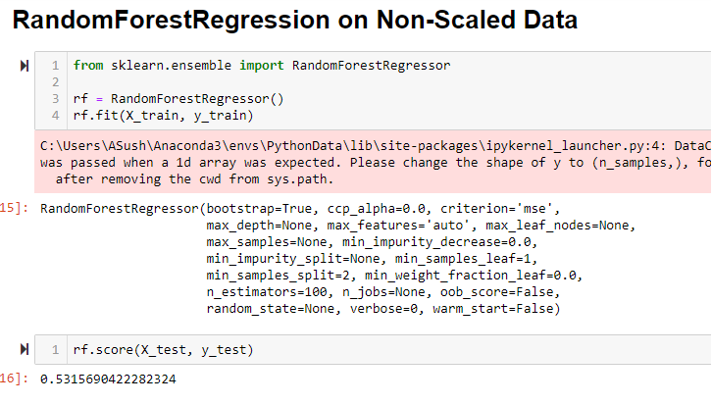
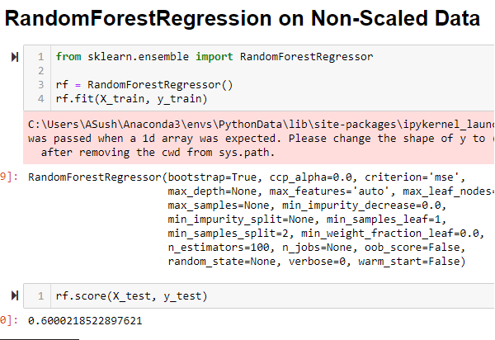
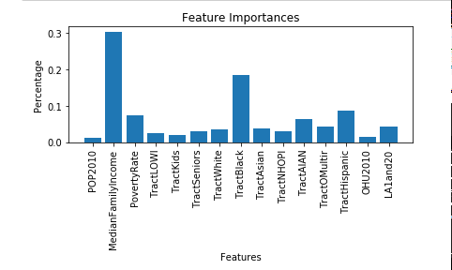
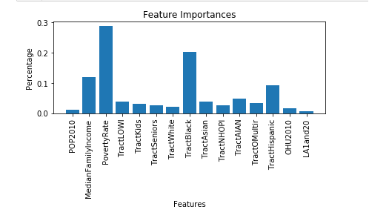
Random Forest Regressor: Urban vs. Rural
Urban:
Rural:

Slide 6
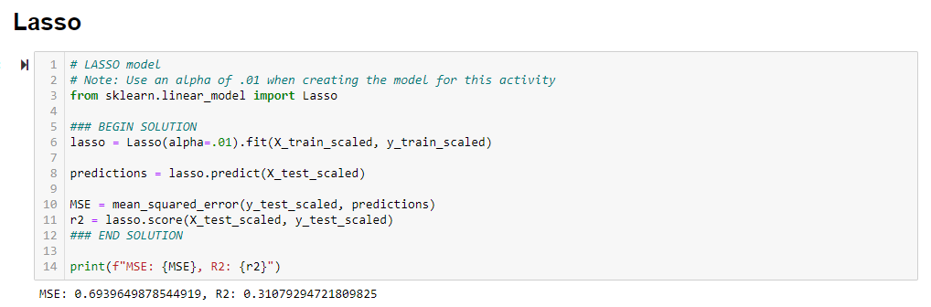
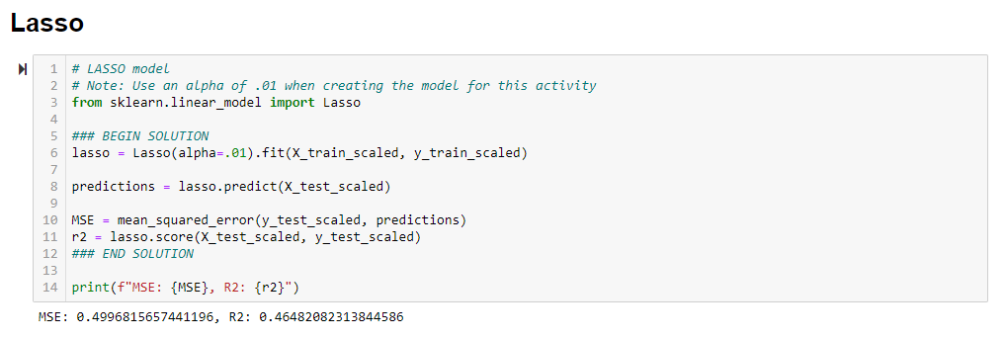
Lasso
Urban:
Rural:

Slide 7

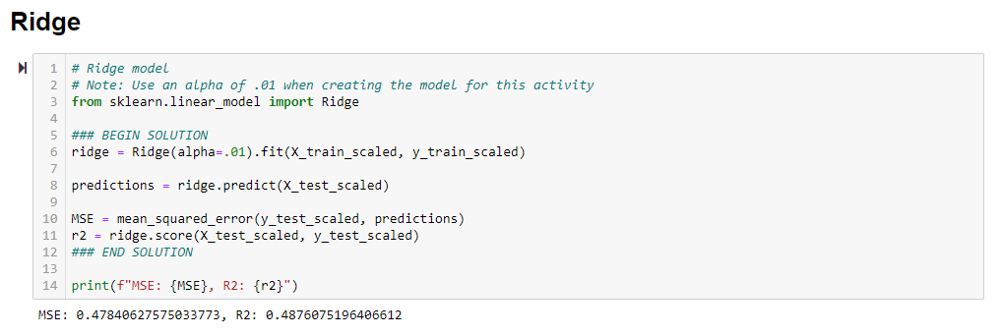
Ridge
Urban:
Rural:

Slide 8
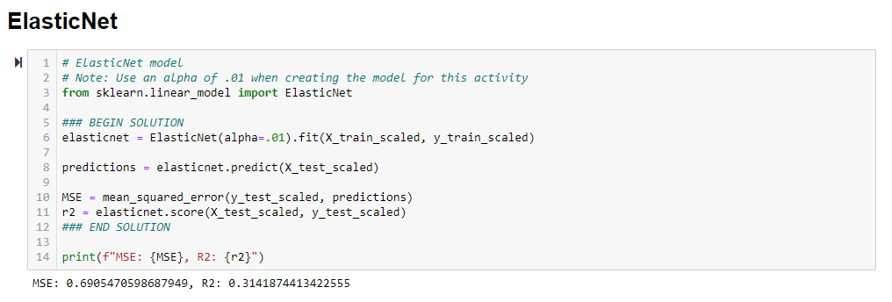
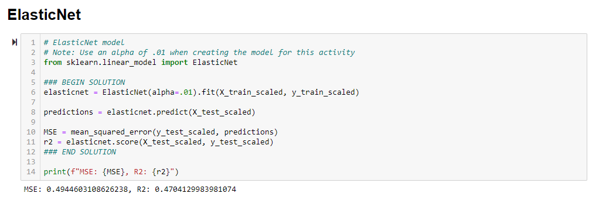
ElasticNet
Urban:
Rural:

