Slide 1

SMART INDIA HACKATHON 2026
PRAKALP-DRISHTI
प्रकल्प-दृष्टि
Predictive, physically-verified and prescriptive decision intelligence for India's Central Sector infrastructure portfolio.
Problem Statement ID — SIH26103
Problem Statement Title — Use case on web-based integrated project-monitoring platform
Theme — Smart Automation
PS Category — Software
Team ID — [TEAM ID]
Team Name — [TEAM NAME — as registered on portal]
2,207 projects · ₹47.44 Lakh Cr · Ministry of Statistics & Programme Implementation

Slide 2
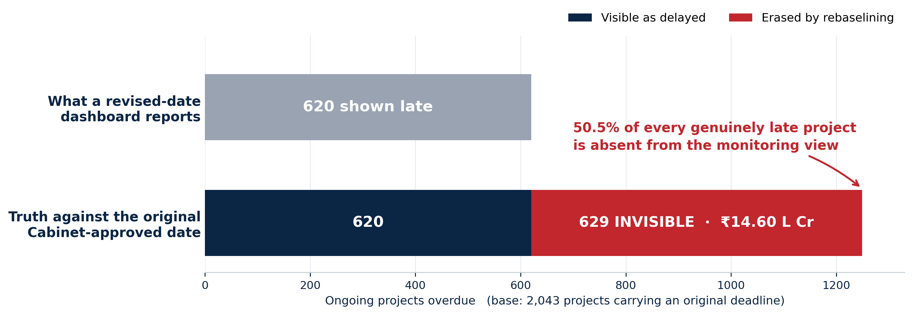
PRAKALP-DRISHTI
[TEAM NAME]
Half of India's project delay is invisible to the dashboard that monitors it. We measured it — and built the layer that ends it.
PROPOSED SOLUTION — A DECISION LAYER OVER PAIMANA
1. KAAL-CHAKRA — completion as a calibrated P10–P95 band, not a promised date
2. SETU-GRAPH — cross-ministry dependency DAG; slack-absorbed vs propagating delay
3. VITTA-VYUHA — capital allocation as a stochastic LP under the 10% NER floor
4. PRATIBIMB / KAAL-DARPAN — dated satellite epochs bound to statutory progress reports
5. PRAGATI-SAARTHI — bilingual briefings; every figure carries a Merkle proof
FLAGSHIP CASE — WESTERN DEDICATED FREIGHT CORRIDOR (ID 705237)
▸ Sanctioned Feb 2008 — original completion 31 Mar 2022, since revised to 31 Dec 2025
▸ Cost ₹51,101 Cr → ₹1,24,005 Cr — an escalation of ₹72,904 Cr (+142.7%)
▸ Reports 96% physical progress — while the official completion date has moved 45 months
▸ Model output — 7.3% probability the original Cabinet target was ever achievable
When a deadline slips it is formally revised — and the project resets to "on schedule". Recomputed against the original Cabinet-approved date on the 2,207-project MoSPI corpus.
HOW IT ADDRESSES THE PROBLEM
▸ Restores the original baseline as the yardstick — recovers 629 hidden projects worth ₹14.60 L Cr
▸ Replaces a single deterministic date with an interval an officer can actually provision against
▸ Adds independent physical corroboration wherever optical imagery can genuinely see the work
▸ Turns "which project is worst" into "where does the next ₹1 Cr buy the most completion"
INNOVATION & UNIQUENESS
▸ Rebaselining-aware delay accounting — a metric no monitoring dashboard currently computes
▸ Evidence verdicts, never a satellite "completion %": surface change vs reported progress correlates at r = 0.007
▸ Corpus sealed as an RFC 6962 Merkle root; every briefing number is independently verifiable
▸ Runs air-gapped by default — the sovereign configuration is the one with no outbound calls
WHAT WE REFUSE TO CLAIM
▸ Sub-metre change detection — measured GSD is 2.08–2.35 m/px
▸ NDVI / NDBI / NDWI — the basemap carries RGB only; no NIR or SWIR band exists
▸ A "fine-tuned" Prithvi model — no labelled Indian construction-stage corpus exists
▸ MILP — every decision variable is continuous, so it is an LP and is named one

Slide 3
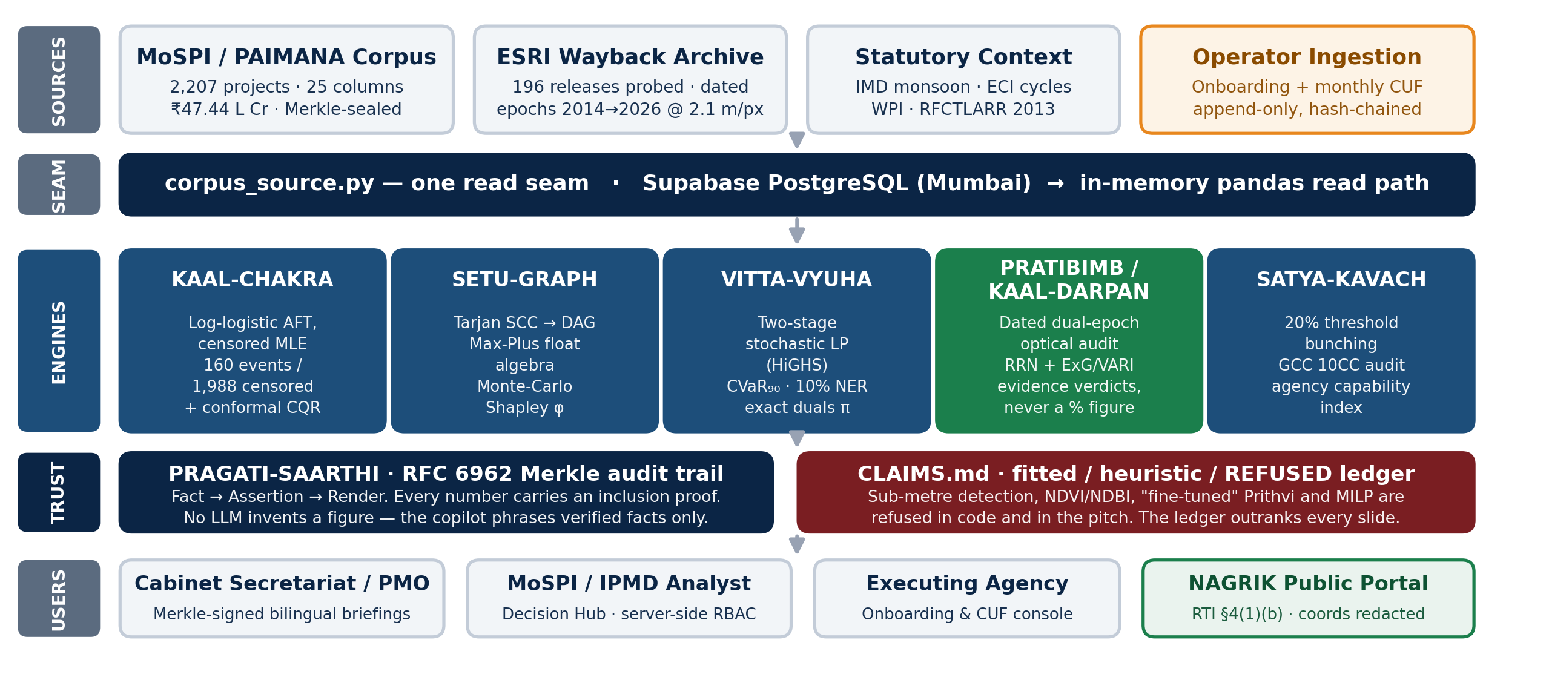
TECHNICAL APPROACH
[TEAM NAME]
One read seam, five engines, and a proof on every number. Postgres writes · pandas reads · Merkle signs.
STACK Python 3 · FastAPI · pandas / NumPy · SciPy (L-BFGS-B, HiGHS) · scikit-learn · NetworkX · OpenCV · Pillow · scikit-image · React 18 + Vite · Leaflet · Recharts · Supabase PostgreSQL (ap-south-1) · pytest
METHOD Censored-MLE AFT with CV-selected shrinkage → split-conformal calibration → Tarjan/Max-Plus float algebra → HiGHS simplex with CVaR₉₀ → RRN-normalised dual-epoch optical differencing → RFC 6962 Merkle attestation

Slide 4
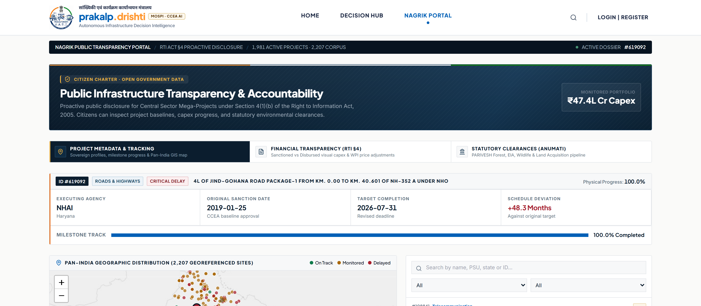
FEASIBILITY AND VIABILITY
[TEAM NAME]
This is not a proposal — it is running. 87 endpoints, 476/476 assertions green in CI, on the real 2,207-project corpus.
2,207
projects, sealed as a
Merkle root
93.3%
measured conformal
coverage (450 held-out)
476/476
assertions, 19 suites,
enforced in CI
12.2%
MAE lift over the
sector-mean baseline
27
dated satellite epochs
resolved, 5 corridors
WORKING PROTOTYPE — LIVE PUBLIC TRANSPARENCY PORTAL
CHALLENGES, RISKS AND HOW EACH IS HANDLED
RISK Optical imagery cannot see tunnels, interiors or underground work
→ The engine returns SENSOR_CANNOT_RESOLVE instead of a verdict. Sector and name tokens gate this before any comparison runs.
RISK Only 7.4% of the corpus has an observed completion (160 of 2,148)
→ Right-censored MLE uses the 1,988 unfinished projects as evidence rather than discarding them; each group publishes its event count and a prior-dominated tag.
RISK Satellite change does not track reported progress (r = 0.007)
→ So no completion % is ever derived from imagery. The output is an evidence verdict that asks for inspection, never an accusation.
RTI §4(1)(b) citizen view. Schedule deviation is reported against the original target, and site coordinates are redacted for critical national infrastructure.
RISK A cloud LLM would send project data off the network
→ Air-gapped is the default; with no API key the copilot answers from locally computed Merkle-signed facts. Health endpoint discloses egress state.

Slide 5
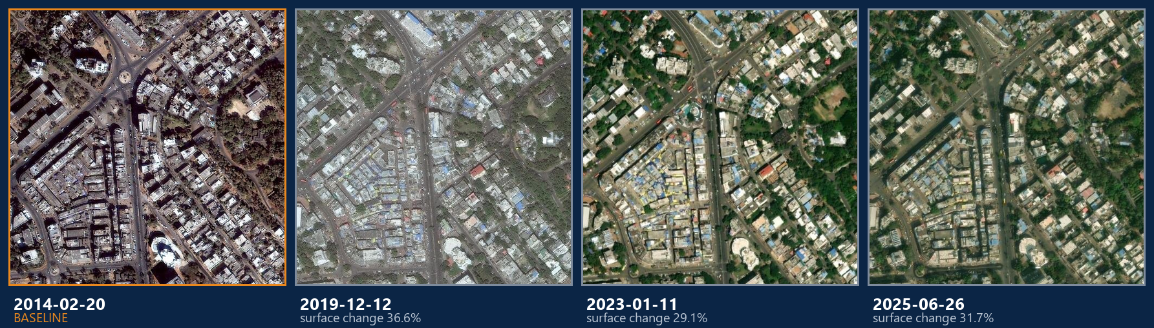
IMPACT AND BENEFITS
[TEAM NAME]
₹14.60 Lakh Crore of delay returns to the monitoring view. And the claim now has a dated photograph beside it.
PHYSICAL CORROBORATION — BHOPAL METRO (PROJECT 702625), FOUR GENUINE DATED EPOCHS FROM 196 ARCHIVE RELEASES
Each epoch is a real, dated ESRI Wayback capture with its own SHA-256. Surface change is radiometrically normalised and vegetation-masked — it is reported as evidence of activity, never converted into a completion percentage.
GOVERNANCE
▸ 629 projects (₹14.60 L Cr) restored to the delay register
▸ Cabinet briefings become independently verifiable, not disputable
ECONOMIC
▸ Capital steered by marginal completion yield, not historical share
▸ ₹5.66 L Cr of escalation on 1,183 revised projects made visible
ADMINISTRATIVE
▸ Inspection effort triaged to sites where evidence disagrees
▸ Bilingual (English / CSTT Hindi) briefings generated in seconds
CIVIC
▸ RTI §4(1)(b) proactive disclosure to every citizen
▸ Statutory 10% North-Eastern floor enforced as a hard constraint

Slide 6
RESEARCH AND REFERENCES
[TEAM NAME]
Every method is standard, cited, and reproducible from the committed corpus.
DATA SOURCES (all official / open)
▸ MoSPI · PAIMANA — Central Sector project CUF returns, ≥ ₹150 Cr — mospi.gov.in
▸ ESRI World Imagery Wayback — dated optical archive; 196 releases probed, 2014–2026
▸ India Meteorological Department — state rainfall departure from LPA (% of Long Period Average)
▸ Election Commission of India — assembly election calendar, 2000–2026
▸ DPIIT / RBI — WPI series — steel, cement, fuel & bitumen
▸ NSE / BSE disclosures — executing-PSU leverage and solvency indicators
METHOD REFERENCES
▸ Romano, Patterson & Candès (2019) — Conformalized Quantile Regression, NeurIPS — the P10–P95 calibration
▸ Kalbfleisch & Prentice (2002) — Statistical Analysis of Failure Time Data — log-logistic AFT under censoring
▸ Rockafellar & Uryasev (2000) — Optimization of Conditional Value-at-Risk — the CVaR₉₀ dial
▸ Shapley (1953); Castro et al. (2009) — permutation Monte-Carlo Shapley for network criticality
▸ Tarjan (1972) — depth-first search and linear graph algorithms — SCC condensation to a DAG
▸ Woebbecke (1995); Gitelson (2002) — ExG and VARI visible-band vegetation indices
▸ RFC 6962 (Laurie, Langley & Kasper) — Certificate Transparency Merkle tree — the audit trail
▸ RFC 8785 — JSON Canonicalisation Scheme — deterministic row serialisation
STATUTORY & DOMAIN BASIS
▸ RTI Act 2005 §4(1)(b) — proactive-disclosure duty, implemented as the NAGRIK portal
▸ RFCTLARR Act 2013 — land-compensation regime shift used as a structural break
▸ CPWD GCC Clause 10CC — statutory price-escalation formula audited by SATYA-KAVACH
▸ CCEA 20% re-appraisal threshold — the Cabinet trigger the bunching test examines
VALIDATION ACTUALLY PERFORMED
▸ Calibration — 93.3% empirical coverage on 450 held-out projects (84.7% uncalibrated)
▸ Leakage control — chronological train/test split; 12 outcome-derived columns excluded
▸ Honest ablation — monsoon, WPI, EO and graph features made MAE worse (16.24 → 17.90) and were dropped
▸ Regression safety — 476 assertions over 19 suites, enforced in GitHub Actions on every push
REPRODUCE ANY NUMBER python analytics_engine/aft_survival.py && python analytics_engine/conformal_calibration.py && python tests/verify_features.py
Corpus sealed at Merkle root e659bf58f2a62e7d7f530792b54b3159ad68a464e7cbf956c2f02bffb61558e2 over 2,207 canonically-serialised rows. Every artifact regenerates from the committed corpus under a fixed seed.

