Slide 1

SMART INDIA HACKATHON 2026
TITLE PAGE
Problem Statement ID – SIH26103
Problem Statement Title – Use case on web-based integrated project-monitoring platform
Theme – Smart Automation
PS Category – Software
Team ID –
Team Name – BUBBLESORT
PRAKALP-DRISHTI — calibrated early warning for PAIMANA
Notes:
Problem statement 26103 — MoSPI's DIID, for IPMD. Our idea in six words: calibrated early warning for PAIMANA. Everything that follows was measured on the Ministry's own public register.

Slide 2









IDEA TITLE
BUBBLESORT
PRAKALP-DRISHTI — tells IPMD which PAIMANA projects will slip, when, and how sure we are
Real-world issue
Proposed Solution (Describe your Idea/Solution/Prototype)
Detailed explanation of the proposed solution
PAIMANA records a delay after it happens. 1,988 of 2,103 projects are still running — nobody can say which one slips next.
617185 · Kurnool-IV REZ transmission (POWERGRID) · ₹5,550 Cr
25% built · sanctioned Mar 2025 · not yet late by PAIMANA's own dates
Finish window — a likely finish date with a best-to-worst range, made for projects that have not finished yet
PAIMANA's own dates (red):
original 23 Mar 2027 · revised 30 Sep 2027
22%
chance it finishes by PAIMANA's Sep 2027 date
Cost-overrun estimate — checked against the Ministry's own sector averages on newer projects
Why it matters
1,981 ongoing projects; cost already up from ₹37.13 to ₹42.78 lakh crore. Every month of warning is time to act.
what we add: the finish window
Ranked watch-list — which projects to look at this month, and why; weights set by the Ministry
2025
2026
2027
2028
2029
2030
2031
2032
2033
P10 7 Feb 2027 · most likely (P50) 15 Nov 2028 · P80 10 Nov 2031 · P95 19 Dec 2032
English / Hindi brief — every sentence points to its source record; runs offline; open-source
Solution
Read it like this: most likely finish Nov 2028; the band holds 10–95% of outcomes. It is wide because the project is 25% built in 15 months on a 24-month plan, and this sector has few finished projects to learn from.
A monthly add-on to IPMD's report. For every ongoing project: a likely finish window, a cost-overrun estimate, and a ranked list of what to look at first — with the reason.
Innovation and uniqueness of the solution
Tested on 596 held-out projects: the official revised date fell inside the band 79% of the time (51% before calibration).
Today
With PRAKALP-DRISHTI
How it addresses the problem
Outcomes covered: a b c d e g h i · f partly
Promised dates
Calibrated window
Prototype
a
Statistical and predictive models → three built (survival model for time; OLS and boosting for cost), tested on projects newer than the training data
AI assumed to help
AI measured (+2.6% vs OLS)
Live ▸ prakalp-drishti.vercel.app
b
Does AI beat conventional statistics? → boosting beats the sector average by 12% but OLS by only 2.6%; the real gain is calibration — window hit-rate 51% → 79%
Code ▸ github.com/amey-bauchkar/Prakalp-Drishti-
1,981-row list
Ranked, with reasons
c
Extra variables beyond CUF fields? → rain, prices, elections and seven more did not help; land, clearance and milestone fields would — our ask to MoSPI
made for unfinished projects · re-runnable (slide 6)
MEASURED, NOT PROMISED · BUILT BESIDE PAIMANA
Notes:
PAIMANA tracks 1,981 projects worth ₹42.78 lakh crore and records every slip faithfully — after it happens. 1,988 of the 2,103 projects in the public register are still running; nobody can say which one slips next. Here is one: Kurnool-IV transmission, ₹5,550 crore, a quarter built, not late by PAIMANA's own dates. Our model says: most likely finish November 2028, and only a 22 percent chance of meeting the September 2027 date. That is early warning before the slip. The band is wide because this sector has few finished projects to learn from — we show the honest range, and on 596 held-out projects that band covered the official date 79 percent of the time. What we deliver is a monthly add-on to IPMD's report: this window for every project, a cost estimate checked against the Ministry's own sector averages, a ranked list with the reason for each, and an English/Hindi brief where every sentence points to its record. The PS asked three questions; we answered each by measurement — including that AI beats plain statistics by only 2.6 percent on cost. We say that on purpose.

Slide 3













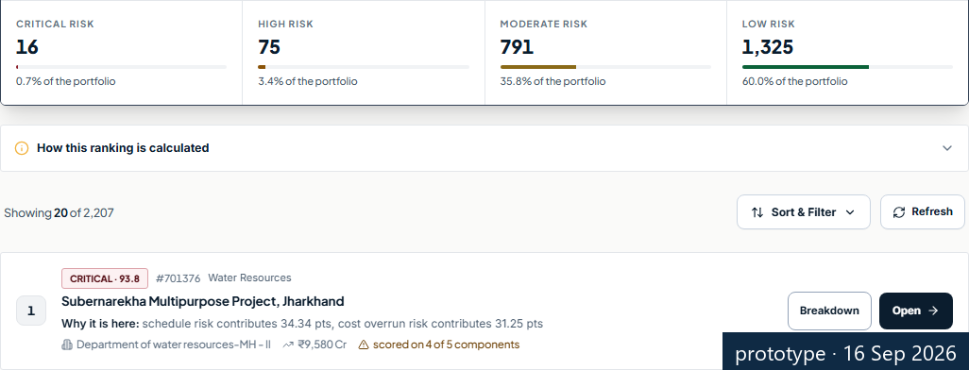
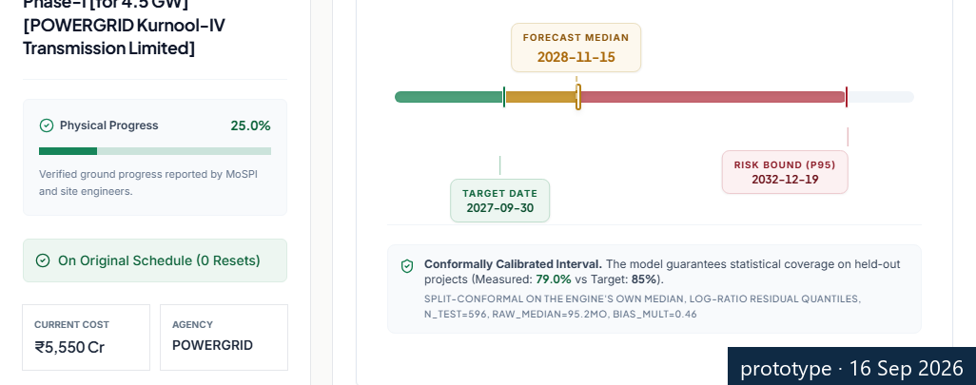
TECHNICAL APPROACH
BUBBLESORT
How the numbers are made — and how we checked them
Technologies to be used (e.g. programming languages, frameworks, hardware)
Python · scikit-learn · scipy
the models and the statistics
FastAPI + PostgreSQL
the service and the records
React
the officer's screens
Docker on one NIC Cloud VM
open-source; no licences; no external calls
Methodology and process for implementation (Flow Charts/Images/ working prototype)
Time model
survival model, built for unfinished projects → finish window
79%
hit-rate · was 51%
PAIMANA data
2,207 projects · 25 public fields
Future-info guard
12 columns that only exist after the outcome are removed
Split by time
learn on projects up to 2020; test on 2020–21
Cost model
boosting, checked against plain statistics (OLS) and the sector average
Ranked queue
Ministry-set weights · a reason per project
Officer outputs
queue · windows · EN/HI brief
Monthly annex
into the IPMD report
−12%
error vs sector avg.
How we checked
Same result every time
What we found, honestly
tested on projects newer than the ones we learned from · 12 future columns removed · compared with naive, sector-average and OLS forecasts · finish window checked on 596 held-out projects
fixed seeds · identical output on any machine · 152 automated checks pass
AI beats plain statistics by only 2.6% on cost · ten extra variables did not help · for time, no regression was good enough — the survival model is used
the ranked queue
project 617185's window
MEASURED, NOT PROMISED · BUILT BESIDE PAIMANA
Notes:
Left to right. PAIMANA's public data: 2,207 projects, 25 fields. First we remove twelve columns that only exist after the outcome — revised cost, revised date, spending — because a model that sees them is reading the answer, not predicting it. Then we split by time: learn on projects up to 2020, test on 2020–21. Two models. Time: a survival model built for projects that have not finished, which gives the finish window — it covered the official date 79 percent of the time on 596 held-out projects, up from 51. Cost: boosting, checked against plain statistics and the sector average — 12 percent better than the sector average, only 2.6 percent better than OLS, and we say so. Both feed a ranked queue with a reason per project, and the officer's outputs into the monthly annex. Everything re-runs from a fixed seed with 152 automated checks.

Slide 4









FEASIBILITY AND VIABILITY
BUBBLESORT
Fits beside PAIMANA as it is — and the four limits we state up front
PAIMANA today
NIC Cloud · MS SQL · SSRS reports · monthly CUF uploads (64% arrive automatically via IPMP)
Our add-on
one container + one database, beside PAIMANA · no licences · no external calls · roles for viewer / analyst / admin
What the officer gets
ranked queue · finish windows with reasons · English/Hindi brief — inside the monthly Project Monitoring Report
CUF export
SSRS tables
NIC on PAIMANA's next step (Oct 2025): “AI-driven forecasting… to predict time and cost overruns, resource needs, and potential risks.”
What we need from MoSPI: actual completion dates from OCMS · the monthly archive · the fields the literature names — land status, clearance dates, milestones (untested by us)
Analysis of the feasibility of the idea
Potential challenges and risks
Strategies for overcoming these challenges
Built — working prototype: 20 screens · ~93 API endpoints · 152 automated checks · Docker image
1
Only one snapshot of data, no month-by-month history yet — so the windows are wide (about 8 years on average)
read the Monthly Flash Report archive; add month-to-month change; same checks
Remaining — monthly data feed from the Flash Report archive · back-test of the queue · recalibration on real completion dates · NIC sign-on · Hindi review
The queue's weights are set by policy, not yet tested against what happened next
back-test now; Ministry sets the weights on its own screen
2
Smallest pilot — one ministry's projects, one quarter · used by IPMD monitoring officers · owner: IPMD
The cost model was tested on projects sanctioned up to 2021; 55% of the portfolio is newer
newer projects fall back to the sector average and are labelled so — never scored as safe
3
Runs on — one NIC Cloud VM · open-source · outputs as plain tables · roles enforced server-side
Inputs are self-reported; some fields are missing
a validation check; missing signals shown as “not reported”, never as zero risk
4
What we refuse to claim: sub-metre satellite verification · fraud verdicts — the 20% CCEA bunching test came back null (p = 0.68) and we report it as null
MEASURED, NOT PROMISED · BUILT BESIDE PAIMANA
Notes:
PAIMANA runs on NIC Cloud with MS SQL and SSRS and takes a monthly CUF feed — and NIC's own write-up names AI-driven forecasting as the next step. We sit beside it as one container and one database and return plain tables: the queue, the windows with reasons, the brief. Built: twenty screens, ninety-three endpoints, a hundred and fifty-two checks. Remaining: the monthly feed, the queue back-test, recalibration on real completion dates, NIC sign-on, Hindi review. Pilot: one ministry, one quarter. Four limits, before you ask: one snapshot, so windows are wide; weights set by policy, not yet tested; cost model tested to 2021, newer projects fall back to the sector average and say so; inputs self-reported, missing shown as missing. Two refusals: no sub-metre satellite claims, no fraud verdicts.

Slide 5

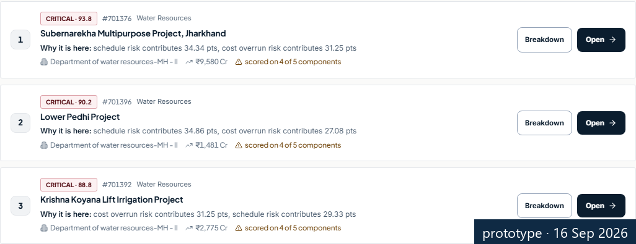
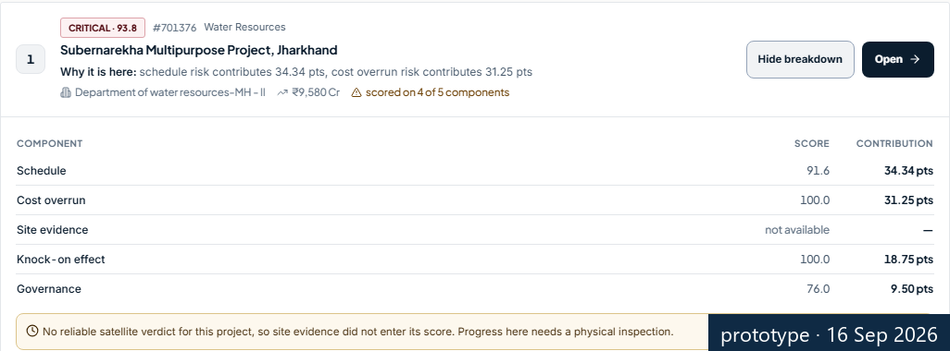
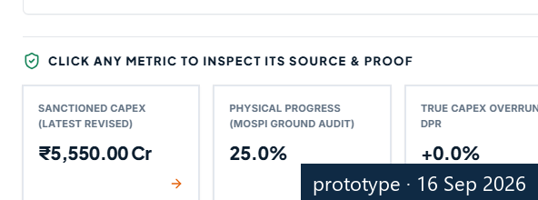




IMPACT AND BENEFITS
BUBBLESORT
From describing delays to catching them early — measured, not promised
Finish window hit-rate
Typical error in the finish date
Cost-overrun estimate error
51% → 79%
100 → 23 months
18.5% → 16.2%
official revised date inside the window · nominal 85% · 596 held-out projects
median error of the most-likely date · 596 held-out projects
vs the sector-average forecast · plain statistics (OLS) 16.7% · 265 held-out projects
today
ours
today
ours
today
ours
What the officer gets — real screens from the prototype (16 Sep 2026)
Benefits of the solution (social, economic, environmental, etc.)
Today: a 1,981-row report
A ranked list, with reasons
An escalation note, EN / HI
Governance — ranked, reasoned, contestable; every figure has an audit trail
Economic — earlier intervention on a ₹42.78 lakh crore portfolio; the size of any saving is not claimed
The pilot will measure — officer review time per month · escalations raised before the slip · window hit-rate against real completions
Potential impact on the target audience
IPMD monitoring officers — which projects to escalate this month, and why: computed, not compiled
Social — English / Hindi briefs (Hindi templates, pending official review); plain-language reasons
Line ministries and PMG cells — a finish window and reasons per project, instead of a promised date
Environmental — no claim
DIID statisticians — every number can be re-run; models, baselines and limits are written down
MEASURED, NOT PROMISED · BUILT BESIDE PAIMANA
Notes:
Three numbers, all on held-out projects. The finish window covered the official revised date 51 percent of the time before calibration and 79 percent after, against an 85 percent target — we show the gap. The typical error in the most-likely date fell from 100 months to 23. The cost-overrun estimate is 12 percent better than the sector-average forecast — and only slightly better than plain statistics, which we say. Below, what the officer gets: the 1,981-row report becomes a ranked list with a reason per project, and the escalation note drafts itself in English or Hindi. We claim no rupees saved; the pilot will measure officer time, escalations raised before the slip, and the hit-rate against real completions.

Slide 6






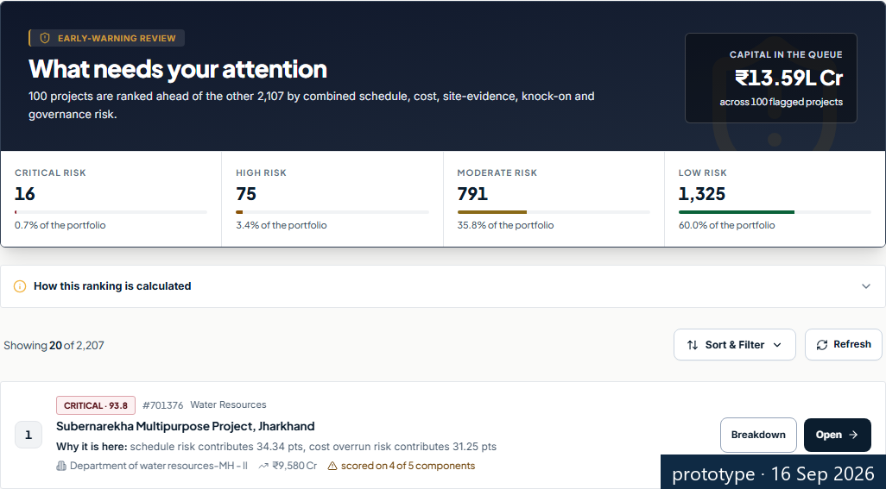
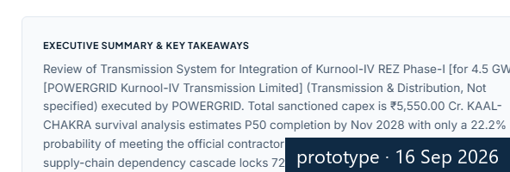
RESEARCH AND REFERENCES
BUBBLESORT
What we read — and how anyone can re-run our numbers
Details / Links of the reference and research work
on this database → the methods we used → the Ministry's own documents
Ram Singh (2010)
Morris (1990)
Flyvbjerg (2006)
Wei (1992)
Romano et al. (2019)
McCrary (2008)
NIC · PIB · MoSPI
894 MoSPI projects, 1992–2009: delays and overruns
EPW — early evidence on public-sector overruns
reference-class forecasting — our baseline
the survival model for projects not yet finished
conformal calibration — checking the window's hit-rate
bunching test at the 20% CCEA threshold (null result)
PAIMANA write-up (Oct 2025) · PIB release (Mar 2026) · April 2026 report
LINK
LINK
LINK
LINK
LINK
LINK
The working prototype — real screens, 16 Sep 2026
RERUN — three commands, every number on these slides comes back
github.com/amey-bauchkar/Prakalp-Drishti-
CLAIMS.md — fitted / heuristic / refused · corrections on record
(93.3% coverage and p < 0.001 withdrawn)
python analytics_engine/aft_survival.py
python analytics_engine/conformal_calibration.py
python tests/test_engine_precision.py
artifacts/aft_survival.json · conformal_calibration.json · overrun_models.json · seed 42 · same output on any machine
project 617185
English / Hindi brief
early-warning queue
Live ▸ prakalp-drishti.vercel.app Code ▸ github.com/amey-bauchkar/Prakalp-Drishti-
MEASURED, NOT PROMISED · BUILT BESIDE PAIMANA
Notes:
What we read: Ram Singh's 2010 paper on this very database; Flyvbjerg's reference-class forecasting — the plain statistics we compare against; the survival and calibration method papers; the Ministry's own PAIMANA documents. How to check us: the repository, the claims ledger with our corrections on record, and three commands that regenerate every number from seed 42. If any number does not match, that is our defect, and we stand by the code.

