Slide 1

Recipe Site Traffic
Presentation by Amey Ghate

Slide 2
Business Objective
The business pursuits encompass two primary aims:
To forecast recipes that will experience high traffic.
To predict, with an 80% probability, the occurrence of "High" traffic for recipes.

Slide 3
Dataset Description
The Product Manager has thoughtfully simplified our task by furnishing us with data for each recipe, along with information about whether the recipe experienced high traffic during its appearance on the home page.
However, it's worth noting that not all available information about each recipe has been provided.
This dataset contained 947 rows and 8 columns.

Slide 4
Approach
Dataset Preparation and Visualization
Model Comparison
Feature Selection
Conclusions
Remove the outliers if any
Transform data type if needed
Working with Data Gaps
Recoding and collapsing features
Culling into categories
Logistic Regression
Random Forest
Linear Support Vector Classification
Split the Dataset into Training Data and Test Data
Data balancing
Models and evaluation
Approach
Two Examples for Data Cleaning and Preparation done
Calories, Carbohydrate, Sugar, and Protein:
52 missing values in each column were imputed with the mean of their respective categories and servings group.
Category:
Initially contained 11 unique values without any missing entries.
The extra value 'Chicken Breast' was identified and subsequently merged with the 'Chicken' value.

Slide 5
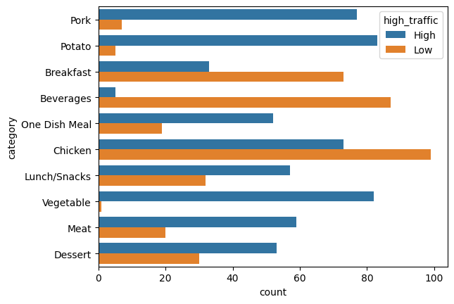
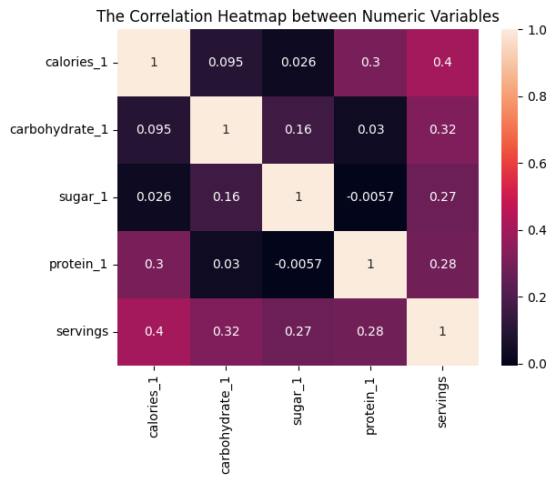
Data Visualization
Within the categories of Potato, Pork, and Vegetable, there is a notable prevalence of recipes generating high traffic as opposed to low traffic.
All the values in the above heatmap are approximately close to zero, these connections can be considered weak.

Slide 6
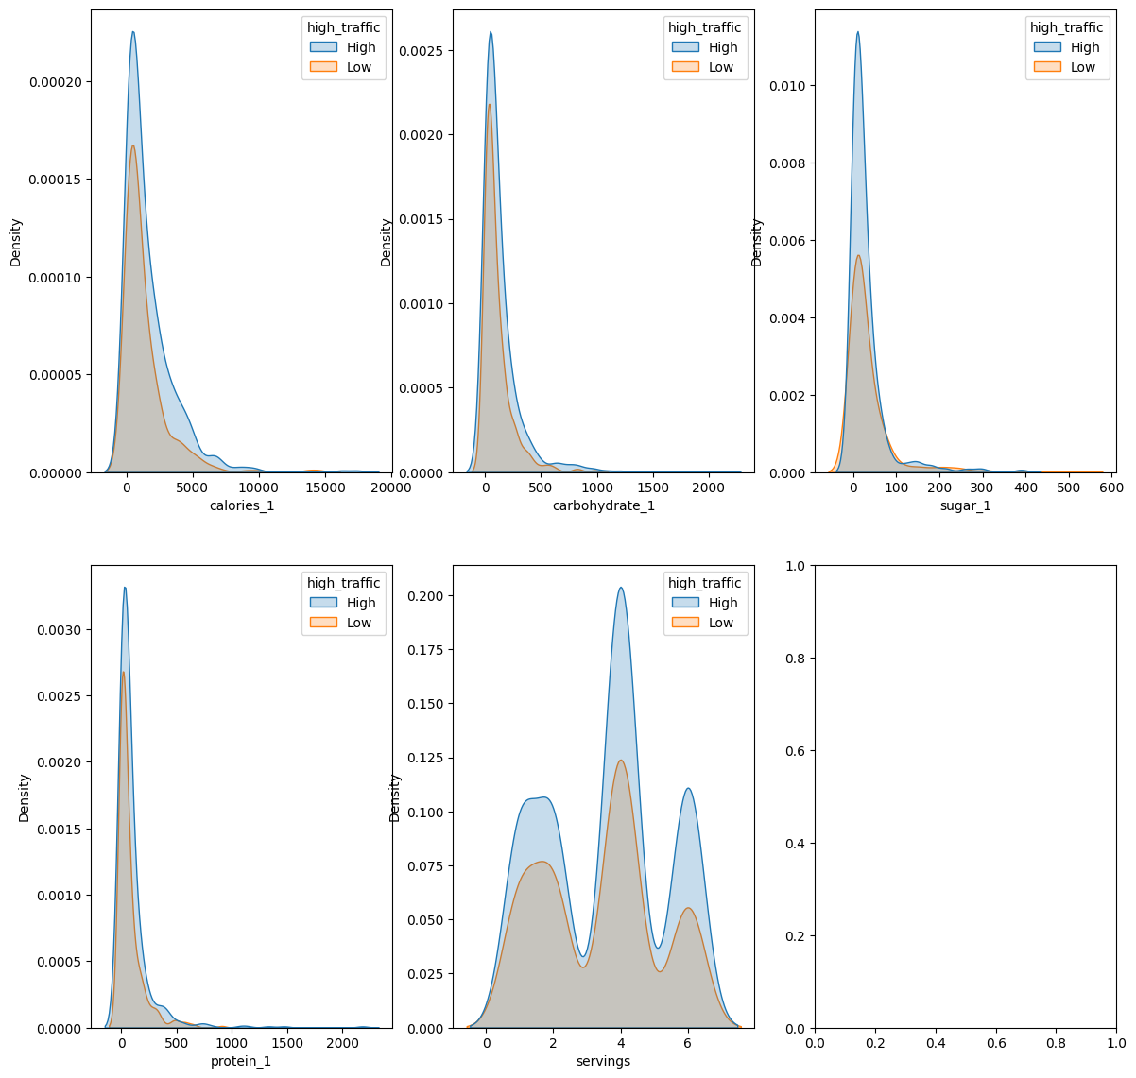
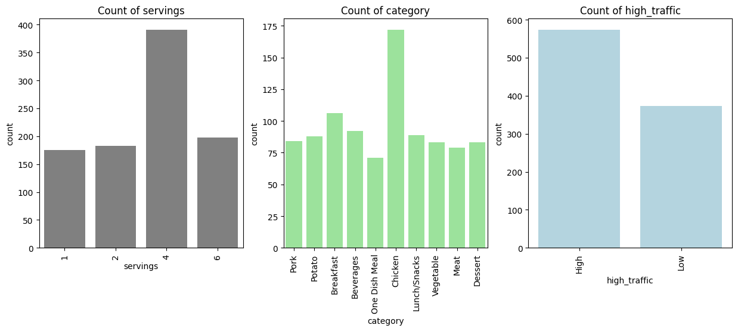
Data Visualization
Notably, the combination of Servings = 4 and the Chicken category emerges as the most popular values.
This indicates the absence of substantial dependencies between traffic and the following numerical features: calories, carbohydrates, protein, sugar, and servings.

Slide 7
Data Visualization Insights
There exists no evident correlation between traffic and servings.
Conversely, the category feature demonstrates a notable influence on the target variable.

Slide 8
Model Evaluation
Given our requirement to forecast "high_traffic," the variable denoting high traffic will serve as our target variable.
Precision | Recall | F1 Score
0.82 | 0.80 | 0.81
Results for Logistic Regression
Precision | Recall | F1 Score
0.80 | 0.77 | 0.79
Results for Linear Support Vector Classification
Precision | Recall | F1 Score
0.78 | 0.80 | 0.79
Results for Random Forest
Logistic Regression model exhibits a superior fit to the features with reduced prediction errors compared to the other models.

Slide 9
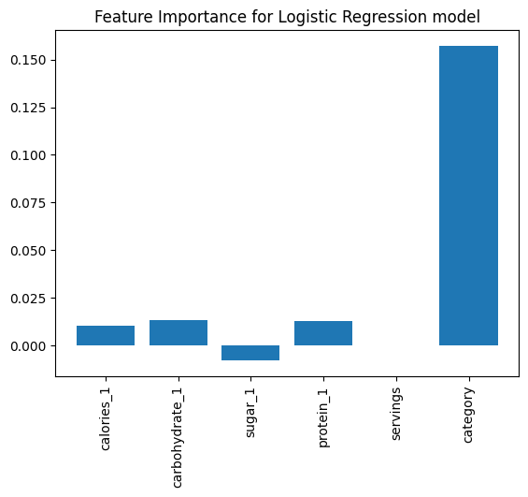
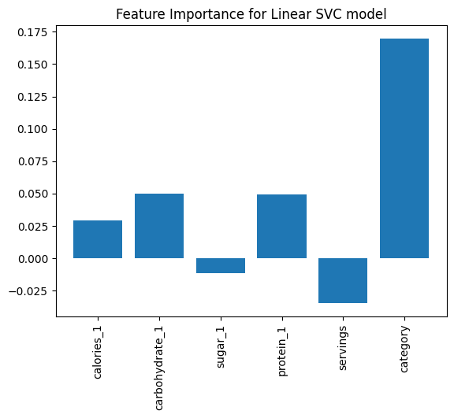
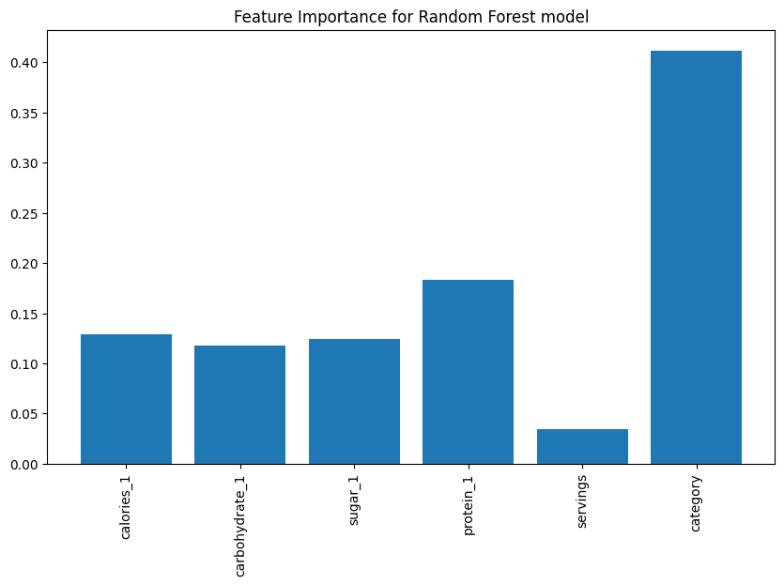
Feature Importance based on Models
Results for Logistic Regression
Results for Linear Support Vector Classification
Results for Random Forest
As observed earlier, it is evident that the "category" attribute holds the primary influence over high traffic occurrences.

Slide 10
Recommendations for Business
Deploying the Logistic Regression Model into production is advised.
This deployment would yield approximately 81% accuracy in predicting high traffic instances. Such implementation stands to boost the confidence in driving greater traffic across the entirety of the website.
To enhance and advance the model's efficacy, the following actions can be undertaken:
Deployment Optimization: Thoroughly investigate deployment strategies to balance performance and cost-effectiveness. Deploying the machine learning model on edge devices is an advantageous route, offering convenience and security. Further, testing the model with newly recruited product analysts can provide valuable insights.
Data Augmentation: Expand the available dataset by incorporating additional data points. Examples include variables like time taken to prepare, cost per serving, ingredients used, duration users spend on recipe pages, incoming link sources, and patterns of recipe visits within a single session.
Feature Engineering: Amplify the model's feature set by diversifying the values within categories. Creating more insightful features from existing variables can substantially elevate the model's predictive prowess.
By executing these steps, the predictive capacity of the Logistic Regression Model can be fortified, driving more accurate high traffic predictions and empowering the Product Manager to optimize traffic generation throughout the website.

Slide 11
Thank you

