Slide 1
IBM University Engagement Project Submission
“Exploring the Power of Agentic AI with IBM Granite and IBM Bob”

Slide 2

Project Tile – Smart Home Energy Advisor
Domain of Project – Electronics/Electrical
Student Name | Passport Photo | Email Id | Mobile number [WhatsApp]
Amey Naik |  | drameynaik@gmail.com | 9503149315
2

Slide 3
Smart Home Energy Advisor
AI-Powered MCP Server for Intelligent Home Energy Management
Progress Report
MCP • AI • Smart Energy
1

Slide 4
Abstract
Transforms raw smart meter data into actionable energy intelligence.
Enables natural-language questions and data-driven recommendations.
Supports cost optimisation, anomaly detection, and appliance scheduling.
Runs as a lightweight Node.js process with zero cloud infrastructure.
2

Slide 5
Problem Statement
Energy costs are increasingly volatile and difficult for households to explain.
Smart meters produce large volumes of data but often provide limited actionable insight.
Shiftable appliances may operate during expensive tariff periods.
Consumption anomalies can remain unnoticed until the monthly bill arrives.
Traditional REST integrations require significant manual AI orchestration.
3

Slide 6
Objectives & Key Features
Conversational AI interface for plain-English energy questions.
Tariff-aware optimisation across flat, time-of-use and dynamic pricing.
Three anomaly strategies: spike, sustained-high and overnight drain.
Real-time meter reading ingestion with immediate analysis updates.
Lightweight deployment using a single Node.js process.
4

Slide 7
System Architecture
TypeScript + Node.js MCP server.
Entry point registers 8 tools and 1 conversational prompt.
In-memory meter store contains readings and appliance data.
Pure analysis engine provides usage, bill, scheduling and anomaly functions.
Standalone dashboard provides a visual companion.
5

Slide 8
Data Flow & Analysis
AI host sends an energy question through the MCP server.
The server retrieves meter data and invokes the required analysis function.
Tariff information is used for cost calculations where required.
Results are returned as structured data and presented through the AI assistant.
6

Slide 9
Technologies Used
TypeScript 5.5 — primary development language.
Node.js 22 — runtime environment.
Model Context Protocol (MCP) — AI integration and tool exposure.
Zod 4.2 — runtime schema validation.
ES Modules and stdio JSON-RPC transport.
Vanilla HTML/CSS/JavaScript — standalone dashboard.
7

Slide 10
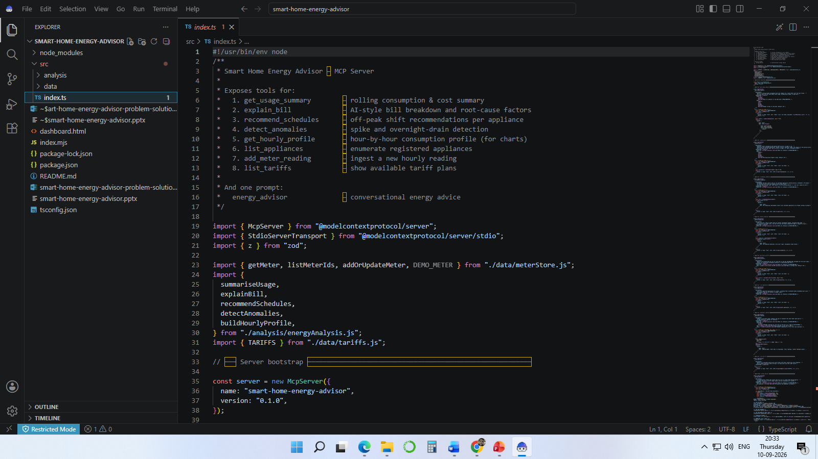
IBM Bob Screenshots
7

Slide 11
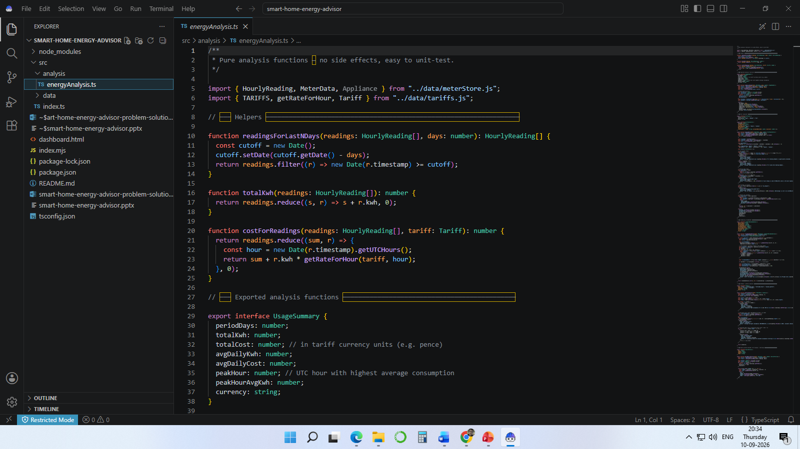
IBM Bob Screenshots(contd)
7

Slide 12
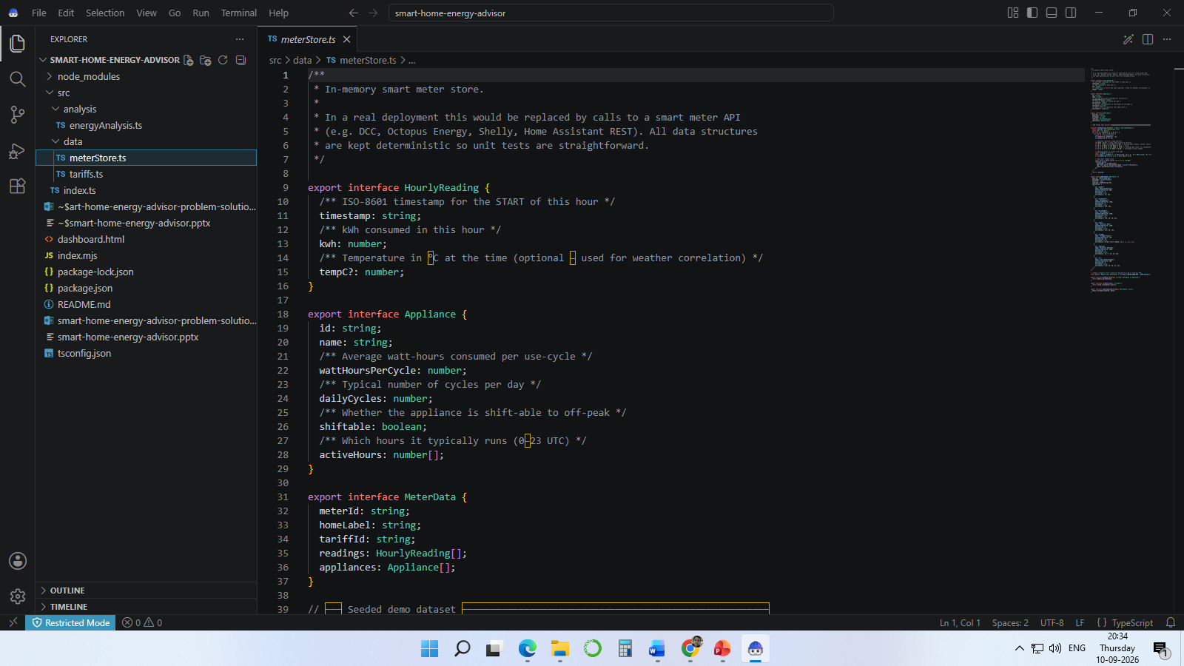
IBM Bob Screenshots(contd)
7

Slide 13
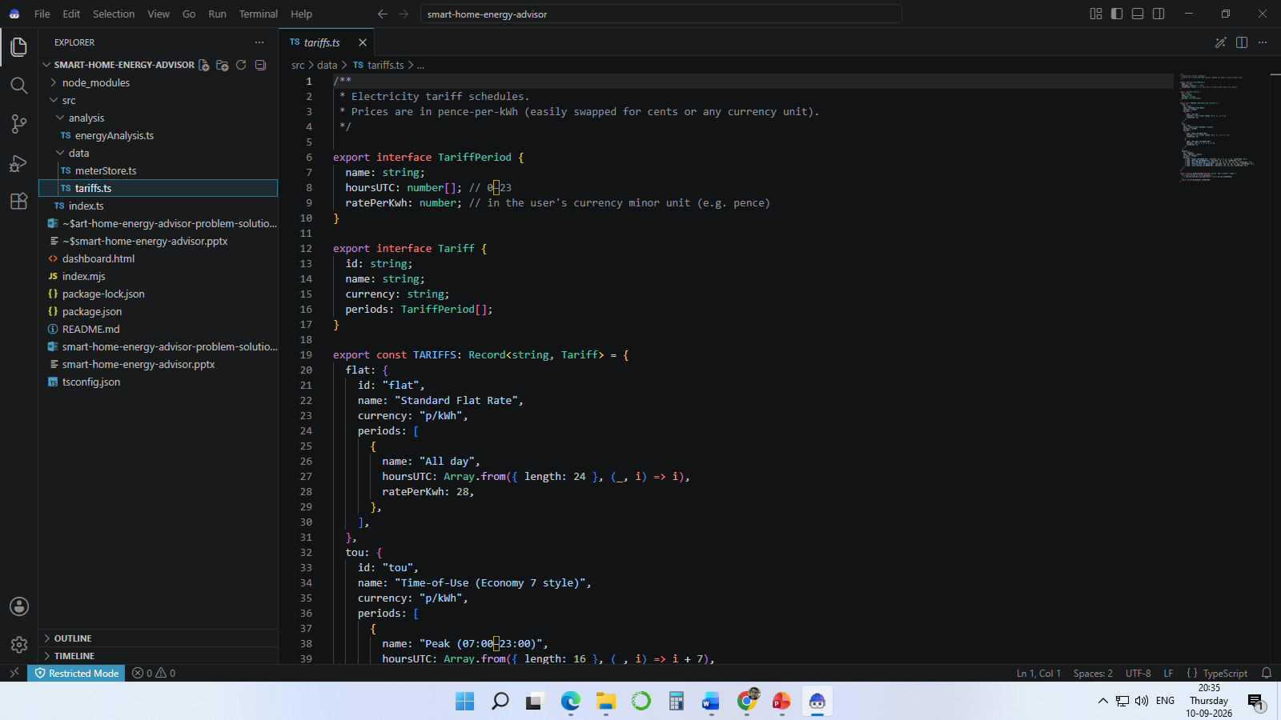
IBM Bob Screenshots(contd)
7

Slide 14
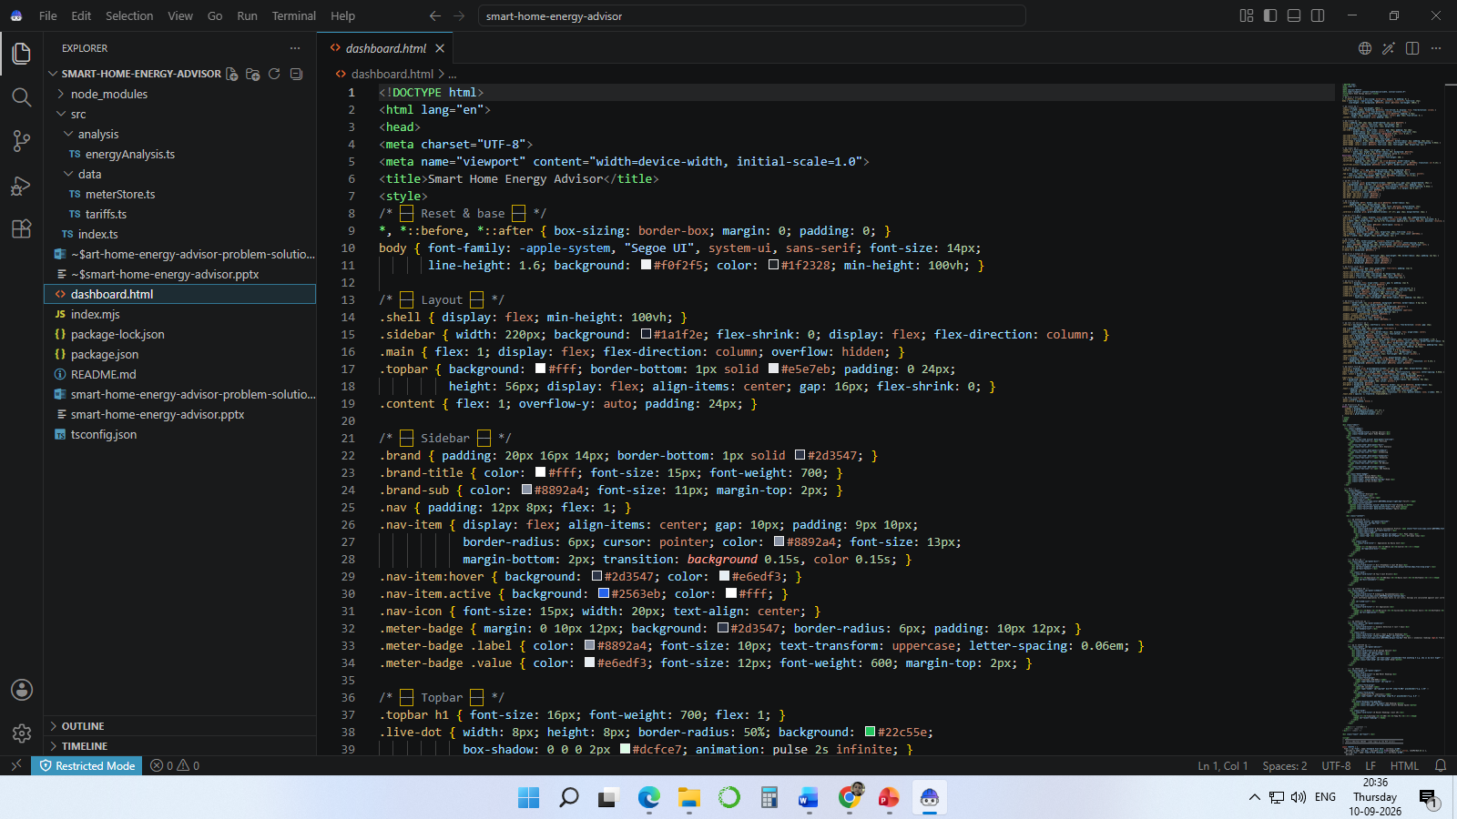
IBM Bob Screenshots(contd)
7

Slide 15
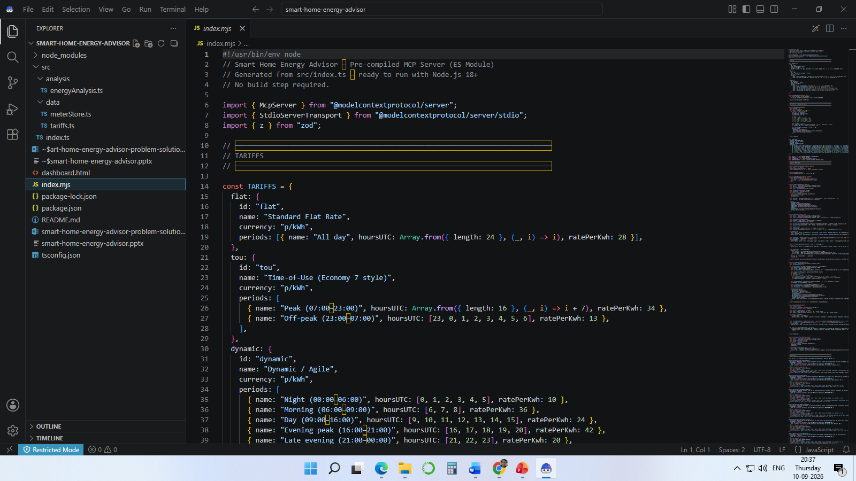
IBM Bob Screenshots(contd)
7

Slide 16
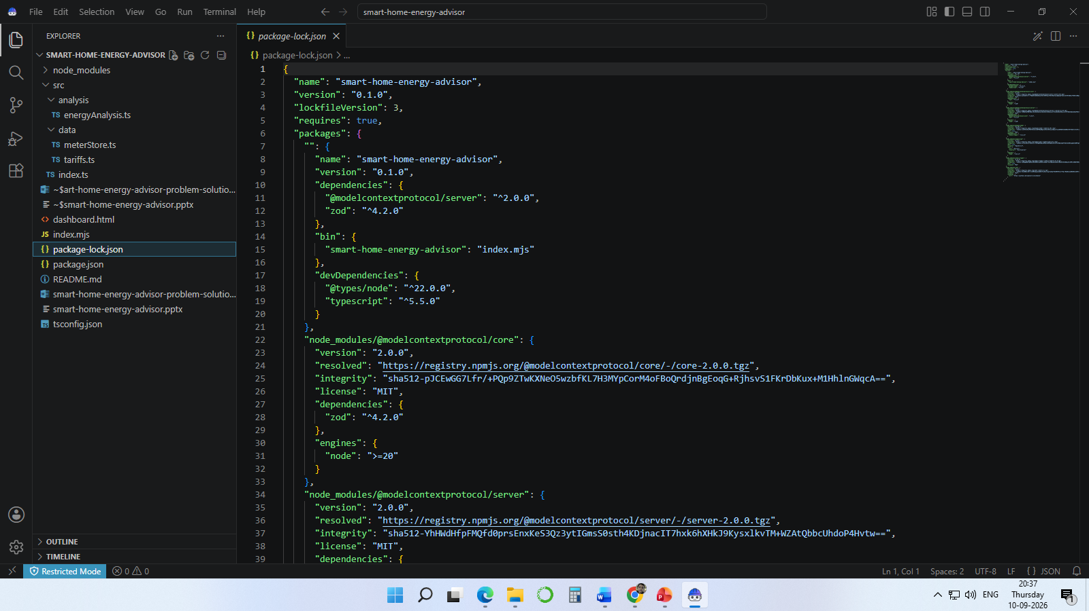
IBM Bob Screenshots(contd)
7

Slide 17
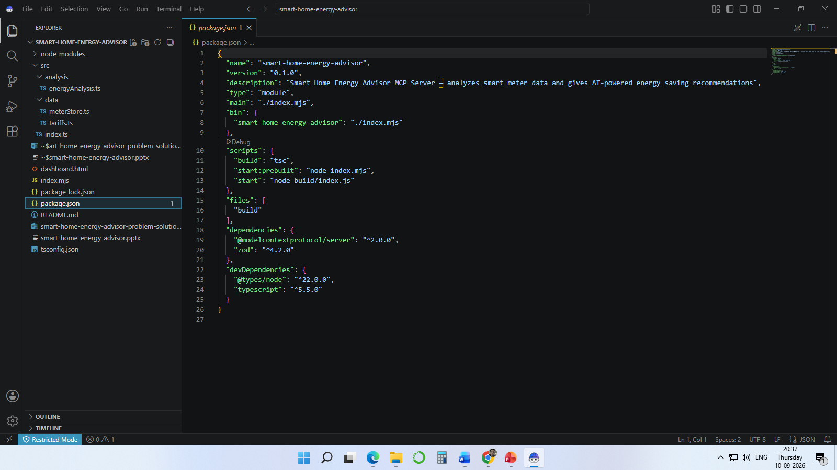
IBM Bob Screenshots(contd)
7

Slide 18
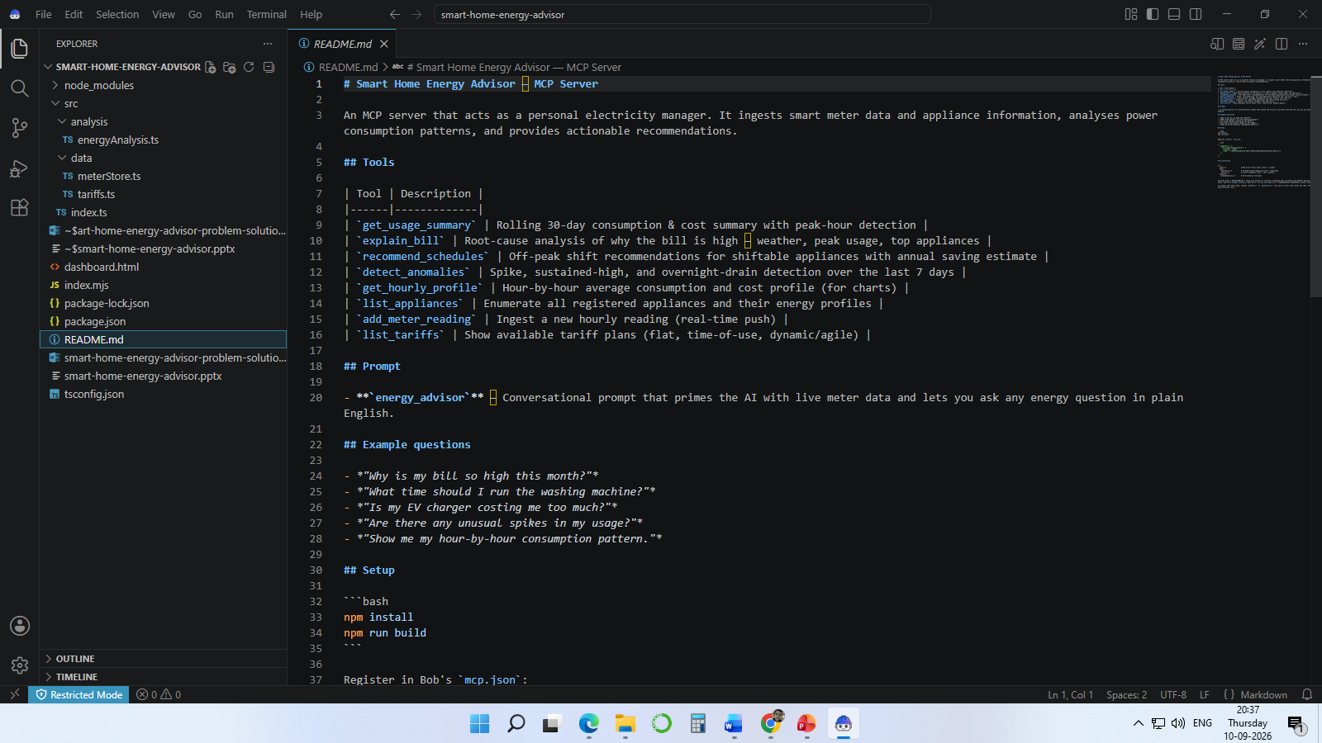
IBM Bob Screenshots(contd)
7

Slide 19
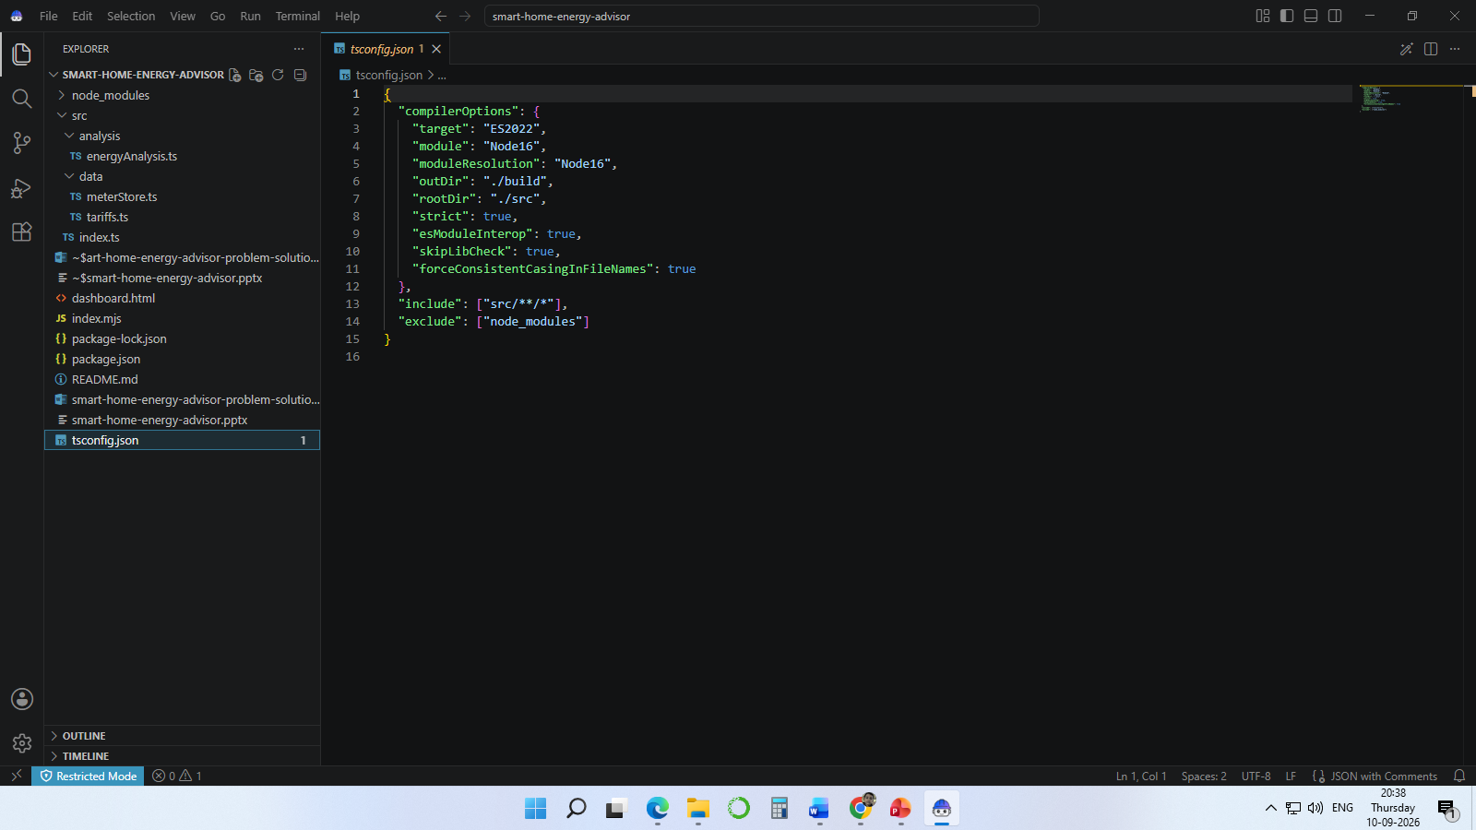
IBM Bob Screenshots(contd)
7

Slide 20
MCP Tools & Agentic AI
The server exposes 8 tools and 1 conversational prompt.
The AI agent interprets the user's intent and selects the appropriate tool.
Complex questions can be handled through multi-step tool chaining.
The energy_advisor prompt pre-loads usage context and active anomalies.
The add_meter_reading tool supports a reactive perceive → analyse → notify loop.
8

Slide 21
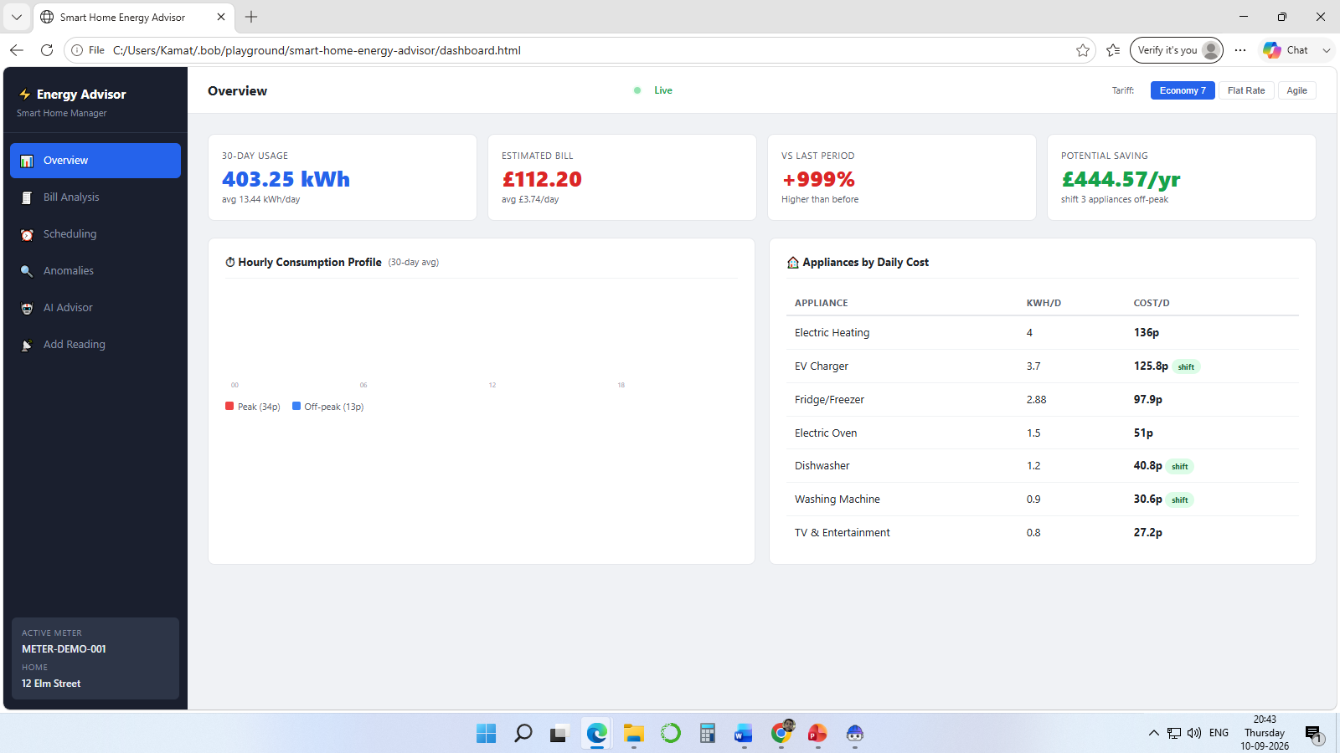
Project Screenshots
7

Slide 22
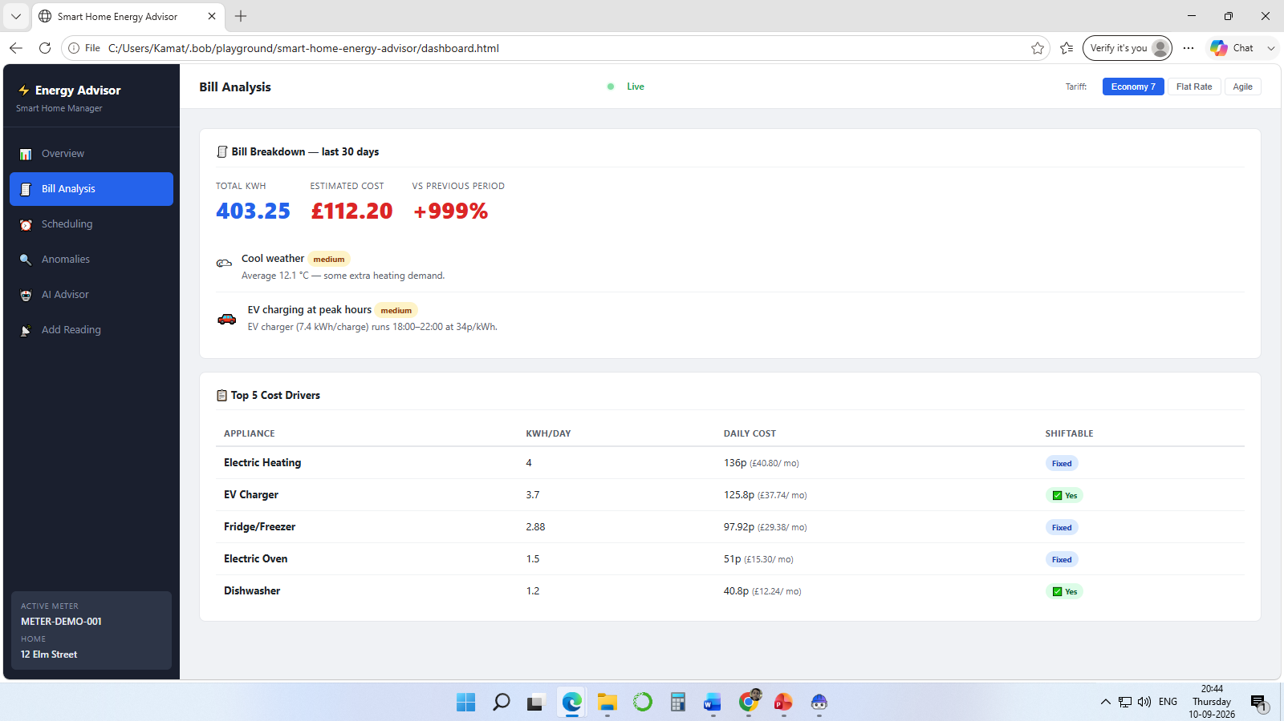
Project Screenshots(contd)
7

Slide 23
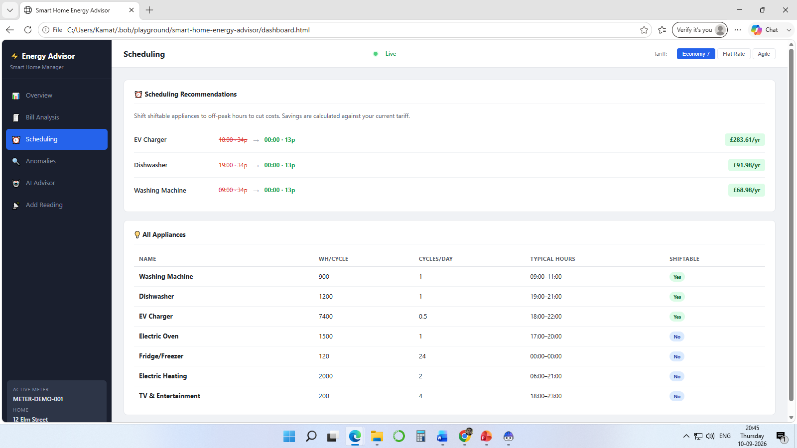
Project Screenshots(contd)
7

Slide 24
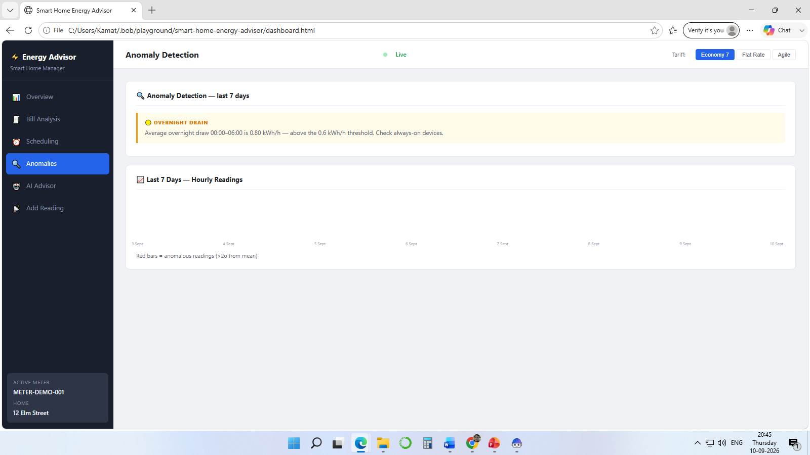
Project Screenshots(contd)
7

Slide 25
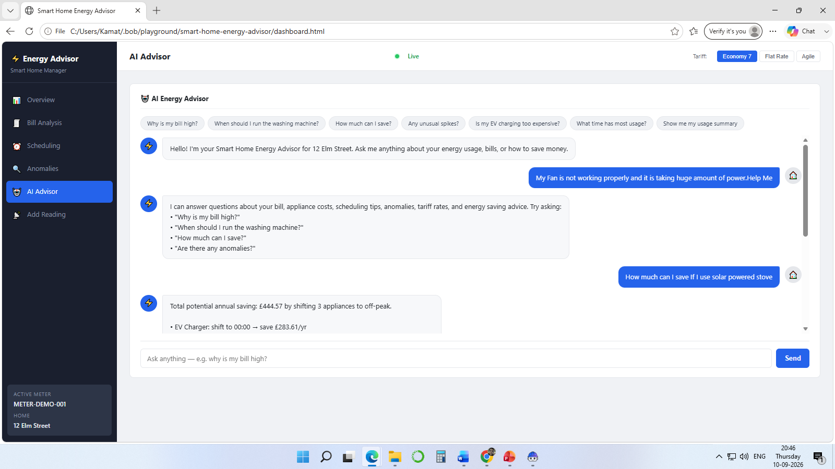
Project Screenshots(contd)
7

Slide 26
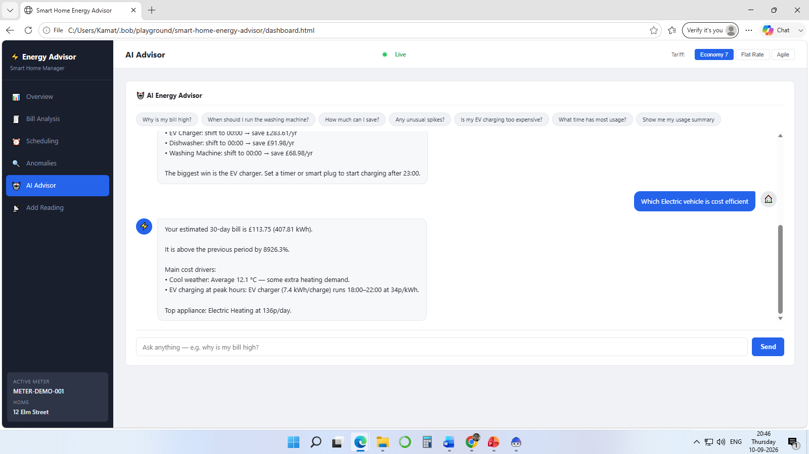
Project Screenshots(contd)
7

Slide 27
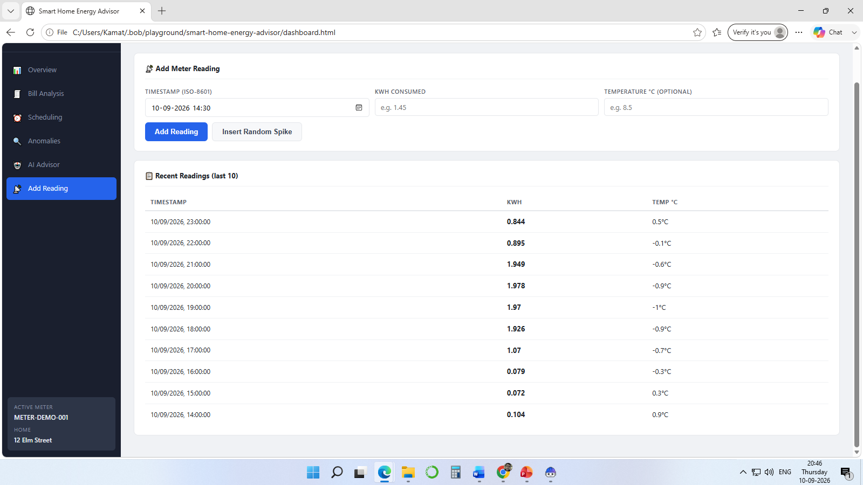
Project Screenshots(contd)
7

Slide 28
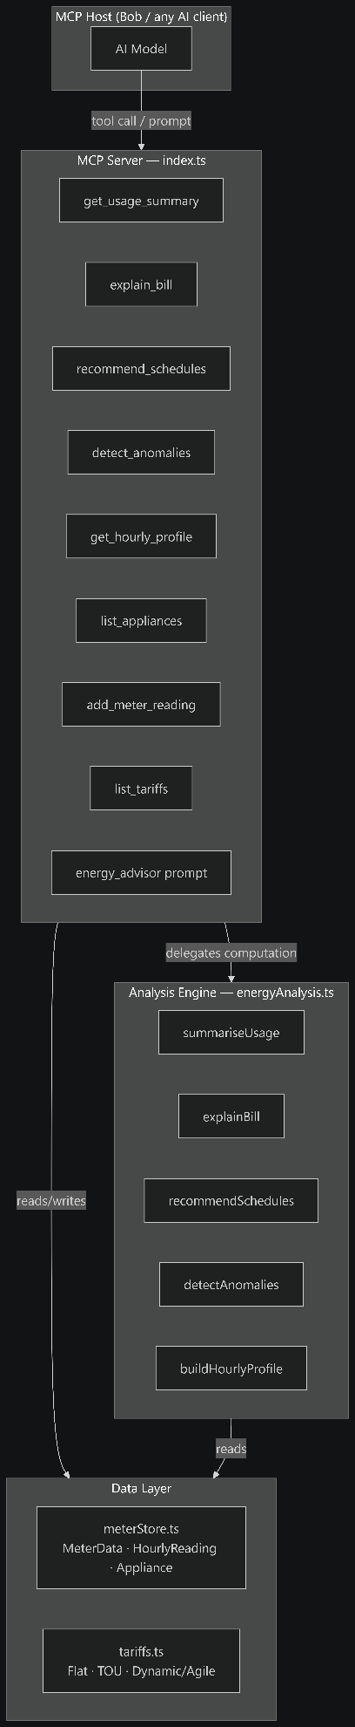
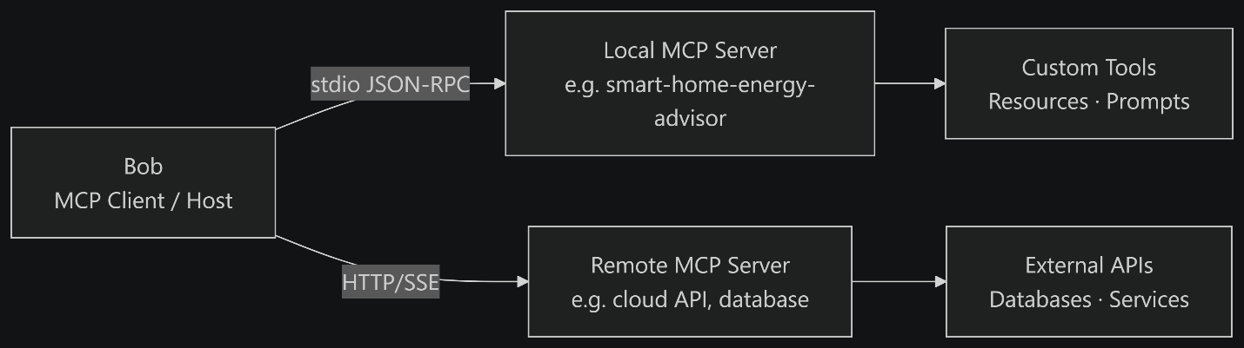
Project Screenshots — AI Assistant
AI Assistant provides conversational, data-grounded energy guidance.
Users can ask questions about bills, scheduling, savings and consumption.
11

Slide 29
Results & Benefits
Converts meter readings into understandable recommendations.
Makes tariff savings visible at the appliance level.
Detects multiple categories of abnormal consumption.
Provides an AI-friendly, self-describing interface through MCP.
Can operate locally without a database, web server or cloud service.
12

Slide 30
Conclusion & Future Scope
The project demonstrates an agentic approach to smart-home energy management.
MCP provides the bridge between household data and AI reasoning.
The current implementation uses synthetic demo readings and an in-memory store.
Future development can extend the solution toward richer real-world integrations and deployment scenarios.
13

Slide 31
GitHub Repository
Project source code and documentation:
https://github.com/amey05081999/Edunet-IBM_Watsonx-Internship
14

Slide 32
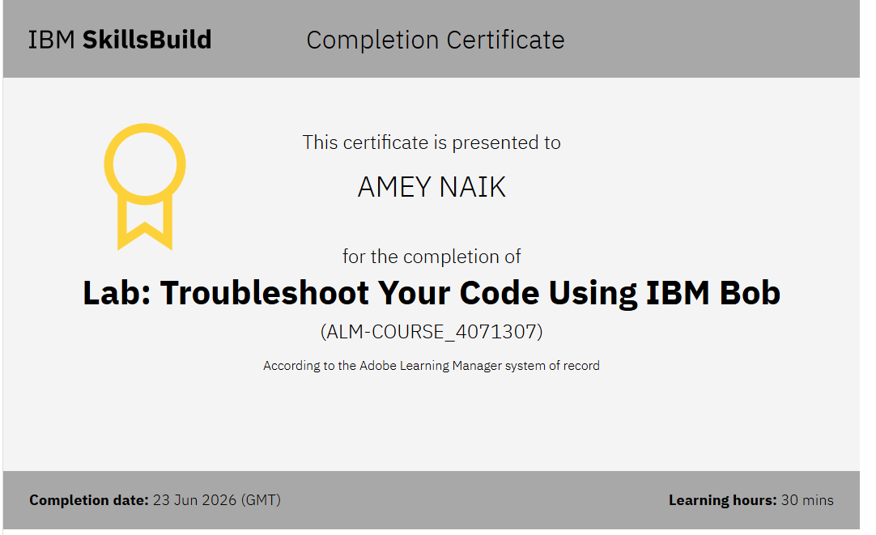

Slide 33
