Slide 1
Convolutional Neural Networks Continued
Pre-trained Neural Networks
Transfer Learning and Fine Tuning

Slide 2
Pre-trained Neural Networks
Pre-trained models can also be used as feature extractors
Convolution Block
Top Layer
Input

Slide 3
Pre-trained Neural Networks
Pre-trained models can also be used as feature extractors
Convolution Block
Top Layer
Prediction
Input

Slide 4
Pre-trained Neural Networks
Pre-trained models can also be used as feature extractors
Convolution Block
Extracts Features
Input

Slide 5
Code Demo

Slide 6
Transfer Learning and Fine Tuning: Using Pre-trained models
Pre-trained models can be fine tuned to do a task very similar to what the model was originally trained for
For example, if a model is able to identify a car then it can be adapted to differentiate between a sports car and a luxury car.
In such a scenario, the pre-trained model is used as a feature-extractor.
When we do, as suggested above, its said to be transfer learning

Slide 7
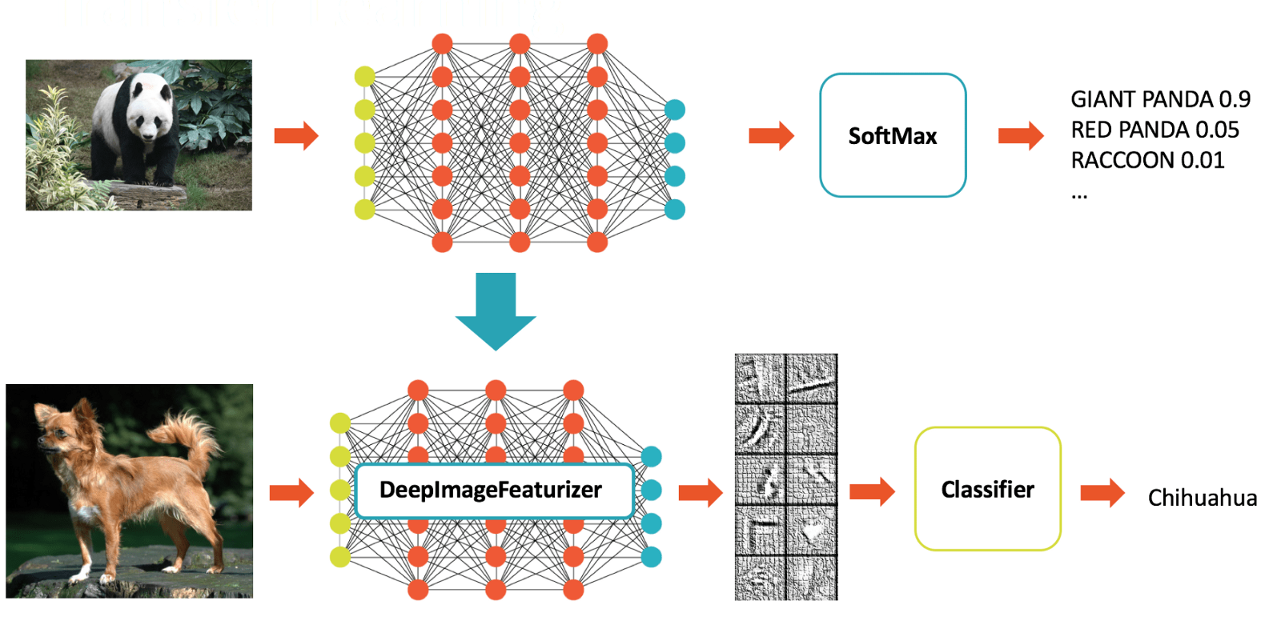
Transfer Learning: How does it work

Slide 8
Transfer Learning: How does it work
Pre-trained model

Slide 9
Transfer Learning: How does it work
Weights Learnt
Pre-trained model

Slide 10
Transfer Learning: How does it work
Weights Learnt

Slide 11
Transfer Learning: How does it work
Weights Learnt
Learn the weights of this layer only

Slide 12
Transfer Learning: How does it work
Original Data
Convolution Block
Softmax Layer

Slide 13
Transfer Learning: How does it work
Original Data
Convolution Block
Softmax Layer
Training

Slide 14
Transfer Learning: How does it work
Original Data
Convolution Block:
Learn Weights
Softmax Layer
Training

Slide 15
Transfer Learning: How does it work
Original Data
Convolution Block:
Learn Weights
Softmax Layer
Training
Convolution Block:
Learnt Weights

Slide 16
Transfer Learning: How does it work
Original Data
Convolution Block:
Learn Weights
Top Layer
Training
New Data
Convolution Block:
Learnt Weights
New Top Layer

Slide 17
Transfer Learning: How does it work
Original Data
Convolution Block:
Learn Weights
Top Layer
Training
New Data
Convolution Block:
Learnt Weights
New Top Layer

Slide 18
Transfer Learning: Image Augmentation
Transfer learning is usually used when the data size is small.
To avoid the model from overfitting, Image Augmentation can be used
This essentially, is a process, in which new image data is generated from the existing images by introducing some distortions

Slide 19

Transfer Learning: Image Augmentation
Transfer learning is usually used when the data size is small.
To avoid the model from overfitting, Image Augmentation can be used
This essentially, is a process, in which new image data is generated from the existing images by introducing some distortions

Slide 20


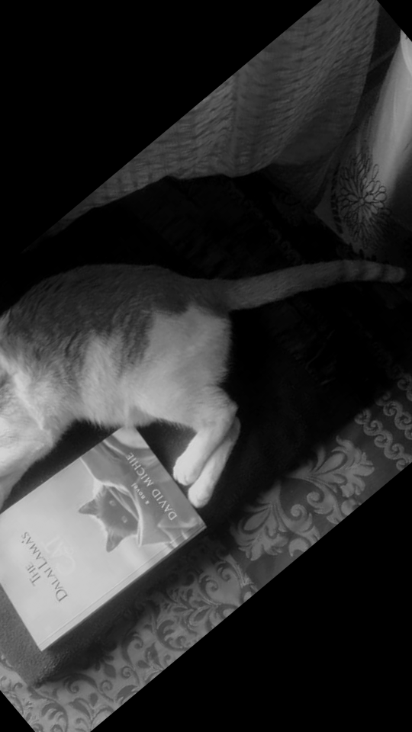
Transfer Learning: Image Augmentation
Transfer learning is usually used when the data size is small.
To avoid the model from overfitting, Image Augmentation can be used
This essentially, is a process, in which new image data is generated from the existing images by introducing some distortions
Flips

Slide 21
Transfer Learning: Image Augmentation
Transfer learning is usually used when the data size is small.
To avoid the model from overfitting, Image Augmentation can be used
This essentially, is a process, in which new image data is generated from the existing images by introducing some distortions
Rotation

Slide 22
Transfer Learning: Image Augmentation
Transfer learning is usually used when the data size is small.
To avoid the model from overfitting, Image Augmentation can be used
This essentially, is a process, in which new image data is generated from the existing images by introducing some distortions
Random Crop

