Slide 1
Agenda
Segmentation Task
Conv Transpose: Meaning and Implementation
Popular Architectures

Slide 2
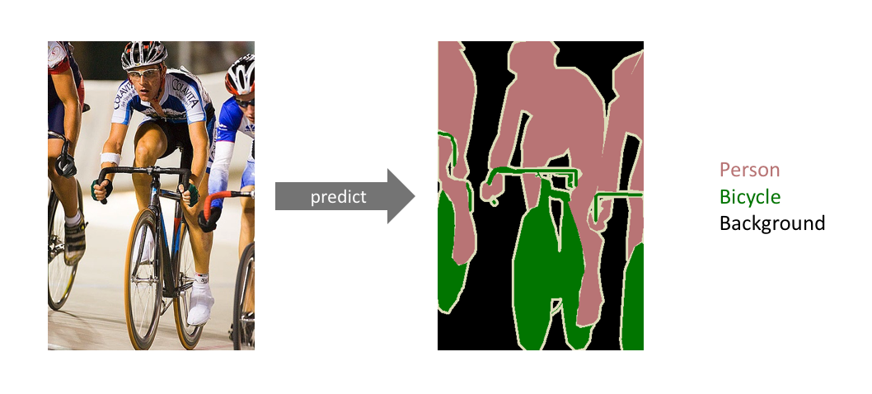
Segmentation Task

Slide 3
Segmentation Task
Classification task at pixel level

Slide 4
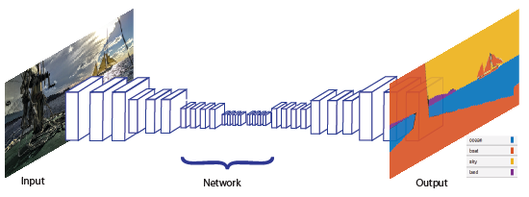
Segmentation Task

Slide 5
Segmentation Task

Slide 6
Segmentation Task
Encoder

Slide 7
Segmentation Task
Decoder

Slide 8
Segmentation Task
Up-sampling
Decoder

Slide 9
Segmentation Task
Output Image
Input Image

Slide 10
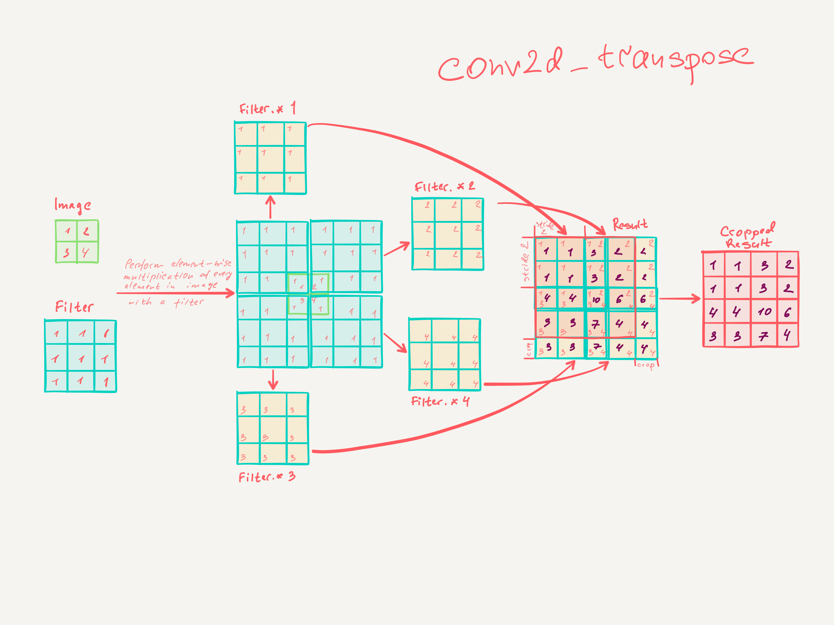
Segmentation Task
3*3, with stride 2
Crop is not a default behaviour

Slide 11
Segmentation Task
Most commonly used architectures for segmentation task comprise of an encoder (Vgg16 or Resnet) and a decoder with transpose convolution blocks.
One of the very commonly used family of architectures is known as FCN (Fully Connected Networks)
FCN32
FCN16
FCN8
No skip connections
Skip connections from intermediate layers
Skip connections from intermediate layers

Slide 12
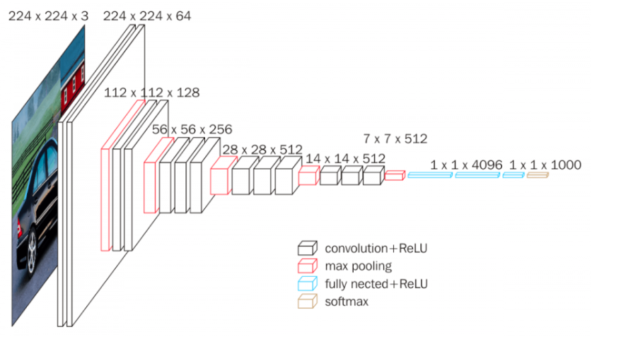
Semantic Segmentation: VGG16 Backbone

Slide 13
Semantic Segmentation: VGG16 Backbone
Converted to Conv Layer (FC6) (512,4096,7)

Slide 14
Semantic Segmentation: VGG16 Backbone
Converted to Conv Layer (FC6) (512,4096,7) [I,O,K]
Converted to Conv Layer (FC7) (4096,4096,1) [I,O,K]
Pooling=(100,100)

Slide 15
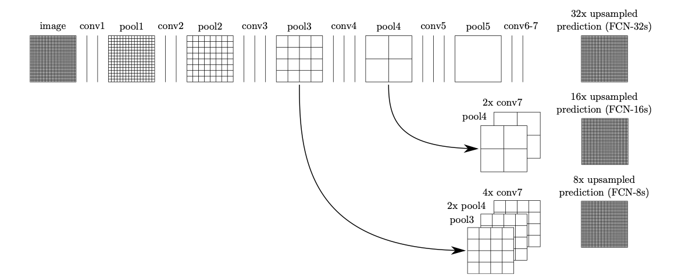
Semantic Segmentation: (FCN8,FCN16,FCN32)

Slide 16
Semantic Segmentation: (FCN8,FCN16,FCN32)
FCN32
VGG16 Features
Conv from FC of vgg16
Deconv
32x
Crop
X
224*224
7*7
256*256
224*224

Slide 17
Semantic Segmentation: (FCN8,FCN16,FCN32)
FCN16
Vgg16 (Pool4)
Vgg16 (Pool5)
Conv from FC of vgg16
Deconv
2x
Deconv
16x
Crop
X
224*224
7*7
16*16
272*272
224*224
Crop
Add
26*26
16*16
16*16

Slide 18
Semantic Segmentation: (FCN8,FCN16,FCN32)
52*52
26*26
13*13
7*7
Dconv
2x
X
Pool3
Pool4
Pool5
Conv FC layers
224*224
16*16
Crop
Dconv
4x
Add
16*16
34*34
Add
Dconv
8x
Crop
Crop
34*34
224*224
280*280

Slide 19
Semantic Segmentation

Slide 20
Semantic Segmentation
How do we measure the performance of a semantic segmentation model?
We can compute IOU (Intersection Over Union)
Dice Coefficient

Slide 21
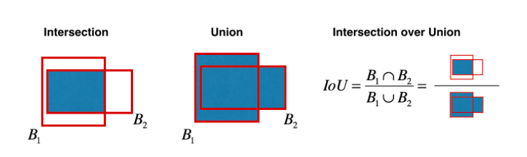
Semantic Segmentation
IOU = (Area of Overlap)/(Area of Union)
If there are many classes then, we compute IOU for each class and find the average.

Slide 22
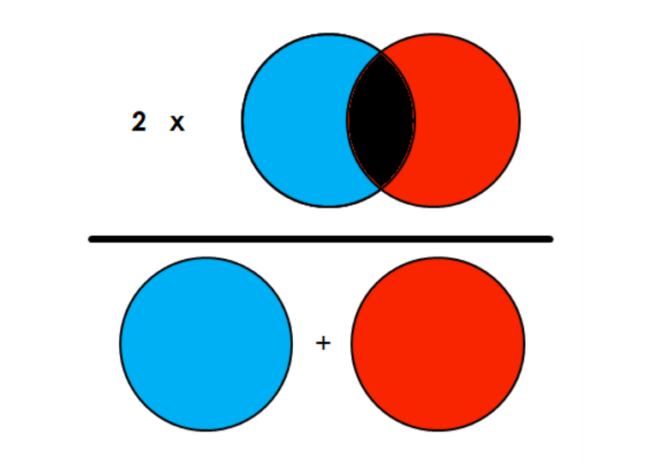
Semantic Segmentation:
Dice Co-efficient: (2*Area of Intersection)/(Total Number of Pixels)

