Slide 1

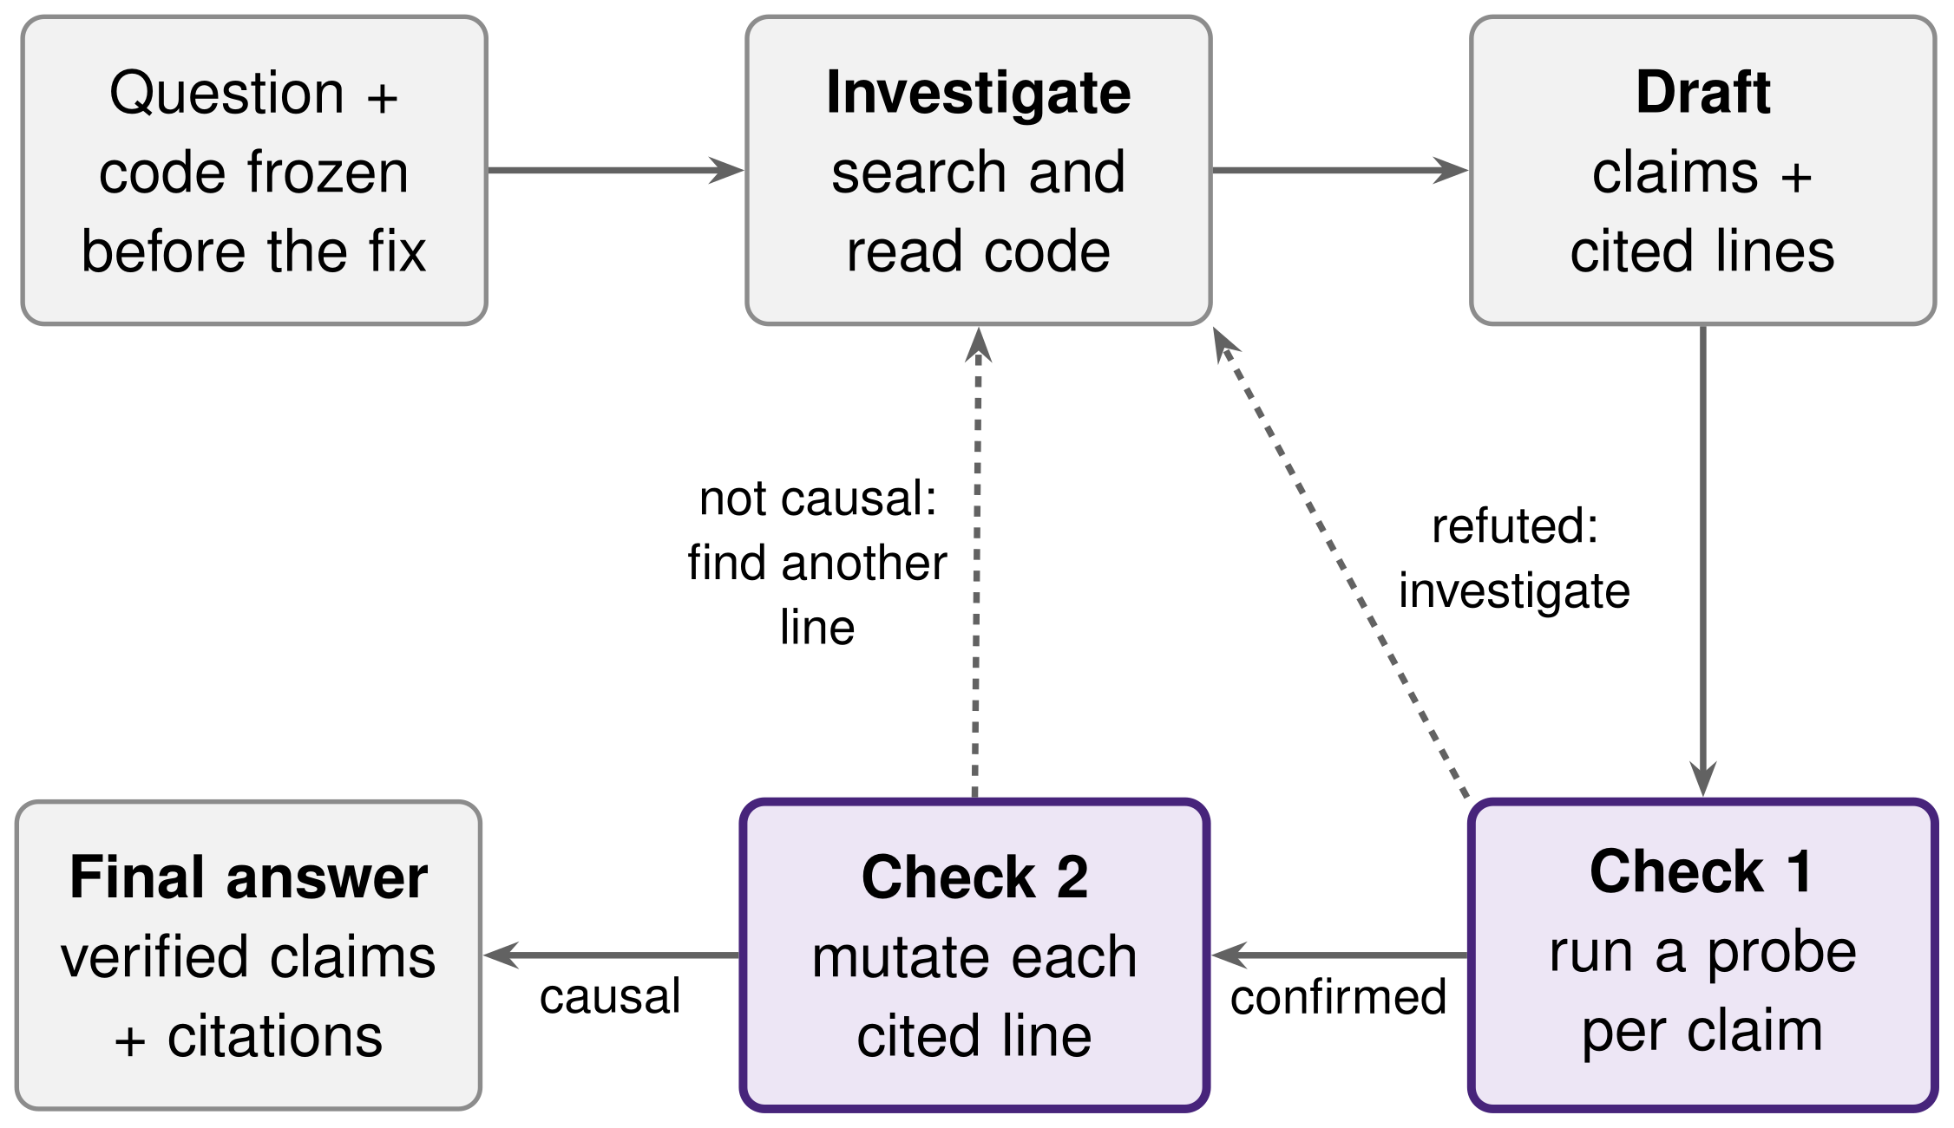

Run It, Then Cite It: Execution- and Mutation-Verified Answers to Developer Questions
ABSTRACT
RESULTS
Disco 82
Developers often ask how a library behaves when its documentation may be wrong. LLM assistants tend to repeat the documentation and cite code that does not decide the behaviour. We built an agent that checks its own answer twice: it runs a test for each claim, and it keeps a cited line only if changing that line changes the test result. We evaluated it on 145 GitHub issues from click and marshmallow, with answer keys taken from the developers' own fixes and hypotheses fixed in advance. It did not beat a ReAct agent with the same tools, and the line-changing check proved unreliable on real code.
145 test questions, LLM judge. Our agent did not beat ReAct (B2) with the same tools: 40.0% of its answers were correct and causally cited, against 49.7% for B2. Both are far ahead of the baselines without tools. Removing one check (A1 to A3) changed little; flagging instead of re-investigating (A3) gave the fewest confident errors.
LMA course project, IIIT Hyderabad
CONCLUSION AND FUTURE WORK
Main result: execution and mutation checks did not beat a ReAct agent with the same tools.
Why: mutation is not a reliable test of causality in real code.
What helped: flagging failed checks instead of re-investigating cut confident errors by a third.
Safety: no unsafe code was executed.
Next: a graded causal test, and a Chain-of-Verification baseline.
METHODOLOGY
Dataset. 170 questions from GitHub issues, built like SWE-bench: the merged fix and its test form the answer key, with no LLM involved. Code is frozen before the fix. A human check left 145 test questions.
Check 1, run it. Each claim is tested by a generated probe in an offline Docker sandbox.
Check 2, flip the switch. Each cited line is mutated. It counts as causal only if the claim's result changes while control tests stay the same.
Baselines. B0 no retrieval, B1 single-call RAG, B2 ReAct with the same tools and budget.
HYPOTHESES
MUTATION CHECK
H1, ours beats B2 by 8+ points: not supported. Ours 25.0%, B2 41.7%.
H2, 40% fewer confident errors: not supported. Ours 29.7%, B2 31.7%.
H3, mutation raises citation precision by 15+ points: not supported. With it 30.6%, without 44.1%.
Human labels decide, because the LLM judge agreed only weakly with humans (κ 0.36).
The agent used the strictest rule. It accepted only 24% of the lines developers actually fixed, and its agreement with human judgements was at chance level (κ −0.10). Each rejected line sent the agent looking for another, often weaker, citation.
ACKNOWLEDGMENT
LMA instructors and TAs; Google Gemini and Groq for free API access.
REFERENCES
[1] Yao et al. ReAct. ICLR 2023.
[2] Jimenez et al. SWE-bench. ICLR 2024.
[3] Dhuliawala et al. Chain-of-Verification. ACL Findings 2024.
[4] Moon et al. Ask the Mutants (MUSE). ICST 2014.
[5] Kiecker et al. CASCADE. FSE 2026.
[6] Gao et al. ALCE: citations in LLM text. EMNLP 2023.
Code, data, report
github.com/
ameya-purohit/LMA-Final-Project
README gives every step
Author names: Ameya Purohit, Sunil Kumar, Aditya Narayan Dwivedi, Sourav Nath (Team Disco 82)
Course: CL3.410, Monsoon 2026

