Slide 1
IoT in detail
Speaker : Swanand Jugade (Mech 4th year, GCOEN)
swanandjugade@gmail.com
www.linkedin.com/in/swanand-jugade-25a970175

Slide 2
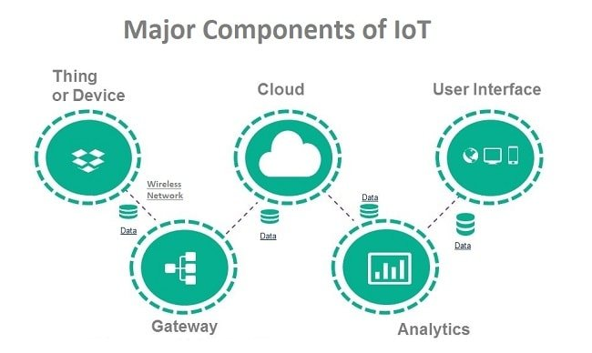
Core Components of IoT
Things
Nodes
Gateways
Protocols
Databases
User interface

Slide 3
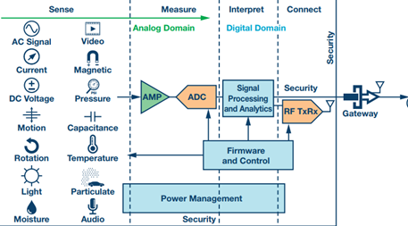
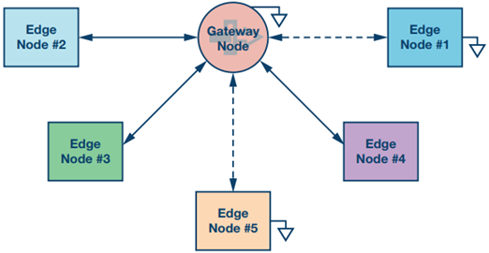
Things and Nodes
IoT Device : Can transmit data to another device or to people, includes wireless sensors, software, actuators and computer devices.
Edge Node : Interconnected devices, providing the intelligence to sense, measure, interpret, and connect to an internet gateway.

Slide 4
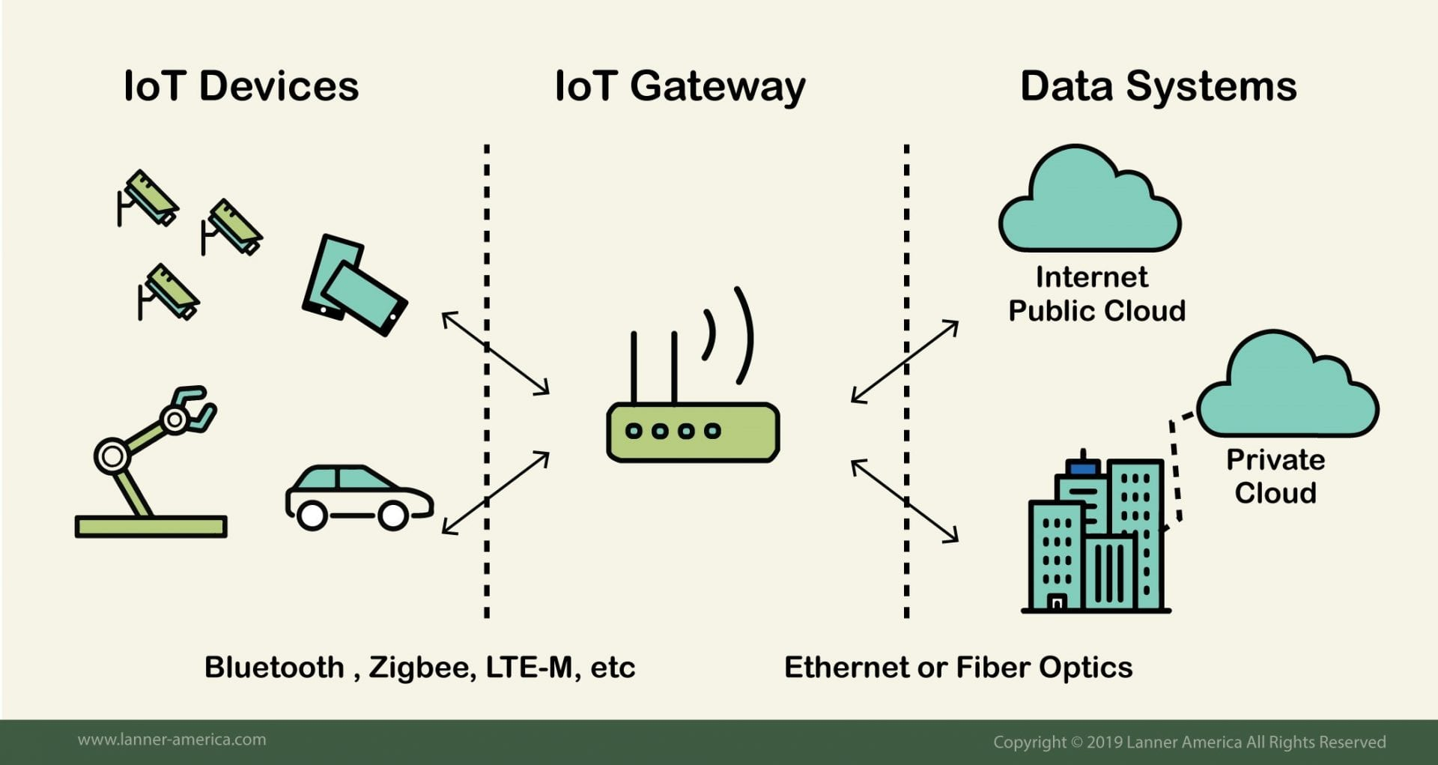
IoT Gateway
The IoT Gateway follows this simple process:
Pre-processes, cleans, and filters raw data.
Translates protocols for encryption and communication.
Sends data to a destination on the Internet or Intranet.
Gateway creates a bridge between the IoT sensors/actuators and the Internet.
It aggregates all data, translates sensor’s protocols, and pre-process the data before sending it.
IoT devices connect to the IoT gateway using short-range or long-range wireless transmission modes.
Then it links them to the Internet through LAN or WAN.

Slide 5
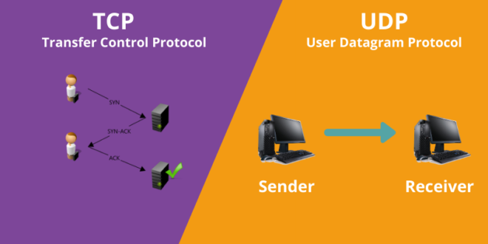
Protocols
TCP is best suited to be used for applications that require high reliability where timing is less of a concern.
World Wide Web
Secure Shell
File Transfer Protocol
Email
UDP is best suited for applications that require speed and efficiency.
VPN tunneling
Streaming videos
Online games
Live broadcasts
Transmission Control Protocol (TCP) is a connection orientated protocol with error correction and guarantees that packets are received in order.
You can consider a TCP/IP connection to be similar to a telephone connection.
Once a telephone connection is established you can talk over it until one party hangs up.
User Datagram Protocol (UDP) is a connectionless protocol but assumes that error-checking and recovery services are not required.
Instead, UDP continuously sends datagrams to the recipient whether they receive them or not.

Slide 6
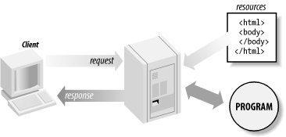
Network communication models
Request and response model
A client computer or software requests data or services
A server computer or software responds to the request by providing the data or service.

Slide 7
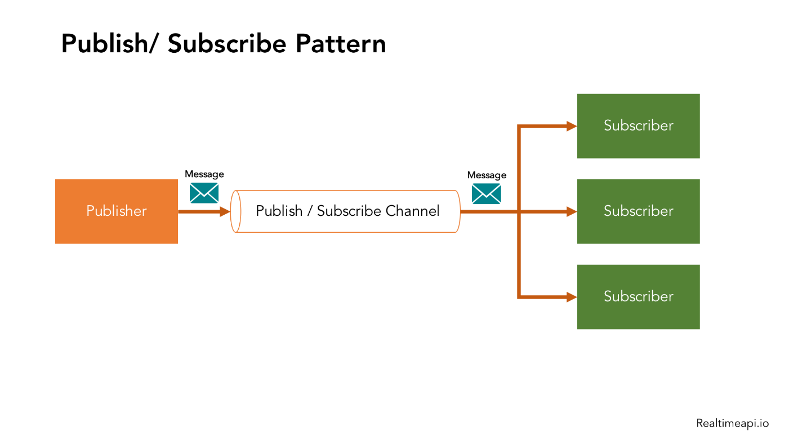
Network communication models
Publish and subscribe
A central source called a broker (server) receives and distributes all data.
Pub-sub clients can publish data to the broker or subscribe to get data from it or both.

Slide 8
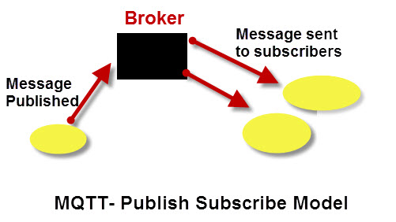
MQTT
MQTT is a messaging protocol designed for transferring messages, using a publish and subscribe model.
In MQTT a publisher publishes messages on a topic and a subscriber must subscribe to that topic to view the message.
MQTT uses TCP/IP to connect to the broker.

Slide 9
MQTT
The topic is like a Communication channel on which Publisher publishes data and Subscriber subscribes data.
Machine or computer on which broker is installed called as host.
The broker can receive the maximum payload size of 268,435,455 bytes.
MQTT has 3 Quality of services(QOS) level :
Qos 0 -At most Once
Qos 1- At least once
Qos 2- Exactly once

Slide 10
MQTT
# (hash character) – multi level wildcard
+ (plus character) -single level wildcard
Valid Topic subscriptions
Single topic subscriptions
/
/house
house/room/main-light
house/room/side-light
Using Topic Wildcards
Subscribing to topic house/#
house/room1/main-light
house/room1/alarm
house/garage/main-light
house/main-door
Subscribing to topic house/+/main-light
covers
house/room1/main-light
house/room2/main-light
house/garage/main-light
but doesn’t cover
house/room1/side-light
house/room2/side-light
Invalid Topic Subscriptions
house+ – Reason- no topic level
house# – Reason- no topic level

Slide 11
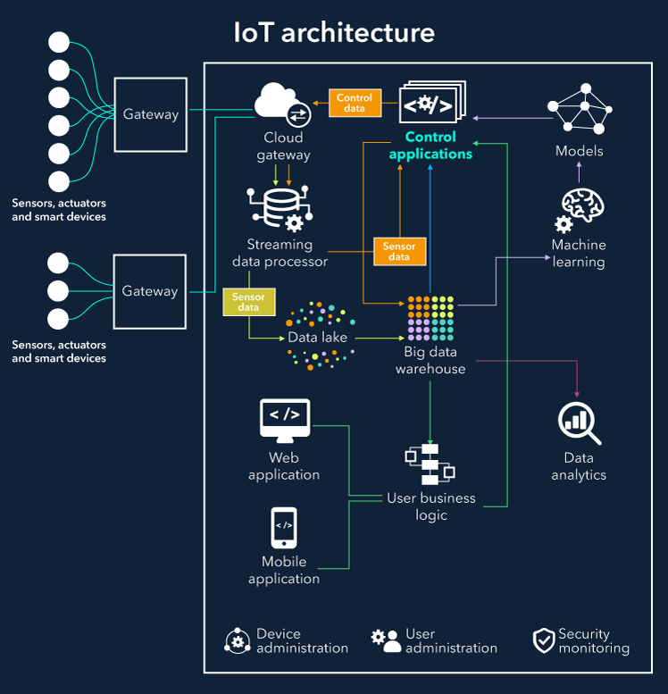
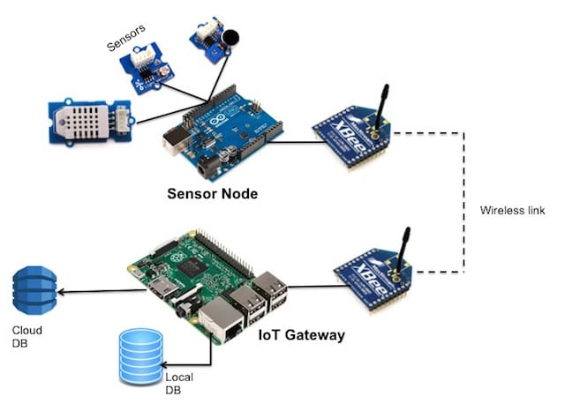
IoT Architecture

Slide 12
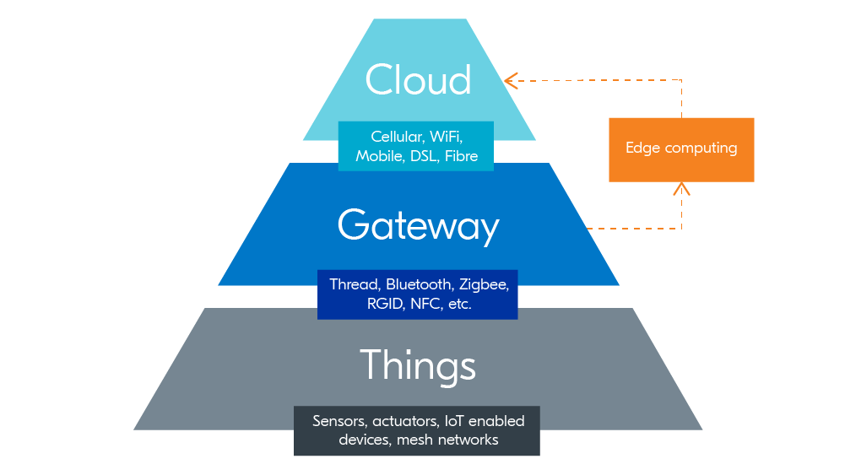
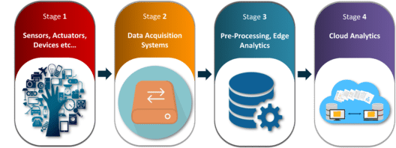

Slide 13
