Slide 1
DataMB Visualization Critique
An Analysis of Interactive Data Visualization for Football Analytics

Slide 2
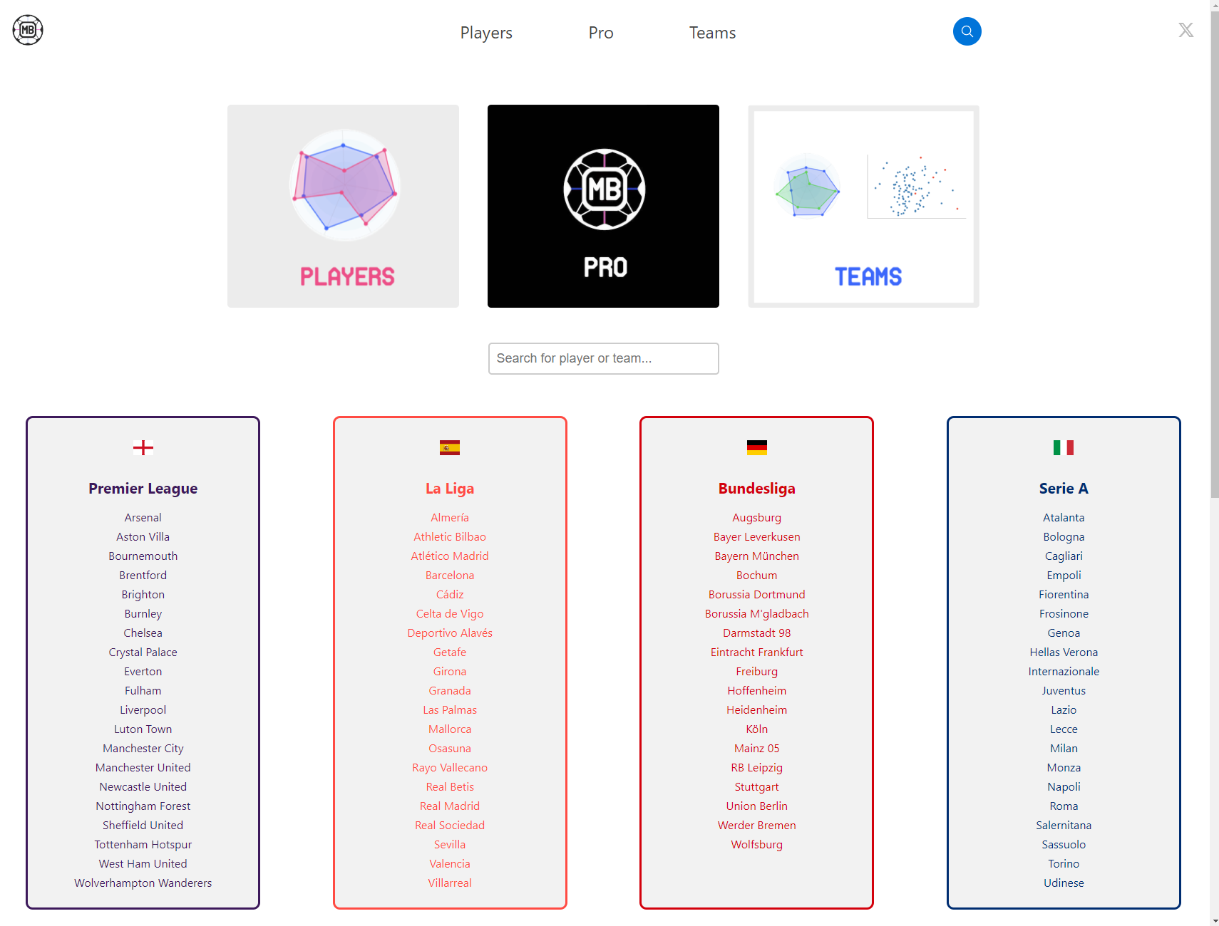
Purpose & Target Audience
Purpose: DataMB serves as an analytics platform to visualize football players' stats, aiming to assist coaches, analysts, and fans in making informed decisions.
Users: Designed for football enthusiasts and professionals who require detailed and comparative analysis of players and teams across various leagues.

Slide 3
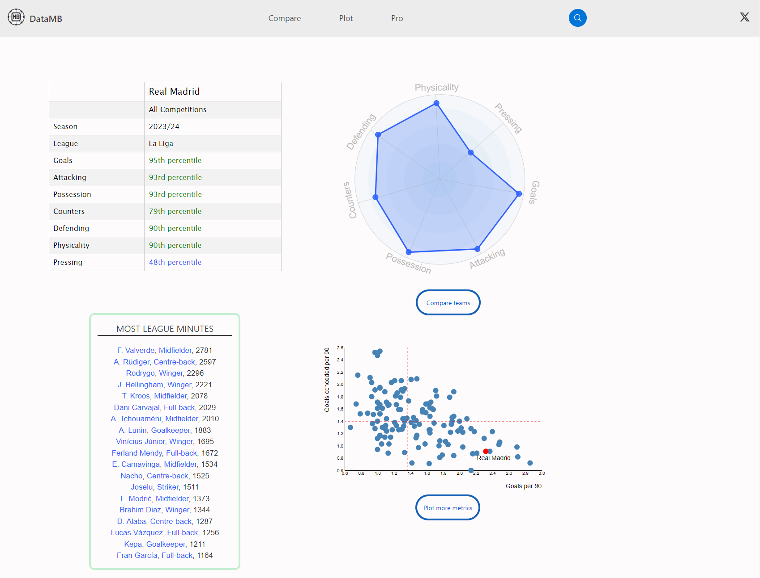
Interactive Features & Data Analysis
Search Functionality: Users can search for any player or team, making the platform highly accessible and user-friendly.
Interactive Visualizations:
Percentile Tables for quick comparison across different metrics.
Spider Charts for visual comparison of team strengths and weaknesses.
Customizable Scatter Plots for in-depth analysis of performance metrics like goals per 90 minutes.

Slide 4
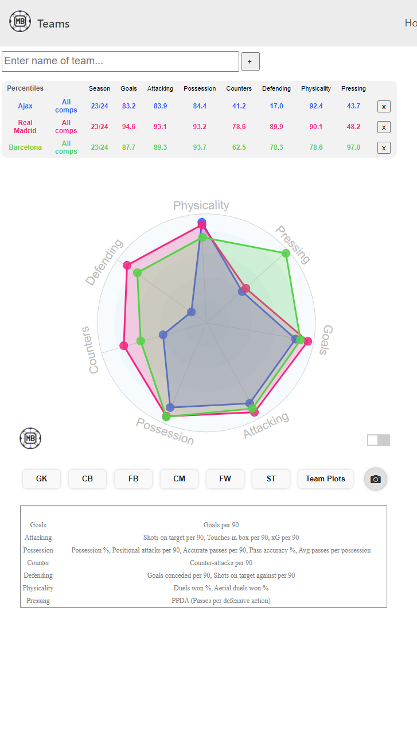
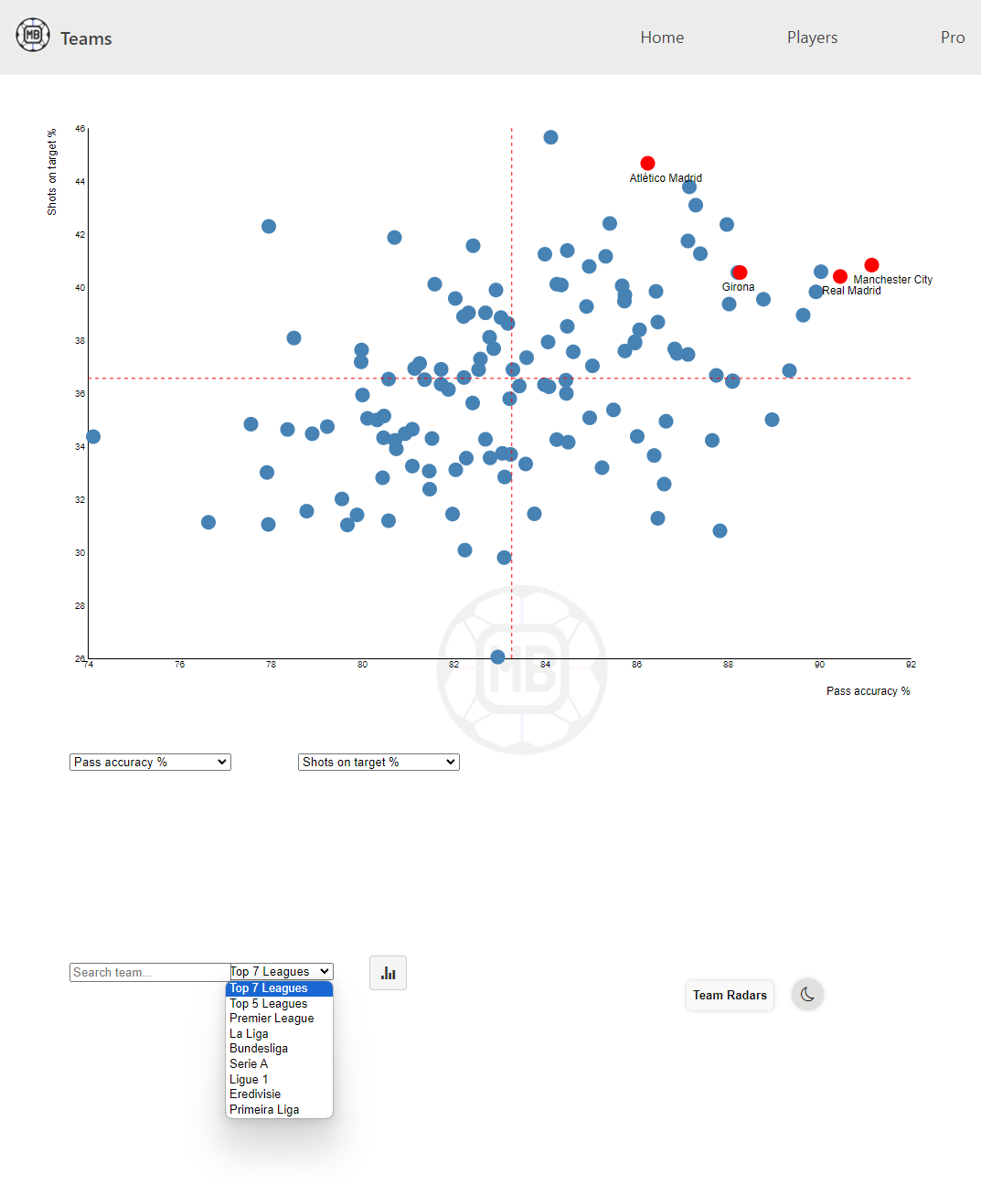
Design Effectiveness & Limitations
Effective Design:
The use of color and layout effectively highlights key data and trends.
Interactive elements like charts and customizable plots engage users meaningfully.
Limitations:
The platform can be overwhelming due to the depth of data presented; simplification could aid newer users.
Lack of predictive analytics features.
Improvements:
Incorporating guided analytics and predictive features could enhance user engagement and provide forward-looking insights.

Slide 5
Conclusion & Future Directions
Summary:
DataMB offers robust football analytics through interactive visualizations.
Empowers users to make informed decisions and understand football dynamics.
Recommendations:
Introduce guided analytics and tooltips for improved user experience.
Add predictive analytics features for forward-looking insights.
Expand data coverage to include historical and contextual information.
Future Directions:
Explore partnerships for richer datasets and analytical capabilities.
Develop a mobile app for enhanced accessibility.

