Slide 1
How Good is a Security Policy against Real Breaches?
A HIPAA Case Study

Slide 2

What is a Security Policy?
A security policy describes the requirements, regulations, and standards that an organization should meet to protect its assets, and enables technical and social protocols to be implemented accordingly.

Slide 3
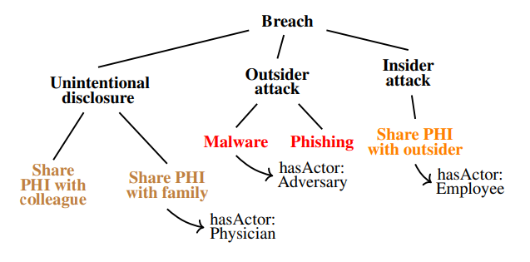
What is a Data Breach?
A data breach is an intentional or unintentional release of secure or private/confidential information to an untrusted environment. Intentional releases correspond to outsider attacks, whereas unintentional releases correspond to insider attacks or human errors, some of which are unavoidable given the needed functionality.
Example - Healthcare Breach Ontology:

Slide 4
Research Questions
RQ1: How can we formalize security policies and breaches to bring out their mutual correspondence?
RQ2: What are the commonalities and differences between concepts in security policies and breach descriptions?
RQ3: How do commonalities and differences between individual concepts correspond to gaps between security policies and breaches?
RQ4: How prevalent are accidental misuses among reported breaches, and do security policies account for them?

Slide 5
Research Goal
Our main research goal is to help analysts measure the gaps between security policies and reported breaches by developing a systematic process based on semantic reasoning.
Accordingly, the researchers propose SEMAVER, a semantic reasoning framework for measuring the gaps between a security policy and reported breaches.

Slide 6
Note
Throughout the research paper, examples from the healthcare domain are used to explain elements of SEMAVER.

Slide 7
What are norms?
Norms describe the expectations of users from each other regarding their social interactions, and formalize who is accountable to whom and for what.
A norm is a tuple n, SBJ, OBJ, ant, con, where n, its type, is one of {c, a, p}.Here, SBJ and OBJ are roles adopted by people or organizations; ant and con are propositional conditions.

Slide 8
Technical Background
Norm:
We write a norm as n(SBJ, OBJ, ant, con). Where, SBJ is its subject; OBJ is its object; ant is its antecedent; and con is its consequent.
Security Policy:
A security policy S is a set of norms, S = {n1, ..., nk}.
Breach:
A breach bi is a violation of a norm ni, i.e., bi = violated(ni).

Slide 9

Equation 1
Equation 1 describes the distance between two ontology concepts c1 and c2 via edge count(c1, c2), which is the number of edges connecting concepts c1 and c2.
Assumption 1: This equation computes distance for tree-like taxonomies, and does not work when multiple inheritance is allowed
Assumption 2: Edges have uniform weights.
Therefore, we count each edge as one.

Slide 10

Equation 2
Equation 2 describes our similarity metric between two ontology concepts c1 and c2 (simc1,c2 ). We denote taxonomy based distance between concepts c1 and c2 via Δc1,c2 , and property similarity between concepts c1 and c2 via sim prop c1,c2 .
The maximum possible similarity value, of one, is only achieved when two concepts are identical.`

Slide 11
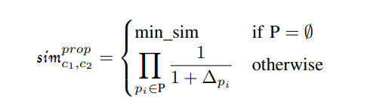
Equation 3
Equation 3 describes property similarity between concepts c1 and c2 based on the set of common properties (P) of c1 and c2, and distances between the values of those properties.
When two concepts have no common properties, we assign a minimum value (min_sim) to the similarity between them.
Assumption 3:
min_sim = 0.001

Slide 12
Similarity Between Norms
The similarity between norms n1(SBJ1, OBJ1, ant1, con1) and n2(SBJ2, OBJ2, ant2, con2) is the average similarity of its elements:
Assumption 4: sim φ,true = min_sim.
The antecedent of a norm can be true. According to Assumption 4, we assign the minimum similarity value to any predicate that is compared with true.
Assumption 5: sim c,a = sim c,p = sim a,p = min_sim
Norms of different types are not similar. According to Assumption 5, we assign the minimum similarity value to comparisons between different norm types.
sim n1,n2 = (sim SBJ1,SBJ2 +sim OBJ1,OBJ2 + sim ant1,ant2 + sim con1,con2)/4

Slide 13
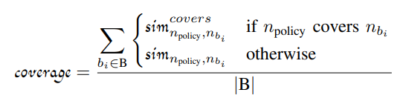
Coverage
Norm n1 covers norm n2 if n1 is satisfied whenever n2 is satisfied. The ⊢ symbol represents logical consequence. For example, Commitment c(SBJ, OBJ, ant1, con1) covers commitment c(SBJ, OBJ, ant2, con2) if and only if ant2 ⊢ ant1 and con1 ⊢ con2.
Here, B represents the set of all breaches, and |B| represents the cardinality of B.
Also, here

Slide 14
Results
We investigated how policy clauses differ from breaches with respect to individual elements of a norm.
The similarity of individual norm elements enables us to identify where commonalities and differences reside between policy clauses and breach descriptions.
Using policy coverage, we measured the gaps between HIPAA and HHS breaches.
Moreover, the fact that consequent similarity is the lowest implies that there are gaps in HIPAA policy for stating what needs to be done or avoided to prevent breaches.
We differentiated between two types of breaches: accidental misuses and malicious misuses.
Moreover, we computed coverage for each breach category to understand which parts of HIPAA contain more gaps and need revision.
Semantic reasoning can help fill the gaps between policies and breaches.
In essence, our coverage metric measures whether the incident described by a breach description has been considered by policy designers.

Slide 15
Limitations
Modeling of security policies and breaches is subjective and inherently error prone.
We cannot assess the completeness of the breaches reported in the HHS dataset.
The coverage of breach concepts by our ontology is based only on the incidents from the healthcare domain.

Slide 16
What did I liked in this research paper?
SEMAVER is the first attempt to investigate real breaches for evaluating policies. The concept that I liked the most is that most parts of SEMAVER can be automated. Firstly, norm similarity can be used to identify the most relevant policy clause to a given breach, which would reduce the manual effort and prevent potential human errors. Secondly, natural language processing (NLP) can be adopted to automatically extract norms from policies and breaches. Thirdly, we can develop heuristic guidelines for the development of the breach ontology, where concepts and properties are automatically extracted from breach descriptions.
Threat models, such as misuse case diagrams or attack/defense (A/D) trees, describe potential ways a software system can be attacked and how those attacks can be mitigated. While threat models identify potential breaches, they do not directly translate to policy designs. It would interesting to see how SEMAVER can help bridge this gap, in particular via norm-based patterns

