Slide 1


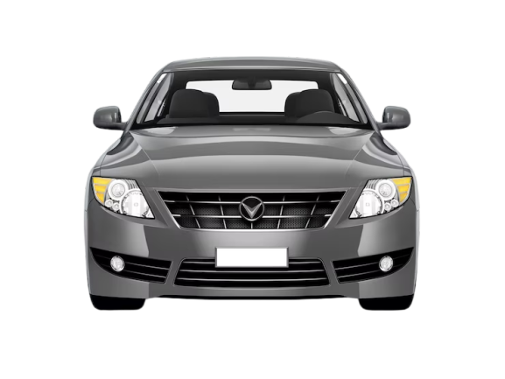

RESUME PROJECT
Challenge #12
ALTIQ MOTORS
Electric Vehicle Insights
ameyamodak26@gmail.com
linkedin.com/in/ameya-modak/
Presented By
Ameya Prakash Modak

Slide 2
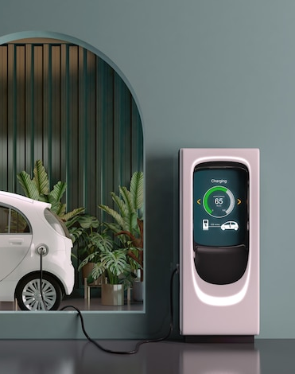
Agenda
01
Problem Statement
02
Goal
03
Dashboard Showcase
04
Insights
05
Recommendations

Slide 3
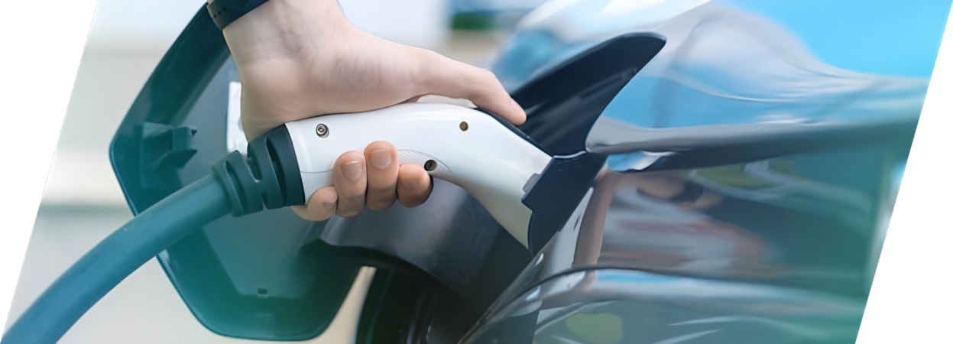
AtliQ Motors, an automotive leader in the USA specializing in electric vehicles (EVs), aims to expand its market presence in India, where its current market share in the EV and hybrid segment is less than 2%. To address this, I, as a Data Analyst, need to analyze the existing EV/Hybrid vehicle market in India and provide insights that will inform strategic decisions on the potential launch of AtliQ Motors' bestselling models in the country. The goal is to deliver actionable recommendations that help AtliQ Motors successfully penetrate the Indian market and increase its market share in this segment.
Problem Statement

Slide 4
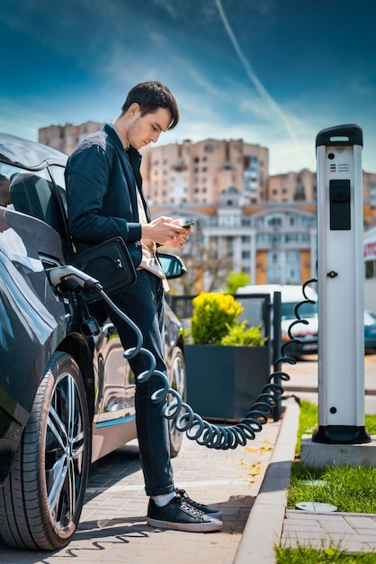
Goal
My Goal is to conduct a comprehensive analysis of the EV/Hybrid vehicle market in India using the provided datasets to create impactful metrics and visuals, and develop a user-friendly dashboard for AtliQ Motors. The objective is to deliver data-driven recommendations.

Slide 5
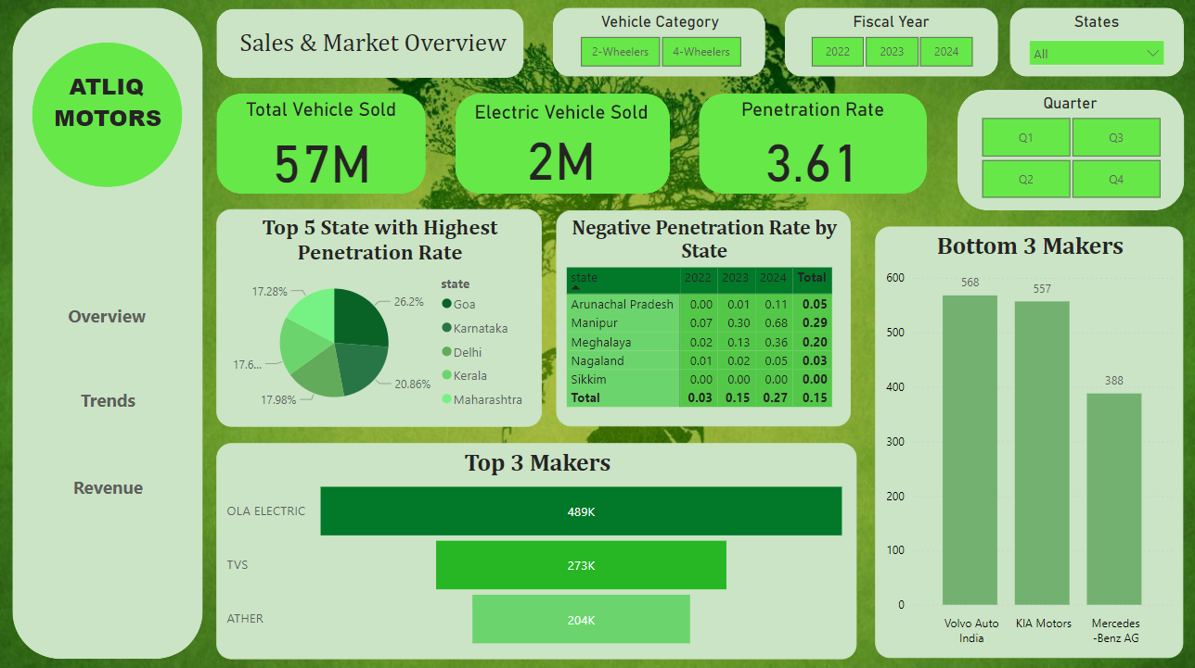
DashBoard (Desktop Layout)

Slide 6
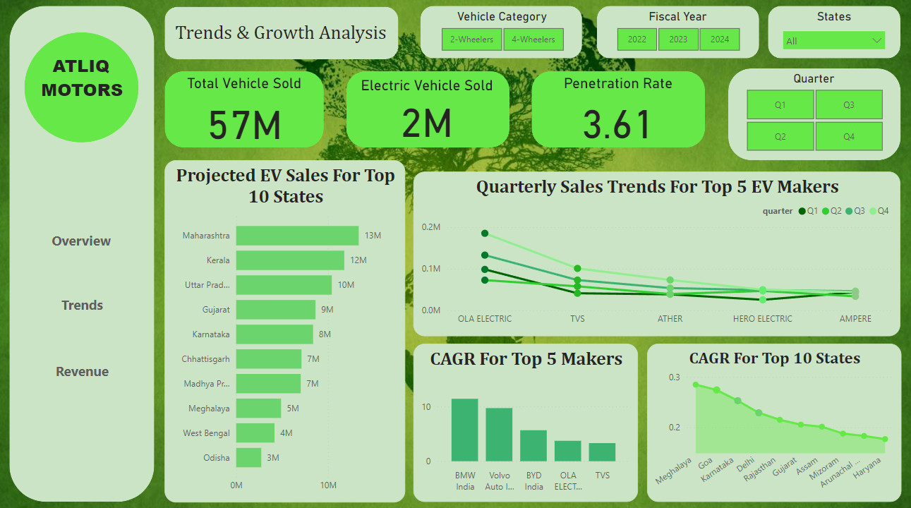
DashBoard (Desktop Layout)

Slide 7
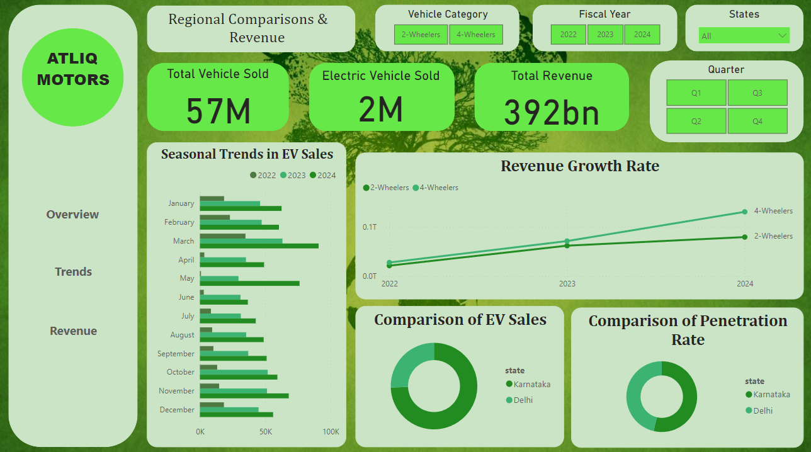
DashBoard (Desktop Layout)

Slide 8
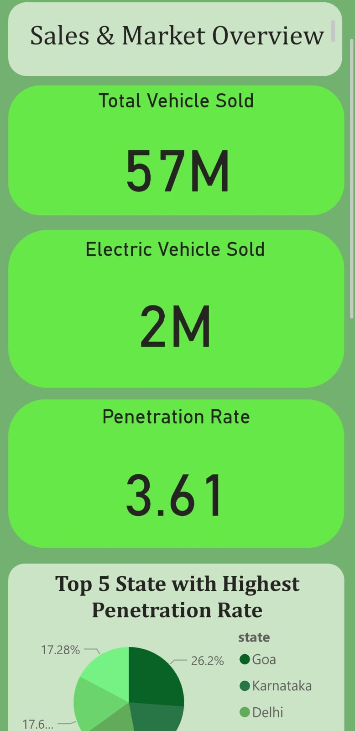
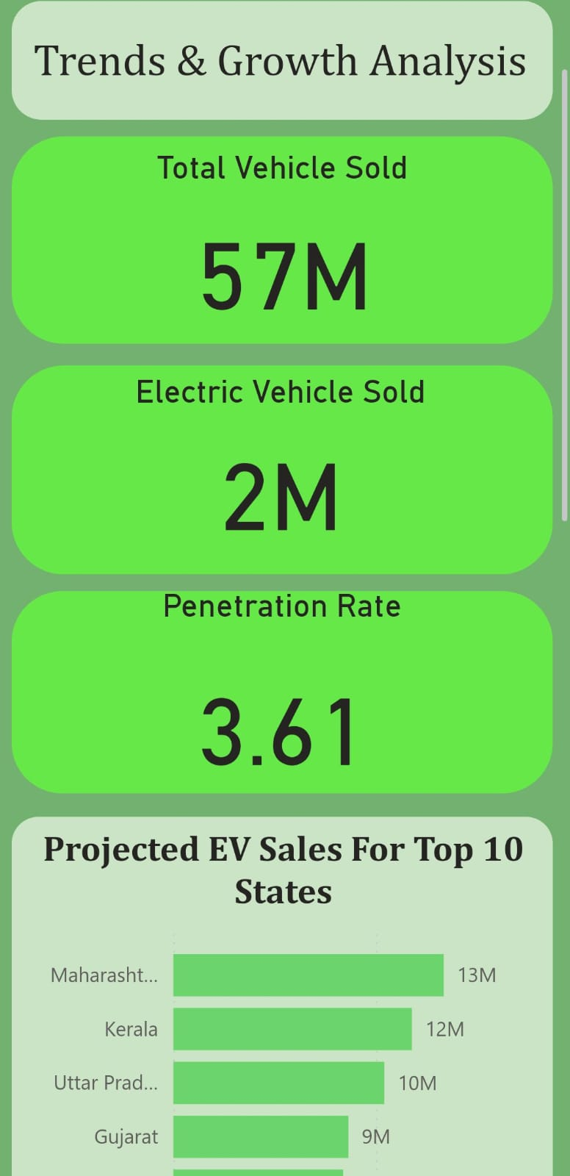
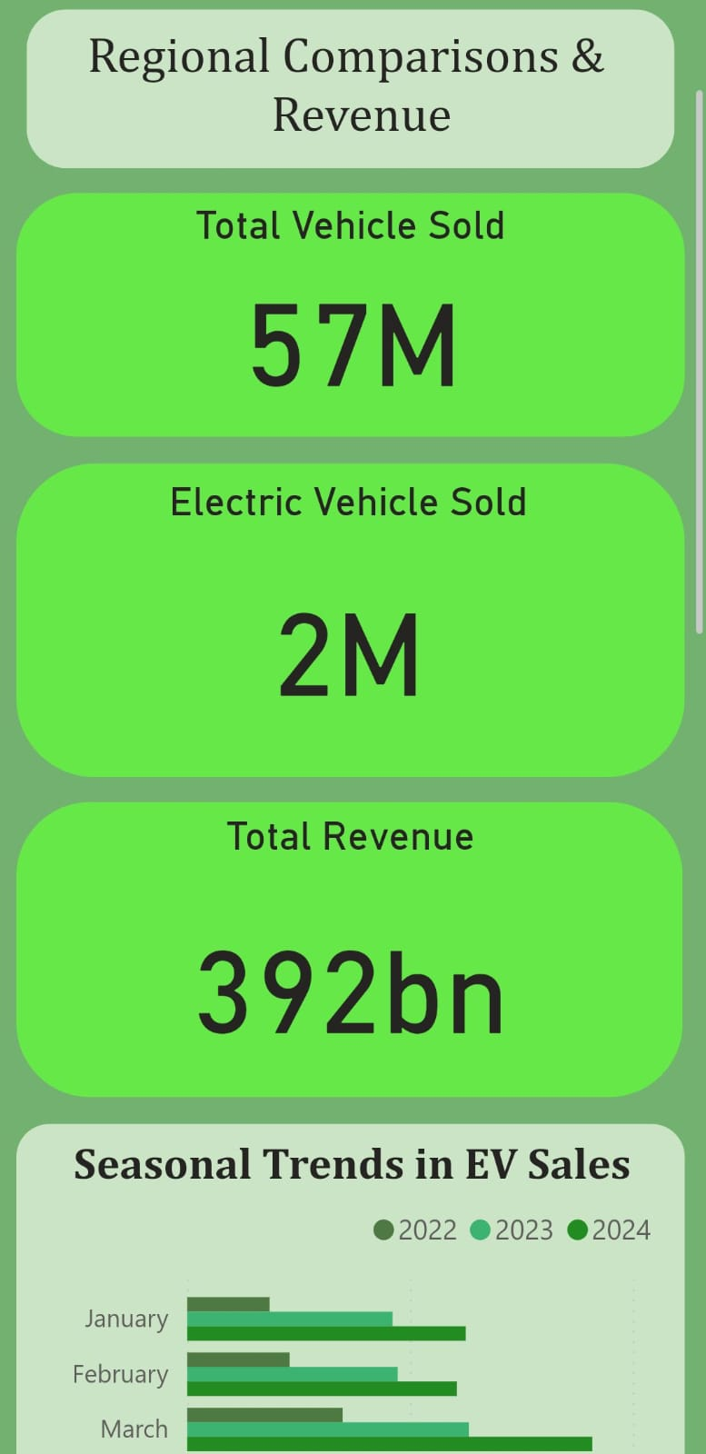
DashBoard (Mobile Layout)

Slide 9
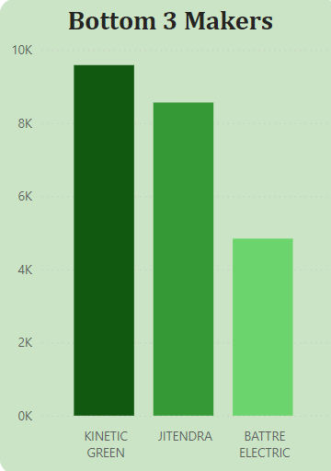
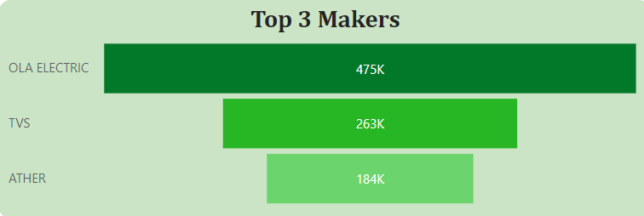
Primary Insights
1. List the top 3 and bottom 3 makers for the fiscal years 2023 and 2024 in terms of the number of 2-wheelers sold.

Slide 10
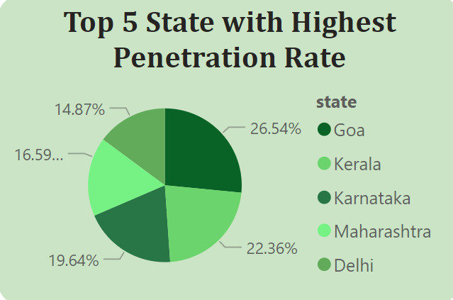
Primary Insights
2. Identify the top 5 states with the highest penetration rate in 2-wheeler and
4-wheeler EV sales in FY 2024.

Slide 11
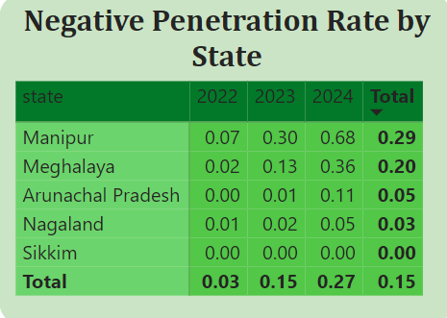
Primary Insights
3. List the states with negative penetration (decline) in EV sales from 2022 to 2024?

Slide 12
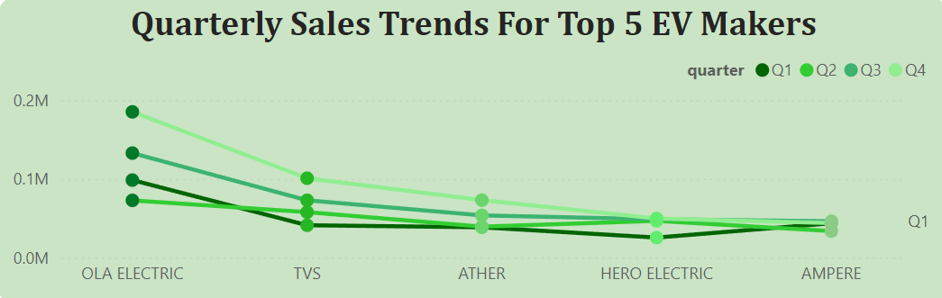
Primary Insights
4. What are the quarterly trends based on sales volume for the top 5 EV makers (4-wheelers) from 2022 to 2024?

Slide 13
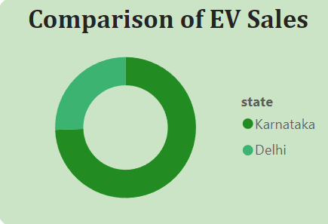
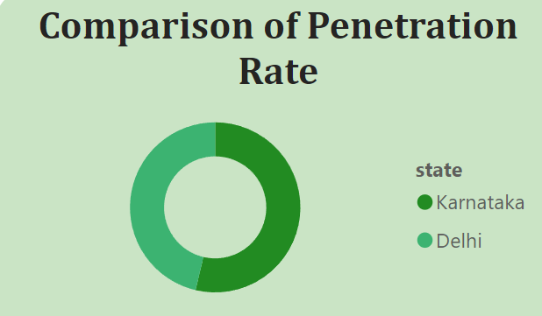
Primary Insights
5. How do the EV sales and penetration rates in Delhi compare to Karnataka for 2024?

Slide 14
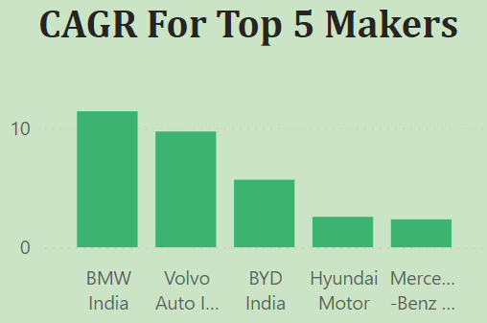
Primary Insights
6. List down the compounded annual growth rate (CAGR) in 4-wheeler units for the top 5 makers from 2022 to 2024.

Slide 15
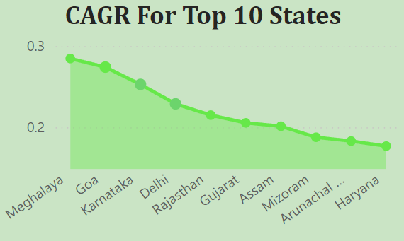
Primary Insights
7. List down the top 10 states that had the highest compounded annual growth rate (CAGR) from 2022 to 2024 in total vehicles sold.

Slide 16
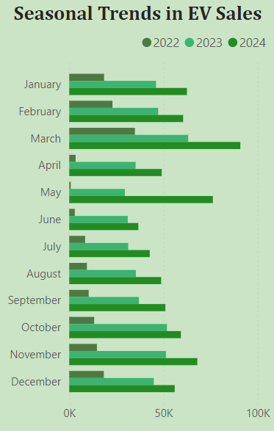
Primary Insights
8. What are the peak and low season months for EV sales based on the data from 2022 to 2024?

Slide 17
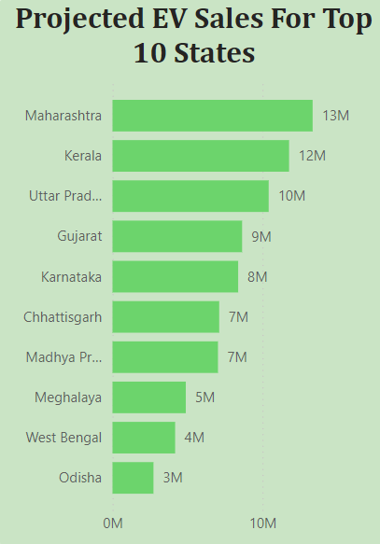
Primary Insights
9. What is the projected number of EV sales (including 2-wheelers and
4-wheelers) for the top 10 states in 2030?

Slide 18
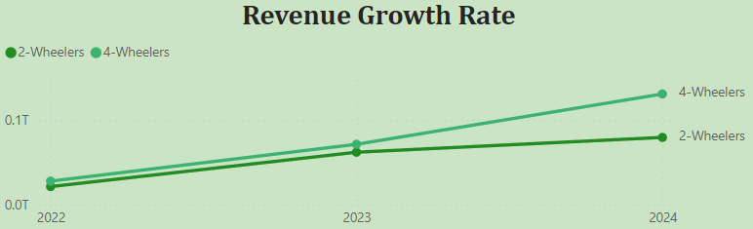
Primary Insights
10. Estimate the revenue growth rate of 4-wheeler and 2-wheelers EVs in India. Assuming an average unit price for 2-Wheelers is Rs. 85,000 and for 4-Wheelers is Rs. 15,00,000.

Slide 19
Secondary Insights
1. What are the primary reasons for customers choosing 4-wheeler EVs in 2023 and 2024 (cost savings, environmental concerns, government incentives)?
Cost Savings: Lower operating and maintenance costs make EVs more economical in the long run.
Environmental Concerns: EVs produce fewer emissions, appealing to eco-conscious consumers.
Government Incentives: Financial subsidies, tax benefits, and improved charging infrastructure encourage EV adoption.

Slide 20
Secondary Insights
2. How do government incentives and subsidies impact the adoption rates of
2-wheelers and 4-wheelers? Which states in India provided most subsidies?
Government incentives and subsidies make EVs more affordable by reducing purchase costs, offering tax exemptions, and lowering registration fees. This decreases the overall cost of owning an EV, making them more accessible and encouraging more consumers to adopt electric vehicles.
Key subsidizing states in India, such as Maharashtra, Gujarat, Delhi, Tamil Nadu, and Karnataka, provide substantial subsidies, tax exemptions, and infrastructure incentives, significantly boosting the adoption of 2-wheelers and 4-wheelers EVs.

Slide 21
Secondary Insights
3. How does the availability of charging stations infrastructure correlate with the EV sales and penetration rates in the top 5 states?
The availability of charging station infrastructure strongly correlates with higher EV sales and penetration rates in the top 5 states. States with a well-developed network of charging stations, such as Maharashtra, Delhi, Karnataka, Gujarat, and Tamil Nadu, see greater consumer confidence in adopting EVs due to reduced range anxiety and increased convenience. This, in turn, drives higher EV adoption and market penetration in these regions.

Slide 22
Secondary Insights
4. Who should be the brand ambassador if AtliQ Motors launches their EV/Hybrid vehicles in India and why?
Aamir Khan would be a strong choice for the brand ambassador due to his credibility and alignment with environmental values.

Slide 23
Secondary Insights
5. Which state of India is ideal to start the manufacturing unit? (Based on subsidies provided, ease of doing business, stability in governance etc.)
Gujarat is an ideal state to start a manufacturing unit in India. It offers significant subsidies for EVs, has a favorable business environment, and boasts a stable governance framework. Additionally, Gujarat’s infrastructure and support for industrial development make it a prime location for setting up a manufacturing facility.

Slide 24
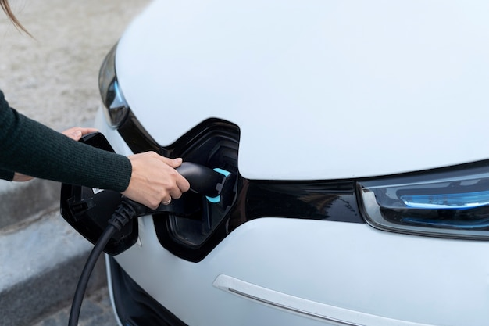
01
Establishing a manufacturing unit in Gujarat allows AtliQ Motors to benefit from the state's subsidies, favorable business environment, and robust infrastructure, ensuring efficient and cost-effective production.
Recommendations
02
Partnering with a prominent Indian celebrity like Aamir Khan or Priyanka Chopra can enhance AtliQ Motors' brand visibility and credibility, aligning with local values and boosting market appeal.
03
Enhancing charging infrastructure by collaborating with local partners will reduce range anxiety and increase EV adoption.

Slide 25
Thank You!

