Slide 1



Food_&_Beverage_Dashboard
View in Power BI
Last data refresh:
6/20/2024 8:32:59 PM UTC
Downloaded at:
7/31/2024 6:36:33 PM UTC

Slide 2
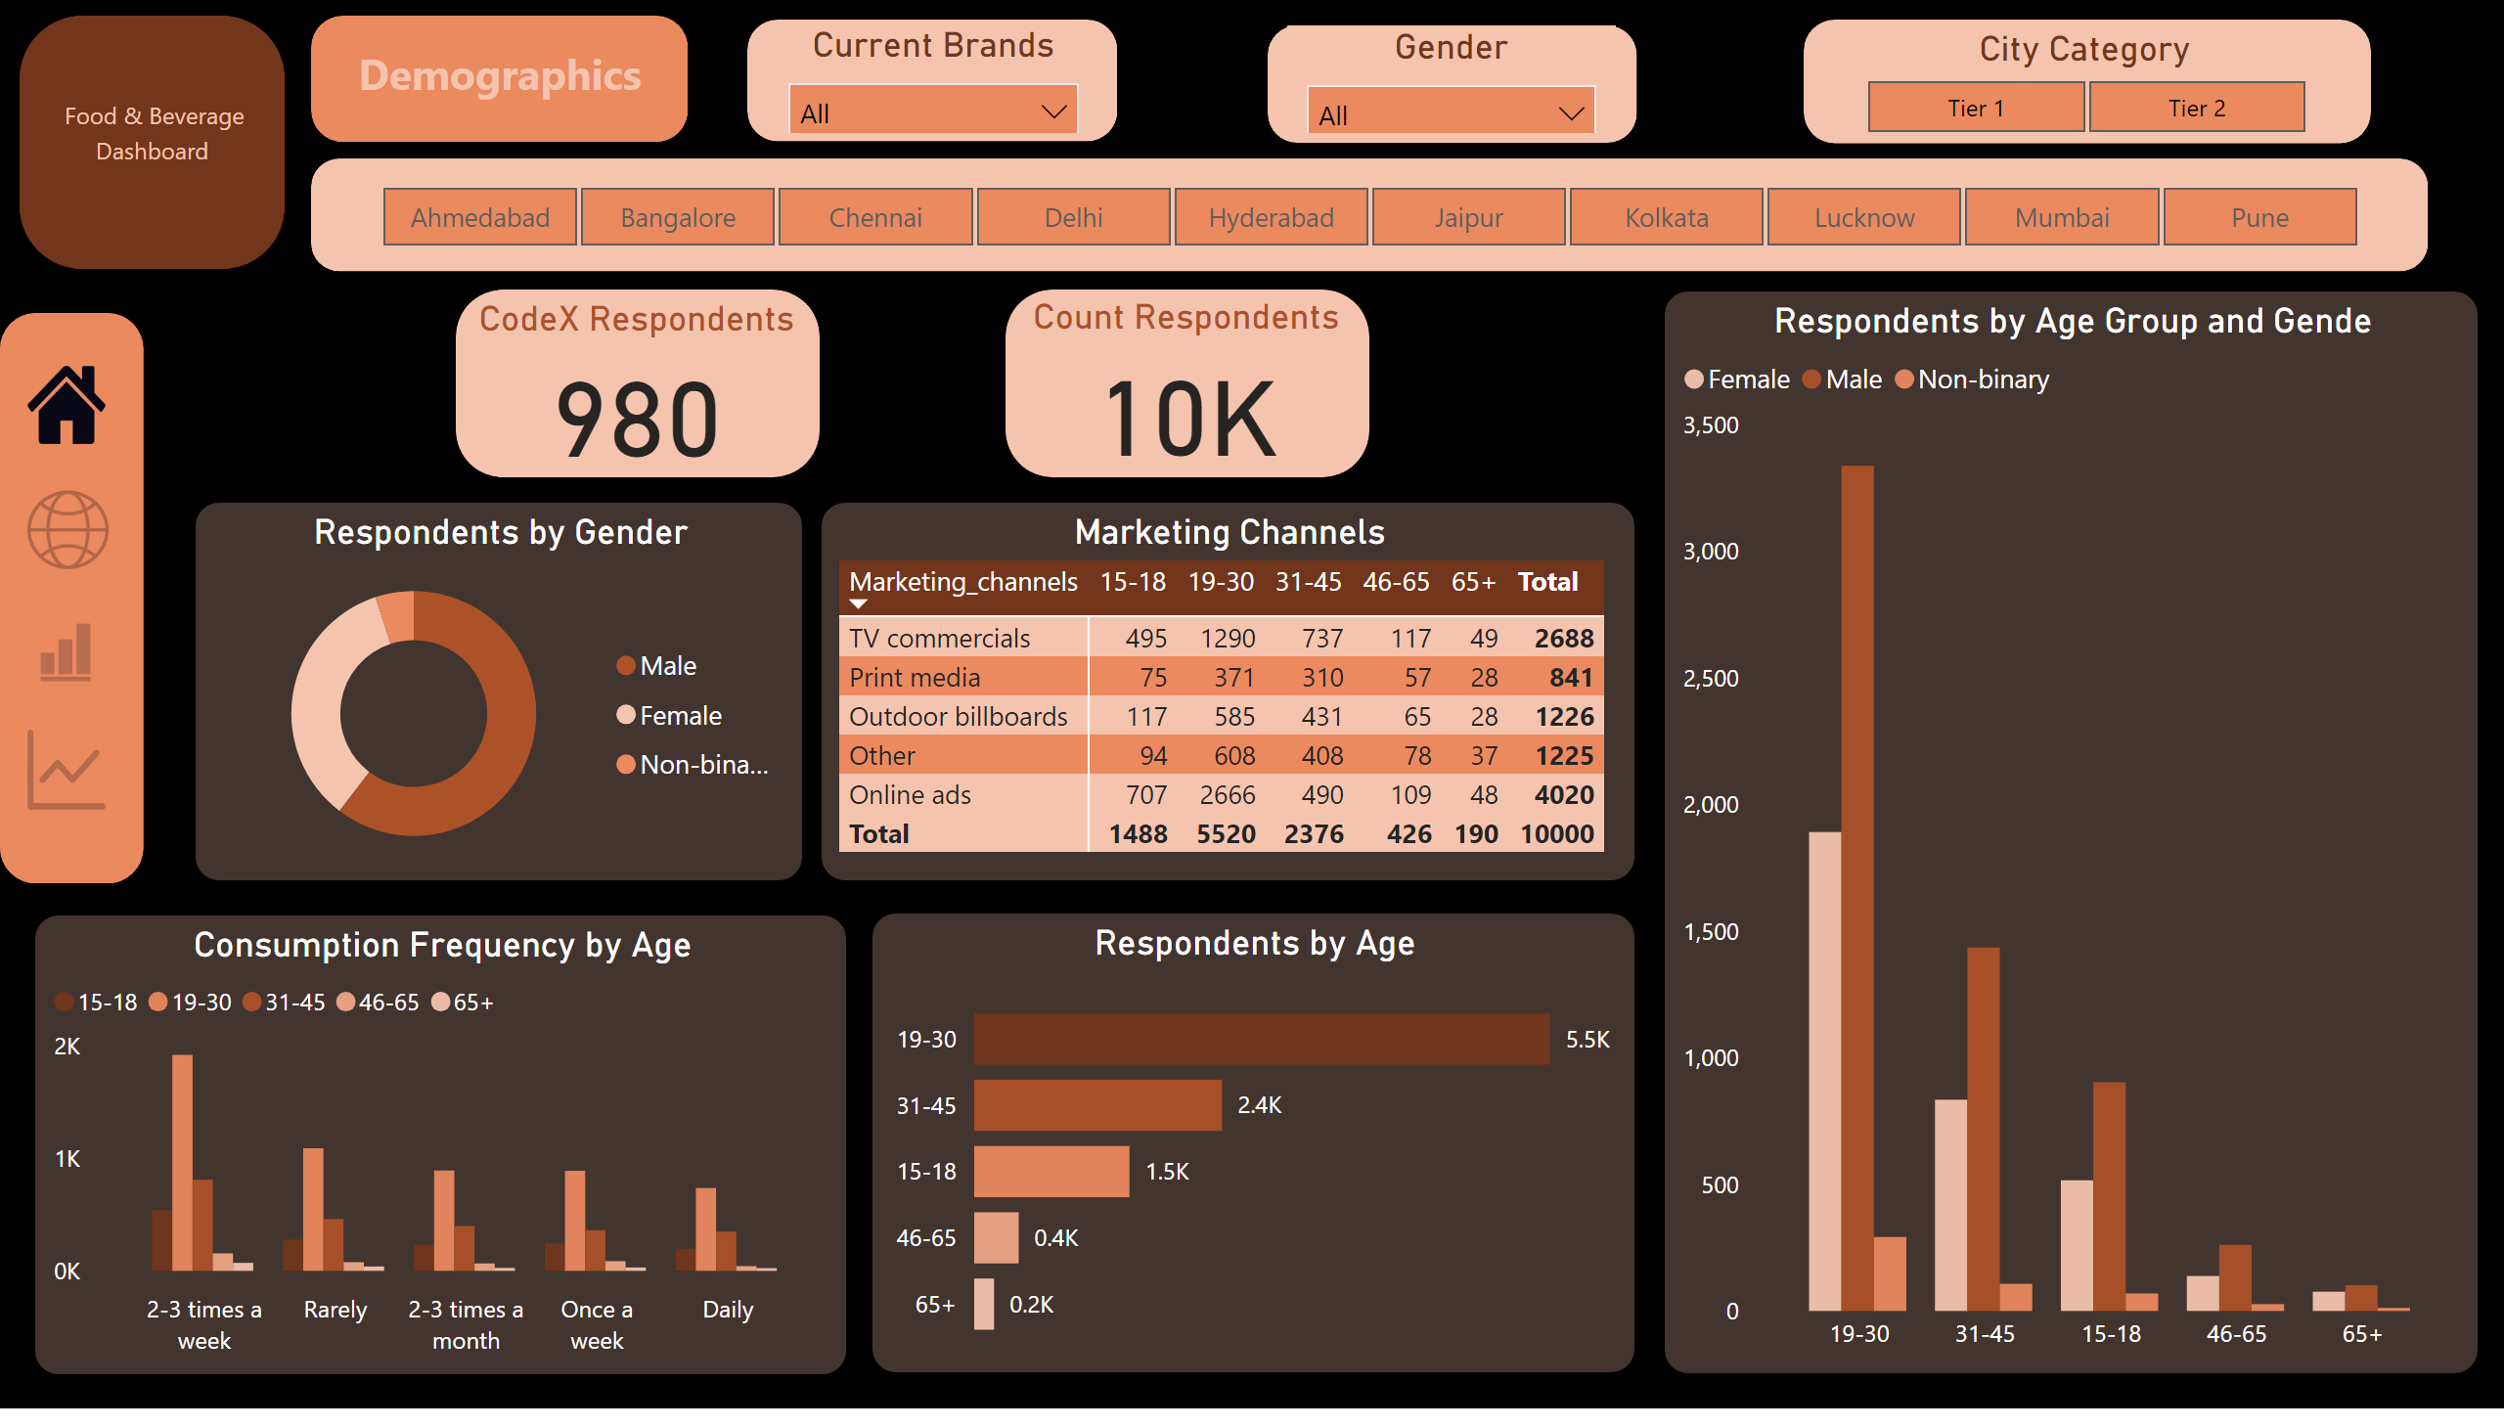
Demographics
Notes:
Respondents by Gender
No alt text provided
Respondents by Age
No alt text provided
Marketing Channels
No alt text provided
Respondents by Age Group and Gende
No alt text provided
Count Respondents
No alt text provided
CodeX Respondents
No alt text provided
Consumption Frequency by Age
No alt text provided
slicer
No alt text provided
shape
No alt text provided
actionButton
No alt text provided
shape
No alt text provided
textbox
No alt text provided
textbox
No alt text provided
shape
No alt text provided
City Category
No alt text provided
Gender
No alt text provided
Current Brands
No alt text provided
shape
No alt text provided
shape
No alt text provided
shape
No alt text provided
shape
No alt text provided
shape
No alt text provided
shape
No alt text provided
actionButton
No alt text provided
actionButton
No alt text provided
actionButton
No alt text provided

Slide 3
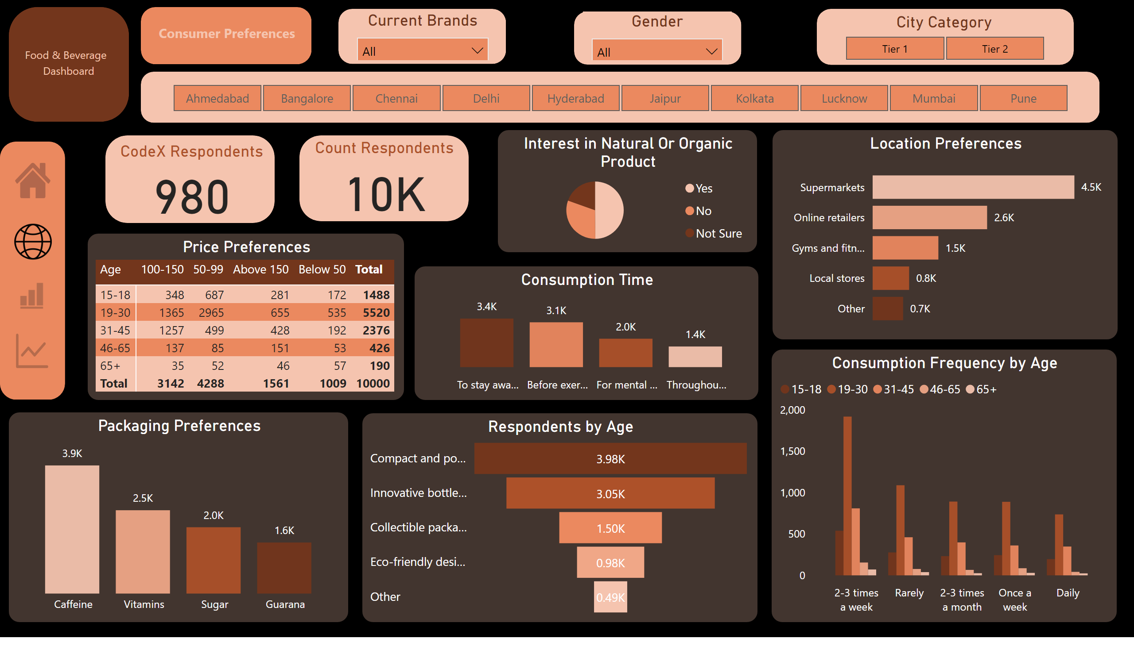
Consumer Preferences
Notes:
Interest in Natural Or Organic Product
No alt text provided
Respondents by Age
No alt text provided
Price Preferences
No alt text provided
Count Respondents
No alt text provided
CodeX Respondents
No alt text provided
Packaging Preferences
No alt text provided
slicer
No alt text provided
shape
No alt text provided
shape
No alt text provided
textbox
No alt text provided
textbox
No alt text provided
shape
No alt text provided
City Category
No alt text provided
Gender
No alt text provided
Current Brands
No alt text provided
shape
No alt text provided
shape
No alt text provided
shape
No alt text provided
shape
No alt text provided
shape
No alt text provided
shape
No alt text provided
Location Preferences
No alt text provided
Consumption Time
No alt text provided
Consumption Frequency by Age
No alt text provided
actionButton
No alt text provided
actionButton
No alt text provided
actionButton
No alt text provided
actionButton
No alt text provided

Slide 4
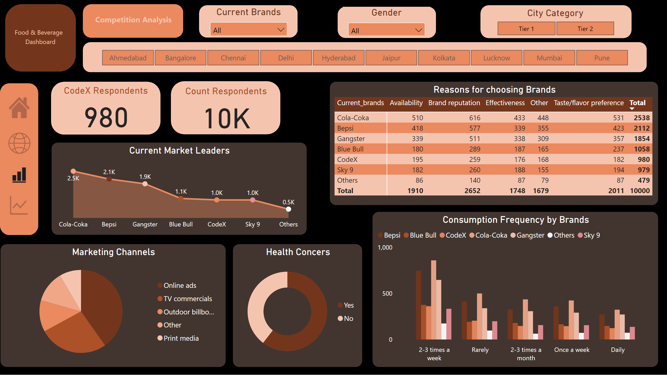
Competition Analysis
Notes:
Health Concers
No alt text provided
Marketing Channels
No alt text provided
Count Respondents
No alt text provided
CodeX Respondents
No alt text provided
slicer
No alt text provided
shape
No alt text provided
shape
No alt text provided
textbox
No alt text provided
textbox
No alt text provided
shape
No alt text provided
City Category
No alt text provided
Gender
No alt text provided
Current Brands
No alt text provided
shape
No alt text provided
shape
No alt text provided
shape
No alt text provided
shape
No alt text provided
shape
No alt text provided
shape
No alt text provided
Current Market Leaders
No alt text provided
Reasons for choosing Brands
No alt text provided
Consumption Frequency by Brands
No alt text provided
actionButton
No alt text provided
actionButton
No alt text provided
actionButton
No alt text provided
actionButton
No alt text provided

Slide 5
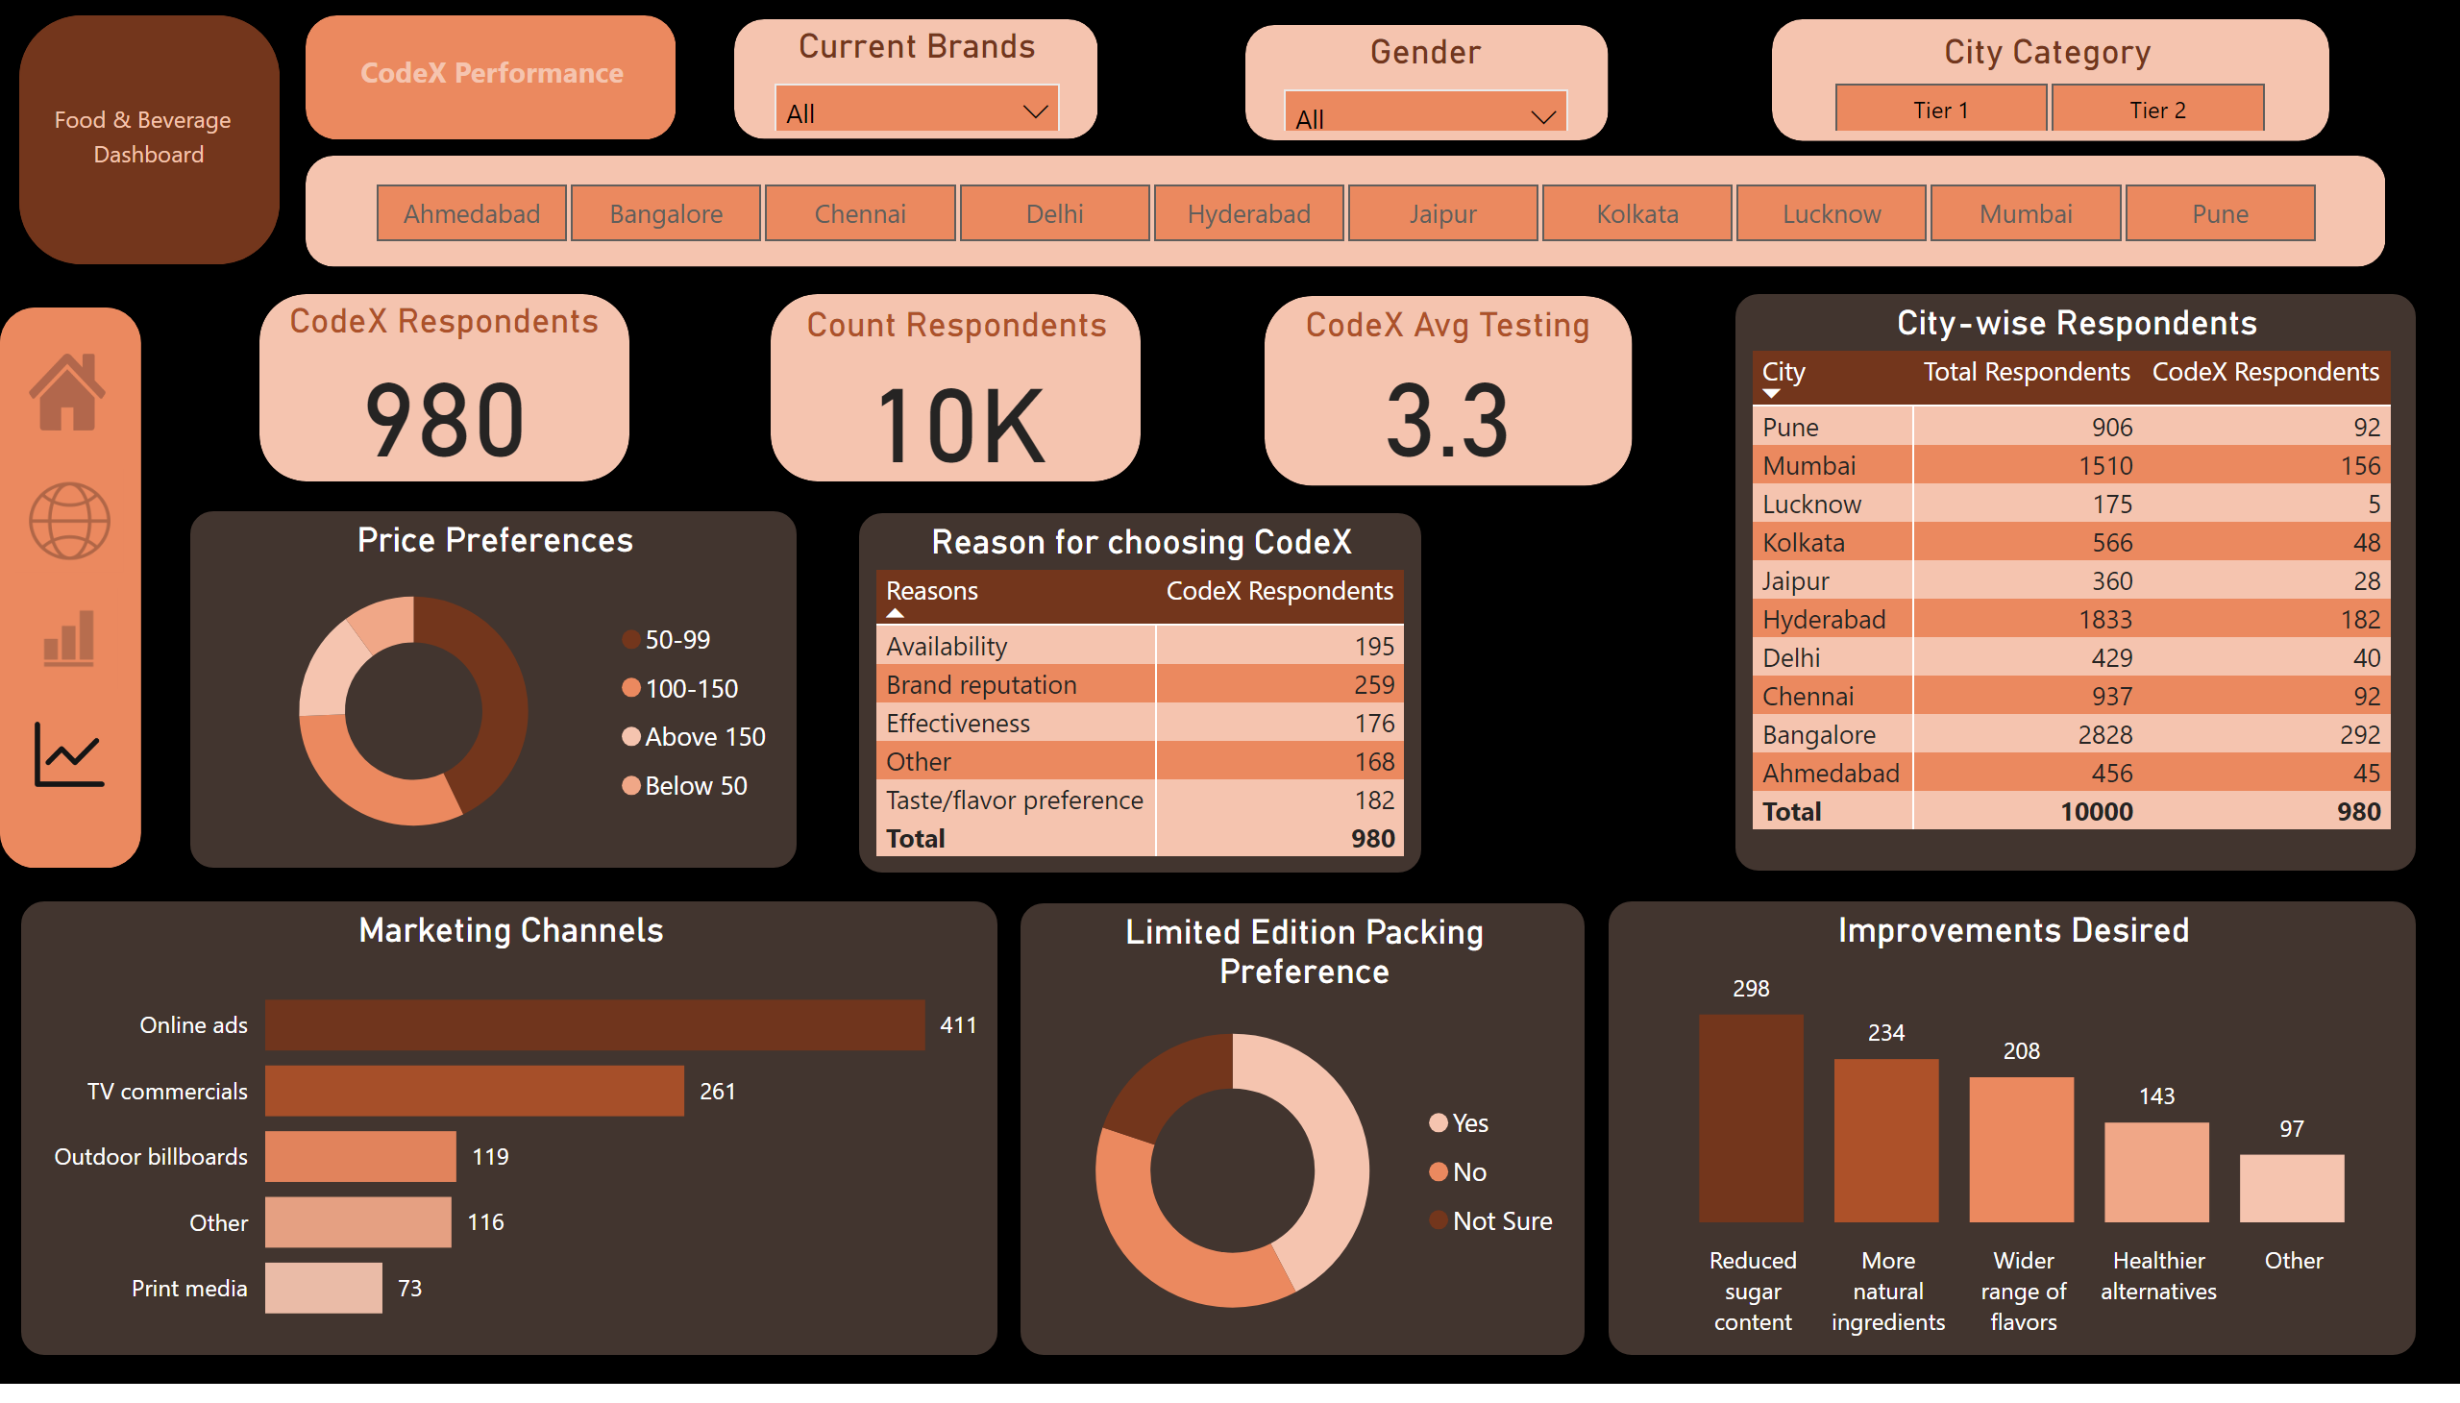
CodeX Performance
Notes:
Limited Edition Packing Preference
No alt text provided
Price Preferences
No alt text provided
Count Respondents
No alt text provided
CodeX Respondents
No alt text provided
slicer
No alt text provided
shape
No alt text provided
shape
No alt text provided
textbox
No alt text provided
textbox
No alt text provided
shape
No alt text provided
City Category
No alt text provided
Gender
No alt text provided
Current Brands
No alt text provided
shape
No alt text provided
shape
No alt text provided
shape
No alt text provided
shape
No alt text provided
shape
No alt text provided
shape
No alt text provided
Improvements Desired
No alt text provided
Reason for choosing CodeX
No alt text provided
Marketing Channels
No alt text provided
shape
No alt text provided
CodeX Avg Testing
No alt text provided
City-wise Respondents
No alt text provided
actionButton
No alt text provided
actionButton
No alt text provided
actionButton
No alt text provided
actionButton
No alt text provided

