Slide 1



Sales_Dashboard_Insights
View in Power BI
Last data refresh:
6/13/2024 12:09:02 PM UTC
Downloaded at:
6/17/2024 7:30:46 AM UTC

Slide 2
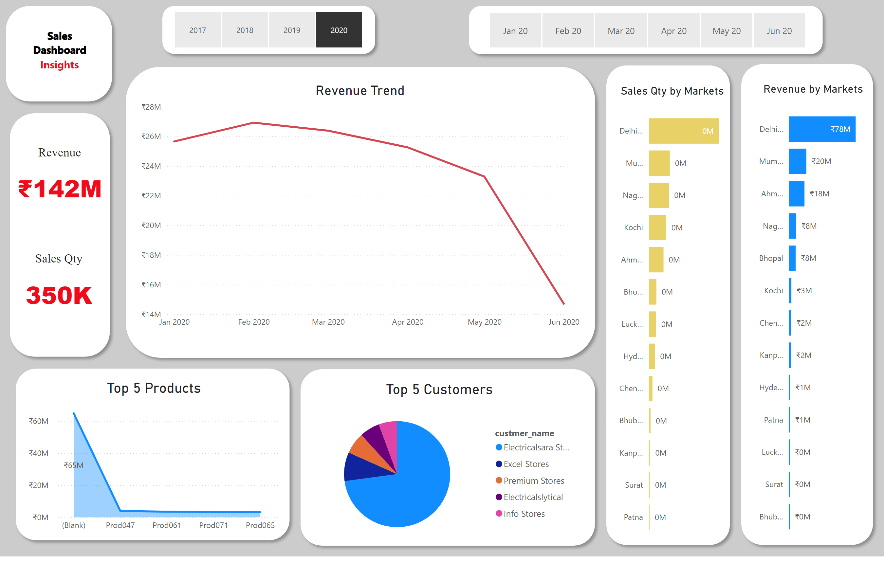
Key Insights
Notes:
Revenue by Markets
No alt text provided
Sales Qty by Markets
No alt text provided
slicer
No alt text provided
slicer
No alt text provided
Top 5 Customers
No alt text provided
Top 5 Products
No alt text provided
Revenue Trend
No alt text provided
shape
No alt text provided
textbox
No alt text provided
textbox
No alt text provided
Revenue
No alt text provided
Sales Qty
No alt text provided
shape
No alt text provided
shape
No alt text provided
shape
No alt text provided
shape
No alt text provided
shape
No alt text provided
shape
No alt text provided
shape
No alt text provided
shape
No alt text provided

Slide 3
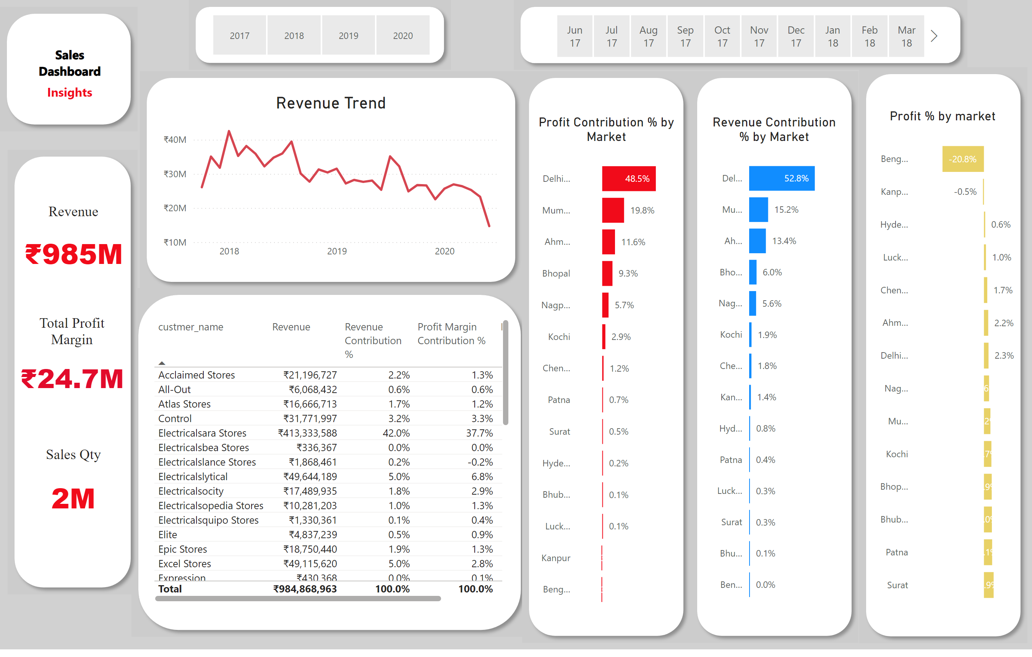
Profit Analysis
Notes:
shape
No alt text provided
shape
No alt text provided
shape
No alt text provided
shape
No alt text provided
textbox
No alt text provided
textbox
No alt text provided
shape
No alt text provided
shape
No alt text provided
shape
No alt text provided
shape
No alt text provided
shape
No alt text provided
Revenue Contribution % by Market
No alt text provided
Total Profit Margin
No alt text provided
Revenue Trend
No alt text provided
Top 5 Customers
No alt text provided
slicer
No alt text provided
slicer
No alt text provided
Profit Contribution % by Market
No alt text provided
Profit % by market
No alt text provided
Sales Qty
No alt text provided
Revenue
No alt text provided

Slide 4
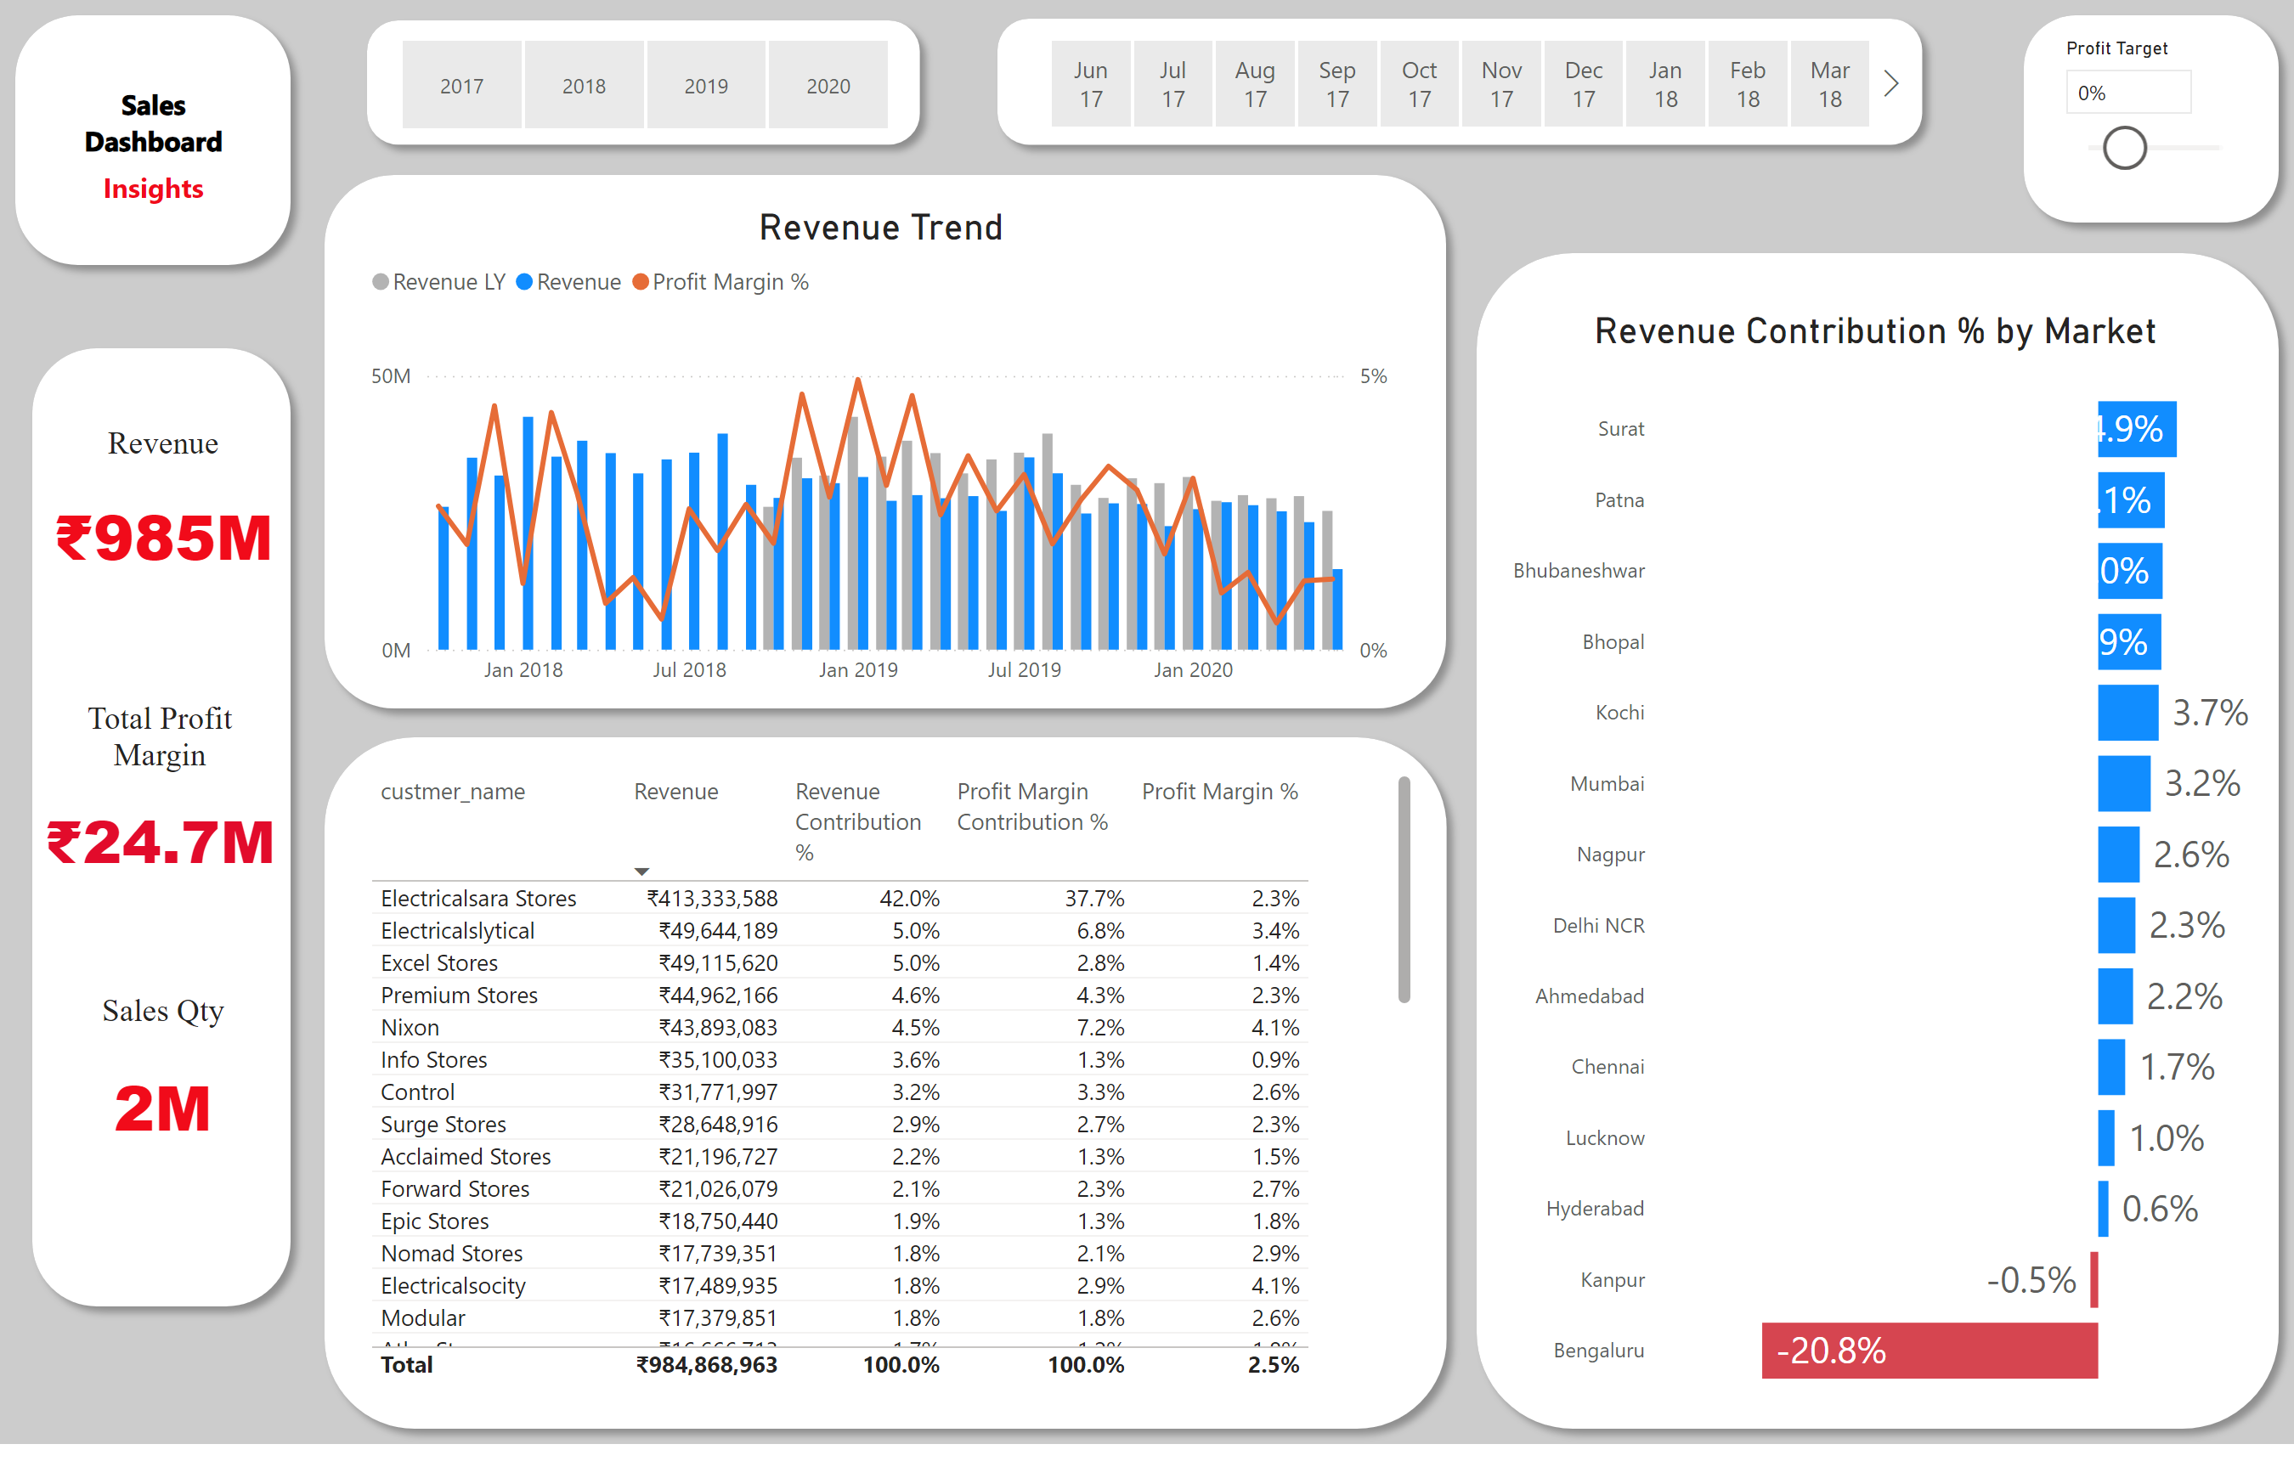
Performance Insights
Notes:
slicer
No alt text provided
slicer
No alt text provided
Top 5 Customers
No alt text provided
Revenue Trend
No alt text provided
Revenue Contribution % by Market
No alt text provided
slicer
No alt text provided
shape
No alt text provided
textbox
No alt text provided
textbox
No alt text provided
shape
No alt text provided
Revenue
No alt text provided
Total Profit Margin
No alt text provided
Sales Qty
No alt text provided
shape
No alt text provided
shape
No alt text provided
shape
No alt text provided
shape
No alt text provided
shape
No alt text provided
shape
No alt text provided

