Slide 1

INSTITUTE FOR ADVANCED COMPUTING AND
SOFTWARE DEVELOPMENT AKURDI,PUNE
Presentation On
PG-DAC Feb 2020
Created By: Group No:49
Mr. Balaji Kadam 1145
Mr. Ameya Patil 1174
Mr. Prashant Karhale Mr. Kashinath Patil
Center Coordinator Project Guide

Slide 2
Contents
Introduction
Scope
Activity Diagrams
Aim and Objectives
ScreenShots
Features
ScreenShots
Conclusion
Future Scope

Slide 3
INTRODUCTION
Online Medical Passport is a One-stop solution for all medical records management system
It maintains record of every individual residing in that area
It updates you for a health check-up after every 6-months

Slide 4
SCOPE
This application can be used by any group or hospitals or can be implemented by any government body
System can be used by any hospital maintain its medical records
This system can help to keep a trace of anay upcoming medical pandemic

Slide 5
AIM & OBJECTIVES
To provide an user friendly interface for the user
To update all records in a organised manner
To increase efficiency in maintaining health records and reducing physical efforts
Objective of this project to maintain a user record and keep trace of health of every user registered on this system

Slide 6
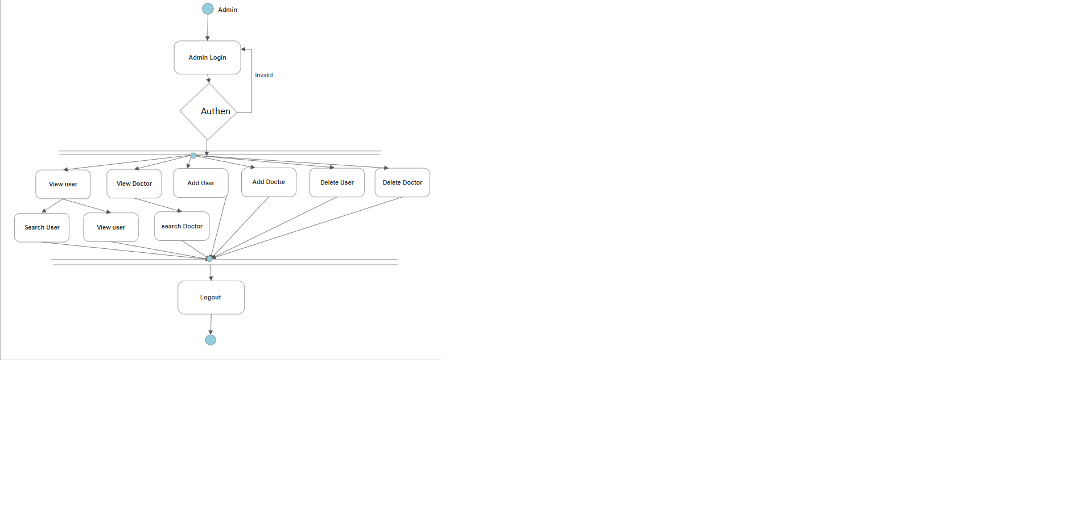
Activity Diagram of Admin

Slide 7
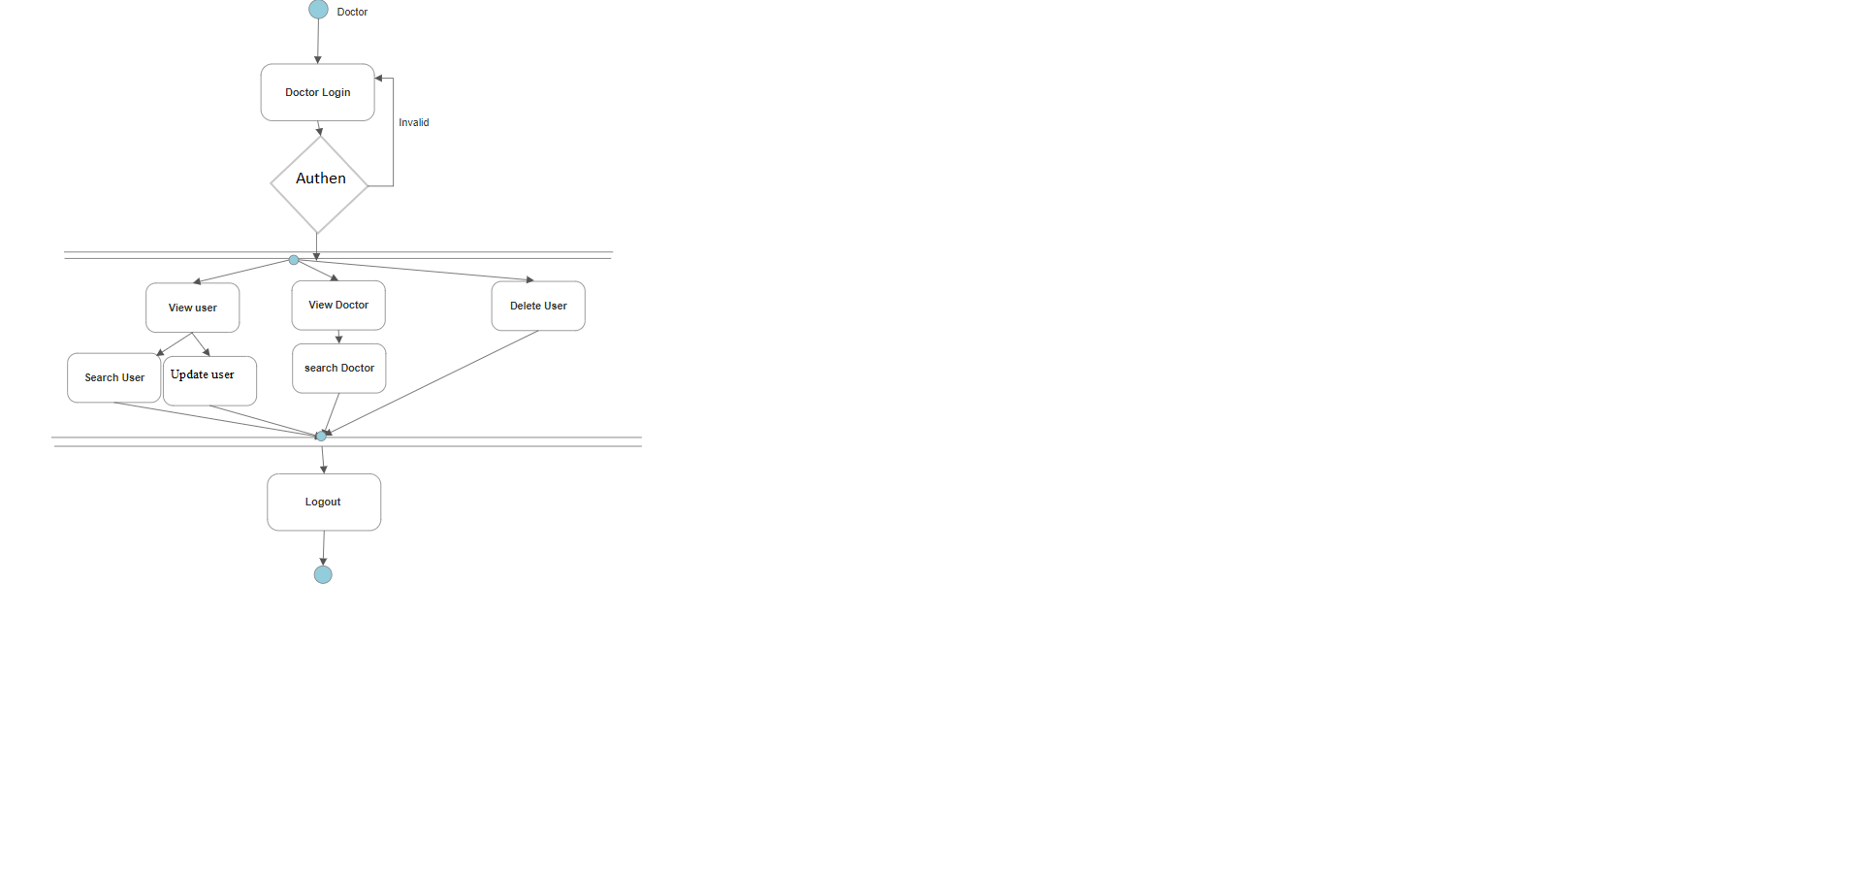
Activity Diagram of Doctor

Slide 8
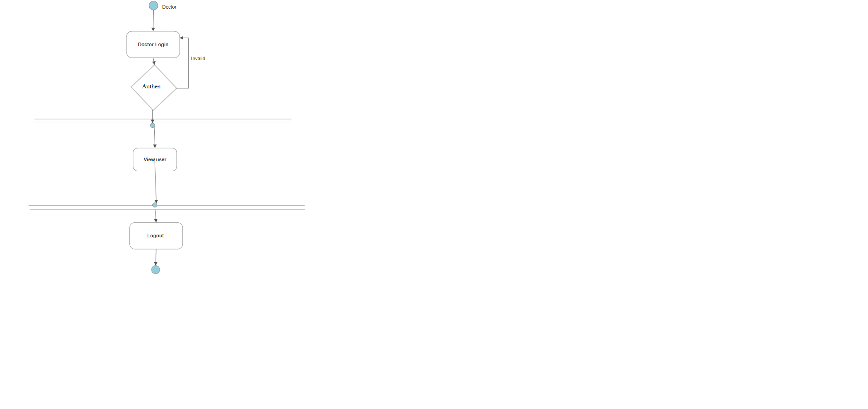
Activity diagram of user

Slide 9
Feature Provided for user
Easy to use and implement user interface has been provided
User can check his medical description through this system
User login has been provided and can login using his email and password

Slide 10
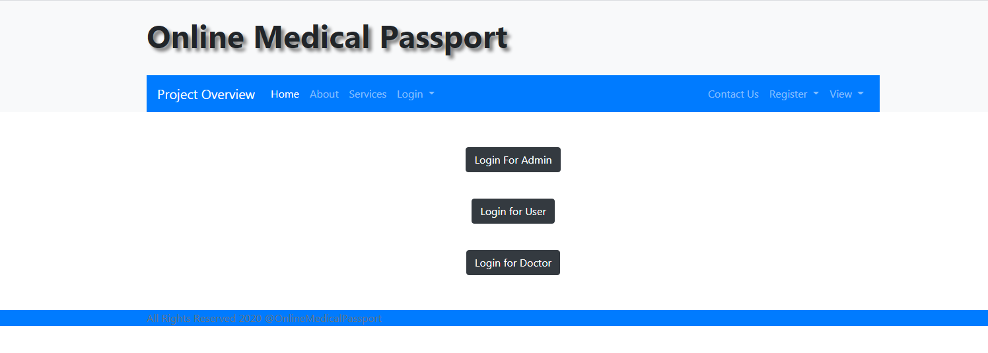
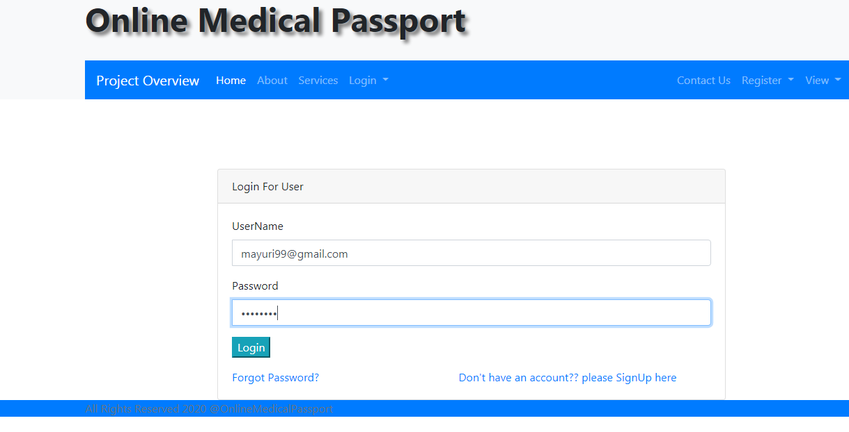

Slide 11
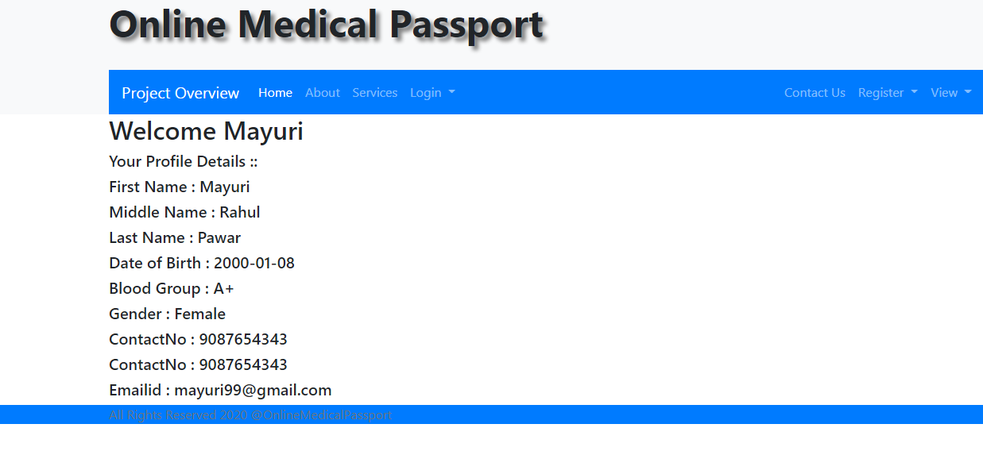

Slide 12
Feature provided for Doctor
Easy to use and implement user interface has been provided
Doctor can add a user
Doctor can view all users
Doctor can update his users
Doctor login has been provided and can login using his email and password

Slide 13
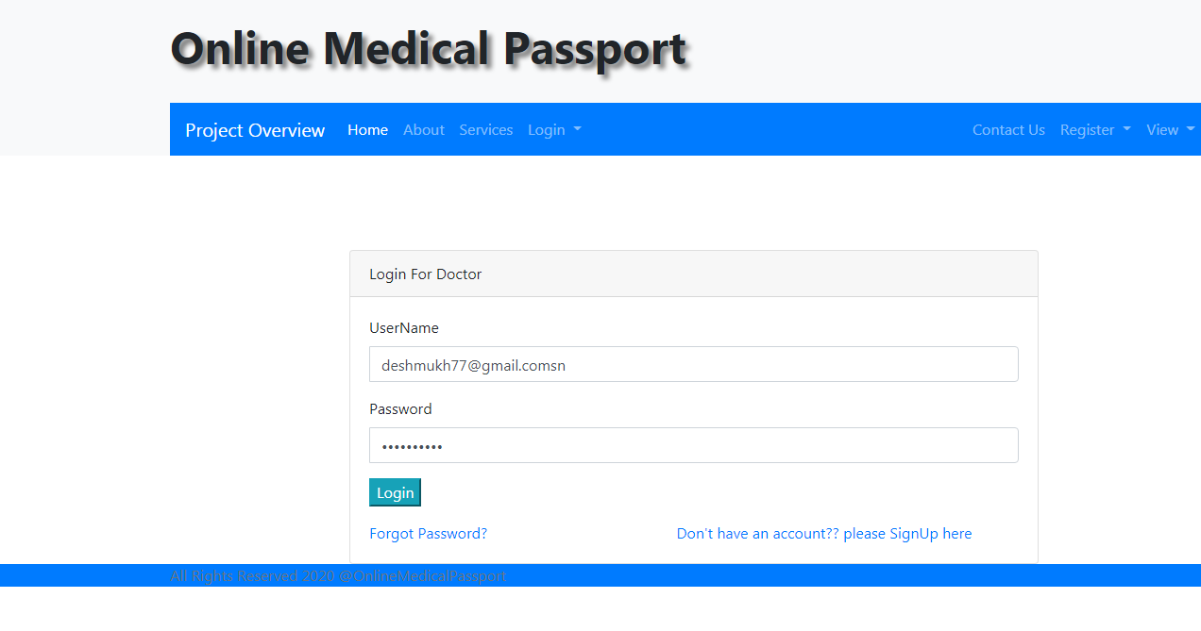
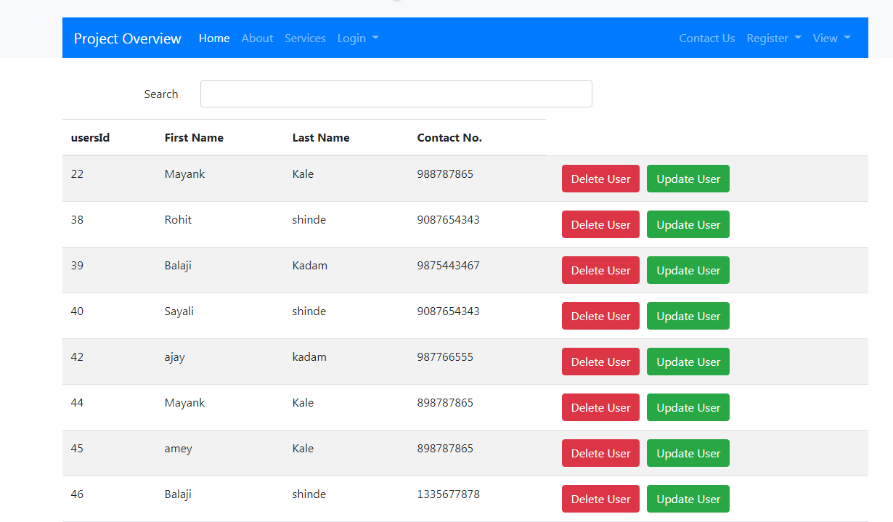

Slide 14
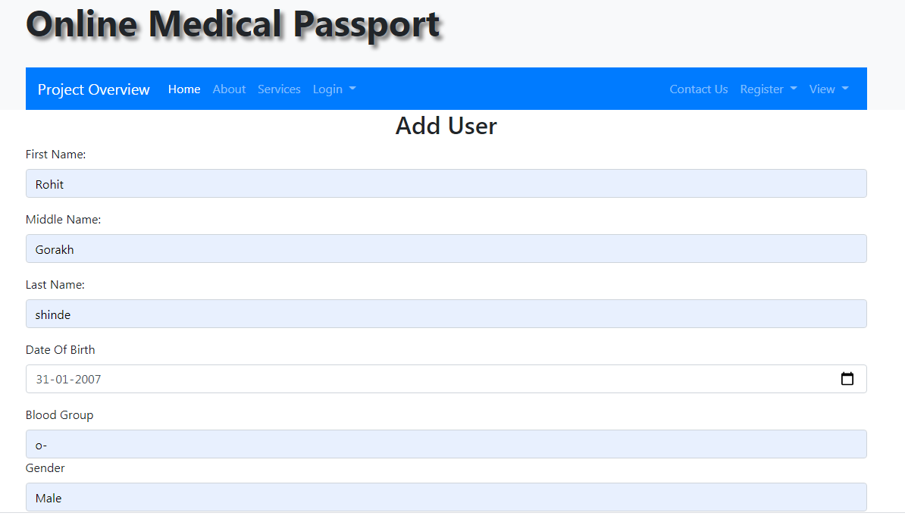
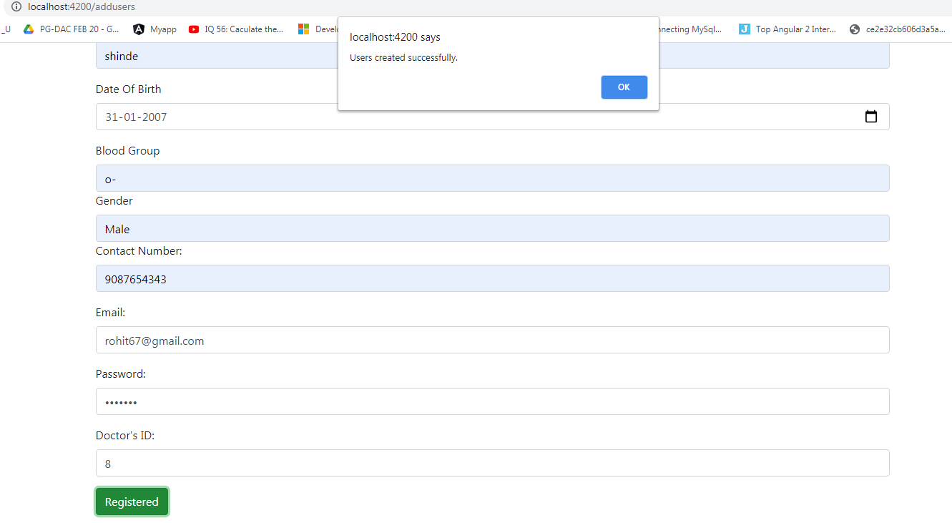

Slide 15
Feature provided by admin
Admin can add a user
Admin can add a doctor
Admin can delete a user
Admin can delete a doctor
Admin can update user and doctor
Admin can view user and doctor

Slide 16

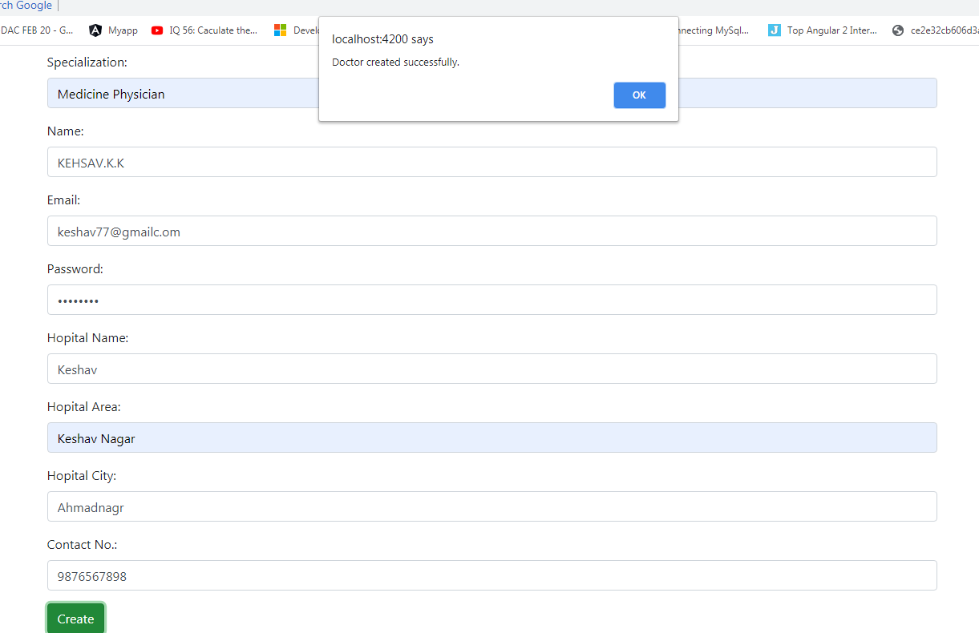

Slide 17
Conclusion
Online medical passport puts forth the actual working of a medical database.Administartion management, patient management, searching for patients, updating heath history, etc.
User and doctor can access services and functionalities from the system from anywhere and anytime for their own comfort

Slide 18
Future Scope
This project can be enhanced further access to the booking webistes,visa booking websites to check for health status before confirmation of any booking.Job recuirters can also check for candidates health status.
The software is flexible enough to be modified and implemented as per future requirements.

Slide 19
Thank You

