Slide 1
Rapid Prototyping Practice Using Object Oriented Programming
Topic :
2D GRAPH PLOTTING
Group Members :
Akshay Ganpat Kolhe. (111903012)
Ameya Pandurang Andhare. (111903013)
Anap Vishal Bhausaheb. (111903015)

Slide 2

ABOUT THE TOPIC…
The language used for implementation : CPP
The Platform Used : Qt Creator
Qt Creator provides a cross platform, complete integrated development (IDE) for application developers to create graphical user interfaces (GUI) and applications that run on all major desktop or mobile platforms.
It is available for Linux, macOS and Windows operating systems.

Slide 3
Library Used : Qt (Custom Plot) :
QcustomPlot is a widget used for plotting and data visualization.
This plotting library focuses on making good looking 2D plots, graphs and charts.
It offers high performance for realtime visualization applications.
Overview :
2D Graph Plotting
Option Window
Input
Output
Window
Output
Output
Saved
Select
I/P & Plot
download

Slide 4
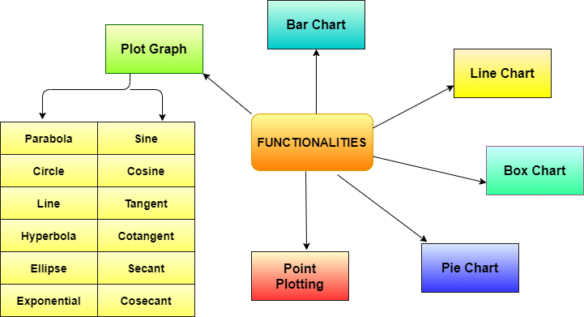

Slide 5
Advantages :
Graph plotting can summarize large data set in visual form.
Standard curves known as calibration curves which can be used in quantitative analysis and research.
Point plotting helps to estimate exact location of a entity with respect to other entities.
Bar chart can be used to display relative numbers or proportions of multiple categories and also clarify trends better than tables.
Line chart gives quick analysis of data and we can easily observe changes over a certain period of time.
Pie chart represents data visually as a fractional part of a whole, which can be an effective communication tool for the even uninformed audience.
Statistical box chart is five-number data summary which can handle and present large amount of data.

Slide 6
References :
http://qtstalker.sourceforge.net/doc/_plot_8cpp.html
https://www.qcustomplot.com/documentation/classQCustomPlot.html#af6fea5679725b152c14facd920b19367
https://ducciogasparri.it/2019/12/06/best-plot-and-charting-c-packages-for-data-visualization/
https://www.bogotobogo.com/cplusplus/application_visual_studio_2013.php
https://en.wikipedia.org/wiki/Qt_Creator
https://www.hackerearth.com/blog/developers/list-top-c-c-books-programming-enthusiasts/

