Slide 1
Code For Change
Reg No.
2019048
Team Members :
Ameya Bhamare
Sparsh Temani
Adhwaith Menon
Sumukh Aithal

Slide 2
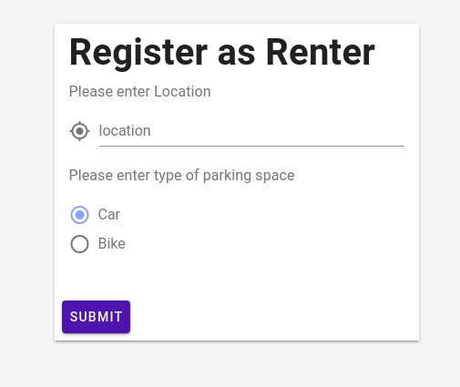
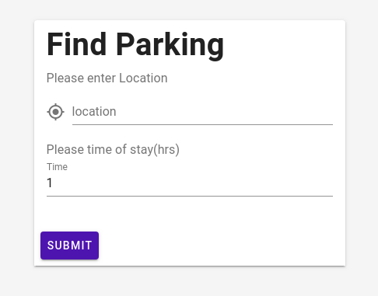
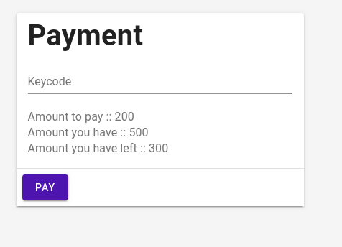
Parkonnect

Slide 3
Business Proposition
We provide a very efficient platform that allows our users to have an hassle free parking experience.
Our clientele mainly includes underused parking spaces, and privately owned garages allowing them to make an extra buck while enabling our users to pre-book a parking spot saving them the trouble of having to look for one.
We offer a very robust, decentralized payment system that ensures fair payment without human intervention.
We use an automated system for detection of vehicular movement using a Masked R-CNN which contributes to increased security.

Slide 4
Tech Stack
Django
Vue JS
HTML/CSS
MapBox API
TensorFlow – Keras
000webhost

Slide 5
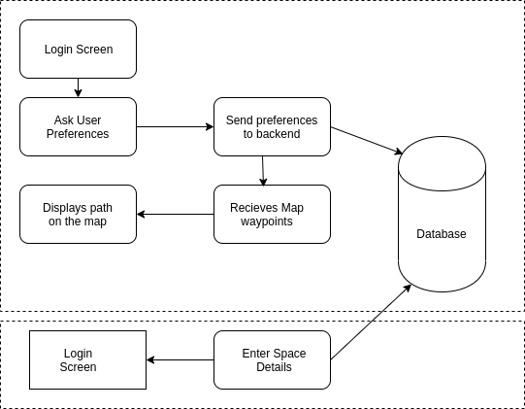
FRONT-END

Slide 6
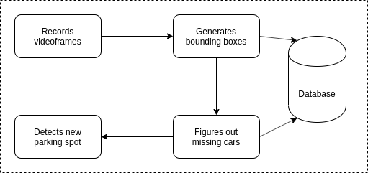
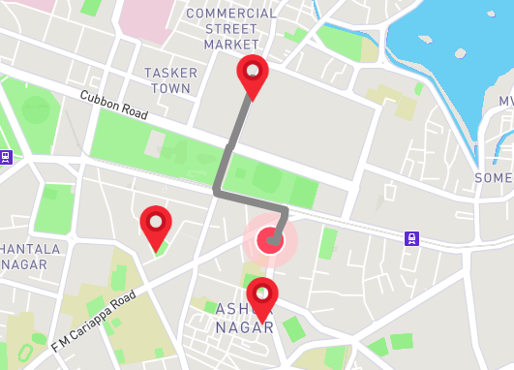
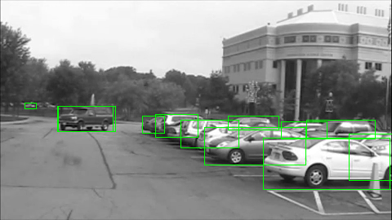
BACK-END

Slide 7
Thank You

