Slide 1
Improving Direct – Mapped Cache Performance by the Addition of a Victim cache
EE 5423
Under
Professor Wei-Ming Lin
By
Vijay Ram Mondi
(@01266503)

Slide 2
Contents
Overview
Types of Caches misses
Victim Cache Organization
Approach
Code
Results
Conclusion

Slide 3
Overview
Improving Direct –Mapped Cache Performance by the Addition of a Small Fully – Associative Cache.
- by Norman P. Jouppi
This paper describes about different hardware techniques to improve the performance of caches
The large performance loss due to memory hierarchy is a motivation for the techniques in this paper .

Slide 4
Types of Caches misses
Conflict misses
If the block-placement strategy is set associative or direct mapped, conflict misses will occur because a block can be discarded and later retrieved if too many blocks map to its set.
Compulsory misses
The first access to a block is not in the cache, so the block must be brought into the cache. These are also called cold start misses.
Capacity misses
If the cache cannot contain all the blocks needed during execution of a program, capacity misses will occur due to blocks being discarded.

Slide 5
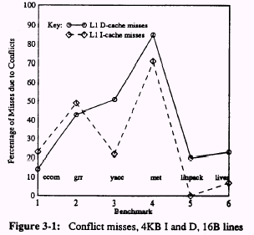
Conflict misses constitute 20% to 40% of all the misses.

Slide 6
What is Victim cache ???
It is a small fully associative cache placed between direct mapped L1 cache and L2 cache
L1 cache
Victim cache
L2 cache
Memory
Why victim cache?
The memory address of a cache block that is replaced is likely to be accessed again in the near future. This is based on the principle of temporal locality.

Slide 7
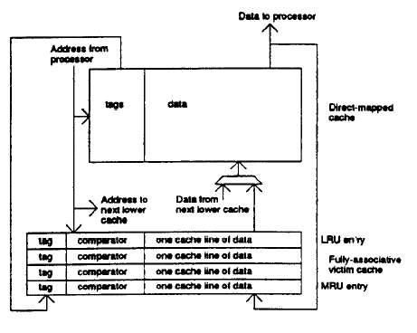
Victim cache organization

Slide 8
Flow chart
Start
Look in L1 cache
hit
Return data
miss
Look in victim cache
hit
Swap the contents of the block with L1 cache and return data
miss
Look in L2 cache
hit
Return data
miss
Look in memory
hit
Return data
Stop

Slide 9
Victim cache (continue)
5
L1 cache
12
6
45
32
7
67
82
93
26 (LRU)
Victim cache

Slide 10
Victim cache
L1 cache
5
12
6
45
32
7
67
82
93 (LRU)
Victim cache
26

Slide 11
Victim cache
With victim caching no data block appears both in the direct-mapped cache and victim cache. It is loaded only with the items thrown out of direct-mapped cache.
L1 cache
5
12
6
45
32
7
67
82
93 (LRU)
26
Victim cache
26
hit

Slide 12
Victim cache
In the case of a miss in L1 cache, the contents of the direct-mapped cache block and the matching victim cache block are swapped.
L1 cache
5
12
6
45
32
7
67
82
26 (LRU)
Victim cache
93
swapped

Slide 13
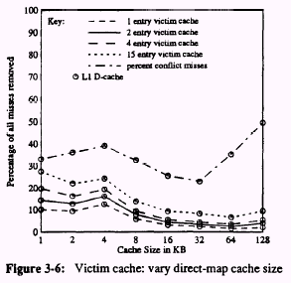
The effect of Direct Map cache size on victim cache performance
Direct Map size increase, likelyhood of conflict miss removed by victim cache reduces

Slide 14
Approach
Simplescalar 3.0 simulator has been changed for creating victim cache and establishing connectivity between L1 and victim caches.
So the files cache.c, cache.h, sim-outorder.c are modified.
These files are Compiled and simulated with different benchmarks on the sim-outorder simulator tool.
Spec2000 CPU benchmarks have been used for analyzing the results

Slide 15
Code: cache connectivity
dl1_access_fn(enum mem_cmd cmd,/* access cmd, Read or Write */ md_addr_t baddr,/* block address to access */ int bsize,/* size of block to access */ struct cache_blk_t *blk,/* ptr to block in upper level */
tick_t now)/* time of access */{
unsigned int lat;
if (cache_dv) {
victimhit=1;
/* access next level of data cache hierarchy */
lat = cache_access(cache_dv, cmd, baddr, NULL, bsize, /* now */now, /* pudata */NULL, /* repl addr */NULL);
if (cmd == Read)
return lat;
else{
/* FIXME: unlimited write buffers */
return 0;
} }
else if (cache_dl2) {
/* access next level of data cache hierarchy */
lat = cache_access(cache_dl2, cmd, baddr, NULL, bsize, /* now */now, /* pudata */NULL, /* repl addr */NULL);
if (cmd == Read)
return lat;
else{

Slide 16
Code:Victim cache creation
else /* dl1 is defined */
{
if (sscanf(cache_dl1_opt, "%[^:]:%d:%d:%d:%c“, name, &nsets, &bsize, &assoc, &c) != 5)
fatal("bad l1 D-cache parms: <name>:<nsets>:<bsize>:<assoc>:<repl>");
cache_dl1 = cache_create(name, nsets, bsize, /* balloc */FALSE, /* usize */0, assoc, cache_char2policy(c), dl1_access_fn, /* hit lat */cache_dl1_lat);
/* is the victimcache defined */
if(!mystricmp(cache_dv_opt, "none"))
cache_dv = NULL;
else {
if (sscanf(cache_dv_opt, "%[^:]:%d:%d:%d:%c“, name, &nsets, &bsize, &assoc, &c) != 5)
fatal("bad victim D-cache parms: “ "<name>:<nsets>:<bsize>:<assoc>:<repl>");
cache_dv = cache_create(name, nsets, bsize, /* balloc */FALSE,
/* usize */0, assoc, cache_char2policy(c),
dvictim_access_fn, /* hit lat */cache_dv_lat);
}
/* is the level 2 D-cache defined? */
if (!mystricmp(cache_dl2_opt, "none"))
cache_dl2 = NULL;
else
{
if (sscanf(cache_dl2_opt, "%[^:]:%d:%d:%d:%c“, name, &nsets, &bsize, &assoc, &c) != 5)
fatal("bad l2 D-cache parms: “ "<name>:<nsets>:<bsize>:<assoc>:<repl>");
cache_dl2 = cache_create(name, nsets, bsize, /* balloc */FALSE, /* usize */0, assoc, cache_char2policy(c), dl2_access_fn, /* hit lat */cache_dl2_lat);

Slide 17
Code : swap function
void cache_swap (struct cache_t *cp, struct cache_blk_t *blk, md_addr_t addr) {
md_addr_t set = CACHE_SET(cp, addr);
struct cache_blk_t *temp;
temp = blk;
blk = cp->sets[set].way_tail;
cp->sets[set].way_tail = temp;
}
unsigned int/* latency of access in cycles */
cache_access(struct cache_t *cp,/* cache to access */ enum mem_cmd cmd,/* access type, Read or Write */
md_addr_t addr,/* address of access */ void *vp,/* ptr to buffer for input/output */
int nbytes,/* number of bytes to access */ tick_t now,/* time of access */
byte_t **udata,/* for return of user data ptr */ md_addr_t *repl_addr)/* for address of replaced block */
{
.
.
.
.
.
cp->log_hits++;
// if the hit was a victim hit, swap the block in victim cache with LRU block of l1
if (victimhit)
{
victimhit=0;
cache_swap(cp, blk, addr); //cp is a pointer to victime cache and blk is the "hit" blk.
}

Slide 18
Command
../../simplesim-3.0 sim-outorder -fastfwd 20000000 -max:inst 50000000 -redir:sim test2.txt -cache:dl1 dl1:128:32:1:l -cache:dv dv:1:32:128:l -cache:il1 il1:128:32:1:l -cache:iv iv:1:32:128:l ./gzip.alpha gzip.lgred.graphic 1

Slide 19
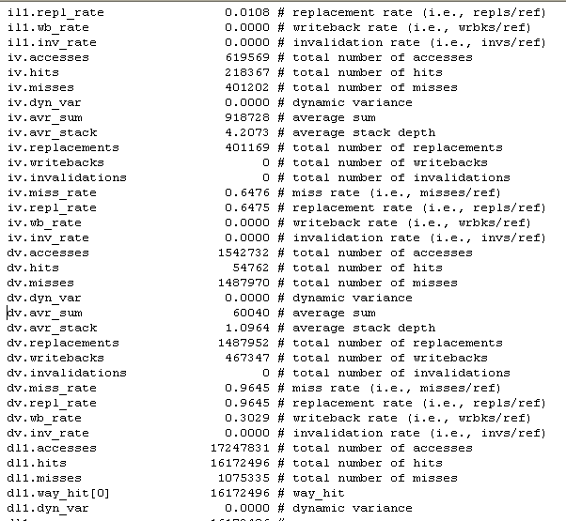
Output file

Slide 20
Results

Slide 21
L1 miss rate without and with victim cache

Slide 22
L1 cache size Vs % misses removed in L1 cache by victim cache
As the cache size increases, the number of conflict misses decreases. So the % of misses removed by the victim cache decreases.

Slide 23
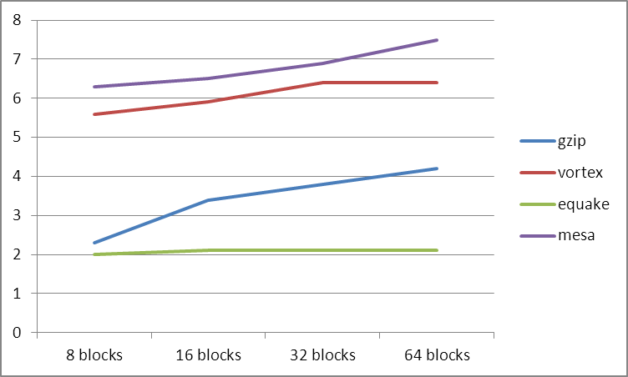
No. of blocks in victim cache v/s % of misses removed from L1 cache

Slide 24
Conclusion
The conflict misses can be considerably reduced by inserting a victim cache.
Victim cache is an improvement over Miss cache
Victim cache also helps in improving the performance of the cache.

Slide 25
Thank you

