Slide 1
APPMETER
SCU Capstone Project
Guided by Prof. Yasin Ceran
Amarjit Dhal
Ameya Ghatpande
Chaitrali M Naik
Omkar Gokhale
Shalini Gopalakrishnan
Notes:
Welcome to Final Demo of AppMeter.
This is our MS - Capstone project under the valuable Guidance of Professor Yasin Ceran.

Slide 2
Agenda
Introduction
What Makes AppMeter Unique
Demo
Machine Learning Models
Future Scope
Learning

Slide 3
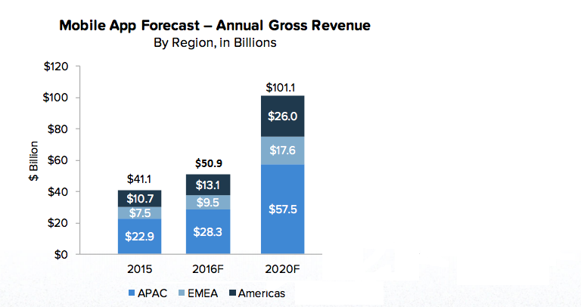
More Smartphone users = More App Development
Notes:
The last decade has seen a tremendous rise of Smartphones. In 2007, the first Iphone was released and their are other big players in market like Samsung, motorola etc. There are 3 main operating systems . ANDROID/ IOS/ and windows.
We rely on smartphones for our daily activities like booking a cab (Uber), connecting with friends (facebook), Checking the google maps to browse to new locations, checking the weather, online shopping and the list goes on.
Today mobile apps have become an integral part of our day-to-day activities.
Mobile Apps are
Revenue can be generated from 3 mediums
1] Selling the app
2] Subscription model
3] Advertisement revenue

Slide 4
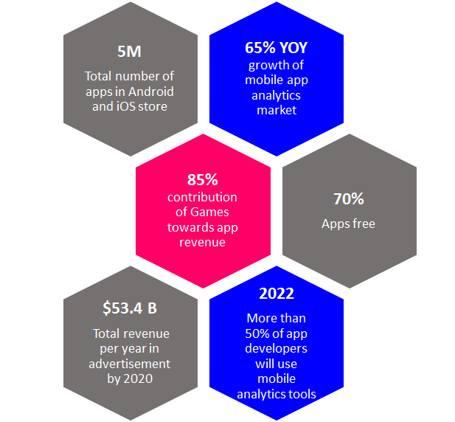
Mobile App Market Stats

Slide 5
What Makes AppMeter Unique
Comprehensive scoring algorithm as compared to its competitors
Unique rank across the Genre
Predicts success of an App
Analytics dashboard about Mobile App ecosystem

Slide 6










Technologies Used
Notes:
HTML, CSS - Designing the webpage
Python - Data cleaning and machine learning
R Studio -
PHP - Session management and DB connection
JS & AJAX - Client & Server side scripting
Github -

Slide 7
DEMO
appmeter.atwebpages.com/home.php

Slide 8
Website Design Considerations
Single-Page Web Design
Session Management
Security
Responsive Web Design
Uniform Design Template
Notes:
Single page website design is a hot trend in the UI domain these days. User does not have to navigate to other pages for viewing some rudimentary information. The user can access different sections of the single page.
Managing user sessions is extremely important when the website has premium and non premium content. We have used session management in AppMeter so as to restrict guest users from accessing premium content without registering. Session management also helps in developing dynamic components of web pages. For example, if a user is already logged in, the website content for that user can be made different as compared to the guest user. In AppMeter website, we have maintained the session until the user logs out.
Security is extremely important when we have payment and premium content. As of now, we haven’t integrated payment gateway. But speaking of website security, we are not allowing any direct access to premium content. The system redirects the user to login/register page. Also, authentication and authorization have been done with validations for the login page. We have used third party web server which guarantees security for the database.
Now a days, due to rise of mobile devices, a lot of people use mobile devices to view the web content. AppMeter website can be viewed with the same content on all the devices. Even if the window size is minimized, the content is efficiently adjusted automatically to fit the screen.
User experience is very important for any web development team. User should feel connected and engaged to the website. Uniformity in the web design makes the user interaction engaging. We have maintained a theme throughout the website, use of colors, icons, images and charts should keep user attracted and interested.

Slide 9
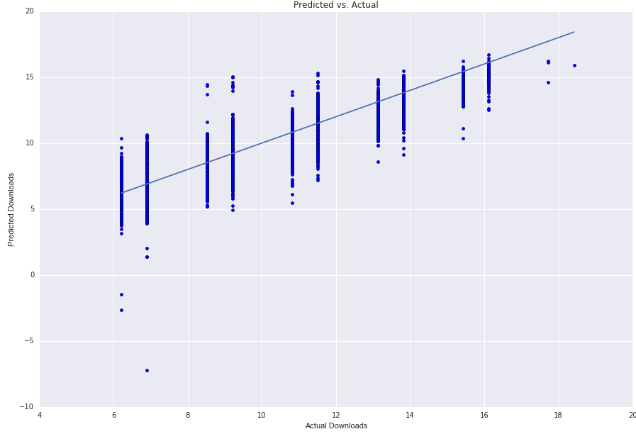
Machine Learning Algorithms
Linear Regression - Not used
Downloads- not a linear function of other parameters
Notes:
ML is a vital aspect of our project which helped us frame the model and predicting the outcomes when a set of input parameters are passed.

Slide 10
Machine Learning Algorithms
Decision Tree Regression - Not used
Tree becomes complex after a few levels
No control over the path of deciding downloads
2SLS - Used for App Success Prediction
Endogenous variables - Downloads, WOM
Exogenous variables - Price, File size, Rating, Age, Genre

Slide 11
Machine Learning Algorithms
PCA - Used for Scoring Algorithm
Reduced the number of dimensions.
Determined the component that has the maximum variance in our dataset
Helped in determining the significant parameters
Score = 0.7(Download Factor + Price Factor) + 0.3(Popularity Factor)

Slide 12
Learnings
Technical Functional
Data Analysis Project Management
Machine Learning App Analytics Business
Web Development Version Control
Visualization Principles SDLC

Slide 13
Future Scope
- Feature Analytics
- Twitter Sentiment Analytics
- Include iOS Apps
- Integration with Payment Gateway
- Real Time Data updates
- Create a mobile app for AppMeter

Slide 14
Thank You !!

