Slide 1

Eye surgeries Analysis
Ameya Ghatpande
11-Sep-2017

Slide 2

Agenda
Hospital overview
Patient overview
Success Insights
Specific Insights
Conclusion

Slide 3

Hospital overview
Number of surgeons - 28
Number of surgeries - 3498
Total minor severity cases - 1784
Total critical severity cases - 1714

Slide 4

Patient overview
Number of Male patients - 2094 (59.9)
Number of Female patients - 1404 (40.1)
Youngest patient age -14 (Surgery successful)
Oldest patient age - 77 (Surgery successful)
Average age of all patients - 34

Slide 5

Success Insights
Success of Minor surgeries > Success Major surgeries
Number of successful surgeries - 2808 (80.27 %)
Number of successful minor surgeries - 1574 (88 %)
Number of successful severe surgeries - 1234 (72 %)
Percentage of successful X treatment surgeries - 77.9
Percentage of successful Y treatment surgeries - 82.5
Success of Female surgeries almost equal to success of Male surgeries
Percentage of successful female patient surgeries - 79.34
Percentage of successful male patient surgeries - 80.89

Slide 6
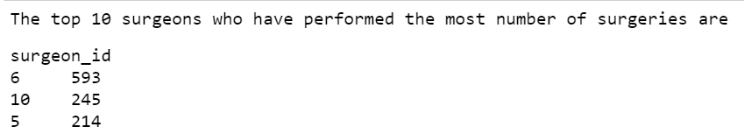
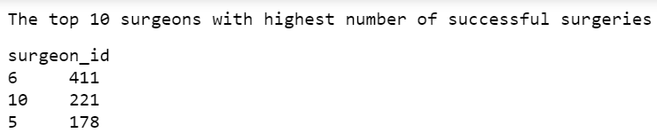
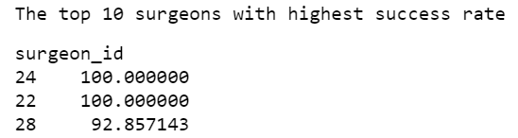
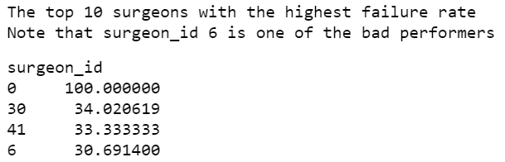
Insights Surgeon 6 performance should be evaluated

Slide 7
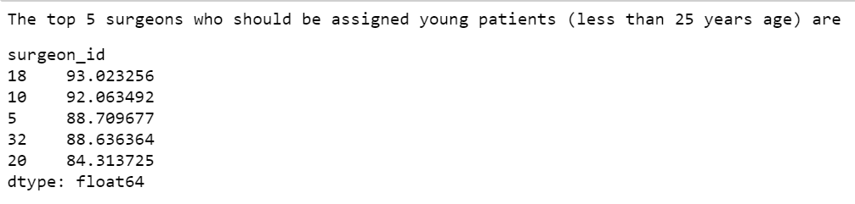
Insights
Following are the specialist surgeons for young adults*
* – patients less than 25 years age and surgeons have performed at least 20 operations

Slide 8
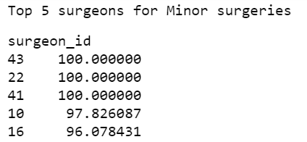
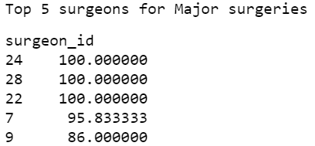
Insights
Top 5 surgeons for Minor surgeries
Top 5 surgeons for Major surgeries

Slide 9
Conclusion
Performance should be evaluated on basis of success ratio and not on the number of surgeries performed
Almost all patients were insured. Good for us.
Major information missing - Date of surgery (time related KPI’s were missed)
Major information missing - patient_id (Does the patient come back to our hospital ?)

Slide 10
Thank you
Ameya Ghatpande
11-Sep-2017

