Slide 1
Mini Capstone Project
Analysis of Rental Patterns and Film Popularity
in MavenMovies Sakila Database

Slide 2
INTRODUCTION
This report aim to analyze rental trends, identify popular films, and assess store performance using the MavenMovies Sakila database.
OBJECTIVES:
1. Analyze monthly rental trends and peak rental hours.
2. Identify popular films and film categories.
3. Assess store performance

Slide 3
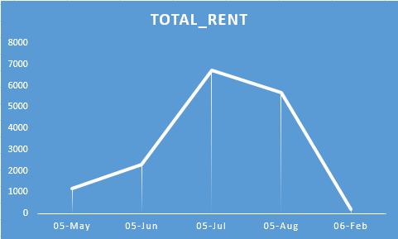
Monthly Rental Trends
Maximum Rentals:
The highest rental count is 6709 (July 2005).
Minimum Rentals:
The lowest rental count is 182 (February 2006).

Slide 4
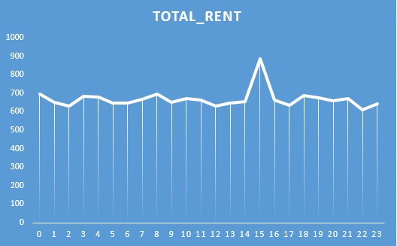
Peak Rental Hours
Maximum Rentals:
The peak rental count is 887 (at hour 15:00).
Minimum Rentals:
The lowest rental count is 610 (at hour 22:00).

Slide 5
Data shows clear seasonal trends with a peak in rental activity during festive season
and a significant decline after festive seasons.
This suggests a pattern where rental activity is significantly influenced by the time
of year.
The data indicates that rental activity peaks in the mid-afternoon and
early evening hours (15:00 and 18:00)
The lowest rental activity occurs late at night (22:00).
Recommendations:
1. Marketing should be increased in peak period.
2. Considerable inventory should be maintained during peak period.
3. Other developmental work should be done in off peak hour.

Slide 6
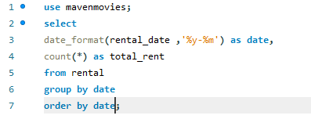
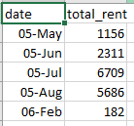
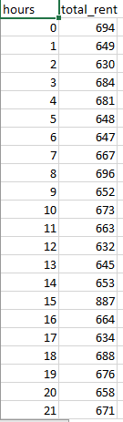
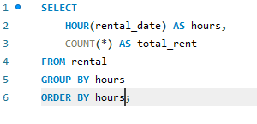

Slide 7
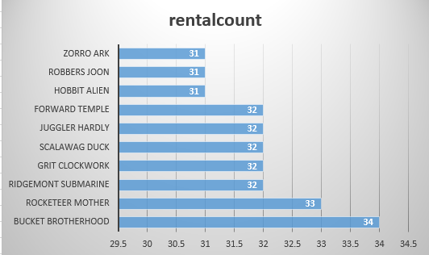
Most Rented Films
31 rentals: 3 films
32 rentals: 7 films
33 rentals: 1 film
34 rentals: 1 film

Slide 8
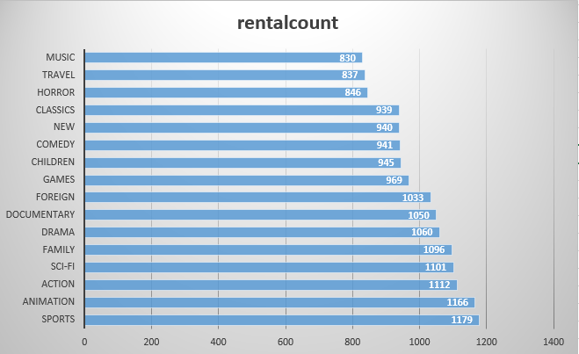
Top Film Categories
Maximum Rental Count:
The highest rental count is in the "Sports" category with 1179 rentals.
Minimum Rental Count:
The lowest rental count is in the "Music" category with 830 rentals.

Slide 9
The data shows rental counts among the films and different categories of film. Rental activity is evenly distributed among the top 10 films with no such variations. But in film categories we see a significant variation.
Recommendation:
1. Film ‘Bucket Brotherhood’ has the highest rental count. And categories
like sports, animation, action has high rental count so consider to
capitalize on there popularity.
2. For films and there categories with lower rental count, evaluate
factors contributing to their lower popularity and marketing of such films should
be increased.

Slide 10
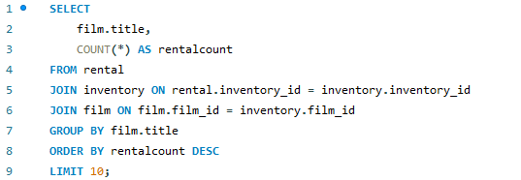
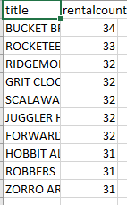
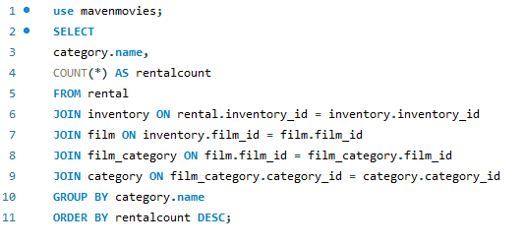
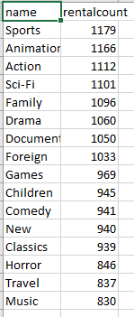

Slide 11
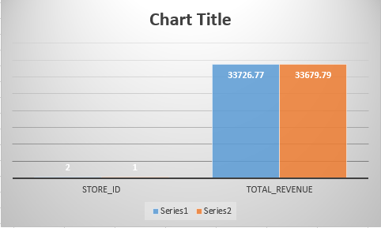
Store Performance
The store 1 is with the highest revenue. This store generates the most rental revenue.

Slide 12

Data shows rentals by staff members. Highest rental assessed by Mike Hillyer followed by Jon Stephens
Recommendations:
1. Consider incentivizing high performing store and
staff member.
2. Evaluate low performing store. Increase on marketing
and advertising that store.

Slide 13
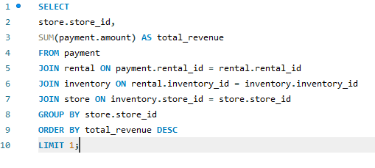

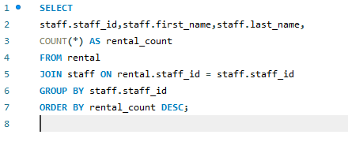

Slide 14
THANK YOU

