Slide 1
ANALYSIS OF MODULATION AND DATA TRANSMISSION TECHNIQUES
By : Rishabh Ramteke
Amey Anjarlekar
Vishwas Bharti

Slide 2
Topics to be Presented
Time-Division Multiplexing
Frequency-Division Multiplexing
QAM
Phase Shift Keying
Low Pass Filtering
FFT & IFFT
Orthogonal functions
OFDMA
SC-FDMA
Channel Bandwidth
Our work is the presentation of our capabilities

Slide 3
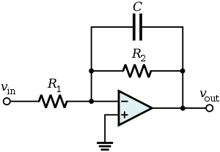
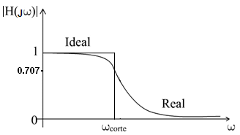
Low Pass Filtering

Slide 4
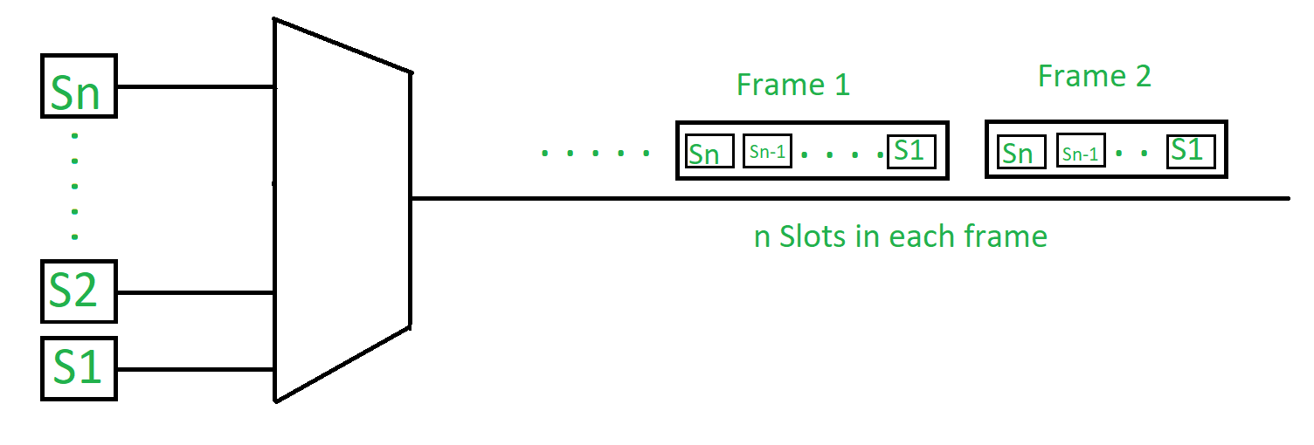
Time-Division Multiplexing
TDM is a method of transmitting and receiving independent signals over a common signal path by means of synchronized switches at each end of the transmission line so that each signal appears on the line only a fraction of time in an alternating pattern
This happens when data transmission
rate of media is greater than that of the
source, and each signal is allotted a
definite amount of time
These slots are so small that all
transmissions appear to be parallel
Notes:
Multiplexing is used in the cases where the signals of lower bandwidth and the transmitting media is having higher bandwidth. In this case, the possibility of sending a number of signals is more. In this the signals are combined into one and are sent over a link which has greater bandwidth of media than the communicating nodes.

Slide 5
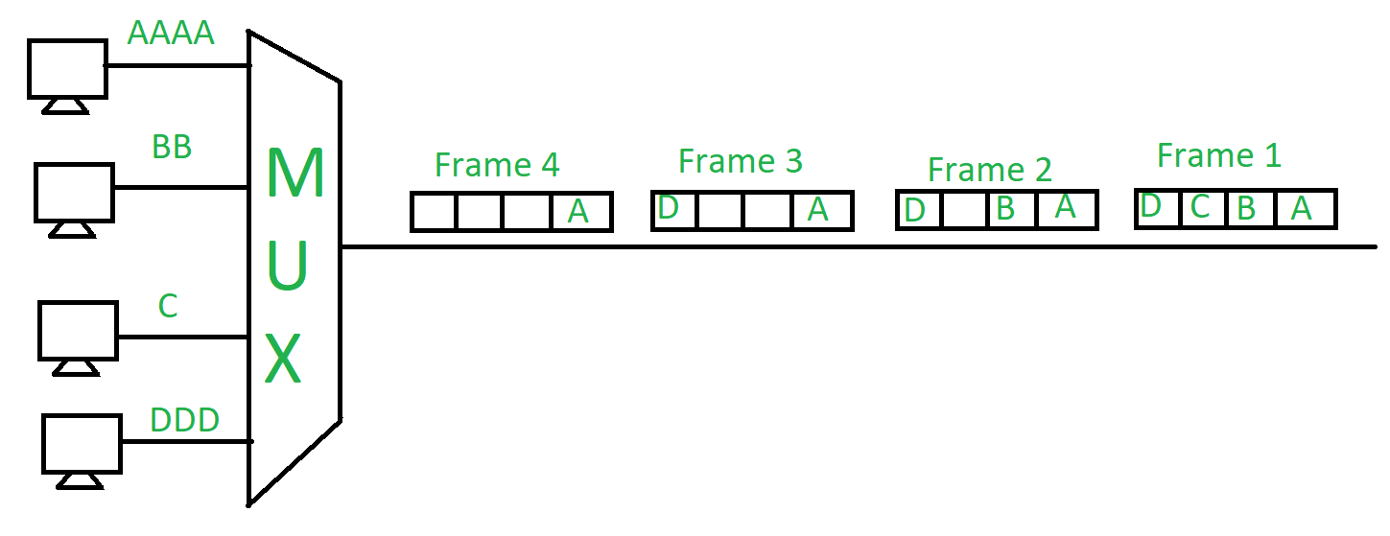
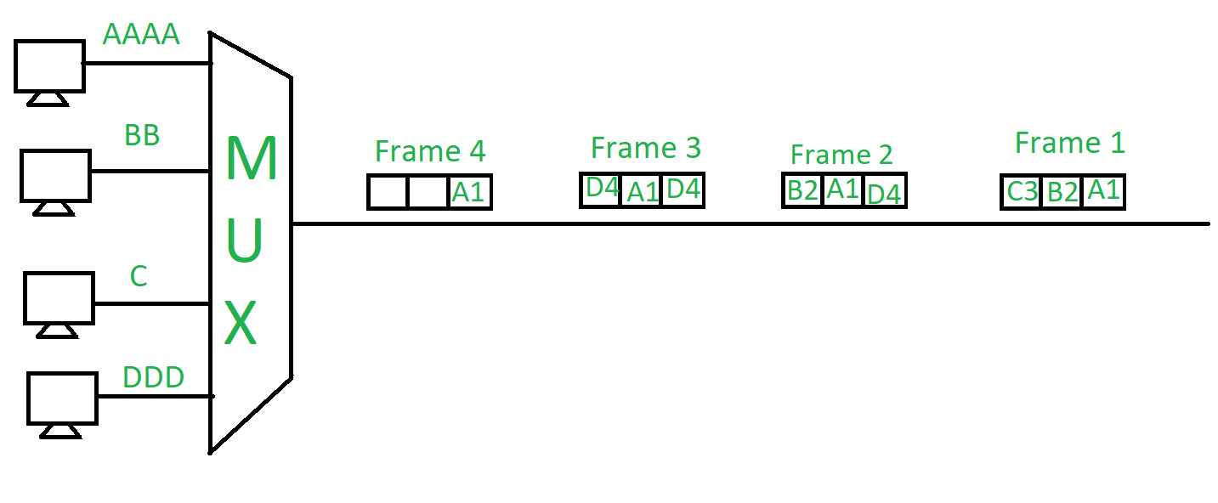
Synchronous TDM vs Asynchronous TDM
Provides a certain amount of time slots to all users
guarantees the users data will be transmitted within the time period
time slots may get wasted
Their rate of data transmission is same. Thus the name ‘synchronous’
Provides time slots to only active users
no guarantee the users data will when be transmitted
saves any wastage of time slots
If the devices have nothing to transmit, then their time slot is allocated to another device

Slide 6
Channel Bandwidth
Channel is a medium through which information is transmitted between transmitter and receiver. Channel bandwidth is the frequency range that constitutes the channel.
Generally, centre frequency is specified and then we say a 'bandwidth of m Hz centered about a frequency fc Hz'

Slide 7
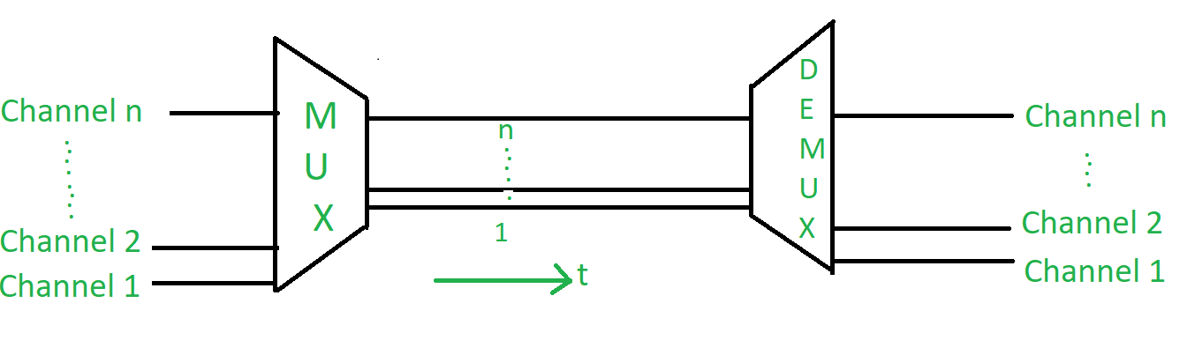
Frequency-Division Multiplexing
Frequency division multiplexing (FDM) is a technique of multiplexing which means combining more than one signal over a shared medium.
There is a suitable frequency gap between the 2 adjacent signals to avoid overlapping\
Frequency spectrum is divided into several
logical channels, in which every user feels
that they possess a particular bandwidth
Notes:
It is used in radio and TV transmission

Slide 8
TDM vs FDM
Divides certain time periods to each channel
Each signal uses all of the bandwidth some of the time
More flexible in allocating more time period to signals who need to send more data at that time
Divides the channel into two or more frequency ranges that do not overlap
Each signal uses a small portion of the bandwidth all of the time
Cannot have this flexibility as certain bandwidths are allocated for each signal all the time
Applications:
To control internet traffic
To transmit signal slowly compared to speed in which it is processed
Digitally transmitting several telephone conversations over the same four-wire copper cable
Since, FDM will take less time to transmit a signal, so used in places where time is of utmost priority like real time data sending.
Notes:
Thus, FDM will take less time to transmit a signal, so used in places where time is of utmost priority like real time data sending.

Slide 9
Orthogonal functions
Functions whose vector product is zero. The vector product will be defined as integral of their multiplication in the real line. Eg - sin,cos
Two signals are said to be orthogonal if they are mutually independent. This in practice means that they do not interfere with each other or that their effects on each other cancel out.

Slide 10

Orthogonal FDM
In FDM systems carriers are far apart with respect to each other and in OFDM systems carriers are densely packed and are orthogonal to the other carriers.
Orthogonal means peak of one carrier occurs at null of the other. Hence OFDM system is bandwidth efficient compare to FDM system. The orthogonality requires that the sub-carrier spacing is
where TU seconds is the useful symbol duration (the receiver-side window size), and k is a positive integer, typically equal to 1.

Slide 11
Orthogonal frequency-division
multiple access
Multiple access is achieved in OFDMA by assigning subsets of subcarriers to individual users.
This allows simultaneous low-data-rate transmission from several users. IN TDM several users could send information but with some queuing system i.e. there used to be a time lag to send the data. Here it could be send simultaneously.

Slide 12
SC-FDMA
(Single Carrier frequency-division multiple access )
In it various users can transmit info simultaneously. This is divided into the various frequencies and transferred rather than providing separate bandwidths to various users.

Slide 13
Quadrature Amplitude Modulation
Method of combining two amplitude-modulated (AM) signals into a single channel, thereby doubling the effective bandwidth
The two carrier waves of the same frequency are out of phase with each other by 90°, a condition known as orthogonality and as quadrature.
Being the same frequency, the modulated carriers add together, but can be coherently separated (demodulated) because of their orthogonality property
In a QAM signal, one carrier lags the other by 90°, and its amplitude modulation is customarily referred to as the in-phase component, denoted by I(t). The other modulating function is the quadrature component, Q(t).

Slide 14


The composite waveform is mathematically modeled as:
where f_{c} is the carrier frequency. At the receiver, a coherent demodulator multiplies the received signal separately with both a cosine and sine signal to produce the received estimates of I(t) and Q(t).
For example:

Slide 15

FFT (Fast Fourier Transform)
a faster way to calculate discrete fourier transform of a sample of signals
IFFT (Inverse Fast Fourier Transform)

Slide 16
Phase Shift Keying
Types
BPSK (Binary Phase Shift Keying )
QPSK (Quadrature Phase shift keying)
the digital modulation technique in which the phase of the carrier signal is changed by varying the sine and cosine inputs at a particular time

Slide 17



Binary Phase Shift Keying
It uses two phases which are separated by 180° and so can also be termed 2-PSK. As it uses just one phase, it will handle noise more efficiently as other forms of PSKs.However, it will handle only one bit/symbol.The phases are:
Thus the signal can be specified using one basis function:

Slide 18

Quadrature Phase shift keying
Uses 4 phases separated by 90 deg . So can handle 2 bits/symbol.
Thus QPSK can be used either to double the data rate compared with a BPSK system while maintaining the same bandwidth of the signal, or to maintain the data-rate of BPSK but halving the bandwidth needed.
Thus, signal can be represented as:
Thus we will have two basis functions for representing the signal

Slide 19
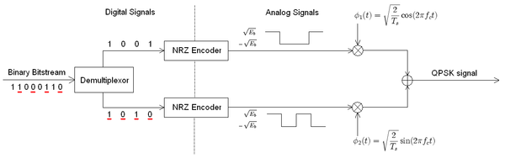
The binary data stream is split into the in-phase and quadrature-phase components. These are then separately modulated onto two orthogonal basis functions. In this implementation, two sinusoids are used. Afterwards, the two signals are superimposed, and the resulting signal is the QPSK signal.

Slide 20
Presented By
Rishabh Ramteke
170070046
Electrical Dept.
IIT BOMBAY

Slide 21

Presented By
Rishabh Ramteke
170070046
Ameya Anjarlekar
170070013
Vishwas Bharti
170070060

Slide 22
THANK YOU

