Slide 1

Car Accident Severity
Coursera Capstone
Ameya Sandeep Pange

Slide 2
Introduction
According to the WHO, approximately 1.35 million people die each year as a result of road traffic crashes. Between 20 and 50 million more people suffer non-fatal injuries, with many incurring a disability as a result of their injury.
Road traffic injuries cause considerable economic losses to individuals, their families, and to nations as a whole. These losses arise from the cost of treatment as well as lost productivity for those killed or disabled by their injuries, and for family members who need to take time off work or school to care for the injured. Road traffic crashes cost most countries 3% of their gross domestic product.

Slide 3
Business Problem
The 2030 Agenda for Sustainable Development has set an ambitious target of halving the global number of deaths and injuries from road traffic crashes by 2020.
This would be made easier if there was a way to analyze the main causes and areas that the accidents took place in.
This would make it easier to take precautionary measures like placing traffic signs to warn people about the high accident risk in a particular area as well as allocate resources like medical and police assistance, etc.
This project aims at using techniques like Data Science and Machine Learning to build a model which can predict the severity of accidents based on historical data. This would make people drive more carefully in accident-prone areas and would also help the government bodies manage and reduce the number of accidents and the deaths related to them more effectively.

Slide 4
Data
The data used in the project is historical accident data for the city of Seattle.
The raw dataset consists of 190000+ unique records and has 37 attributes, numerical (15) as well as categorical(22).
The dataset includes date and time entries in 2 of the coloumns.
The labelled data is the ‘severity’ of the accident which is the target variable.
For feeding the categorical data into the Machine Learning models, it first needs to be cleaned and formatted which will be dealt with in the data preparation stage.
Many columns can be seen to have missing data or ‘unknown’ data. These values too will be addressed in the data preparation stage.

Slide 5
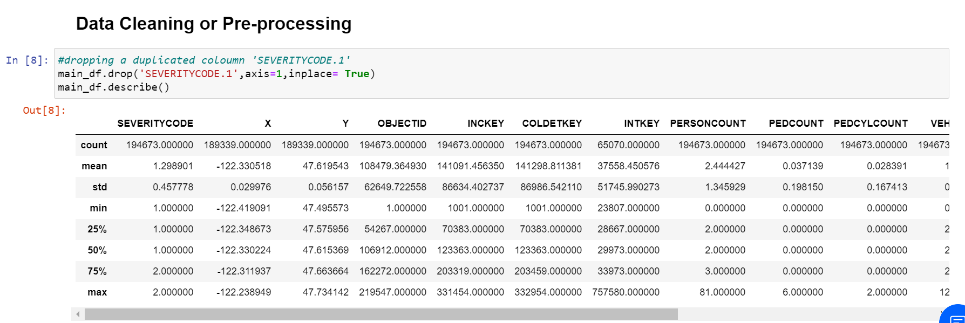
Data Preparation
This stage involves the cleaning of the dataset and the significant feature selection.
The raw dataset has many impurities such as null and unknown values, duplicate coloumns and some unnecessary attributes. There are no duplicate records but the duplicate coloumn ‘SEVERITYCODE.1’ is dropped from the dataset.

Slide 6
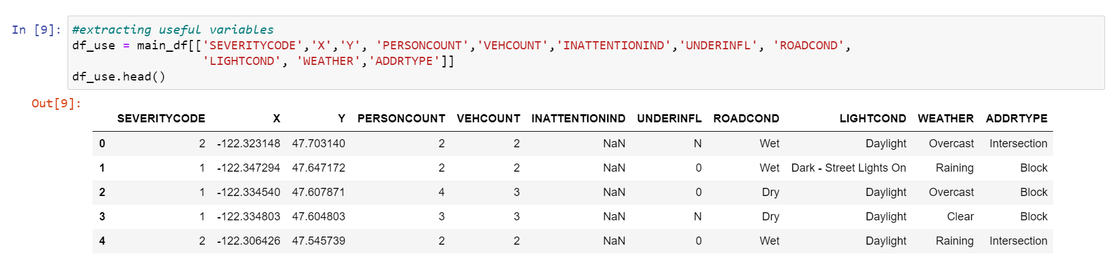
Then the attributes which will be used for EDA and the model are selected, namely- ‘SEVERITYCODE’, ‘X’ , ‘Y’, ‘PERSONCOUNT’, ‘VEHCOUNT’, ‘INATTENTIONIND’, ‘UNDERINFL’, ‘ROADCOND’, ‘LIGHTCOND’, ‘WEATHER’, ‘ADDRTYPE’.
In the ‘INATTENTIONIND’ coloumn, the null values i.e. which are not ‘Y’ are replaced with ‘N’. Then the null and ‘unknown’ values are dropped from the selected coloumns. The cleaned dataset now has 166705 records and 11 coloumns.
Since most of the selected variables are categorical, they are first encoded to numerical variables so that they can be processed. The remining numerical variables are also encoded so that they have a similar impact.

Slide 7
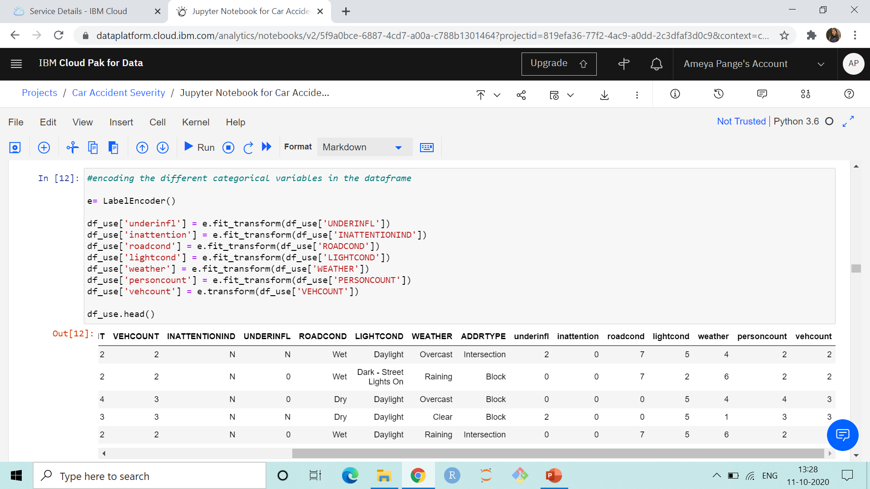
The encoded categorical variables are stored in the same dataframe and will later be extracted as needed.

Slide 8
Exploratory Data Analysis (EDA)
This stage involves analysis of the dataset, with visual methods like graphs and plots, to summarize the characteristics present in the data.
First the different or unique values of the categorical variables ‘ROADCOND’, ‘LIGHTCOND’, ‘WEATHER’ and ‘ADDRTYPE’ are observed.
Next a Subplot containing 3 histograms and 1 pie chart is created. The histograms depict the frequency of accidents for different weather, light and road conditions, grouped by the attribute and then the severity of the accident.
The different road conditions are: ‘Wet’, ‘Dry’, ‘Snow/Slush’, ‘Ice’, ‘Other’, ‘Sand/Mud/Dirt’, ‘Standing Water’ and ‘Oil’.
The different light conditions are: ‘Daylight’, ‘Dark - Street Lights On’, ‘Dark - No Street Lights’, ‘Dusk’, ‘Dawn’, ‘Dark - Street Lights Off’, ‘Other’ and ‘Dark - Unknown Lighting’.
The different weather conditions are: ‘Overcast’, ‘Raining’, ‘Clear’, ‘Snowing’, ‘Other’, ‘Fog/Smog/Smoke’, ‘Sleet/Hail/Freezing Rain’, ‘Blowing Sand/Dirt’, ‘Severe Crosswind’ and ‘Partly Cloudy’.
The different addresses are: ‘Intersection’, ‘Block’ and ‘Alley’.

Slide 9
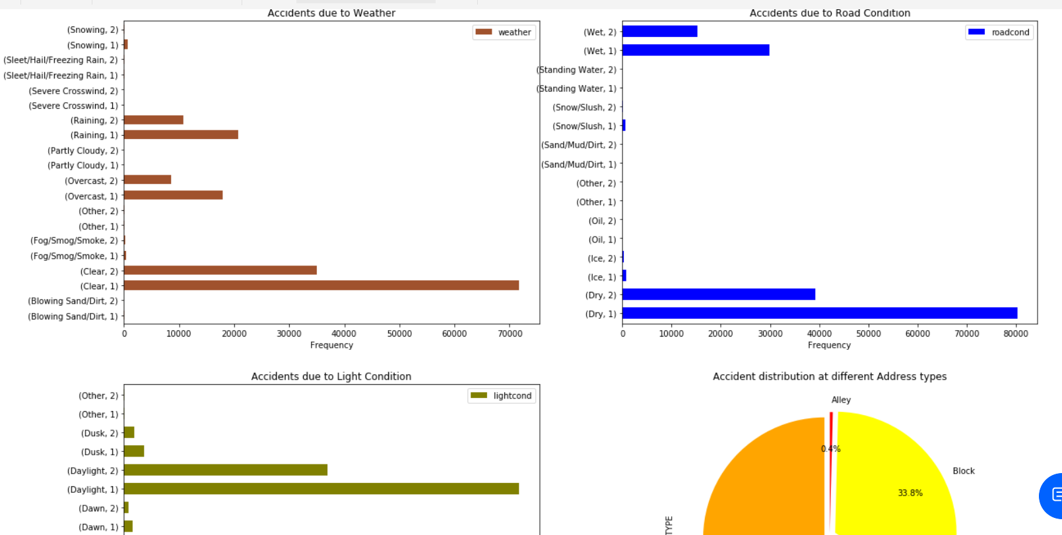
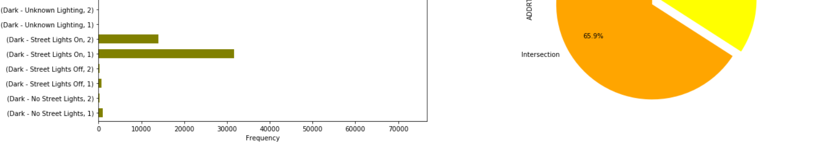
The pie chart depicts the proportions of accidents that take place at different types of addresses.

Slide 10

A correlation matrix between the encoded categorical and numerical variables is constructed. It is then visualised using a Heatmap of colour scheme ‘cmap = ‘RdYlGn’’. This correlation from -1 to +1 is represented by varying intensity of the colours from Red to Yellow and then Green.

Slide 11
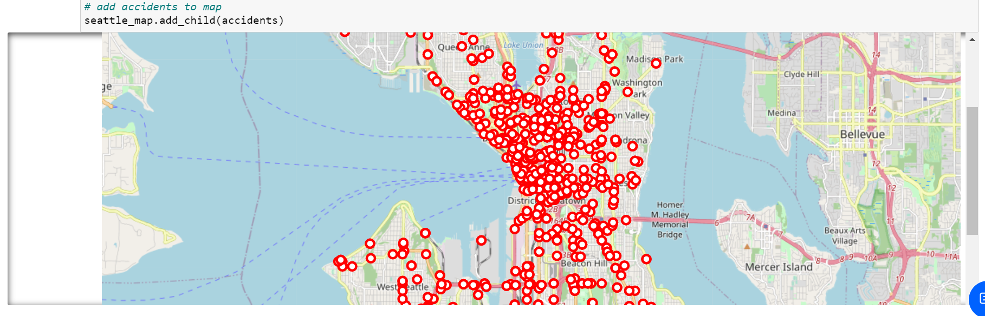
An interactive map of Seattle is created with circle markers at the place the accidents have occurred. Markers have been plotted for the hindmost records in the cleaned dataset so that they show the more recent accident prone areas in the city.
From the map, on zooming in, we can see that the number of accidents are higher around University Street, Westlake, Pioneer Square, Green Lake, etc. In general, they are higher in central Seattle.

Slide 12
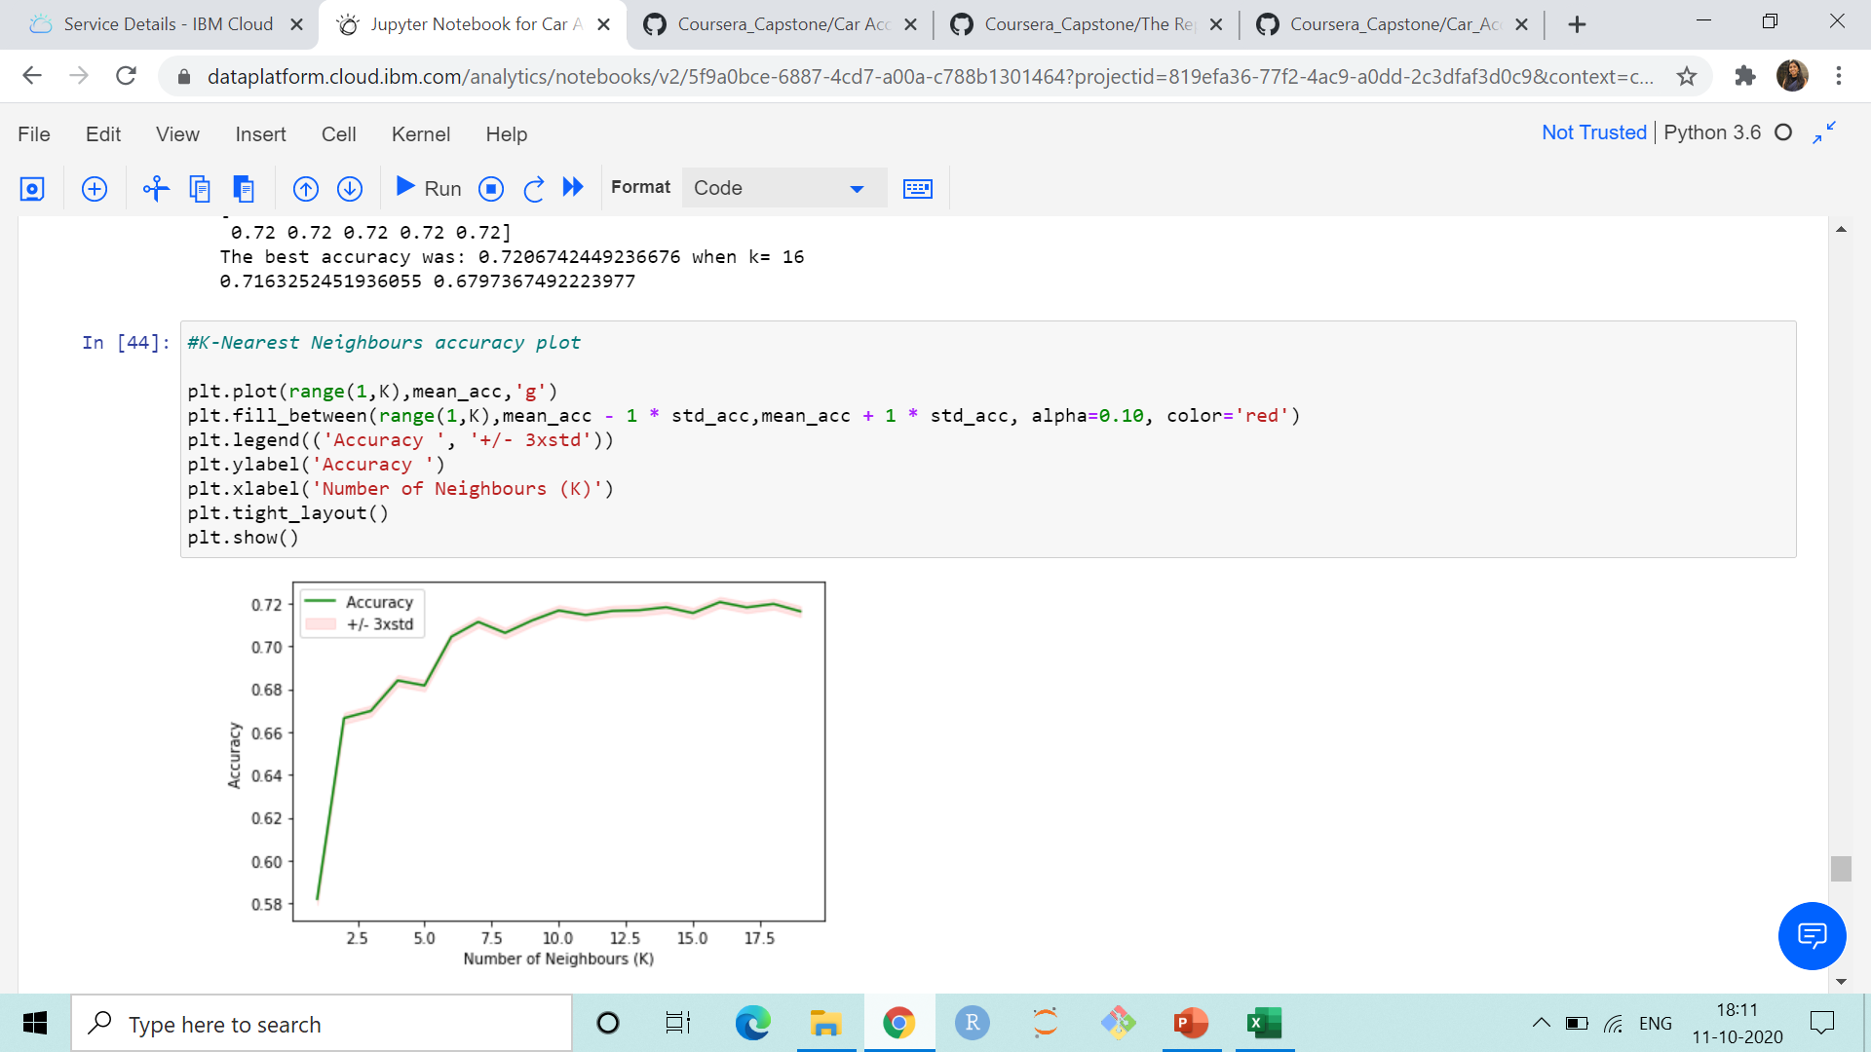
Data Modelling
In this stage, different Machine Learning models are applied to the dataset to predict the target variable i.e. accident severity.
First, the ‘feature’ and ‘target’ sets are defined and then split into training and testing sets. 20% of the data is used for testing and 80% for training.
The models used are Decision Trees, Support Vector Machine(SVM), K-Nearest Neighbours and Logistic Regression.
The predicted values are displayed for the Decision Tree model.
The best ‘K’ value is calculated and the graph of accuracy is plotted for the K-Nearest Neighbours model. The best ‘K’ was found to be 16.

Slide 13


Confusion matrices are constructed for SVM and Logistic Regression.

Slide 14
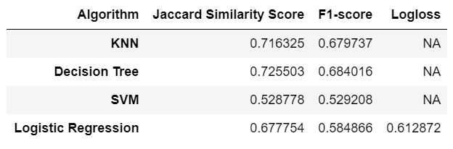
Model Evaluation
In this stage, the different Machine Learning models are compared based on their evaluation metric scores to decide which is the best for the data.
Each model’s accuracy is calculated using the Jaccard Similarity Score, F1-Score and Log Loss (only for Logistic Regression), each of which range between 0 to 1.

Slide 15
Conclusion
From the Model Evaluation stage we get the evaluation metrics for each model.
All models can be seen to have a considerably good accuracy except the SVM model.
The Jaccard Similarity Score and F1-Score for SVM are average as SVM is not very good with handling large datasets.
The model with the highest Jaccard Similarity Score is Decision Trees, with a score of 0.725503
The model with the highest F1-Score is also Decision Trees, with a score of 0.684016.
From these scores, we can say that Decision Trees is the best model for predicting the severity of an accident based on the dataset that was made available.

