Slide 1

Car Accident Severity
Coursera Capstone
Ameya Sandeep Pange

Slide 2
Introduction
According to the WHO, approximately 1.35 million people die each year as a result of road traffic crashes. Between 20 and 50 million more people suffer non-fatal injuries, with many incurring a disability as a result of their injury.
Road traffic injuries cause considerable economic losses to individuals, their families, and to nations as a whole. These losses arise from the cost of treatment as well as lost productivity for those killed or disabled by their injuries, and for family members who need to take time off work or school to care for the injured. Road traffic crashes cost most countries 3% of their gross domestic product.

Slide 3
Business Problem
The 2030 Agenda for Sustainable Development has set an ambitious target of halving the global number of deaths and injuries from road traffic crashes by 2020.
This would be made easier if there was a way to analyze the main causes and areas that the accidents took place in.
This would make it easier to take precautionary measures like placing traffic signs to warn people about the high accident risk in a particular area as well as allocate resources like medical and police assistance, etc.
This project aims at using techniques like Data Science and Machine Learning to build a model which can predict the severity of accidents based on historical data. This would make people drive more carefully in accident-prone areas and would also help the government bodies manage and reduce the number of accidents and the deaths related to them more effectively.

Slide 4
Data
The data used in the project is historical accident data for the city of Seattle.
The raw dataset consists of 190000+ unique records and has 37 attributes, numerical (15) as well as categorical(22).
The dataset includes date and time entries in 2 of the coloumns.
The labelled data is the ‘severity’ of the accident which is the target variable.
Many columns can be seen to have missing data or ‘unknown’ data.

Slide 5
Data Preparation
This stage involves the cleaning of the dataset and the significant feature selection.
The duplicate coloumns or records are dropped
The variables to be used are selected.
The null and ‘Unknown’ values are dropped from the selected coloumns. After cleaning the dataset has 166705 records and 11 attributes.
These attributes are then encoded before feeding them to different Machine Learning models.

Slide 6
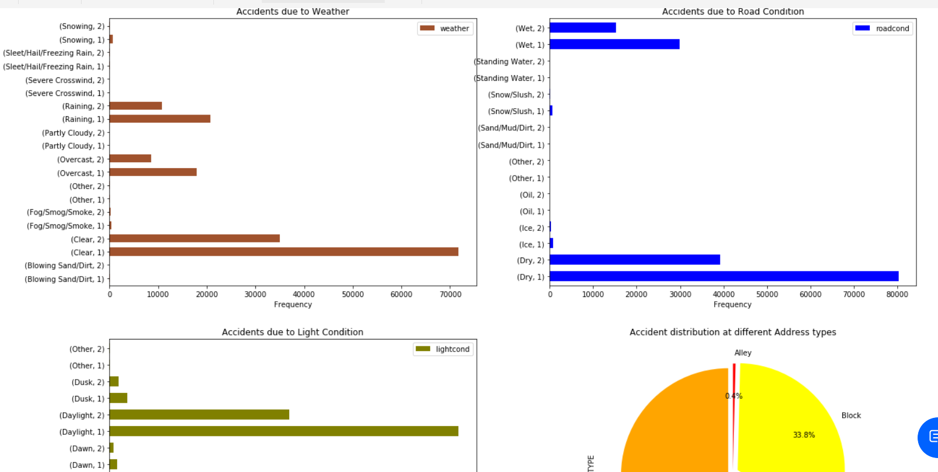
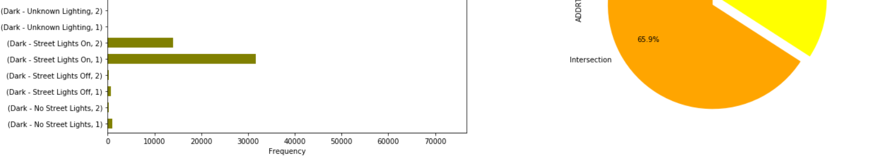
Methodology
Exploratory Data Analysis (EDA)
Most of the accidents of severity 1 occur when weather is Clear, the road condition is Dry and the light condition is Daylight.
Most accidents of severity 2 occur with the same weather, road and light conditions.
The address type at which most accidents occur are intersections.

Slide 7
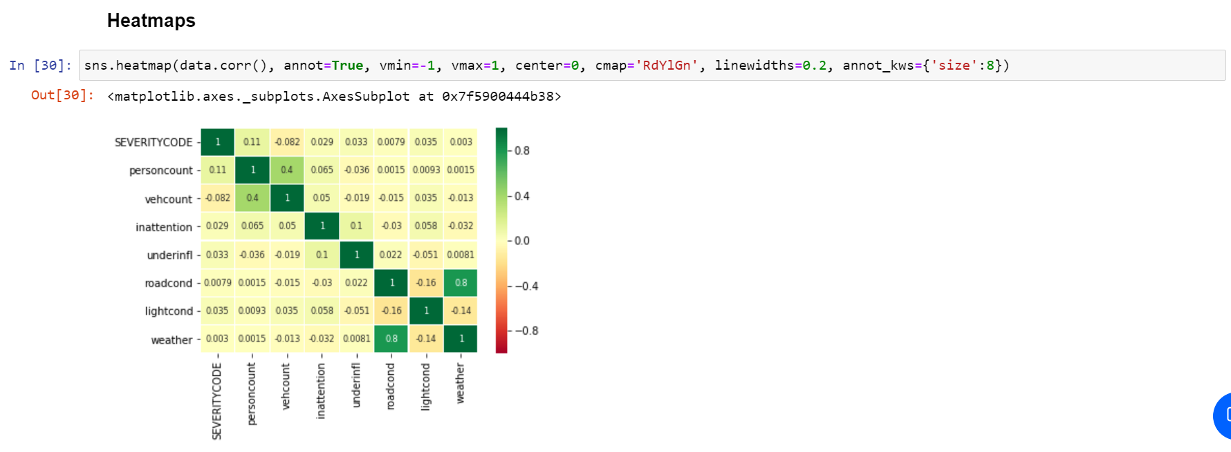
According to the heatmap weather and road conditions are highly positively correlated. Vehicle count and person count too have a weak positive correlation.
Accident severity also has a positive correlation with the feature variables.

Slide 8
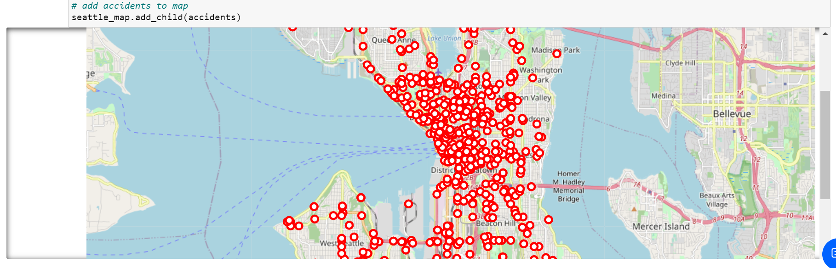
An interactive map of Seattle is created with circle markers at the place the accidents have occurred. Markers have been plotted for the hindmost records in the cleaned dataset so that they show the more recent accident prone areas in the city.
From the map, on zooming in, we can see that the number of accidents are higher around University Street, Westlake, Pioneer Square, Green Lake, etc. In general, they are higher in central Seattle.

Slide 9
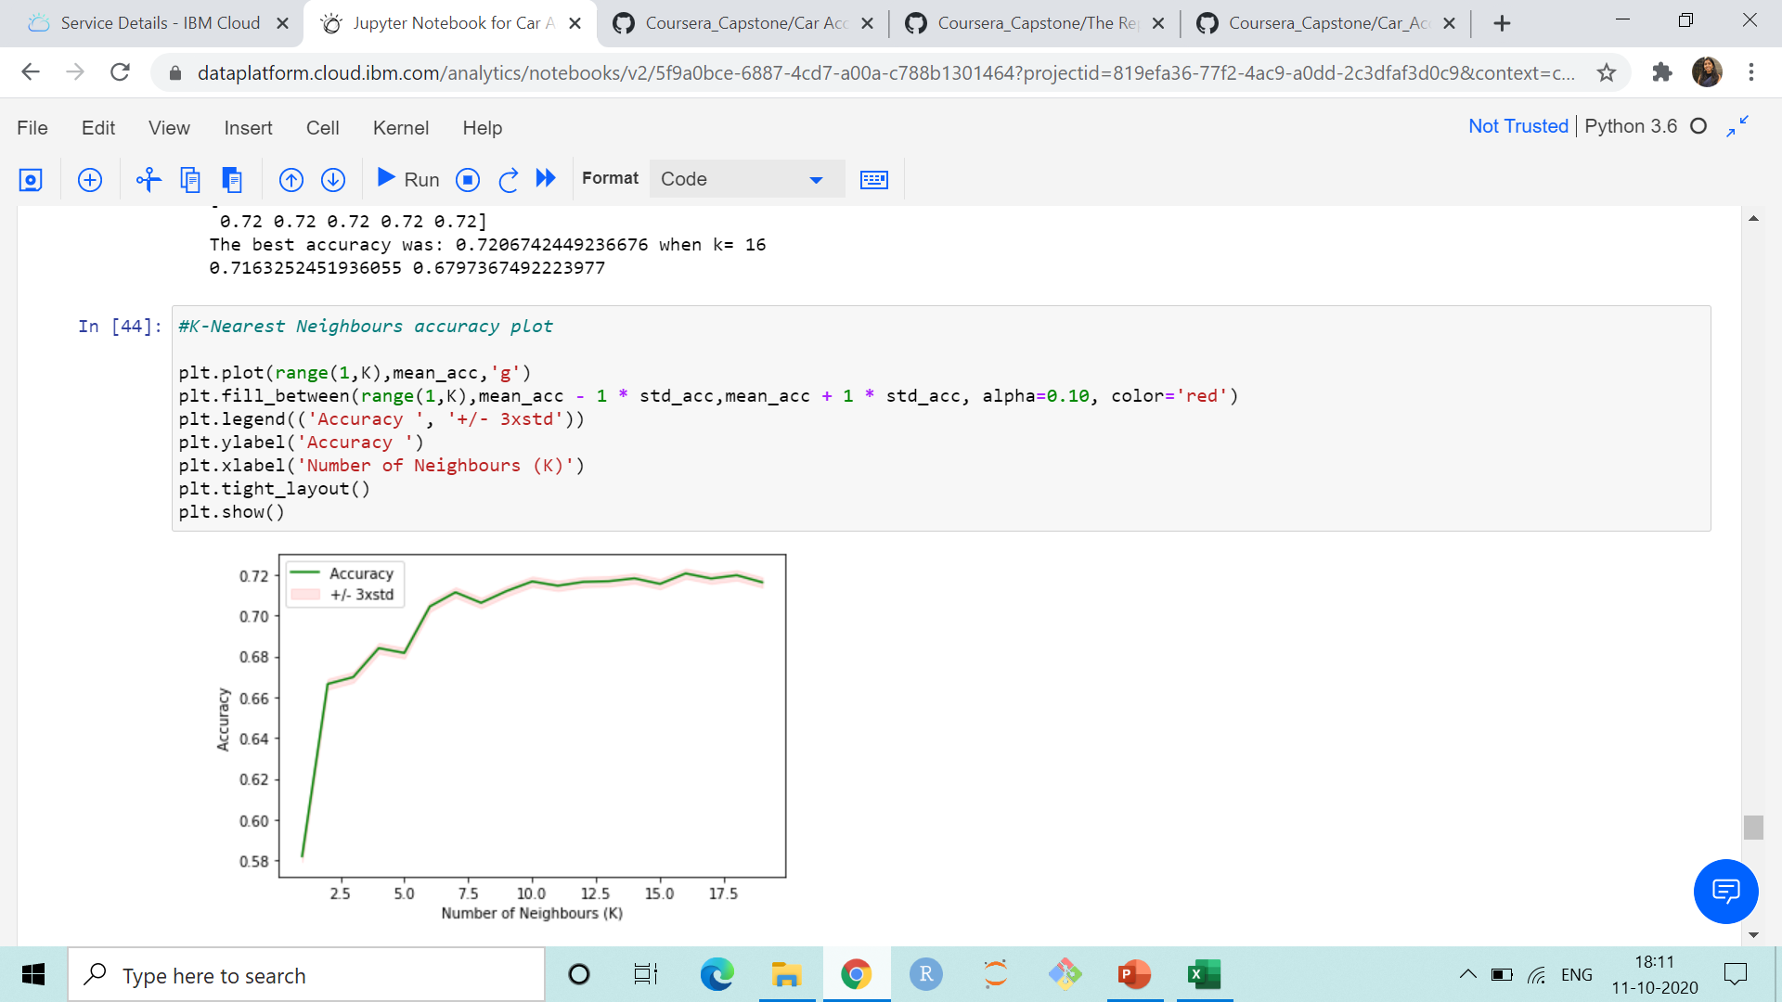
Data Modelling
The models used are Decision Trees, Support Vector Machine(SVM), K-Nearest Neighbours and Logistic Regression.
The predicted values are displayed for the Decision Tree model.
The best ‘K’ value is calculated and the graph of accuracy is plotted for the K-Nearest Neighbours model. The best ‘K’ was found to be 16.

Slide 10
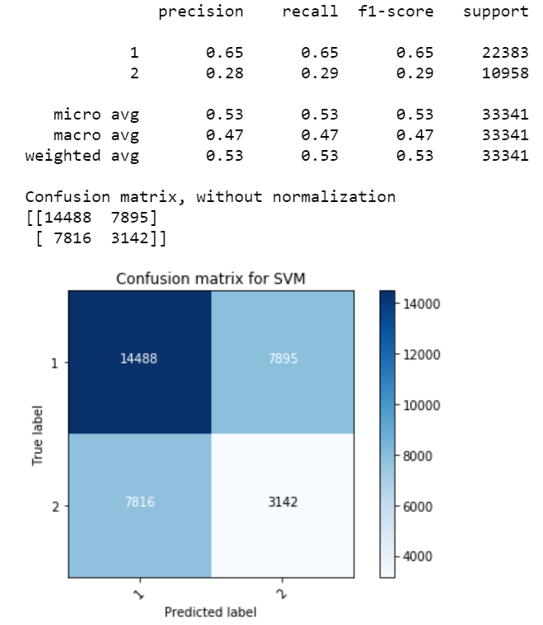
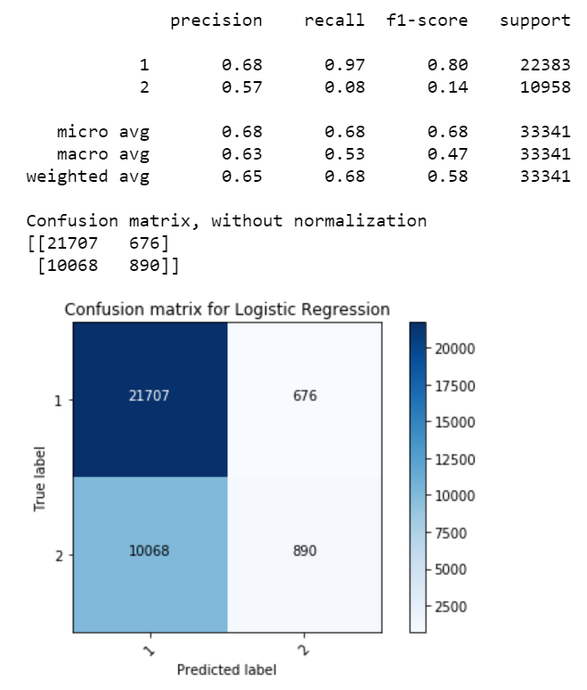
Confusion matrices are constructed for SVM and Logistic Regression. The highest precision and recall is for accidents of severity 1 modelled using Logistic Regression.

Slide 11
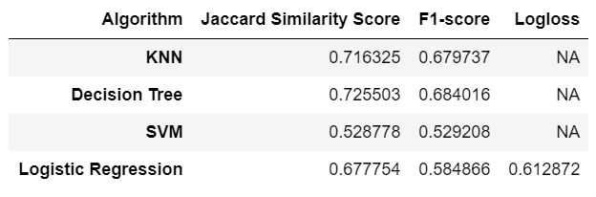
Results
In this stage, the different Machine Learning models are compared based on their evaluation metric scores to decide which is the best for the data.
Each model’s accuracy is calculated using the Jaccard Similarity Score, F1-Score and Log Loss (only for Logistic Regression), each of which range between 0 to 1.
The model with the highest Jaccard Similarity Score is Decision Trees, with a score of 0.725503
The model with the highest F1-Score is also Decision Trees, with a score of 0.684016

Slide 12
Conclusion
From the Model Evaluation stage we get the evaluation metrics for each model.
All models can be seen to have a considerably good accuracy except the SVM model.
The Jaccard Similarity Score and F1-Score for SVM are average as SVM is not very good with handling large datasets.
From these scores, we can say that Decision Trees is the best model for predicting the severity of an accident based on the dataset that was made available.

