Slide 1
BUILDING A SPAM FILTER USING MACHINE LEARNING
Amey Arya & Nikhita Singh

Slide 2
PROBLEM STATEMENT
WHY SPAM FILTERS?
With the entire world moving towards a digital age, emails have become an integral part of our lives. Since, most, if not all the information important to us is communicated through emails, it has become an arduous task to keep track of what is more important. This is where spam filters come in. These filters classify the emails as spam and non-spam to make our lives easier.

Slide 3
MOTIVATION
WHY SPAM FILTERS?
May contain links that lead to phishing web
May host sites that are hosting malware - or include malware as file attachments
Annoying and time-consuming
Identity theft

Slide 4
SOLUTION
We plan to implement various classifiers to build filters so that it predicts if an email is spam or not with some substantial degree of accuracy:
Naïve Bayes
Decision Tree
Random Forest
Support Vector Machine
k Nearest Neighbor

Slide 5
OVERVIEW
General idea of how we go forward with the application of classifiers
1
2
3
Input Dataset
Classifier
Output
Subset of the Ling-Spam Dataset, provided by Ion Androutsopoulos. A dataset that contains spam messages and messages from the Linguist list.
Processing the dataset by techniques like lower-casing, word stemming, stripping html etc.
Generating a dictionary (word : to frequency)
Extracting features
Applying filter using each classifier (training our model)
Testing the model to determine accuracy
Classify an email as spam or non- spam
To develop an intuition for real-world problems
An analysis of how each technique differs from the other and which one gives a better result.

Slide 6
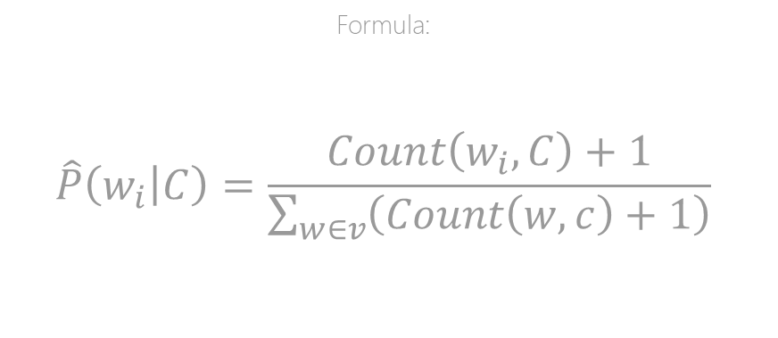
TRAINING THE MODEL
NAÏVE BAYES CLASSIFIER
Called the probabilistic classifier since it is based on calculating the probability that one item (email in our case) belongs to a class (spam or non-spam).
It counts the number of occurrences of a w (word of a dictionary) in all the c (sum of all occurrences of the dictionary words)
This probability will be calculated separately first on spam and then on non-spam emails.
Formula:
$$\hat{P}\left(\left.w_{i}\right|C\right)=\frac{Count\left(w_{i},C\right)+1}{\sum_{w∈v}{\left(Count\left(w,c\right)+1\right)}}$$

Slide 7
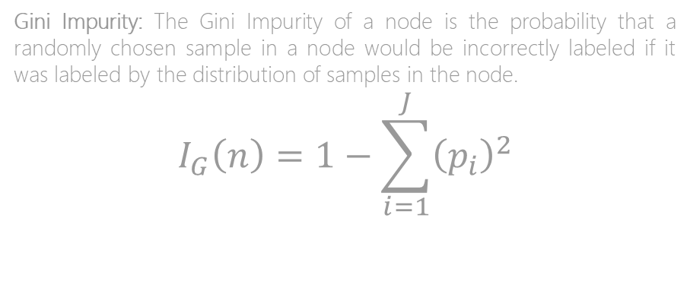
TRAINING THE MODEL
DECISION TREE CLASSIFIER
A decision tree is a straightforward method of classifying something. It organizes a series of test questions and conditions into a tree like structure.
Based on a simple yes/no question
Each question has either a True or False answer that splits the node. Based on the answer to the question, a data point moves down the tree.
Gini Impurity: The Gini Impurity of a node is the probability that a randomly chosen sample in a node would be incorrectly labeled if it was labeled by the distribution of samples in the node.
$$I_{G}\left(n\right)=1−\sum_{i=1}^{J}{{\left(p_{i}\right)}^{2}}$$

Slide 8
TRAINING THE MODEL
RANDOM FOREST CLASSIFIER
Made up of multiple decision trees
Decision tree is prone to overfitting when we don’t limit the maximum depth
Random sampling of training data points when building trees
Random subsets of features considered when splitting nodes
The random forest combines hundreds or thousands of decision trees, trains each one on a slightly different set of the observations, splitting nodes in each tree considering a limited number of the features. The final predictions of the random forest are made by averaging the predictions of each individual tree.

Slide 9
TRAINING THE MODEL
SUPPORT VECTOR MACHINE CLASSIFIER
A Support Vector Machine (SVM) is a discriminative classifier formally defined by a separating hyper-plane.
Regularization parameter – to achieve considerable non-linear classification line with more accuracy in reasonable amount of time
Kernel – another tuning parameter, for learning of hyperplane
Linear Kernel:
f(x) = B(0) + sum(ai * (x,xi))
Polynomial Kernel:
K(x,xi) = 1 + sum(x * xi)^d

Slide 10

TRAINING THE MODEL
k-NEAREST NEIGHBOR CLASSIFIER
kNN is a model that classifies data points based on the points that are most like it
It uses test data to make an “educated guess” on what an unclassified point should be classified as
The algorithm then works by finding the distance between a data point and the test data point (new introduced point)
Euclidean Distance:
d(p,q)=d(q,p)=$\sqrt{\sum_{i=1}^{n}{{\left(q_{i}−p_{i}\right)}^{2}}}$

Slide 11
CONFUSION MATRIX
 | PREDICTED (TRUE) | PREDICTED (FALSE)
ACTUAL (TRUE) | True Positive | False Positive
ACTUAL (FALSE) | False Negative | True Negative

Slide 12
RECALL
ACCURACY
$$a=\frac{True Positive+True Negative}{True Positive+True Negative+False Positive+False Negative}$$
PRECISION
p$=\frac{True Positive}{ True Positive+ False Positive}$
r $=\frac{True Positive}{True Positive+ False Negative}$

Slide 13
COMPARISON OF ACCURACY

Slide 14
COMPARISON OF PRECISION AND RECALL

Slide 15
CHALLENGES
Challenges
Plan of Action
Trying to figure out the best way to represent our features numerical values.
To save our feature matrix we are trying to use an efficient pickling technique such as pkl/NumPy n-D array. But, the prediction accuracy of our models is taking a significant hit
We then decided to create a dictionary of words with their frequency in the dataset
We are trying to tackle this problem by exploring other pickling techniques (JSON and CSV file formats)

Slide 16
WHAT IS STILL TO BE DONE
Random Forest :
max_depth = 2
random_state = 0
n_estimators = 100
We plan to tweak these features analyze how they affect the accuracy of the model.
SVM :
kernel: Radial Basis Function (RBF)
gamma : auto
We plan to tweak these features analyze how they affect the accuracy of the model.
kNN :
n_neighbors = 3
We plan to explore neighbors ranging from 1-10.
Random Forest
Support Vector Machine
k-Nearest Neighbor

Slide 17
FUTURE SCOPE
Our exploration on classification can be used on many other real-world problems such as :
Disease detection
Fraud analysis
Weather forecasting
We plan to extend our trained models to the classic example of fraud detection on Enron Dataset.

Slide 18

THANK YOU!

