Slide 1
Model Building Part....!

Slide 2
1. Splitting The Dataset Into The Training Set And Test Set & Applying K-Fold Cross Validation
What is Model Building?
Model building in machine learning is the process of creating and training a mathematical representation that can make predictions or decisions based on input data
What is Splitting the dataset?
Splitting dataset is a dividing the available data into two or more subsets for different purposes, typically training and testing.

Slide 3
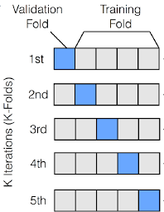
1. Splitting The Dataset Into The Training Set And Test Set & Applying K-Fold Cross Validation
What is K-Fold Cross Validation?
K-fold cross-validation is a technique used in machine learning to assess the performance of a model

Slide 4
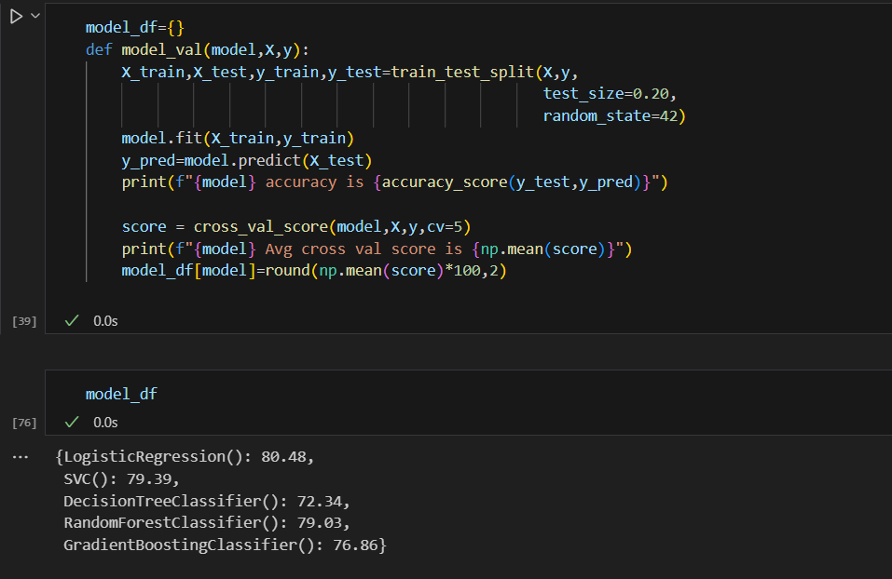
Code and output

Slide 5
2. Logistic Regression
What is Logistic Regression?
Logistic Regression is a statistical method that is used for building machine leaning models where the dependent variable is dichotomous.
Logistic Regression is used to predict the categorical dependent variable.
Its used when the prediction is categorical for example ‘yes’ or ‘no’, ‘true’ or ‘false’, ‘0’ or ‘1’.

Slide 6
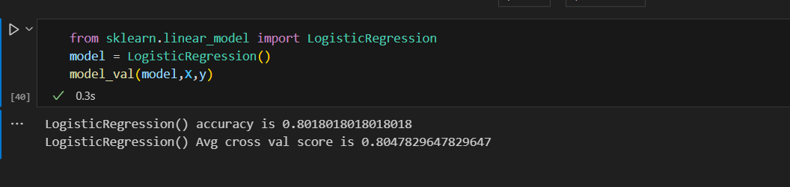
Code and output

Slide 7
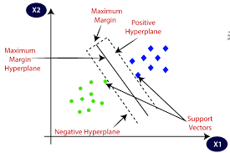
3. SVM (Support Vector Machine)
SVM is a specific implementation of the Support Vector Machine algorithm that is designed specifically for classification tasks.

Slide 8
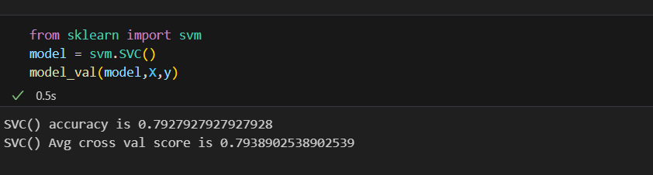
Code and Output

Slide 9
Decision Tree Classifier
Decision Tree is a Supervised learning technique that can be used for both classification and Regression problems, but mostly it is preferred for solving Classification problems.
In a Decision tree, there are two nodes, which are the Decision Node and Leaf Node.
Decision nodes are used to make any decision and have multiple branches, whereas Leaf nodes are the output of those decisions.

Slide 10
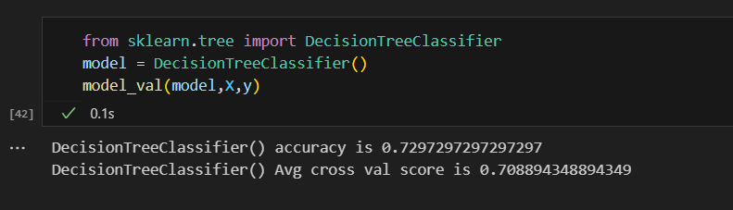
Code and output

Slide 11
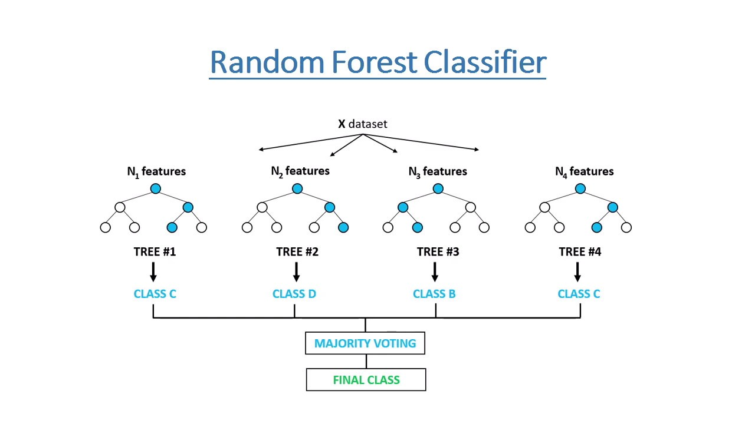
Random Forest Classifier
Random Forest is a popular machine learning algorithm that belongs to the supervised learning technique.
It can be used for both Classification and Regression problems in ML.

Slide 12
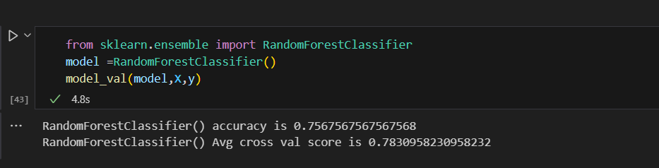
Code and output

Slide 13
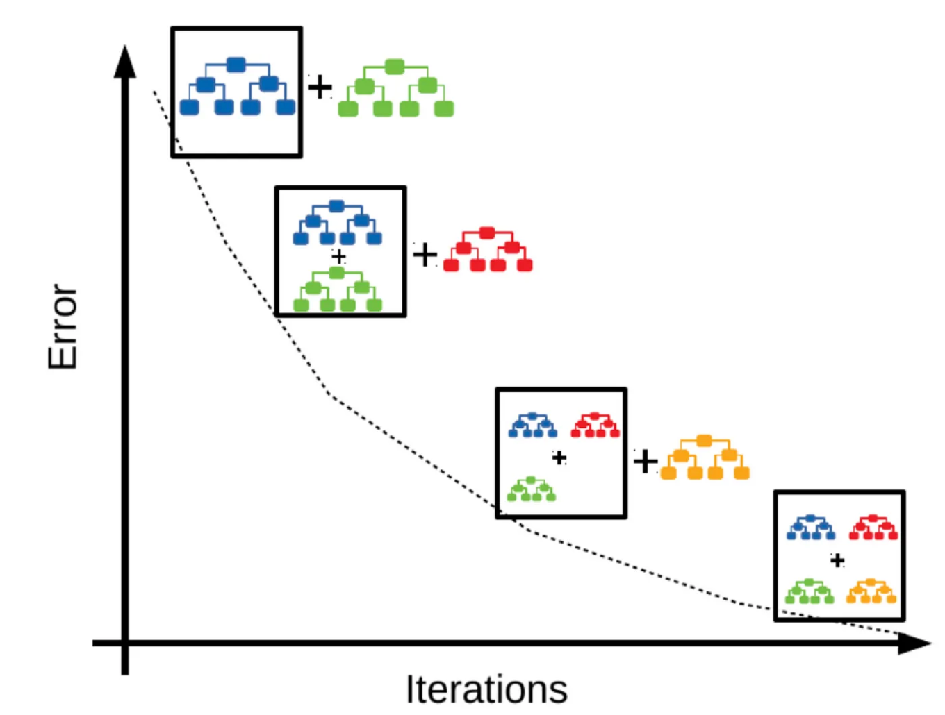
Gradient Boosting Classifier
Gradient Boosting classifier is one of the most popular forward learning ensemble methods in machine learning.
It is a powerful technique for building predictive models for regression and classification tasks.

Slide 14
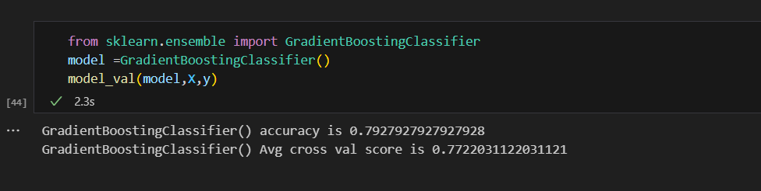
Code and output

Slide 15
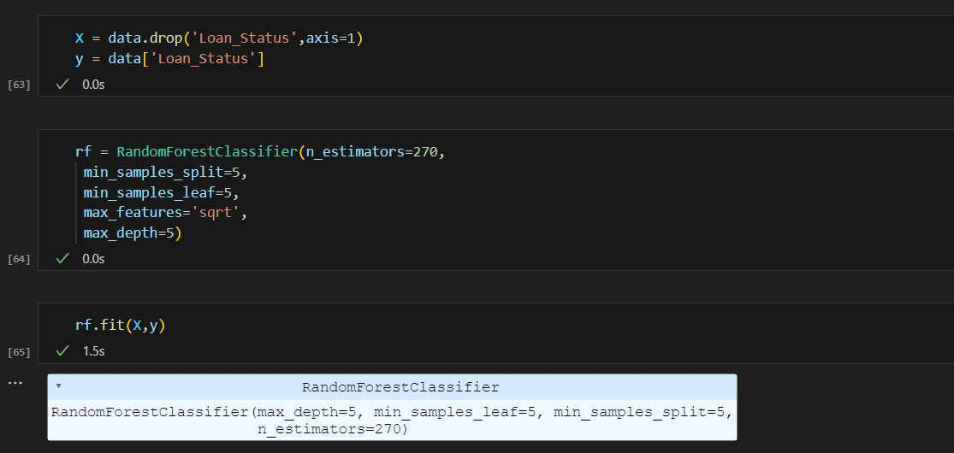
Save the model

Slide 16
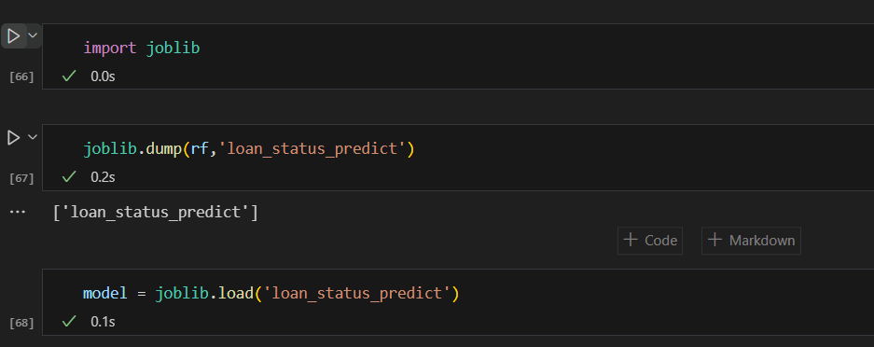
Save the model

