Slide 1

BestFriend
- Amey Bhavsar
Alexa Skills Hackathon
April 2018

Slide 2
About the skill.
Depression
Motivation
The most basic remedy to depression or sorrow is to share it with someone.
A person feels better when they talk on topics they like and not that they hate.

Slide 3
About the skill.
Hence, ‘BestFriend’ converses with you on various topics, so that you never feel off the need for a buddy of yours.
Sad ☹
Talking with the skill
Happy ☺
Well, this takes care of your boredom too ;)

Slide 4
About the skill.
So, in a nutshell, ‘BestFriend’ is all about a social bot that is always there for you to chat with, on tons of topic, hours long.
Examples next up

Slide 5
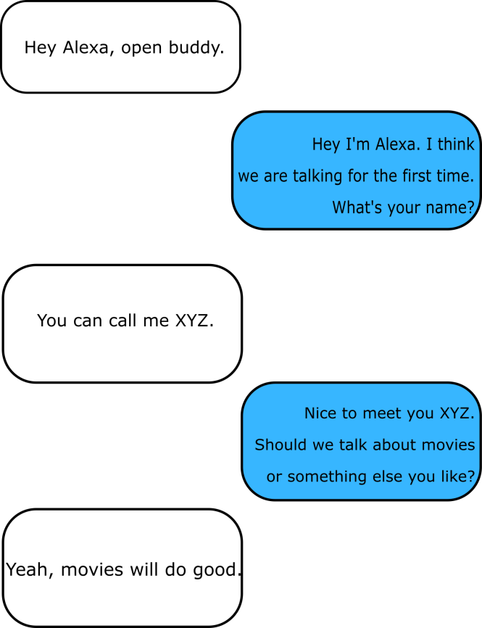
Examples and Usage.
The skill checks with the database if the user has interacted before, using the userID.
If not, it will ask the name; If yes, then the skill continues the conversation from the last interaction.
The skill has a list of 20+ topics for you to discuss about. It selects one randomly and asks the user whether they'd like to converse upon it.

Slide 6
So, how is all of this related to depression and rejoicing a person?

Slide 7
Well, according to reports, when you speak out your heart to somebody, you actually de-stress yourself. You share your feelings and let the skill do its work : Keeping you motivated.
For this, we have a quote collection, which includes some great lines that make sure you never get sad :)
Hope you have a good time with the skill.

Slide 8
Developer Information and other things.
Developer Name : Amey Bhavsar
Vendor ID : M1HAQIORAS9HNM
Skill ID : amzn1.ask.skill.306d6775-ceda-4bc1-8bef-c49841acf3bc
Endpoint used : AWS Lambda
Services used : Lambda, IAM and DynamoDB
Email me at iamamey24@gmail.com
HackerEarth : @amey_bhavsar
Thank You!

