Slide 1
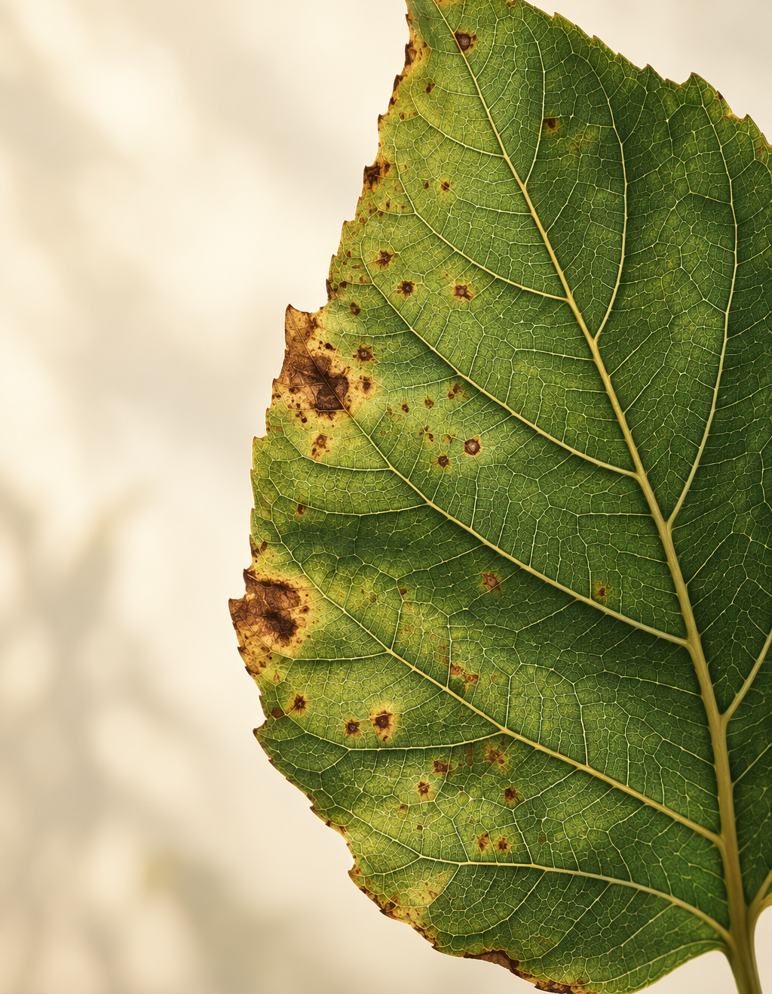
Plant Disease
Detection
Using Convolutional Neural Networks
Developed by
Amey Ravindra Bonde
COEP Technological University
Deep Learning · Image Classification
Illustrative cover image

Slide 2
Project overview & objectives
A leaf image as input.
A plant–condition label
as output.
Problem
Visual symptoms can look similar across diseases. A consistent image classifier can support screening.
Objectives
A supervised classification prototype that learns visible patterns from labelled leaf images.
Classify 38 healthy or diseased categories and measure performance on validation images.
Scope: single-leaf classification within known categories.
02

Slide 3
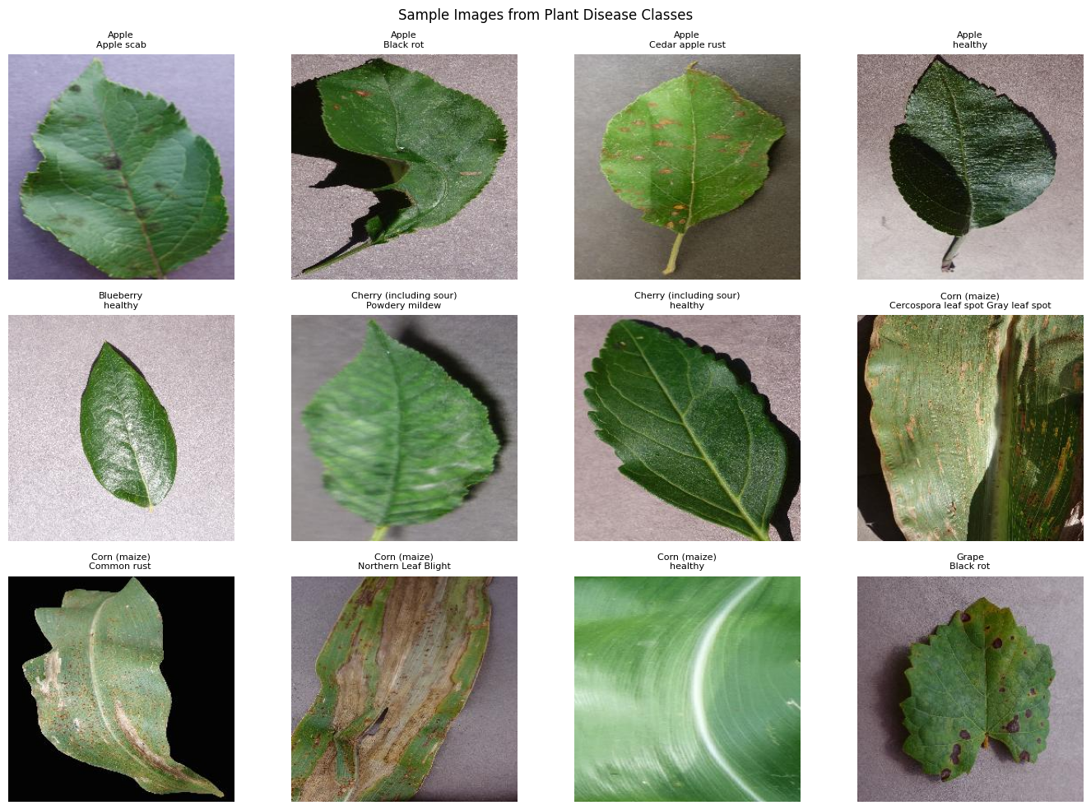
Dataset overview
38
plant–condition categories
54,305
original images in
the notebook copy
Healthy and diseased leaves across multiple crops
03

Slide 4
Dataset preparation
Reduce dominant classes
44,351
Keep 2,000 each: orange citrus greening, tomato yellow leaf curl virus and soybean healthy.
images after downsampling
Subset | Images
Training ≈ 80% | 35,492
Validation ≈ 20% | 8,859
Prepare image tensors
Resize to 224 × 224 RGB. Divide pixel values by 255 to obtain values between 0 and 1.
04

Slide 5
Target variable
One of 38 categories
Training
One-hot encoded label
Length: 38
Each label combines the crop name with its disease or healthy status.
Prediction
Highest softmax score
Example class label | Meaning
Apple___Black_rot | Apple leaf with black rot
Apple___healthy | Healthy apple leaf
Tomato___Early_blight | Tomato leaf with early blight
05

Slide 6
Modeling flow
1. Load & prepare
2. Split the data
3. Train the CNN
→
→
Class folders, resize, rescale
Training and validation
Six epochs with Adam
↓
6. Predict a label
5. Evaluate
4. Select checkpoint
←
←
Preprocess, argmax, class map
Accuracy, F1, confusion matrix
Highest validation accuracy
The saved CNN powers the Streamlit app for uploaded leaf disease prediction.
06

Slide 7
CNN architecture
Input
Conv2D (32)
MaxPool
Conv2D (64)
MaxPool
Flatten
Dense
Softmax
224 × 224 × 3
→
222 × 222 × 32
→
111 × 111 × 32
→
109 × 109 × 64
→
54 × 54 × 64
→
186,624
→
256
→
38
RGB image
3 × 3 · ReLU
2 × 2
3 × 3 · ReLU
2 × 2
features
ReLU units
classes
Image
Feature extraction
Classification
CUSTOM SEQUENTIAL CNN • 47,805,158 trainable parameters • 38 output classes
Dense(256) contributes 47,776,000 parameters; each convolution uses valid padding.
07

Slide 8
Implementation & model selection
TensorFlow / Keras
Training setup
model.compile(
optimizer=Adam(learning_rate=1e-3),
loss="categorical_crossentropy",
metrics=["accuracy"]
)
model.fit(train_generator, epochs=6,
validation_data=validation_generator,
callbacks=callbacks)
Batch size 32
Adam optimizer
Six epochs
Best checkpoint
Monitor validation accuracy. Reload the best saved model after training.
One custom CNN is evaluated. The saved checkpoints do not constitute a comparison of different architectures.
08

Slide 9
Training graphs
99.74% training 89.12% validation
The 10.62 percentage-point accuracy gap indicates overfitting.
09

Slide 10
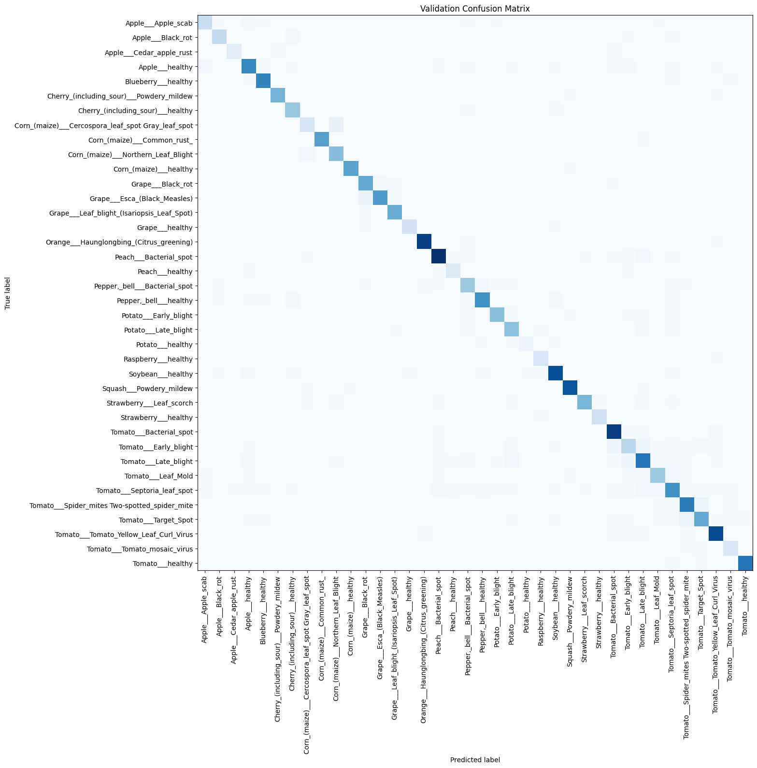
Evaluation results
89.12%
validation accuracy on 8,859 images
Metric | Score
Macro F1 | 0.8762
Weighted F1 | 0.8904
Validation loss | 0.4948
Diagonal entries show correct classifications. Results use the checkpoint-selection split.
10

Slide 11
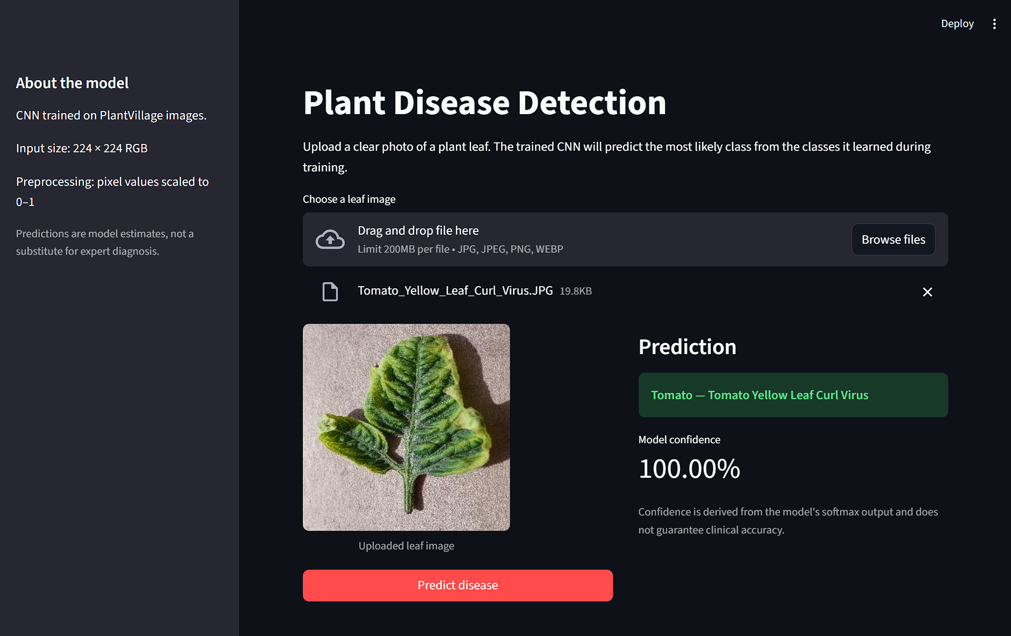
Streamlit Interface
Live prediction workflow
01
Upload image
JPG, JPEG, PNG or WEBP
02
Preprocess
RGB → 224 × 224 → ÷255
03
CNN prediction
Class label + softmax score
EXAMPLE PREDICTION
Tomato Yellow Leaf Curl Virus
100% softmax ≠ proven accuracy
11

Slide 12
Conclusion & future potential
A complete training pipeline
for 38 leaf-image categories
Current achievement
Future work
Custom CNN with 89.12% recorded validation accuracy. Streamlit application enables image upload and disease prediction.
Test independent field images. Add augmentation and a smaller model. Improve confidence calibration and explore a mobile interface.
12

Slide 13
References
[1] Hughes & Salathé (2015)
[4] Too et al. (2019)
An open access repository of images on plant health to enable mobile disease diagnostics.
A comparative study of fine-tuning deep learning models for plant disease identification.
arxiv.org/abs/1511.08060
Computers and Electronics in Agriculture, 161, 272–279
[2] Mohanty et al. (2016)
[5] Pacal et al. (2024)
Using deep learning for image-based plant disease detection. Frontiers in Plant Science, 7:1419.
A systematic review of deep learning techniques for plant diseases. Artificial Intelligence Review, 57:304.
doi.org/10.3389/fpls.2016.01419
doi.org/10.1007/s10462-024-10944-7
[3] Ferentinos (2018)
[6] Kaggle: PlantVillage Dataset
Deep learning models for plant disease detection and diagnosis. Comput. Electron. Agric., 145, 311–318.
PlantVillage dataset of plant leaf images for plant disease classification.
Computers and Electronics in Agriculture, 145
kaggle.com/datasets/abdallahalidev/plantvillage-dataset
Sources follow the bibliography of the supplied project research paper.
13

