Slide 1
4TH ARAB COCHLEAR IMPLANT CONFERENCE · ARABCIC 2026
Jeddah, Kingdom of Saudi Arabia · 26–28 November 2026
A Fuzzy Logic Framework for Sensorineural Hearing Loss Classification
Preserving diagnostic gradation lost to crisp WHO thresholds
Dr. Sanyaolu Ameye (MBBS, FWACS, FMCORL, Pg Cert ML/AI, MSc Data Science)
ENT Surgeon and Data Scientist
King Fahad Specialist Hospital, Tabuk, Kingdom of Saudi Arabia
10,889
48
0–100
adults 20–69 y · 3 NHANES cycles
audiology-derived fuzzy rules
continuous FAI scale
Notes:
Good morning. Hearing loss classification has barely changed since Goodman in 1965. This talk presents a fuzzy logic framework that preserves the diagnostic gradation that crisp WHO thresholds discard, validated on three NHANES adult cycles (20–69 y).

Slide 2
The problem: crisp thresholds on continuous biology
2 / 15
One decibel changes the label
39.2%
PATIENT A
PTA-4 = 25 dB HL
Label: Normal
PATIENT B
PTA-4 = 26 dB HL
Label: Mild hearing loss
of ears fall within ±5 dB of a WHO severity boundary — the zone where crisp labels are most fragile
One decibel, well within the test–retest variability of audiometry (±5–10 dB), produces categorically different labels, follow-up and candidacy decisions.
±5–10 dB
What a single PTA number discards
• A 4 kHz notch and a flat 30 dB loss share one grade, with very different functional profiles
• Configuration and asymmetry are invisible to a pure-tone average
test–retest variability of pure-tone audiometry — smaller than the gaps crisp rules insist on
Goodman (1965) → Clark (1981) → WHO World Report on Hearing (2021): the classification has barely changed in fifty years.
ArabCIC 2026 · Jeddah · Fuzzy Audiometric Index (FAI)
Notes:
Two patients separated by a single decibel are categorically different under WHO rules, even though a decibel sits inside audiometry's own test-retest error. Nearly four in ten ears in NHANES sit within 5 dB of a boundary. And the PTA throws away frequency-specific detail and configuration entirely.

Slide 3
The solution: fuzzy sets for graded severity
3 / 15
CRISP LOGIC — TODAY
FUZZY LOGIC — THIS STUDY
✗ Binary membership: a threshold is in one category or not at all
✗ Sharp cutoffs at 25 / 40 / 55 / 70 / 90 dB
✗ No frequency resolution beyond an average
✗ No configuration typing or asymmetry scoring
✓ Gradual membership (0 → 1) in every severity category
✓ Overlapping trapezoidal functions at each boundary (2.0 dB overlap)
✓ Continuous FAI score (0–100), frequency-resolved
✓ Configuration vector + asymmetry index
Fuzzy Audiometric Index (FAI): continuous 0–100 · frequency-resolved · interpretable rule base
ArabCIC 2026 · Jeddah · Fuzzy Audiometric Index (FAI)
Notes:
Fuzzy set theory, introduced by Zadeh, lets a threshold belong to several severity categories at once. The result is a continuous Fuzzy Audiometric Index, a configuration vector, and an asymmetry index — all produced by an interpretable rule base rather than a black box.

Slide 4
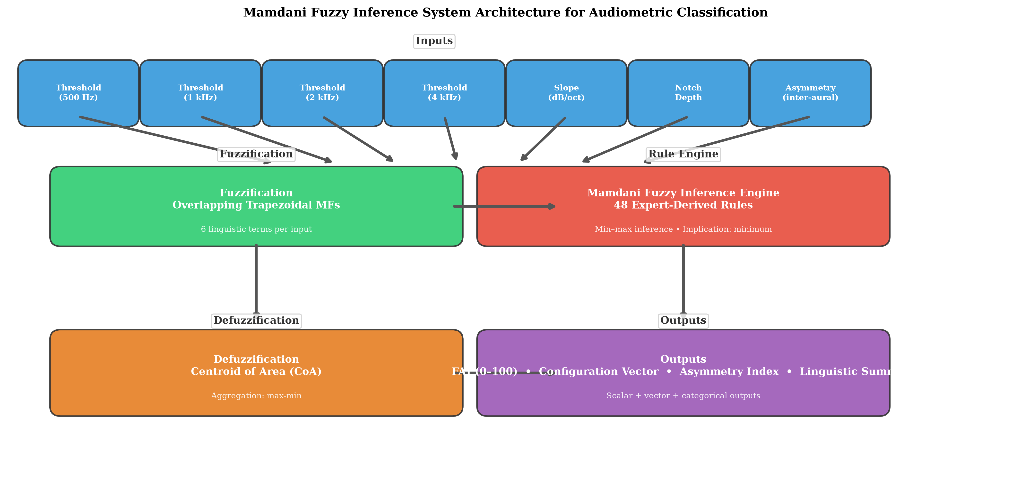
Methods: data and the Mamdani fuzzy inference system
4 / 15
Data: 3 NHANES adult cycles
• Adults 20–69 y: 3 NHANES cycles (1999-2000, 2011-12, 2015-16), n = 10,889
• 80/20 participant-level split: 15,656 training / 3,912 held-out test ears (no bilateral leakage)
• Membership functions and rule base developed on the training set only
• All metrics reported on the held-out test set
Comparators
• PTA-4 (WHO) crisp classification
• XGBoost and Random Forest
Implementation: scikit-fuzzy (v0.5.0), scikit-learn, XGBoost, SciPy
Mamdani FIS: 7 frequency thresholds → fuzzification → 48 rules → centroid defuzzification → FAI
ArabCIC 2026 · Jeddah · Fuzzy Audiometric Index (FAI)
Notes:
We combined three NHANES cycles that tested adults 20-69 y (10,889 participants; 19,568 clean ears). An 80/20 stratified split keeps every WHO category in both partitions, and everything is optimised on training and reported on the held-out test set. Comparators are the WHO PTA-4 rules, XGBoost and Random Forest.

Slide 5
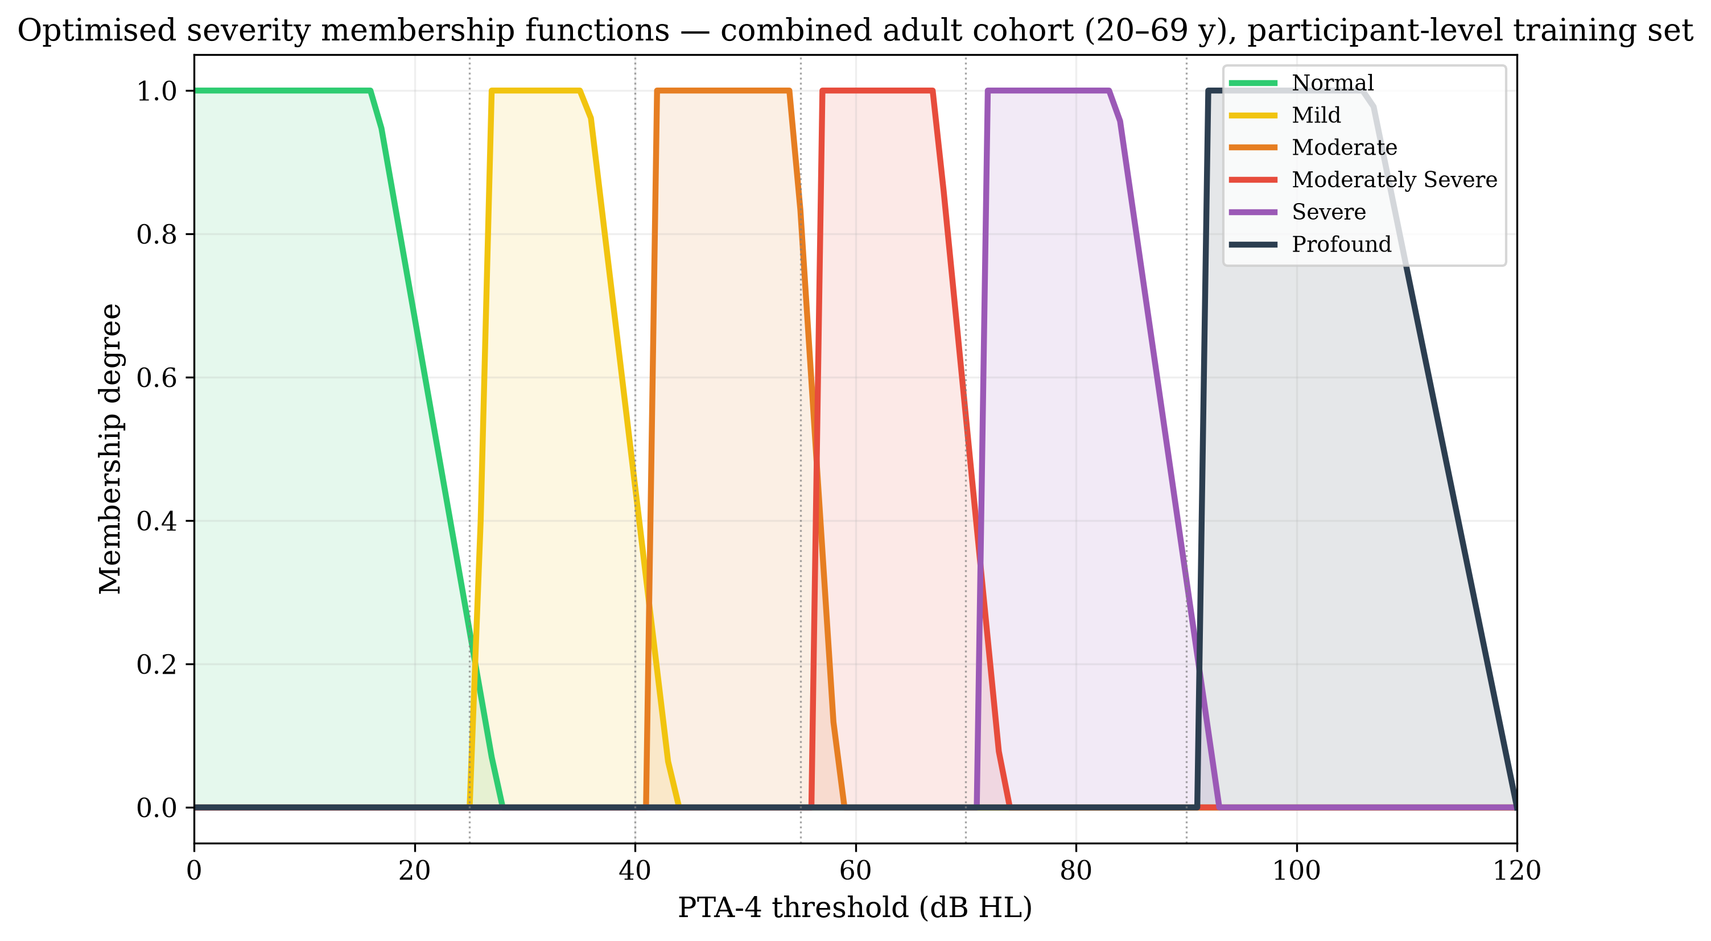
Fuzzification: trapezoidal membership functions
5 / 15
Category | a | b | c | d
Normal | 0.0 | 6.4 | 16.4 | 27.8
Mild | 25.8 | 26.3 | 36.4 | 43.5
Moderate | 41.5 | 42.0 | 54.3 | 58.5
Moderately Severe | 56.5 | 57.0 | 67.9 | 73.5
Severe | 71.5 | 72.0 | 83.7 | 93.0
Profound | 91.0 | 91.5 | 104.6 | 120.0
Optimised on the NHANES training distribution [a, b, c, d]
Overlapping trapezoids for six severity categories, with NHANES density overlay
Exactly 2.0 dB overlap at each WHO boundary → smooth transitions
26 dB HL → Normal μ 0.16 and Mild μ 0.40: borderline, not binary
Why trapezoids
NHANES severity distributions are asymmetric with plateau cores — poorly captured by triangular or Gaussian shapes.
ArabCIC 2026 · Jeddah · Fuzzy Audiometric Index (FAI)
Notes:
Each frequency band has six overlapping trapezoidal membership functions. The optimised parameters sit a few dB to the right of the classic WHO cutoffs, with exactly 2 dB of overlap, so a 26 dB threshold is simultaneously 16% normal and 40% mild.

Slide 6
Rule base: 48 audiology-derived rules in four groups
6 / 15
SEVERITY · 12 RULES
CONFIGURATION · 14 RULES
Map thresholds to severity output; blended rules handle transitional zones.
Combine slope and notch to type the audiogram shape.
IF threshold is Mild AND slope is Flat THEN severity is Mild
IF slope is Steeply Sloping AND notch is Deep THEN configuration is Notched
ASYMMETRY · 12 RULES
MIXED-LOSS · 10 RULES
Score inter-aural differences and adjust severity.
Handle complex presentations combining all dimensions.
IF inter-aural difference > 30 dB at 3+ frequencies THEN asymmetry is Severely Asymmetric
IF asymmetric AND notched THEN flag mixed aetiology
Mamdani min–max composition · centroid-of-area defuzzification · FAI 0–100
ArabCIC 2026 · Jeddah · Fuzzy Audiometric Index (FAI)
Notes:
Forty-eight expert-derived rules in four groups: severity, configuration, asymmetry and mixed-loss patterns. Inference uses Mamdani min-max composition with centroid-of-area defuzzification to produce the continuous FAI.

Slide 7
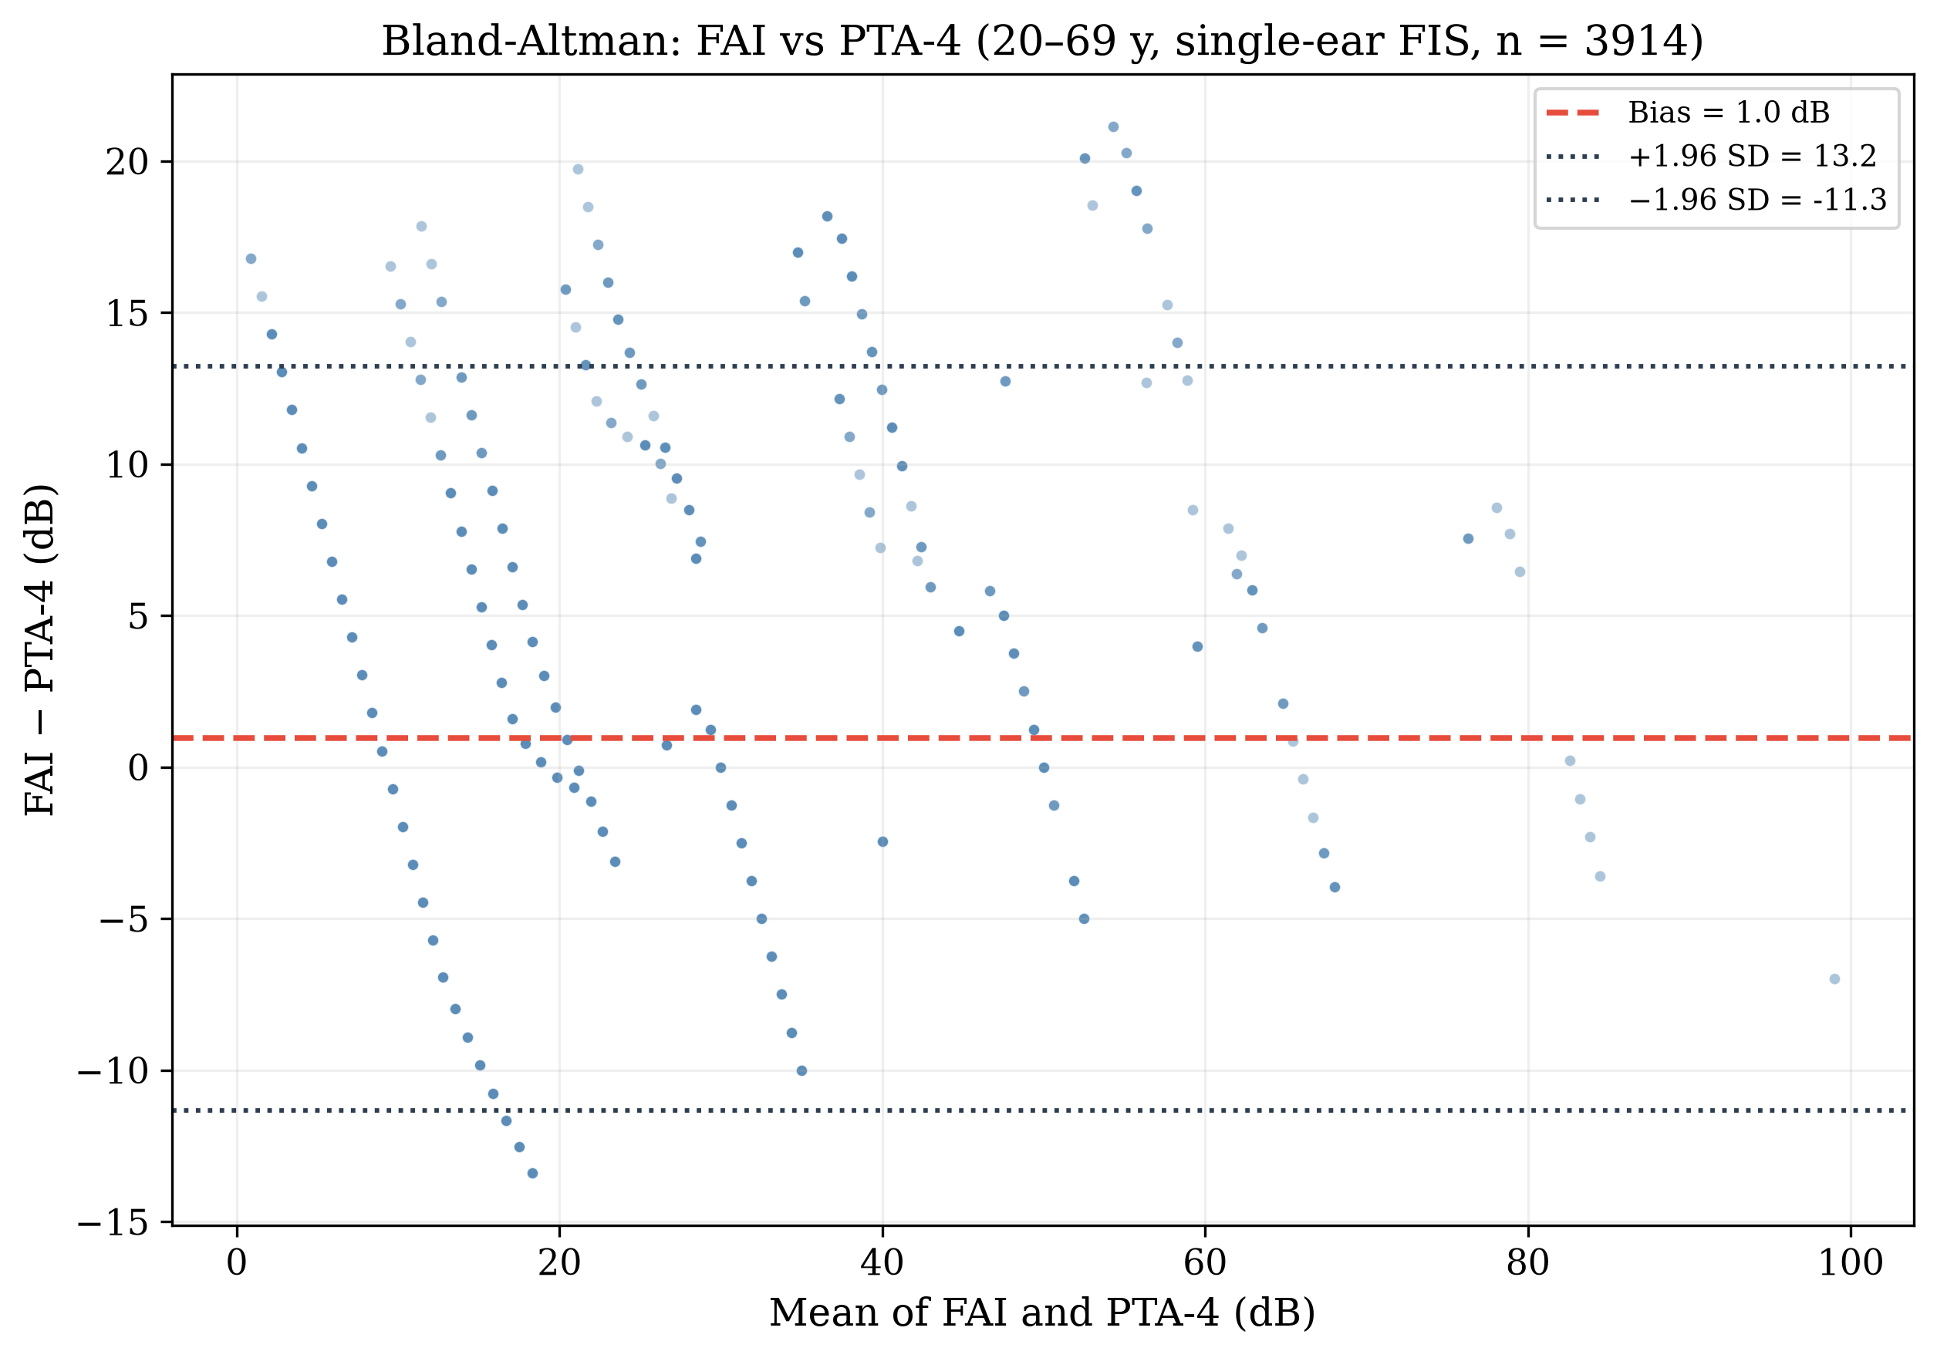
Results: FAI vs WHO PTA-4 and ML comparators
7 / 15
Method | Weighted κ | Borderline (±5 dB) | Clear-case
FAI (fuzzy) | 0.93 | 79.8% | 98.1%
PTA-4 (WHO) | 1.00* | 100%* | 100%*
XGBoost | 0.98 | 93.4% | 100%
Random Forest | 0.98 | 93.6% | 100%
*PTA-4 is the reference standard; borderline accuracy reflects discrepancy within ±5 dB of thresholds.
In borderline cases (±5 dB), the fuzzy system deliberately reclassifies (79.8% agree with the crisp grade) while matching it in clear cases (98.1%).
Bland–Altman: FAI vs PTA-4 reference
κ = 0.93
vs WHO PTA-4 reference, 20–69 y test
ρ = 0.81 · MAE 5.0 dB
FAI vs PTA-4, n = 3,912 test ears
ArabCIC 2026 · Jeddah · Fuzzy Audiometric Index (FAI)
Notes:
On the combined 20-69 y test set the FAI shows substantial agreement with the WHO PTA-4 reference (kappa 0.93, Spearman 0.80) and matches the crisp grade on 98.1% of clear cases. 18.7% of test ears sit within 5 dB of a severity boundary; there the system returns graded membership (79.8% agreement with the crisp label) rather than forcing a binary choice. Spearman is attenuated by range restriction (88.6% normal). The ML comparators regress PTA-4 itself and are reference-in-disguise, not independent benchmarks.

Slide 8
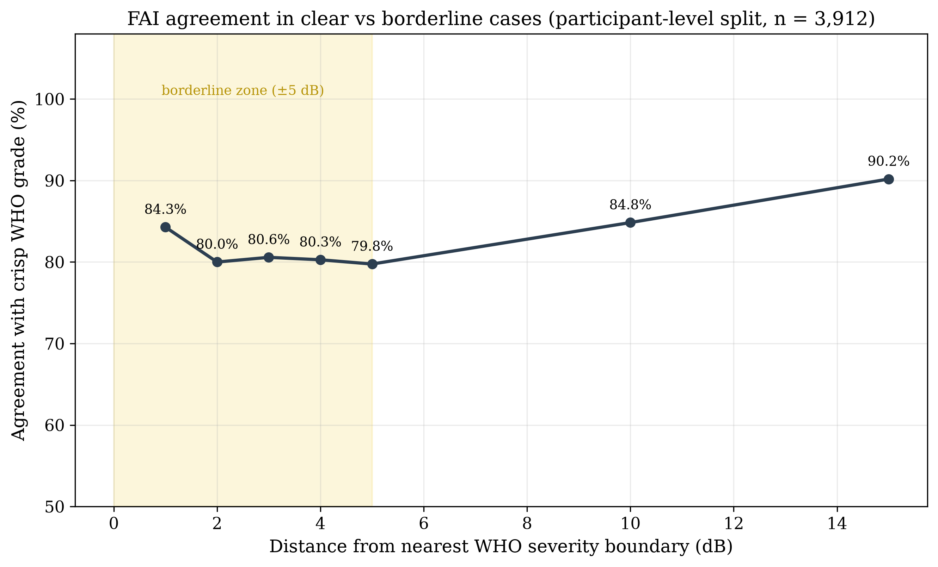
The 25/26 dB boundary: graded, not binary
8 / 15
PTA-4 | Crisp label | Fuzzy label | FAI | Normal μ | Mild μ
24 dB | Normal | Normal | 11.3 | 0.33 | 0.00
25 dB | Normal | Normal | 11.6 | 0.25 | 0.00
26 dB | Mild | Mild | 25.7 | 0.16 | 0.40
30 dB | Mild | Mild | 30.0 | 0.00 | 1.00
A patient with PTA 26 dB is simultaneously 16% normal and 40% mild — the crisp label hides this ambiguity.
FAI rises smoothly from 11.3 at 24 dB to 30.0 at 30 dB; crisp rules impose a step at 26 dB.
The fuzzy system deviates from crisp labels in the borderline zone (agreement 80–84% within ±1–5 dB) while matching crisp in clear cases (98.1%)
ArabCIC 2026 · Jeddah · Fuzzy Audiometric Index (FAI)
Notes:
This is the clinical core. At the normal-mild boundary the fuzzy system reports graded membership instead of a forced binary label; it matches the crisp label in clear cases (98.1%) while deliberately deviating from it in the borderline zone (agreement 83–86% within ±1–3 dB).

Slide 9
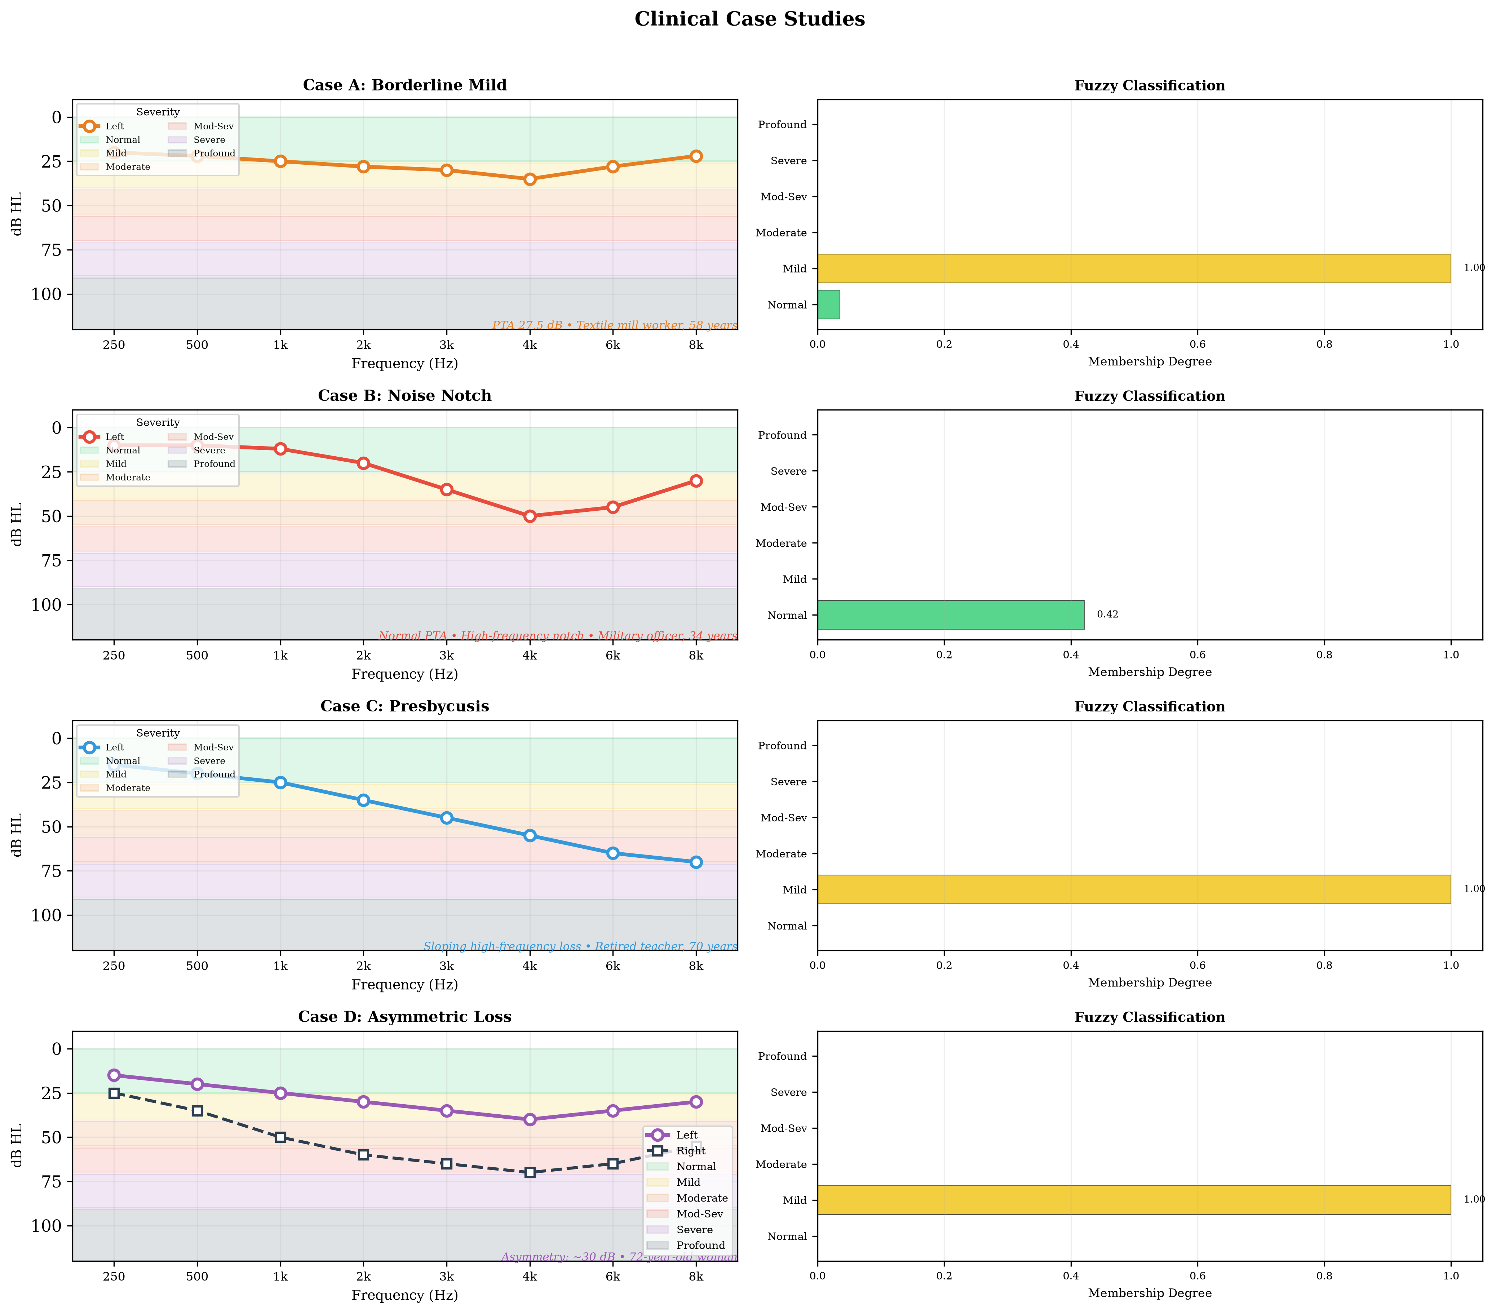
Clinical case studies from NHANES
9 / 15
A · BORDERLINE
PTA 27.5 dB “Mild” · FAI 29.4
Normal μ 0.04, Mild μ 1.00 — graded, not forced
B · MASKED NOTCH
PTA 23 dB “Normal”
25 dB notch at 4 kHz · Notched μ 0.78 — PTA missed it
C · PRESBYCUSIS
PTA 33.8 dB “Mild” · FAI 30.0
Sloping 35 dB — frequency gradient preserved
D · ASYMMETRY
R 53.8 dB Mod / L 28.8 Mild
Composite FAI 54.5 (Mod-Sev) — impact quantified
Four representative audiograms with membership bar charts
ArabCIC 2026 · Jeddah · Fuzzy Audiometric Index (FAI)
Notes:
Four cases illustrate the clinical value. A borderline patient gets graded membership rather than a forced label. A noise notch is caught despite a normal PTA. Presbycusis keeps its frequency gradient. And asymmetric loss has its impact quantified and folded into the severity estimate.

Slide 10
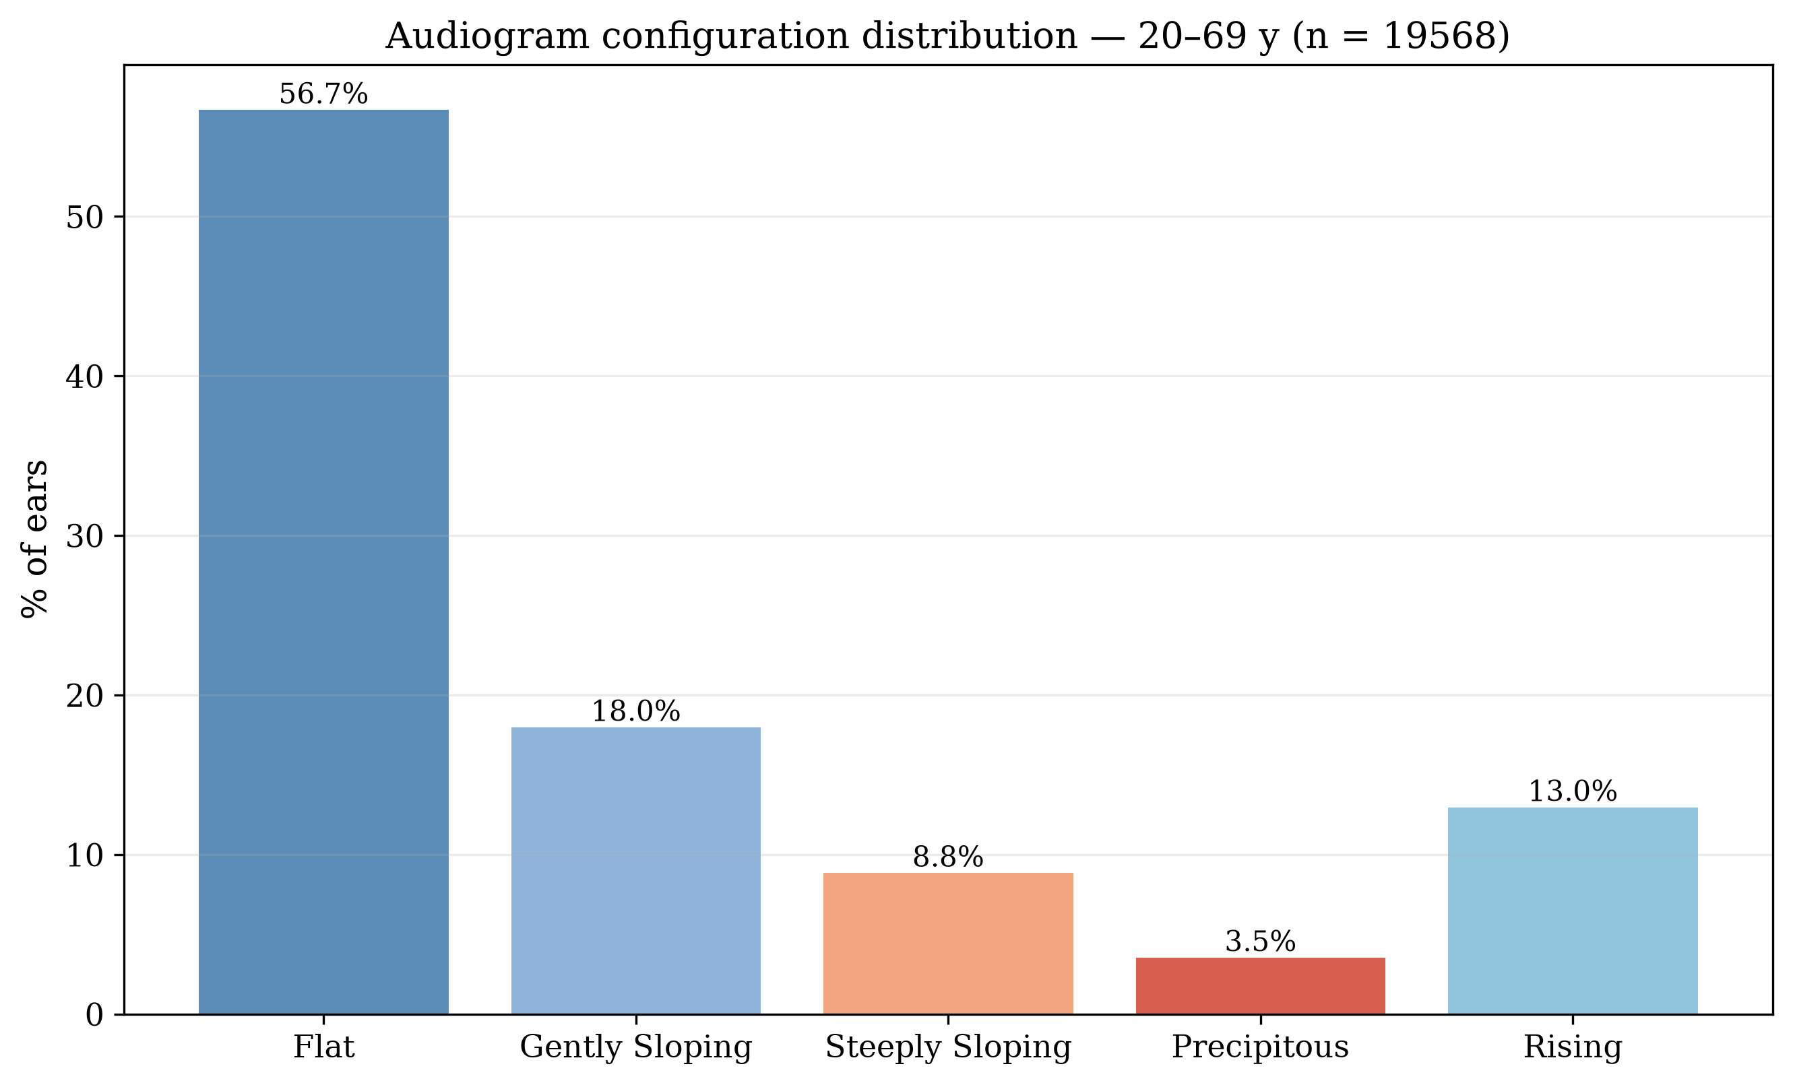
Configuration typing and asymmetry
10 / 15
Flat 56.7% · Gently sloping 18.0%
dominant configurations (4 kHz − 500 Hz)
Steeply 8.8% · Precipitous 3.5% · Rising 13.0%
exploratory output; accuracy table not reproducible
6-shape membership vector
Configuration distribution, combined adult cohort (slope = 4 kHz − 500 Hz)
graded configuration typing per ear
5.1% of participants
exceed 15 dB inter-aural difference; continuous index feeds severity adjustment (Case D)
ArabCIC 2026 · Jeddah · Fuzzy Audiometric Index (FAI)
Notes:
Configuration typing is an exploratory output: the combined adult cohort is predominantly flat and gently sloping, and the fuzzy shape rules emit a six-category membership vector. Asymmetry affects 5.1% of the cohort at the 15 dB threshold, and the fuzzy index quantifies it continuously.

Slide 11
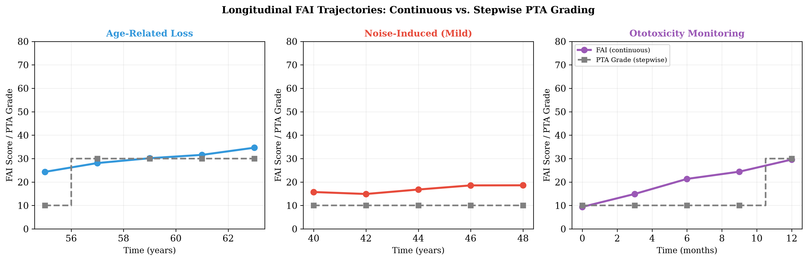
Longitudinal tracking: sub-threshold change
11 / 15
FAI trajectories (coloured) vs PTA grade (grey steps) over 4–8 years — smooth progression instead of discrete jumps
+1.7 pts/yr
1 grade / 4.2 yr
28%
mean annual FAI change, age-related subgroup
PTA steps between categories
FAI shifts ≥ 5 pts without crossing a PTA boundary
ArabCIC 2026 · Jeddah · Fuzzy Audiometric Index (FAI)
Notes:
In the 120-participant longitudinal sub-cohort the FAI moves continuously, about 1.7 points per year in age-related loss, while PTA grades step once every 4.2 years. 28% of participants showed a change of 5 or more FAI points without crossing any PTA boundary — sub-threshold shifts that include both ototoxicity and recovery after acute noise exposure.

Slide 12
Clinical implications
12 / 15
Audiologic triage
Hearing aid fitting
Ototoxicity monitoring
Flag patients straddling severity boundaries for monitoring instead of forcing one label
Continuous FAI maps to gain; configuration vector guides frequency-specific amplification
≥ 5-point FAI shifts (cisplatin, aminoglycosides) before PTA crosses a boundary
Noise surveillance
Low-resource settings
Research endpoints
Notch detection flags early noise damage despite a normal PTA (Case B)
Runs on mobile audiometry (hearWHO, Mimi); interpretable and computationally light
Continuous outcome for hearing-preservation and rehabilitation trials
ArabCIC 2026 · Jeddah · Fuzzy Audiometric Index (FAI)
Notes:
The framework has practical routes into care: more honest triage, gain programming for hearing aids, earlier ototoxicity detection, noise surveillance, low-resource mobile screening, and a continuous endpoint for trials.

Slide 13
Limitations and next steps
13 / 15
Limitations
Next steps
• Air-conduction thresholds only — bone conduction needed for mixed-loss detection
• Rule base expert-derived, not yet through formal Delphi consensus
• NHANES skews toward mild–moderate age-related loss
• No extended high-frequency audiometry (10–16 kHz)
• Reference standard (WHO PTA-4) carries the same boundary issue
• Outcome validation pending (hearing aids, CI candidacy)
• Multi-site validation — paediatric and Menière’s cohorts
• Mobile audiometry integration for community screening in low-resource settings
• Web-based FAI calculator with REST API for EHR integration
• Neuro-fuzzy learning (ANFIS) — learn rule parameters from data while staying interpretable
• FAI as a continuous feature for ML outcome models (speech-in-noise, hearing aid outcomes, CI candidacy)
ArabCIC 2026 · Jeddah · Fuzzy Audiometric Index (FAI)
Notes:
Honest limitations: air-conduction only, no Delphi consensus yet, NHANES's mild-to-moderate skew, no extended high frequencies, and outcome validation still pending. Next: multi-site validation, mobile integration, a web calculator, ANFIS, and using the FAI as a feature in outcome models.

Slide 14
TAKE-HOME
1
A continuous, frequency-resolved Fuzzy Audiometric Index preserves the gradation that crisp PTA thresholds discard.
2
κ = 0.93 against WHO PTA-4; 98.1% agreement in clear cases, with deliberate graded reclassification in the borderline zone (79.8%).
3
Interpretable by design — a rule base clinicians can inspect, question and modify.
“As audiology moves toward personalised, data-driven care, fuzzy logic keeps the continuity of auditory function front and centre.”
Notes:
Three messages: the FAI preserves gradation, it deliberately reclassifies borderline cases where crisp labels force a binary choice, and it stays interpretable throughout.

Slide 15
Thank you
Questions and discussion
Dr. Sanyaolu Ameye (MBBS, FWACS, FMCORL, Pg Cert ML/AI, MSc Data Science)
ENT Surgeon and Data Scientist
King Fahad Specialist Hospital, Tabuk, Kingdom of Saudi Arabia
sanyaameye@hotmail.com
Code and data: github.com/ameye/fuzzy-audiogram
Notes:
Thank you. Happy to take questions on the rule base, the validation, or deployment plans for cochlear implant and hearing aid pathways.

