Slide 1
British Airlines Skytrax Customer Review Analysis
By Adam Meyer

Slide 2
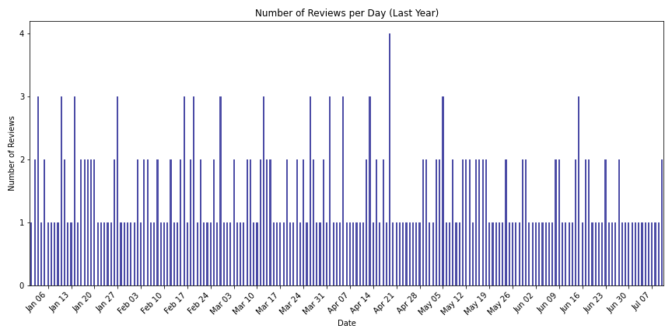
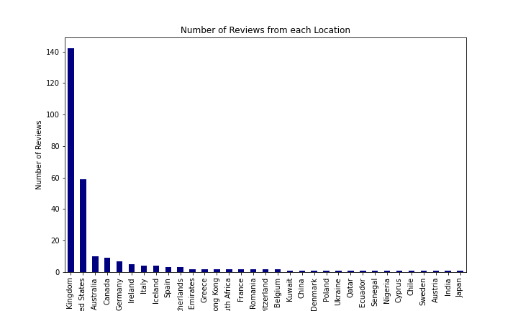
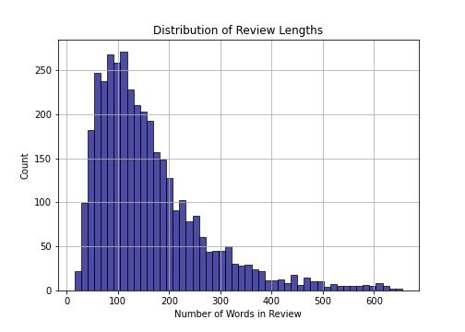


Key Insights from British Airlines Analysis
Consistent daily review patterns indicate stable operations without significant spikes.
Majority of reviews originate from the UK and the US, emphasizing the importance of focusing on feedback from these regions.
Word length analysis suggests a prevalence of concise reviews, prompting an investigation into potential correlations with sentiment.
Identified recurring themes such as food, seat comfort, and service quality, offering valuable insights into customer preferences and concerns.
UK reviews consistently highlight positive sentiments regarding service, while evolving concerns in US reviews signal the need for attention to customer service accessibility and luggage handling for international flights.

