Slide 1
Medical Image Captioning and VQA using Multitasking for Chest X-Rays
Group 22

Slide 2
Presented By
Amey Bhilegaonkar (1225368924)
Disha Agarwal (1225441776)
Ninad Nale (1225710226)
Janaki Venkata Ramachandra Sai Nayani (1225418207)

Slide 3

Introduction

Slide 4
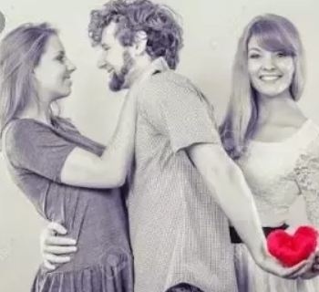
Captioning
VQA
Model
Picture depicting multitasking(only for humor, Disclaimer: We don’t support infidelity!!)

Slide 5
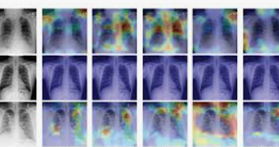
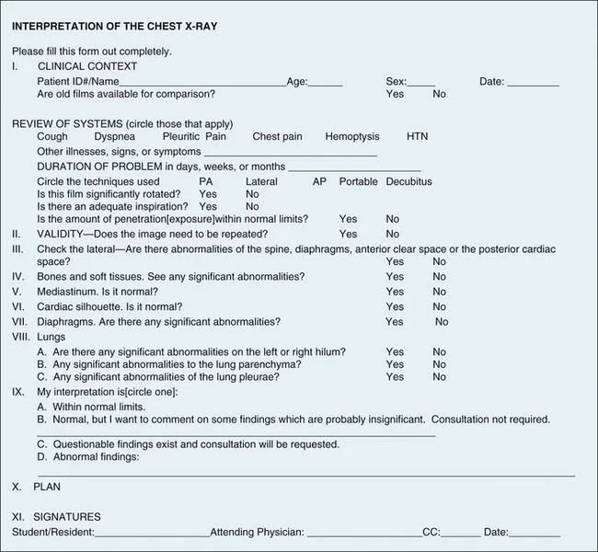
Analysing X-Ray images through captioning and VQA tasks.
Develop a multitask deep learning model that enhances the interpretability and accuracy
Potential for automated report generation and decision-making
Input Images
Task | Model
Image Feature Extraction | Densenet121, Xception
Captioning and VQA | simple encoder-decoder and VisualBERT
Questions and Answers

Slide 6
EDA & Preprocessing

Slide 7
Datasets Used
Indiana University Chest X-rays (7470 X-rays mapped to 3995 reports)
Visual Question Answer Dataset (2248 Images with corresponding questions and answers)

Slide 8
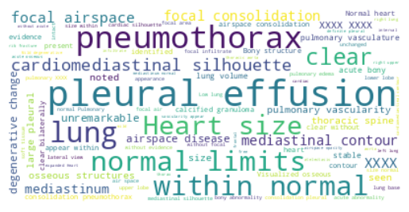
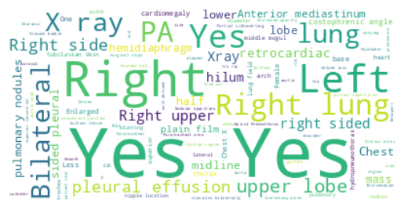
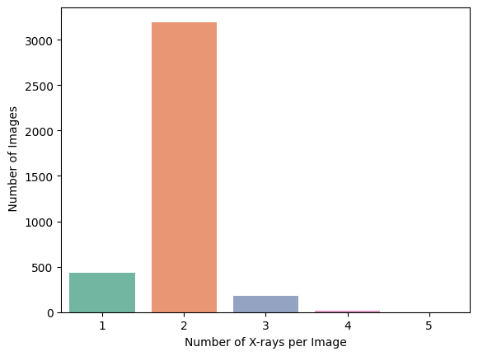
EDA
WordCloud of Indiana Chest X-ray Dataset
WordCloud of VQA Dataset
Notes:
Analyze dataset distributions for better understanding.

Slide 9
Preprocessing
Drop inconsistent data, keep frontal chest X-rays.
Combine findings and report columns in Indiana dataset.
Use prompt column and treat captions based on findings.
Clean captions and create word dictionary.

Slide 10
Related Works

Slide 11
Lateral+ Frontal Images
CNN/ Faster RCNN
Image features + Text features
Word LSTM
Sentence LSTM
Normal +Patient Image
Semantic tags
Most papers used CNNs for the encoder part and LSTM as decoder part, for text generation.
Some of the papers used semantic tags along side image features, other have combined normal and patient images, few combined lateral and frontal images.
Commonly used metrics are BLEU, ROUGE, CIDER etc.

Slide 12
Methodology

Slide 13
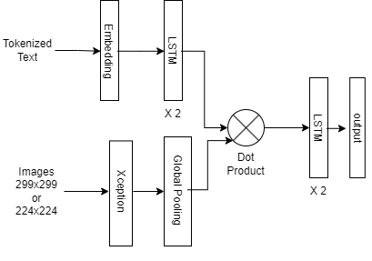
Encoder Decoder Model
Above model will be trained on:
Single Task to obtain baselines of our model on VQA/Captioning
Multi-Task to obtain the final result.
Expected Result: Multi-task should be able to!

Slide 14
Visual Bert
Multi-modal transformer architecture - combines the power of BERT and visual information.
The architecture is similar to that of BERT, with the addition of a visual encoder that processes images.
The Visual BERT model consists of three main components:
A text encoder
A visual encoder
A multi-modal fusion layer

Slide 15
Results

Slide 16
Results for Simple Encoder-Decoder Model
The performance on VQA Data Set
Performance on IUC Datasett
Performance on VQA and IUC Dataset

Slide 17
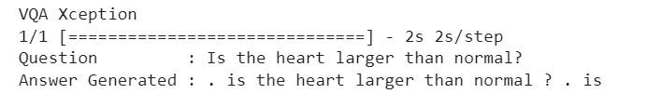

Results for VisualBERT
VQA Xception
We have not trained our VisualBERT model since we, didn’t have enough resources, hence model is just giving jumbled input text as output.
We have used pre-trained models like Xception to extract image features.
IUC Xception

Slide 18

Image Credits :https://makeameme.org/meme/panda-says-thank

Slide 19
Q &A

