Slide 1

Don Bosco Institute of Technology,Mumbai.
Lifespan Monitoring of Buildings Using Data Analytics
Progress Presentation
Group No:19

Slide 2
Project Members: Mr. Amey Kharote Ms. Shannon Fernando Ms. Ninoshka Pinto
Project Guide:
Mayura Gavhane

Slide 3
Aim and Objective
The objective of our project is to create a reasonably accurate procedure for estimating the lifespan of existing building structures.
The model should efficiently predict the lifespan of the building and provide a timeline for the users so that they have information about the necessary repairs, if any.
Our model will help us understand the condition of the building and also tell us whether the building is in need of any extensive repairs or not.

Slide 4
Literature Review
Study Area 1: Understanding various factors associated with the lifespan of a building.
In this area, the Factors are which will be affecting our system our listed:
Age
Type of Construction
How well is the building maintained?
Wear & Tear
Environmental Conditions

Slide 5
Understanding the process of construction of a building and the basic structural details was major task considering we were novice to Civil Engineering.
We were helped by Mr. Mahendra Tiwari (Head-Building Proposals, BMC) when we interviewed him and understood the whole analogy of a building from its inception till the very end.
Then we researched through many books, IEEE papers and research papers.
“Theory of Structures”, Peter Marti
“Elements of Stress Analysis”, Jacques Hayman
“Factors Influencing the Service Life of Buildings”, W.P.S. Dias
“Service life estimation in the design of buildings a development of factor method”, Björn Marteinsson

Slide 6
Types of Construction:
Reinforced Cement Concrete(RCC):
RCC is a combination of cement, concrete and steel to build a structure instead of using only concrete.
Concrete is good in resisting compression but is very weak in resisting tension. On the other hand, steel has high tensile strength and the bond between steel and concrete is good.
RCC construction is most widely used in cities for large projects and also has good lifespan.

Slide 7
Load Bearing:
It essentially consists of thick, heavy masonry walls of brick or stone that support the entire structure, including the horizontal floor slabs, which could be made of reinforced concrete, wood, or steel members.
This type of construction is basically used in villages where the structures are small and the projects aren’t that big.

Slide 8
Composite Structures:
Composite Structures are basically combination of RCC and load bearing construction, it makes use of both the techniques but the composition doesn’t quite work well.
Composite Structures are not widely used.

Slide 9
Maintenance:
Maintenance is basically backbone of a building and the real work to keep a building healthy state is basically done by maintenance.
Maintenance in RCC structured buildings: (Expected lifespan of a RCC structured building is 75 years)
Initial 20-25 years after construction maintenance not necessary.
25-50 years- Maintenance must be carried out after every 8-10 years.
50 and above- Maintenance must be carried out after every 4-5 years

Slide 10
Study area 2: Analysis and Computation
Steps involved in data analytics :
Data gathering.
Pre-processing.
Data mining.
Interpretation.
Computation will include various clustering algorithms as only one algorithm would not be sufficient to give us efficient and accurate results.

Slide 11
To create an predictive analytic model different algorithms will be used from the mining process of data till the visualization of the model.
Algorithms used:
K Nearest Neighbor – Classification
Random Forest – Classification and Regression
Naive Bayes – Probabilistic Classifier
K means – Cluster analysis

Slide 12
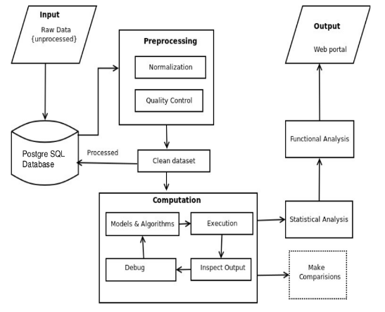
System Architecture

Slide 13
Structural Audit Evaluation Report
Whenever the condition of a building is bad then the Government Organization(BMC) intends the Co-operative Housing Society of the building to conduct a Structural Audit.
It is an document which helps in auditing the building under various criteria which are necessary when the building is not in a proper condition.

Slide 14
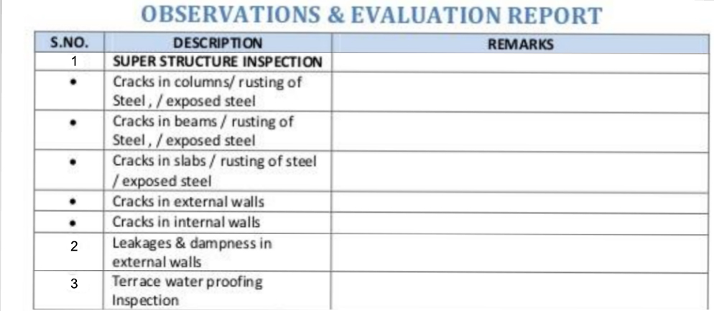
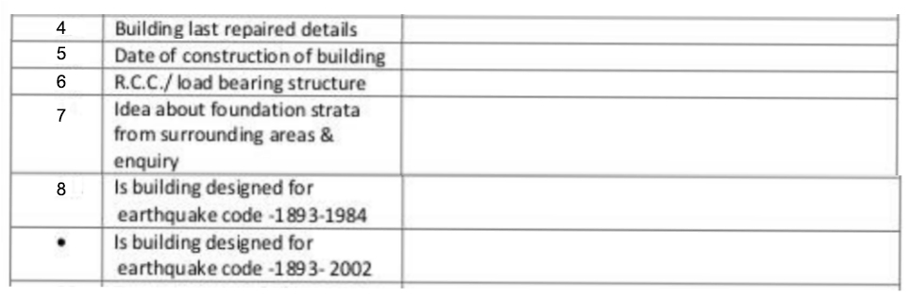
Structural Audit Evaluation Report

Slide 15
Data Gathering
Surveys were conducted to gather data of the various buildings.
All the survey conducted in Worli was conducted in the presence of the above mentioned Govt. official.
Various housing societies in different localities were visited and surveys were conducted based on the factors listed in the structural audit.
Name of Build. | Area | No. of Buildings
1.BDD Buildings | Worli | 121
2.Adarsh Nagar | Worli | 42
3.MIG Colony | Worli | 26
4.Police Camp | Worli | 71
5.Dreams | Bhandup | 16
6.Kukreja | Bhandup | 10
7.Joy Homes | Bhandup | 5
8.Vasant Vihar | Thane | 61
9.Vrindavan | Thane | 169
10.Hiranandani Estate | Thane | 25
11.Hiranandani Meadows | Thane | 12

Slide 16
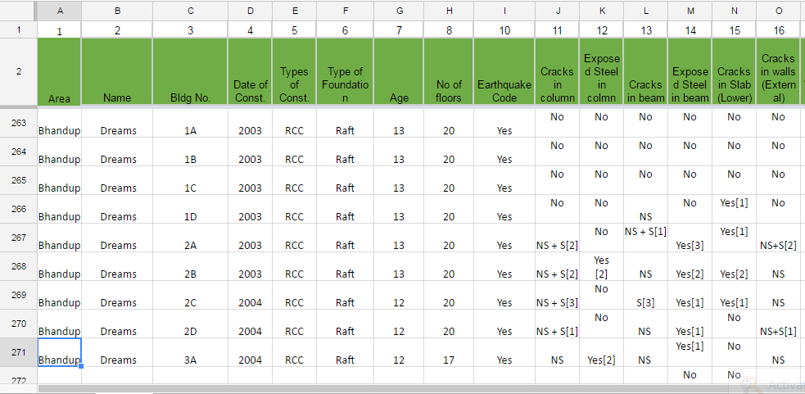

Slide 17
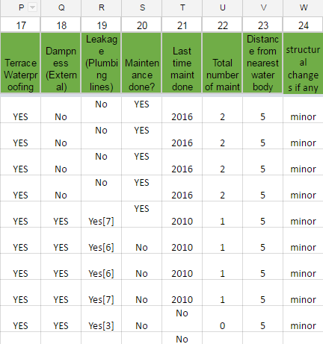

Slide 18
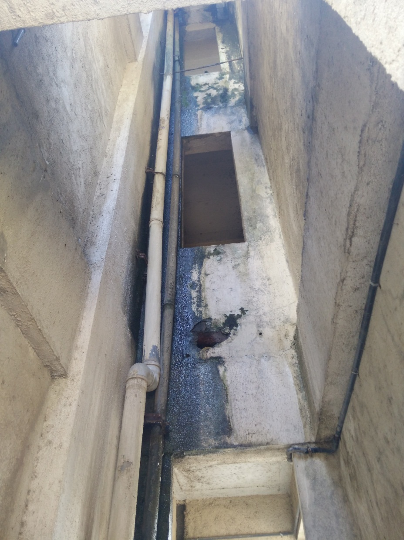
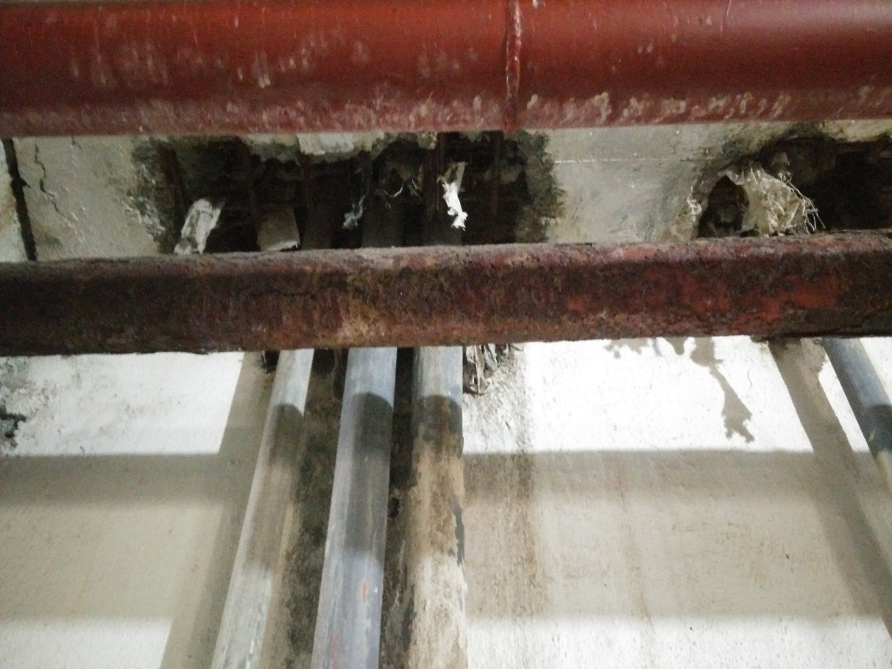
On-site Bhandup Dreams HDIL
Leakage in Plumping lines.
Rusted pipes.
Dampness.

Slide 19
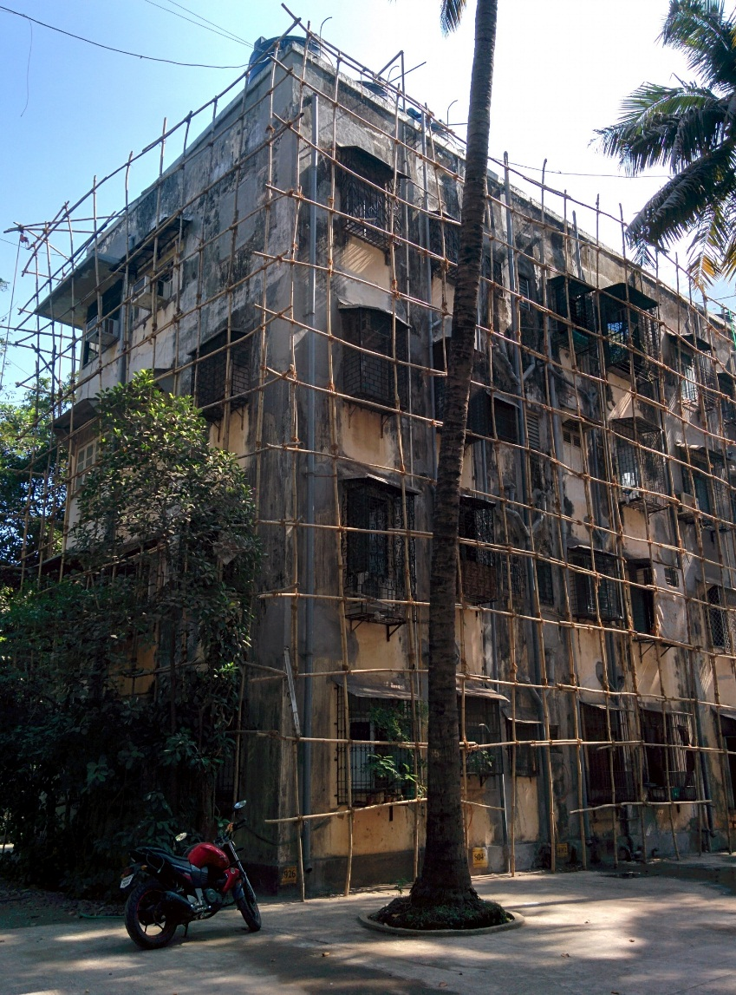
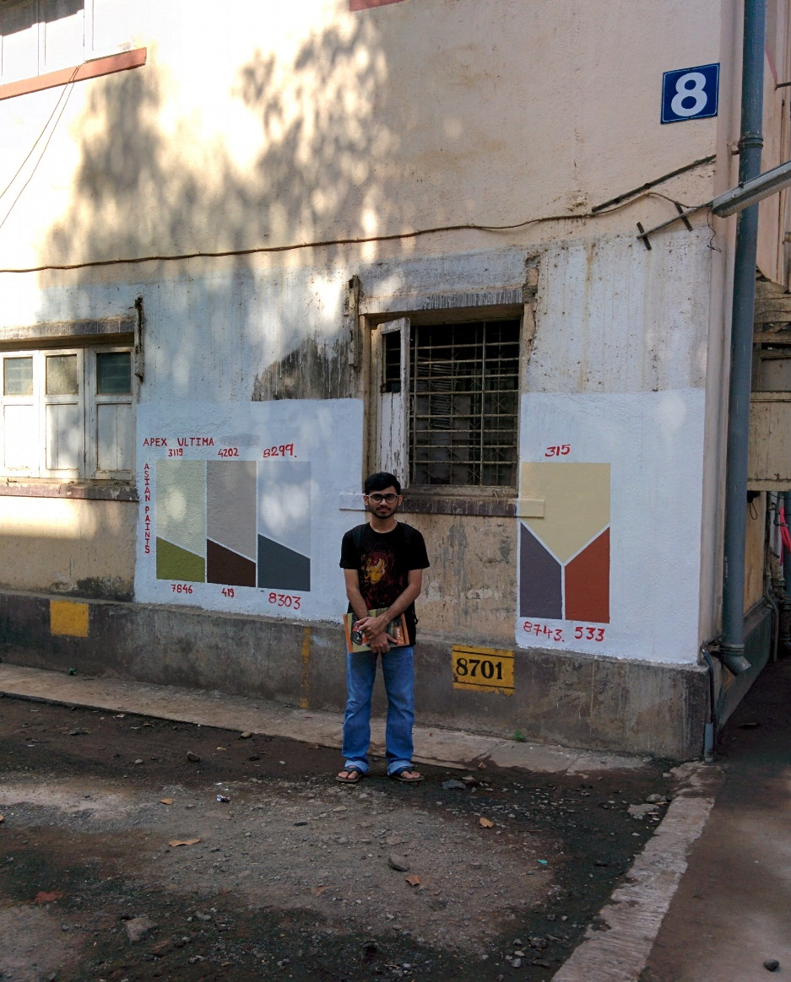
On-site Worli Adarsh Nagar Society

Slide 20
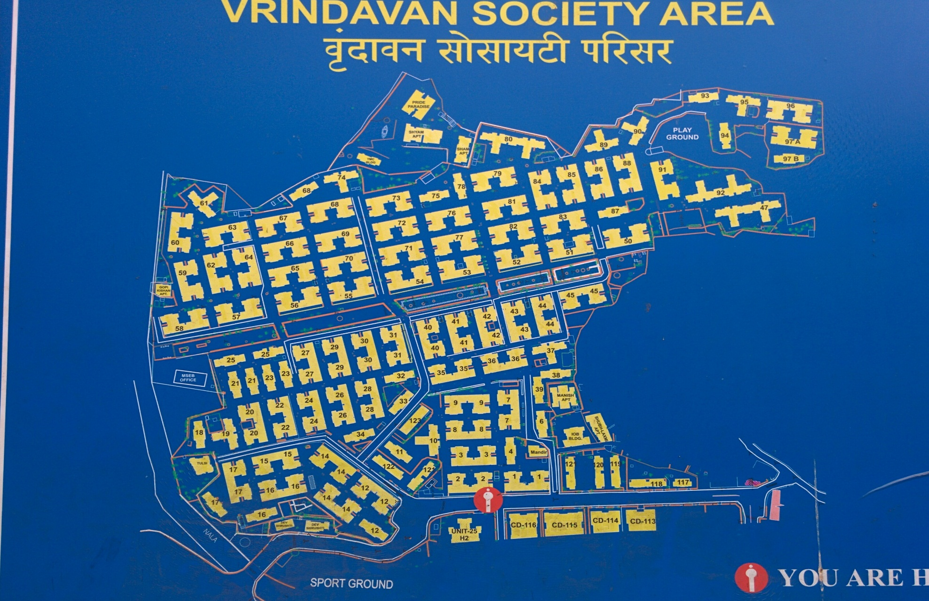
On-site Vrindavan Thane

Slide 21
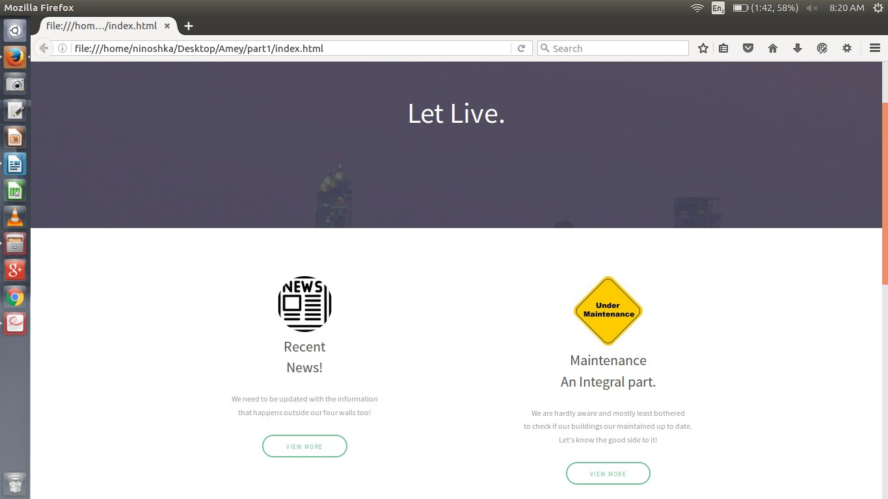
Web Portal

Slide 22
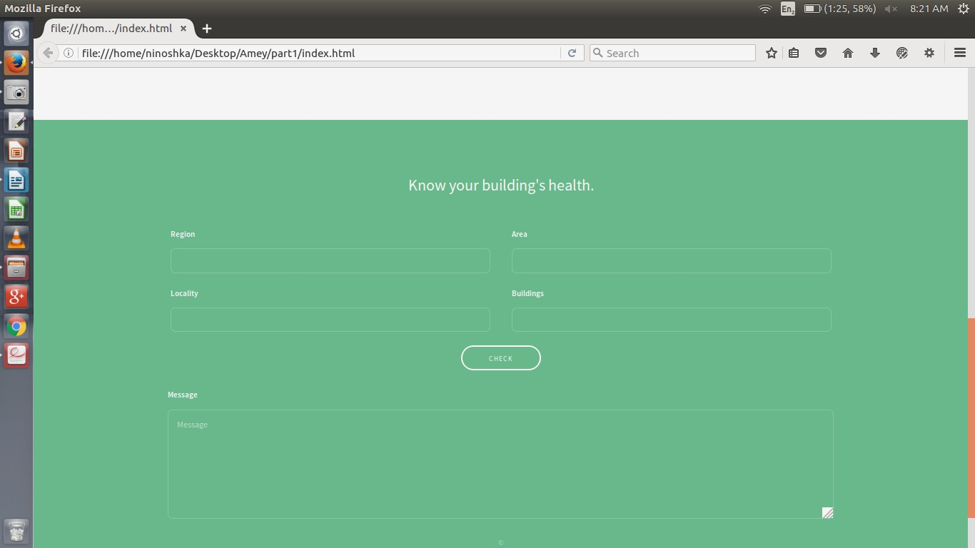

Slide 23
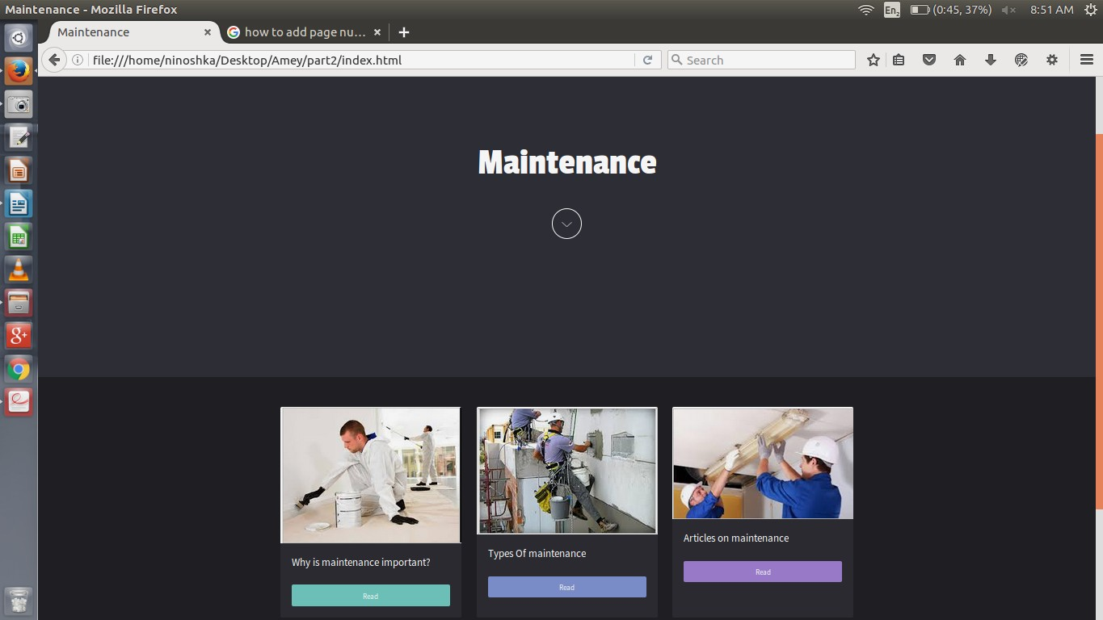

Slide 24
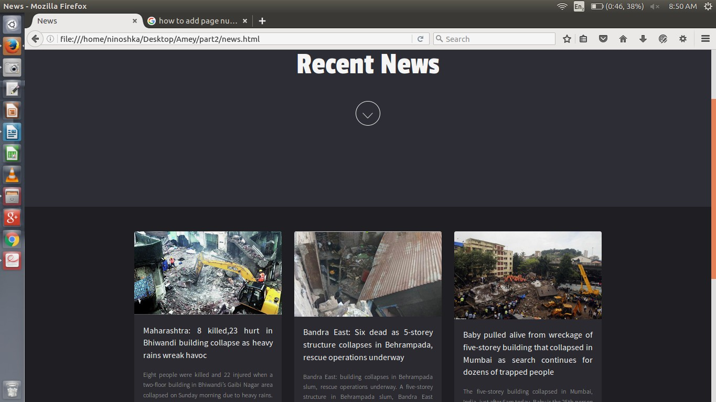

Slide 25
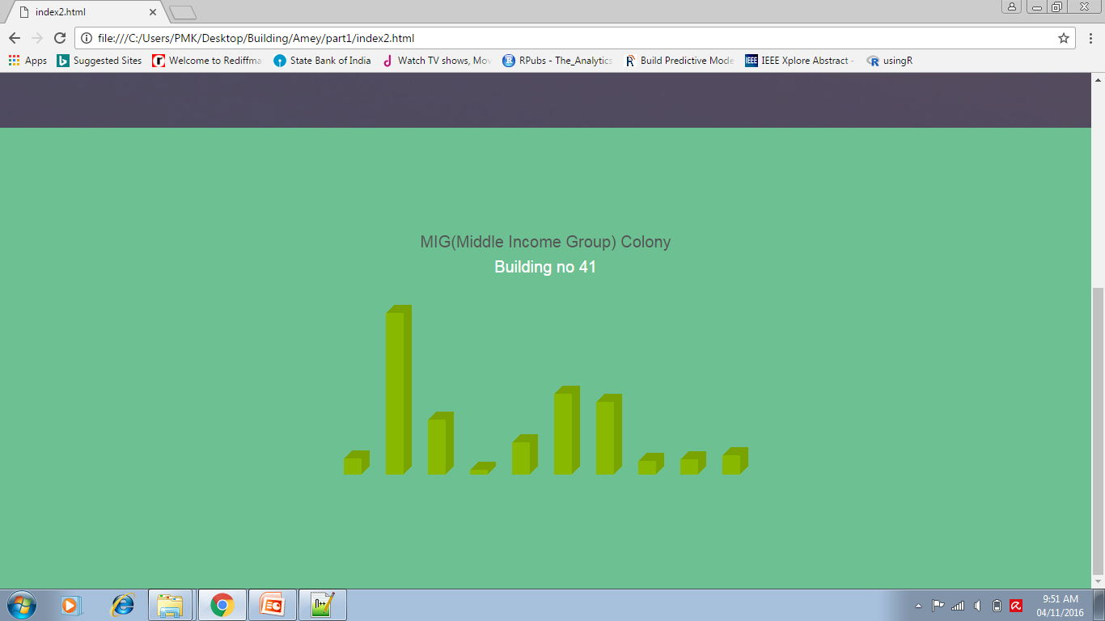

Slide 26
Thank You

