Slide 1











Tenant Definition – Business & Technology Alignment
Corporate Training Center – Tenancy to Platform as a B2B user with a Whitespace Application ownership
Tuition Center - Tenancy to Platform as a B2B user with a Whitespace Application ownership
Individual School - Tenancy to Platform as a B2B user with a Whitespace Application ownership
Consortium( Trustee ) of School – Admin User of Platform as Governance Entity with B2B users mapped and aligned to it.
Neon Edu ( Platform Admin ) - Admin User of Platform as Governance Entity with all B2B users mapped and aligned to it.
User
Enrollment Space
Tenant
Subscription Space
B2B
B2C
Federation Management Functions
Core Business Delivery Functions
B2B Site Admin
Platform Admin Functions
Analytics
Reporting
Data Management Functions
Compliance Management Functions

Slide 2

Tenant Creation Routine
PHP CRUD
Update Master Tenant Table
Update Subscription Data Routine
Create School
Event Trigger Function
Create
Tenant Specific DB Schema
IAM
#Shardkey
#Shardkey
Create Tenant Configuration Objects
Create File Stoarge
Space(S3)
Instantiate
Tenant URL
Delete Tenant Configuration Data
Collaboration
Workflow

Slide 3
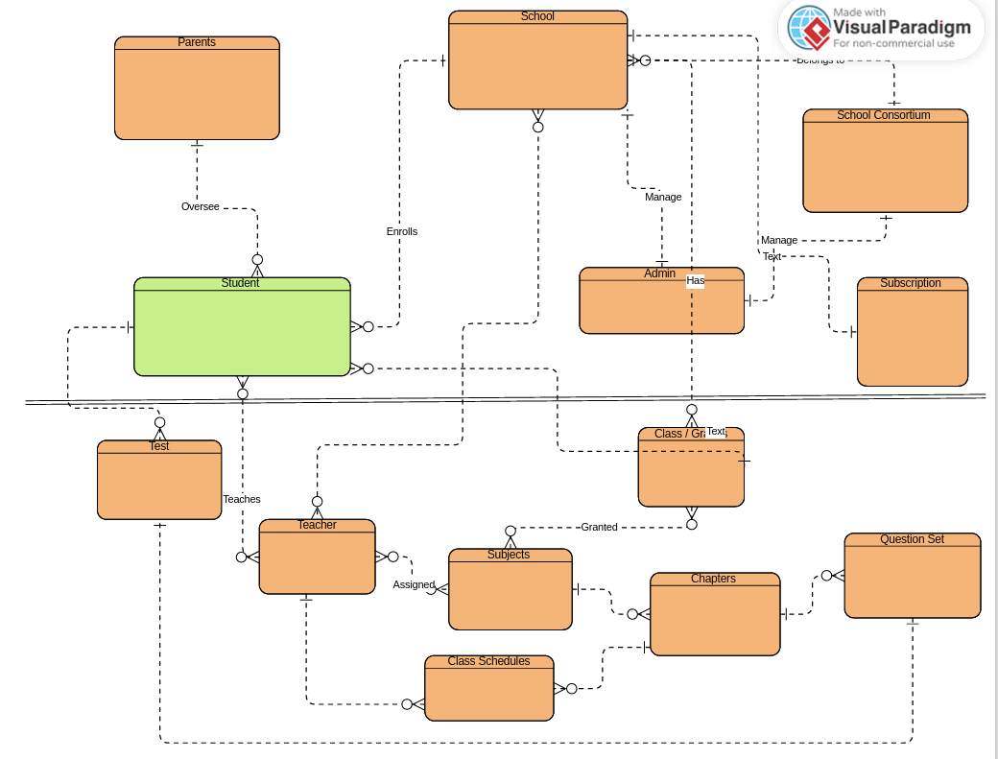
Business Entity Relationship

