Slide 1
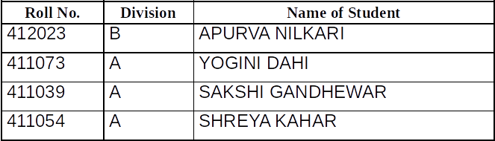

Project Phase – I
Presentation on
“AUTOMATED FIELD SECURITY”
(Domain : IOT)
By : Group No. - A9
Guided by -
Mrs. Aher V.N.
Bansilal Ramnath Agarwal Charitable Trust’s
Vishwakarma Institute of Information Technology
Department of Electronics & Telecommunication
1
Notes:
1

Slide 2
OUTLINE
INTRODUCTION
LITERATURE SURVEY
OBJECTIVES
MOTIVATION
SYSTEM OVERVIEW
METHODOLOGY
HARDWARE AND SOFTWARE SPECIFICATION
APPLICATIONS
FUTURE SCOPE
Bansilal Ramnath Agarwal Charitable Trust’s
Vishwakarma Institute of Information Technology
Department of Electronics & Telecommunication
2

Slide 3
LITERATURE SURVEY
The existing systems for the detection and classification of animal mainly use Thermal imaging cameras, Image processing, Seismic data which are produced by the object in motion and PIR sensors.
In the previously proposed systems, for automatic animal detection used computer vision techniques.
Israel agricultural development in spite of the land conditions
Bansilal Ramnath Agarwal Charitable Trust’s
Vishwakarma Institute of Information Technology
Department of Electronics & Telecommunication
3

Slide 4
INTRODUCTION
Modernization and cultivating procedure .
One of the real difficulties of the agribusiness is issues regarding the disturbance and intruder interruption.
Another situation is giving security from assaults of rodents or creepy crawlies, in fields or grain stores.
These problems can be actually controlled by using a gadget which is fit for detected data and transmitting it to the client which can be useful in giving security to grain stores and agrarian fields.
Bansilal Ramnath Agarwal Charitable Trust’s
Vishwakarma Institute of Information Technology
Department of Electronics & Telecommunication
4

Slide 5
OBJECTIVES
Creating an intelligent system which will give a security system for farm protection and also prohibit the entry of animal into the farm.
To detect and provide the real time information to the farmer about the field we are operating
To keep the prizing of the product affordable.
Monitor the field status using camera.
Design a system that sounds and alerts when animal tries to enter into the farm.
Bansilal Ramnath Agarwal Charitable Trust’s
Vishwakarma Institute of Information Technology
Department of Electronics & Telecommunication
5

Slide 6
MOTIVATION
Agriculture is a basic occupation of every 2nd family in India.
We get to know about the time wastage in surveillance on farm it is important to stop that and utilize that time in other work so for that we need to have a device which will monitor the farm in absence of the farmer.
Less IOT sector for agriculture in india
Israel agricultural development in spite of the land conditions
Bansilal Ramnath Agarwal Charitable Trust’s
Vishwakarma Institute of Information Technology
Department of Electronics & Telecommunication
6

Slide 7
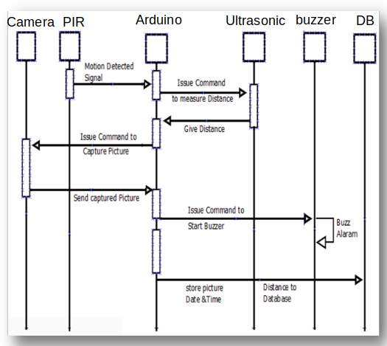
BLOCK DIAGRAM
Bansilal Ramnath Agarwal Charitable Trust’s
Vishwakarma Institute of Information Technology
Department of Electronics & Telecommunication
7
Notes:
7

Slide 8
METHODOLOGY
The proposed system mainly consists of 3 major sections:
Field Area- The field area primarily consists of PIR sensors and IR Temperature sensors placed in various locations of the field and are considered to be the main part in the field section. The animal’s presence is monitored using the PIR sensor and if any object in motion crosses it within its range it gets detected by the sensor and then it sends a data to the microcontroller to which it is connected.
Base Station- The base station has a processing unit which process the data received from the field area and here too a transceiver module is used to receive and transmit the data.
Worker’s Gadget- The worker has a gear which consists of an alarm and a display in which they get notified of animal’s presence. The data which is received from the base station is displayed in the LCD Display and Buzzer is turned on for few seconds.
Bansilal Ramnath Agarwal Charitable Trust’s
Vishwakarma Institute of Information Technology
Department of Electronics & Telecommunication
8

Slide 9
HARDWARE AND SOFTWARE
The components proposed in the system will be mainly sensors for
sensing the input data
The sensors will be consisting of PIR sensors, Camera , Arduino board
Ultrasonic Sensors.
For the processing unit, we have chosen arduino board as well as
Arduino IDE for the software development.
Bansilal Ramnath Agarwal Charitable Trust’s
Vishwakarma Institute of Information Technology
Department of Electronics & Telecommunication
9

Slide 10
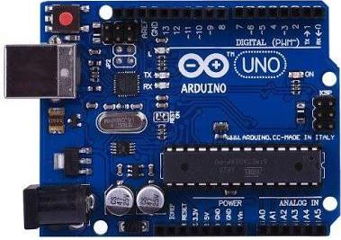
HARDWARE AND SOFTWARE
Arduino Uno Microcontroller AT Mega328P-
ATmega328 is a single chip microcontroller created by
Atmel in the mega AVR family. The Atmel 8-bit AVR RISC-
based microcontroller combines 32 kB ISP flash memory
with read-while-write capabilities, 1 kB EEPROM, 2 kB
SRAM, 23 general purpose I/O lines, 32 general purpose
working registers, three flexible timer/counters with compare
modes, internal and external interrupts, serial programmable
USART, a byte-oriented 2-wire serial interface, SPI serial
port, 6-channel 10-bit A/D converter (8-channels in TQFP
and QFN/MLF packages), programmable watchdog timer
with internal oscillator, and five software selectable power
saving modes. The device operates between 1.8-5.5 volts.
The device achieves throughput approaching 1 MIPS per
MHz.
Bansilal Ramnath Agarwal Charitable Trust’s
Vishwakarma Institute of Information Technology
Department of Electronics & Telecommunication
10

Slide 11
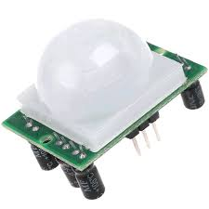
HARDWARE AND SOFTWARE
PASSIVE INFRARED SENSOR (PIR)
Output: Digital pulse high (3V) when triggered (motion
detected) digital low when idle (no motion detected). Pulse
lengths are determined by resistors and capacitors on the
PCB and differ from sensor to sensor.
Power supply: 5V-12V input voltage for most modules (they
have a 3.3V regulator), but 5V is ideal in case the regulator
has different specs.
Range in between 5 to 12m.
Bansilal Ramnath Agarwal Charitable Trust’s
Vishwakarma Institute of Information Technology
Department of Electronics & Telecommunication
11

Slide 12
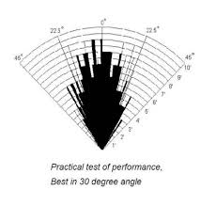
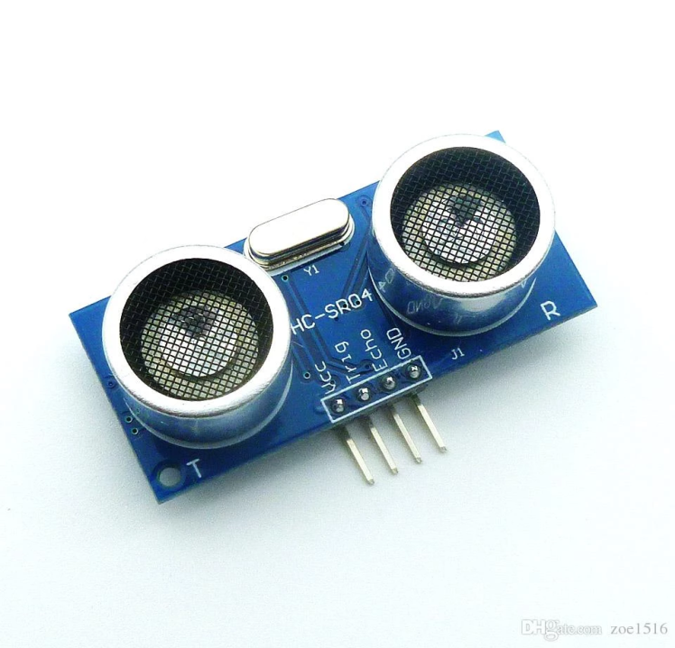
HARDWARE AND SOFTWARE
Ultra- Sonic Sensor
Measuring the distance: By the help of ultrasonic sensor the exact distance of the rodent can be measured from its system through the transmitter and receiver components. And that data
will sends to raspberry pi memory and stored in database.
Detecting range: 3cm-4m Best in 30 degree angle
Electronic brick compatible interface
5VDC power supply
Breadboard friendly
Dual transducer
Bansilal Ramnath Agarwal Charitable Trust’s
Vishwakarma Institute of Information Technology
Department of Electronics & Telecommunication
12

Slide 13
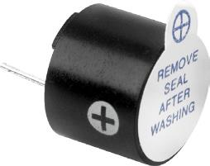
HARDWARE AND SOFTWARE
BUZZER
Rated Voltage : 6V DC
Operating Voltage : 4 to 8V DC
Rated Current* : ≤30mA
Sound Output at 10cm* : ≥85dB
Resonant Frequency : 2300 ±300Hz
Tone : Continuous
A buzzer is a loud noise maker. Most modern ones are civil
defence or air- raid sirens, tornado sirens, or the sirens on
emergency service vehicles such as ambulances, police cars
and fire trucks. There are two general types, pneumatic and
electronic.
Bansilal Ramnath Agarwal Charitable Trust’s
Vishwakarma Institute of Information Technology
Department of Electronics & Telecommunication
13

Slide 14
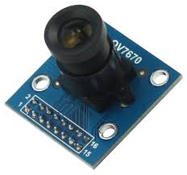
HARDWARE AND SOFTWARE
The OV7670 Camera Module is a small image sensor, low operating voltage, providing all functions of a single chip of VGA camera and image processor.
Through SCCB bus control, the sensor can output the whole frame, sampling, and various resolution 8 bits of data.
The product VGA image can reach up
to a maximum of 30 frames per second.
Users can completely control the image
quality, data format and transmission mode.
All the process of image processing
functions can through the SCCB
programming interface, including
gamma curve, white balance,
saturation and chroma.
Bansilal Ramnath Agarwal Charitable Trust’s
Vishwakarma Institute of Information Technology
Department of Electronics & Telecommunication
14

Slide 15
HARDWARE AND SOFTWARE
ARDUINO COMPILER
A cross-platform application written in Java, and is derived from the IDE for the Processing programming language and the Wiring project.
designed to introduce programming to artists and other newcomers unfamiliar with software development.
includes a code editor features
syntax highlighting,
brace matching
automatic indentation
capable of compiling and uploading programs to the board with a single click.
No need to edit make files or run programs on a command-line interface. Although building on command-line is possible if required with some third-party tools such as Uno.
Bansilal Ramnath Agarwal Charitable Trust’s
Vishwakarma Institute of Information Technology
Department of Electronics & Telecommunication
15

Slide 16
FUTURE ENHANCEMENT
The proposed system has an elegant way of monitoring the animal movement by placing the Passive Infrared sensor in various places across the field and the temperature samples are taken by using the Infrared Temperature sensor without touching it and harming the wild.
The reliability of the system is increased thereby decreasing the unwanted animal attacks.
Thus the system proposed serves as a lifesaving equipment
for human beings as well as the animals.
Bansilal Ramnath Agarwal Charitable Trust’s
Vishwakarma Institute of Information Technology
Department of Electronics & Telecommunication
16

Slide 17
REFERENCES
Nikkila, R., Seilonen, I., Koskinen, K. 2010.‘Software Architecture for Farm Management
Information Systems in Precision Agriculture.’’ Comput.
Electron. Agric. 70 (2), 328-336.
J.Syed Ali 1 , K.Sivaraman 2 , P.Venkatesh 3 , M.Vignesh 4 , M.Prathik 5 “ Animal Sensing Using Smart Sensors and Intimation over Wireless Gears”,A High Impact Factor,Peer Reviewed Journal Vol. 6, Issue 3, March 2018.
Vikhram.B 1 , Revathi.B 2 , Shanmugapriya.R 3 , Sowmiya.S 4 , Pragadeeswaran.G 5 “ Animal Detection System in Farm Areas” International Journal of Advanced Research in Computer and Communication Engineering.
ISO 3297:2007 Certified Vol. 6, Issue 3, March 2017.
Bansilal Ramnath Agarwal Charitable Trust’s
Vishwakarma Institute of Information Technology
Department of Electronics & Telecommunication
17

Slide 18
REFERENCES
Dr. Wilson, "ELECTRIC FENCE," Handbook of Texas, Project report published by the Texas State Historical Association. August 4, 2011
T. Day and R. Mac Gibbon, “Multiple-Species Exclusion Fencing and Technology for Mainland Sites.”, Project Report published by National Wildlife Research Centre, 2007.
R. Padula and W. Head, “Fencing System” Project Report
Published by University of Minnesota, 2003.
Astif bherani, Gauravkumar N. raut, pawan D. kale “smart design of microcontroller monitoring system for agriculture,” international conference on circuit, power and computing technologies,IEEE 2014.
Bansilal Ramnath Agarwal Charitable Trust’s
Vishwakarma Institute of Information Technology
Department of Electronics & Telecommunication
16

