Slide 1

Unified
Character
Recognition
Sneha Gandewar
Neha Jain
Amey Patil

Slide 2
Overview
Introduction to various pattern recognition systems
Plan for implementation
Experiments and Results

Slide 3
Printed Character Recognition
PCR engines turn images of machine-printed characters into machine-readable characters
Images of machine-printed characters are extracted from a bitmap

Slide 4
Intelligent Character Recognition
ICR reads images of hand-written character and converts them into machine-readable characters
Recognition of numeric characters is much more accurate than the recognition of letters

Slide 5
Optical Mark Recognition
OMR technology detects the existence of a mark, not its shape
OMR forms usually contain small ovals, referred to as 'bubbles’, that the respondent fills in
OMR cannot recognize alphabetic or numeric characters

Slide 6
Magnetic Ink Character Recognition
MICR is a specialized character recognition technology to facilitate cheque processing
Since background designs can interfere with optical recognition, magnetic ink is used

Slide 7
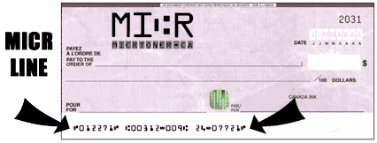
Magnetic Ink Character Recognition

Slide 8

Barcode Recognition
A barcode is a machine-readable representation of information
They can be read by optical scanners
1D Barcode

Slide 9
Plan for Implementation
Pre-Processing
Segmentation
Feature Extraction
Neural Classification

Slide 10
Pre-Processing
Binarization
Post-Thinning
Pre-Thinning
Thinning

Slide 11
Binarization
Coloured images to two colours, black and white
Single bit per pixel
Greatly reduces the complexity of the image
Algorithms
Thresholding
Local Binarization

Slide 12
Pre-Thinning
Reduces the noise due to the binarization
P3 | P2 | P1
P4 | P | P0
P5 | P6 | P7
B(P) = P0 + P2 + P4 + P6
If B(P) < 2 then
set P' to black
Else If B(P) > 2 then
set P' to white
Else
set P' to the value of P

Slide 13
Thinning
Technique that transforms bold thick letters to thin letters of one pixel width
Original Character Image Thinned Character Image

Slide 14
Why thinning is required?
Reduces the amount of information to be processed
Shape analysis is easy
Eliminates some of the contour distortions
Retains significant features of the patterns

Slide 15
Post-Thinning
To correct the deformation of the image
Deformation is caused due to discontinuity
Gaps creates pseudo endpoints
From the end points, paths are explored in all directions looking for the nearest black pixel
Threshold distance

Slide 16
Post-Thinning
Example of an original character and its thinned image
after applying the post-thinning algorithm

Slide 17
Segmentation
Method to isolate characters
Enhances character recognition efficiency
Projection analysis
Detection of white space between successive letters
Basis for the segmentation in non-cursive writing

Slide 18
Segmentation
Character
Character
C | h | a | r | a | c | t | e | r

Slide 19
Feature Extraction
Transforming the input data into the set of features
The process determines various attributes or properties associated with a region
Group of pixels
Normalization

Slide 20
Feature Extraction
000000000000000000000000000000
000000000000001100000000000000
000000000000011110000000000000
000000000000111111000000000000
000000000001111111100000000000
000000000011100001110000000000
000000000111000000111000000000
000000001110000000011100000000
000000011111111111111110000000
000000011111111111111111000000
000000111000000000000011100000
000001110000000000000001110000
000011100000000000000000111000
000111000000000000000000011100
001110000000000000000000001110
A

Slide 21
Feature Extraction
000000000000000000000000000000
000000000000001100000000000000
000000000000011110000000000000
000000000000111111000000000000
000000000001111111100000000000
000000000011100001110000000000
000000000111000000111000000000
000000001110000000011100000000
000000011111111111111110000000
000000011111111111111111000000
000000111000000000000011100000
000001110000000000000001110000
000011100000000000000000111000
000111000000000000000000011100
001110000000000000000000001110

Slide 22
Feature Extraction

Slide 23
Classification
Neural Network
Training
Learning
Application
Error Back-Propagation algorithm

Slide 24
Classification

Slide 25
Experimentation
Experiment has been carried out on a sample OMR specification
A skew angle of ±5° on the input OMR sheet is acceptable
The output text file will have question numbers and corresponding answers marked in the answer-sheet

Slide 26
Steps undertaken
Reading the OMR sheet
Thresholding
Morphological functions
Dilation
Majority
Comparing the text file with actual solution for efficiency

Slide 27
Thresholding
Converting the input image to grayscale image
graythresh(I) computes a global threshold (level)
level converts an intensity image to a binary image
level is a normalized intensity value that lies in the range [0,1]

Slide 28
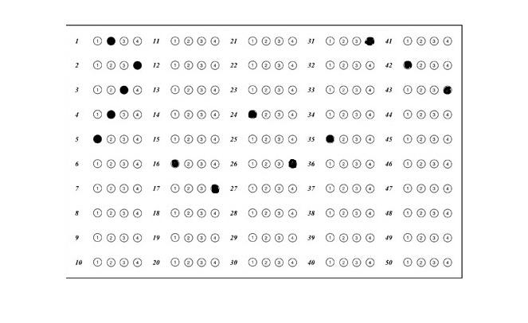
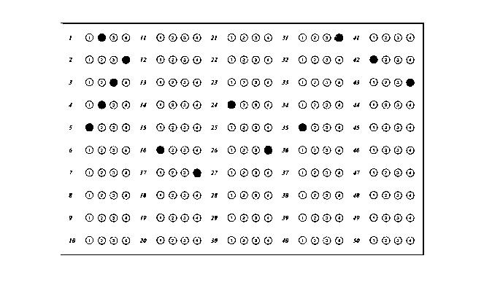
Original image
Image after
thresholding

Slide 29
Morphological Functions
Broad set of image processing operations that process images based on shapes
The operations apply a structuring element to an input image, creating an output image of the same size
The value of each pixel in the output image is based on a comparison of the corresponding pixel in the input image with its neighbors

Slide 30
DILATION
Adds pixels to the boundaries of objects in an image
Number of pixels depend on the size and shape of the structuring element(set of co-ordinates) used to process the image
Dilation of foreground pixels is equal to erosion of background pixels

Slide 31
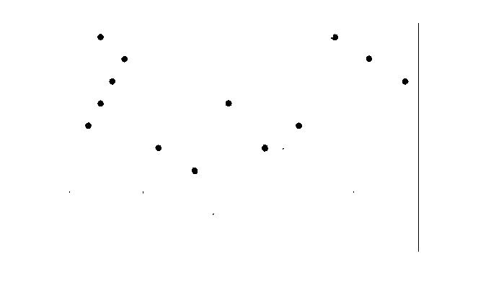
Thresholded image
Dilated image

Slide 32
MAJORITY
Considers a 3-by-3 neighbourhood matrix
Sets a pixel to 1 if five or more pixels among the eight neighbours are 1's; otherwise, it sets the pixel to 0

Slide 33
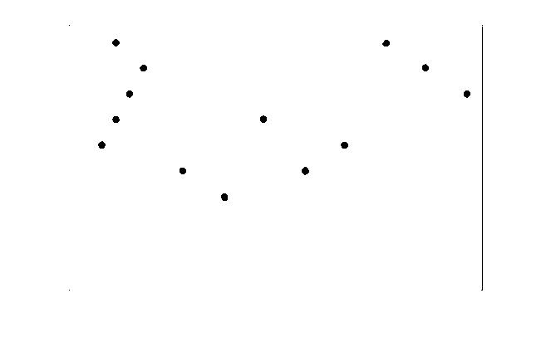
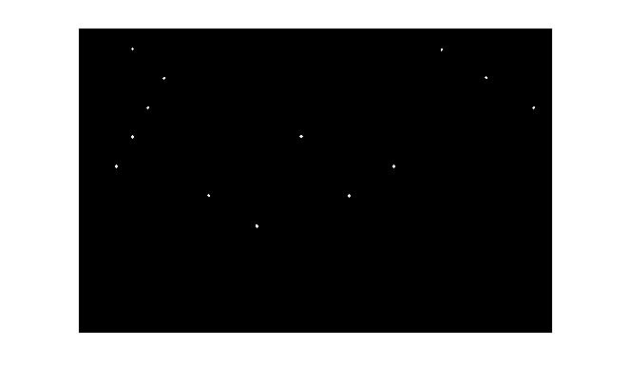
Centres of the filled circles(marked answers) are found
Duplicate centers are eliminated, if any

Slide 34
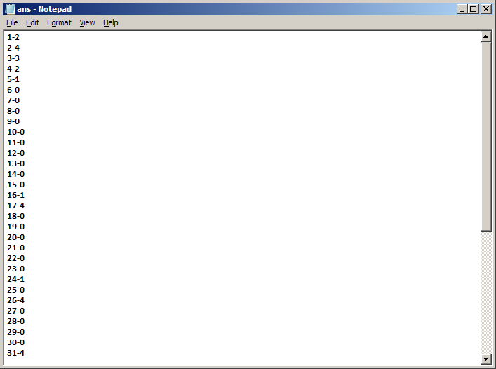
Using the corresponding co-ordinates, each bubble is mapped to its correct question and option number

Slide 35
Future planning
To implement all the proposed recognition systems
To train the network with diverse training samples
To improve the system so as to recognize number of symbols and characters
All the ground work has been laid in preparation for the implementation of the UCR

Slide 36
Thank You

