Slide 1
Report: Sep 16 – Sep 22 – Quentin Sieredzki
Tasks accomplished.
Tasks underway.
Other.
Plans for next week.

Slide 2
Tasks accomplished.
Implemented correct version of CX into Qisdax
Implemented XX4 into Qisdax (demonstrate)
Implemented MS into Qisdax
Updated Gitlab

Slide 3
Tasks underway
Implementing GMS into Qisdax is a little more complicated that I realized
  Doesn’t have params like the other gates, instead it is stored as a circuit → I haven’t figured out yet

Slide 4
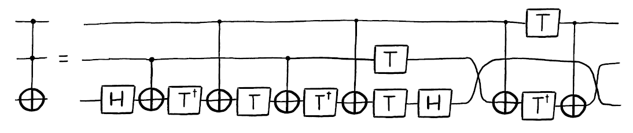
Other
CCX can be implemented using the qiskit method, but lots of gates:

Slide 5
Plans for next week.
Continue working on GMS
  Ask Keith about redefining GMS inside of Qisdax
Continue working on CCX → Figure out using XX
MS(pi/4) → XX4
Change MS to XX in notation, comment

