Slide 1
Report: Oct 6 – Oct 13
Tasks accomplished.
Tasks underway.
Other.
Plans for next week.

Slide 2
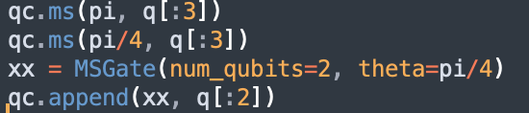
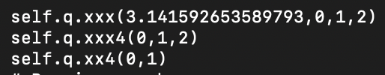
Tasks accomplished.
Allows MS gate to use arbitrary number of qubits now
  Input:
  Output:
Question: should xx4 gate have up to arbitrary number of qubits? Ex. should there be allowed to be an xxx4 gate?
(Note: Like I think we mentioned in the past, this is probably not implemented yet in the real hardware. I have a variable that caps the number of qubits that can be used in a XX… gate at 3 at the moment (meaning only XX gates and XXX gates can work), but an arbitrary number can work if you remove that clause or change the value of the cap)

Slide 3
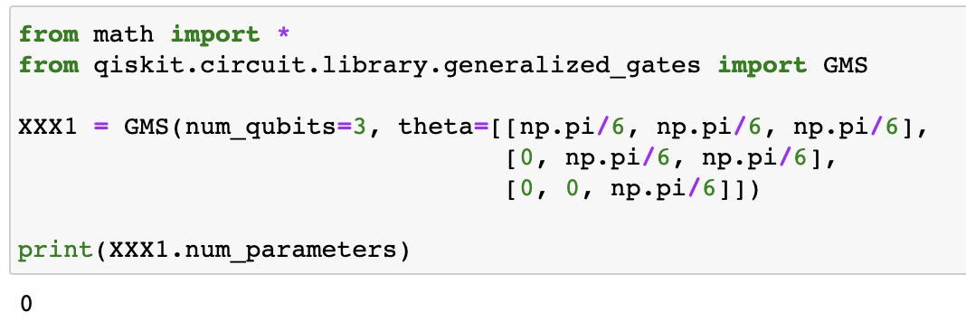

Task underway
Working on finding a way to get Theta for GMS
  Issue here is that parameters doesn’t store anything
  As far as I can tell, this is reflected in the parameter table / vector → No parameters are stored for the GMS function, even though I would imagine it should be two
    (Sidenote: num_qubits does return the proper value of 3, but I’m not convinced it’s using the parameter and not checking in another way)

Slide 4
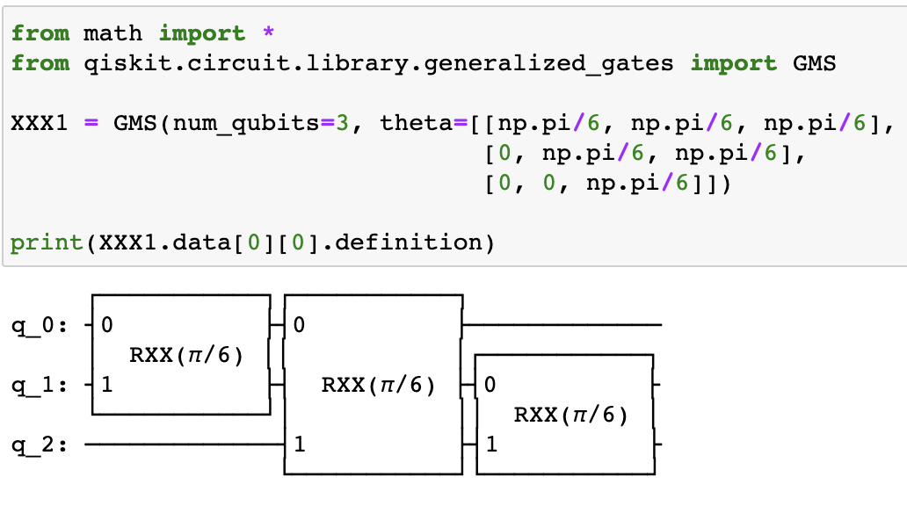
Task underway
Working on finding a way to get Theta for GMS (Cont.)
  However, I can define it with simpler gates
  I think from this definition, I might be able to take theta from one of the smaller gates since they all use the same theta
    Haven’t figured out the right function for it yet, though
    Would this be too inefficient?
  Still feel like there should be an easier way just using GMS

Slide 5
Other
Issues with the simulator set up (STILL)
  So, the VM I set up doesn’t work with Artiq because of the underlying architecture
    Also why I had so much issues setting up the VM
    Took about a week or two to figure this out
  Then, tried installing it on VCL
    Thought this was going well, but didn’t save anything for some reason
      Also took 5+ hours to install the programs
  Tried installing on my Windows desktop, also had issues
  Bit stuck as to what to do next to get it to work
  Very discouraging because I feel like I’m putting time into setting it up just for it not to work 5 hours in so it feels like as though my time has been spent making no progress

Slide 6
Plans for next week.
Hopefully figuring out the simulator
  Changing our code as needed
Hopefully figuring out GMS
  Look through documentation
  Look through codebank
Continue CCX

