Slide 1
Report: Aug. 25 – Aug 31 – Quentin Sieredzki
Tasks accomplished.
Tasks underway.
Other.
Plans for next week.

Slide 2
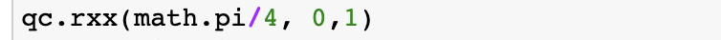
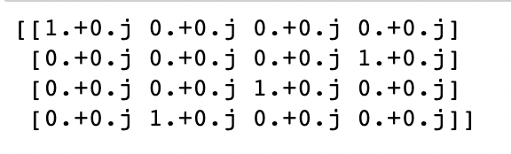
Tasks accomplished.
Rxx-gate works in Qiskit with the following code:
However, the five gate combo didn’t seem to work
  Weird note: qiskit is big-endian, so CX unitary matrix is
  The qiskit gate like this didn’t work (listed on next page)

Slide 3
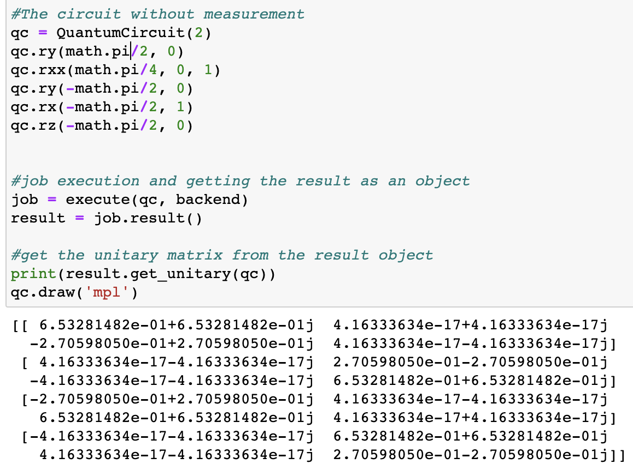
Tasks accomplished.
The qiskit gate like this didn’t work

Slide 4
Tasks accomplished.
Implemented Rxx into Qisdax
Realized that Rx, Ry, Rz didn’t work in Qisdax
  Implemented Rx, Ry
  (Rz isn’t working for some reason, need to troubleshoot)

Slide 5
Tasks underway
Implementing Rz
  Right now, changing it to Rx + Ry – not sure why
  Ask Leon (Duke) about this

Slide 6
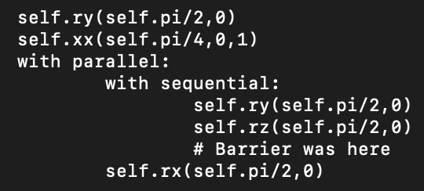

Other
Cx was already implemented with the four gate combo
  However, none of the gates used were implemented
Also, should this be how the gates are listed in Dax?
  The other gates have self.q format

Slide 7
Plans for next week.
Finish implementing Rz
Implement Ms / XX (Rxx(pi/4))
Figure out how to make Cx gate
Figuring out Cz gate combo (eventually, was written as todo in code before I started)
Continue testing to make sure no funny business is happening (like combos of gates changing in the output)
Start to figure out U3 gate
Start to figure out XXX gate (3-qubit version of Ms)

