Slide 1
Report: Feb. 15 – Feb 22 – Keith Mellendorf
Tasks accomplished.
Tasks underway.
Plans for next week.

Slide 2
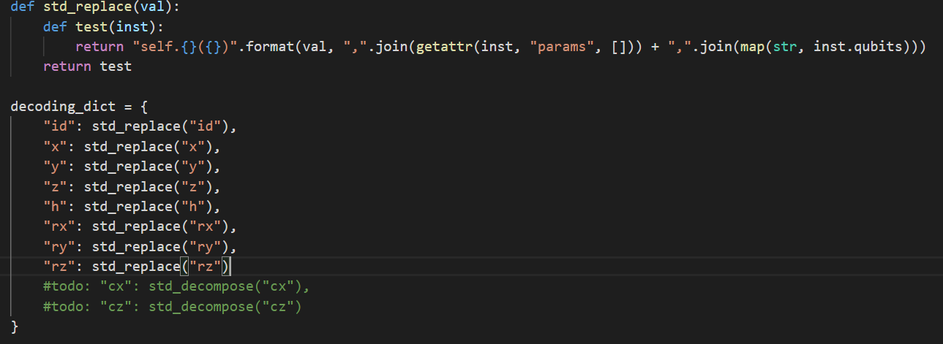
Tasks accomplished.
Designed and implemented dictionary as an improvement to instruction decoding

Slide 3
Tasks underway
Extend functionality of the decoding dict to work on input gates that need to be decomposed into several gates (cx -> xx + others)
Figuring out best to implement sqrt_x() type gates.

Slide 4
Plans for next week.
Start implementation of jinja templates for vastly improved output file format
Start looking at implementation of CI using resources Leon gave

