Slide 1
Report: Mar. 10 – Keith Mellendorf
Tasks accomplished.
Tasks underway.
Plans for next week.

Slide 2
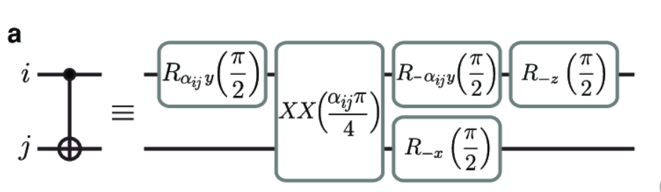
Tasks accomplished.
Attempted to implement the feature allowing instructions that are decomposed into multiple instructions
  Unfortunately, unsuccessful at this time due to the design of our scheduler. More work will be required
  Below is an example of the type of gate I’m trying to implement

Slide 3
Tasks underway
I have begun work on templatizing the output program

Slide 4
Plans for next week.
Finish implementation of templates, will probably use Jinja but will explore alternatives
Meet with Alexander to go over our scheduler to figure out how to allow gates that require decomposition

